Slide 1



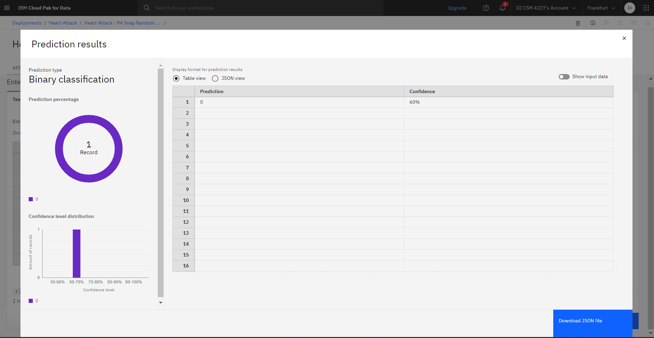
Heart Attack Prediction
Program Feedback
Project Short Summary
The IBM Skill Build program with Edunet Foundation provides a well-structured and impactful learning experience, focusing on enhancing both technical and soft skills crucial for today’s job market. The program effectively combines interactive training, practical projects, and mentorship, helping participants gain proficiency in areas such as AI, cloud computing, and data science. Its collaborative and hands-on approach fosters real-world problem-solving skills, making it highly beneficial for career growth. However, there could be improvements in offering more personalized guidance and expanding the range of advanced modules to cater to varying skill levels.
The Heart Attack Prediction project aims to develop a machine learning-based system that predicts an individual’s risk of having a heart attack based on key health parameters such as age, cholesterol levels, blood pressure, and more. By analyzing this data using classification algorithms, the system provides a predictive output, helping users and healthcare professionals assess the likelihood of heart-related complications. The goal is to offer an early warning system that promotes preventive healthcare measures, potentially reducing the incidence of heart attacks through timely intervention.
Hyma Vathi Peddimudi
duraiemma@gmail.com
VSM College Of Engineering
#skillsbuild

