Slide 1





Movie Recommendation System
Using Machine Learning
Team Members :
Mentor : Mr . Saomya Chaudhury
Vetsa shanmukha abhiram Charan , abhiramcharan327@gmail.com
Polupalli Surya Narayana, suryagoodboy2452@gmail.com
Shaik Mahaboob Sameer Saheb , sksameer46644@gmail.com
Disclaimer: The content is curated for educational purposes only.
Notes:
Slides: Prepare a short slide deck (10-12 slides) summarizing the project objectives, methodology, and key results.

Slide 2
Movie Recommendation System
OUTLINE
Abstract of the Project
Problem Statement
Proposed Solution
System Architecture
Live Demo of the Project
Embedded Video of Project
Conclusion
Future Scope

Slide 3
Abstract : Movie Recommendation System Using Machine Learning With the vast number of movies available across various platforms, users often find it challenging to discover content that aligns with their tastes and preferences. This project, titled Movie Recommendation System, aims to develop a machine learning-based system that provides personalized movie suggestions based on user preferences, viewing history, and ratings. The primary objective of this project is to design an efficient and accurate recommendation model to enhance user experience by suggesting movies they are likely to enjoy. The methodology includes preprocessing the movie dataset, feature selection, and training multiple machine learning algorithms, such as Collaborative Filtering, Content-Based Filtering, and Hybrid Models. The system analyzes factors like genre, director, actors, and user ratings to generate personalized recommendations, ultimately helping users discover new movies while saving time in their search for content.
Movie Recommendation System

Slide 4
Problem Statement
Movie Recommendation System
The entertainment industry is constantly expanding, with an overwhelming number of movies available across various platforms. However, users often struggle to find movies that align with their personal tastes due to the vast amount of content available. Traditional recommendation systems typically rely on generic suggestions that do not take into account individual preferences or viewing history, leading to user dissatisfaction and wasted time searching for content.
The inability to efficiently and accurately recommend movies based on user preferences can result in a frustrating experience and reduced engagement on streaming platforms. There is a growing need for a reliable, personalized, and scalable recommendation system that can help users discover movies they are likely to enjoy, based on factors such as past ratings, genres, and similar users' preferences. This solution aims to enhance user experience by providing tailored recommendations that save time, improve satisfaction, and increase user engagement.

Slide 5
Proposed Solution
Movie Recommendation System
The solution involves developing a web application using Streamlit to recommend movies to users based on their preferences and previous ratings. The system uses a preprocessed movie dataset with features like genre, director, actors, and user ratings. Collaborative Filtering and Content-Based Filtering algorithms were employed to train the model, providing personalized movie suggestions. The model was evaluated for accuracy and deployed to give users real-time recommendations based on their watch history and preferences. The application also allows users to rate movies, improving future recommendations.

Slide 6
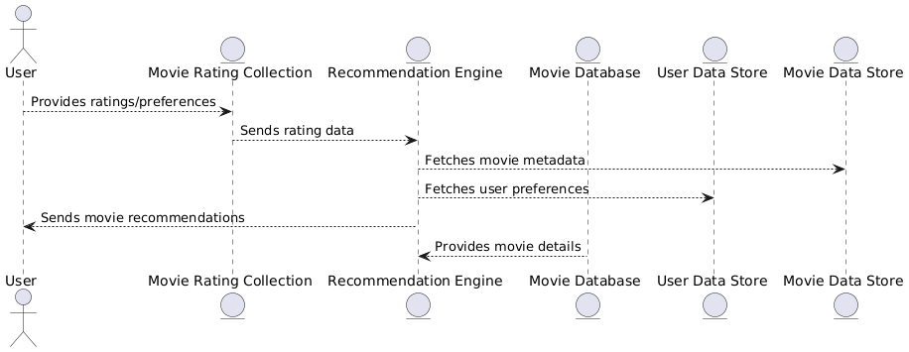
System Architecture
Movie Recommendation System
Level 0 (Context Diagram):
High-level view of the system with one process and external entities (e.g., User, Movie Database).
Shows overall system interaction.
Level 1 (Decomposition Diagram):
Breaks the system into major sub-processes (e.g., Movie Rating Collection, Recommendation Engine).
Shows data flow between processes and data stores.
Level 2 (Detailed Diagram):
Further breakdown of processes from Level 1 into smaller sub-processes.
Shows more detailed data flows within each process.
Each level provides increasing detail of how data moves and is processed within the system.

Slide 7
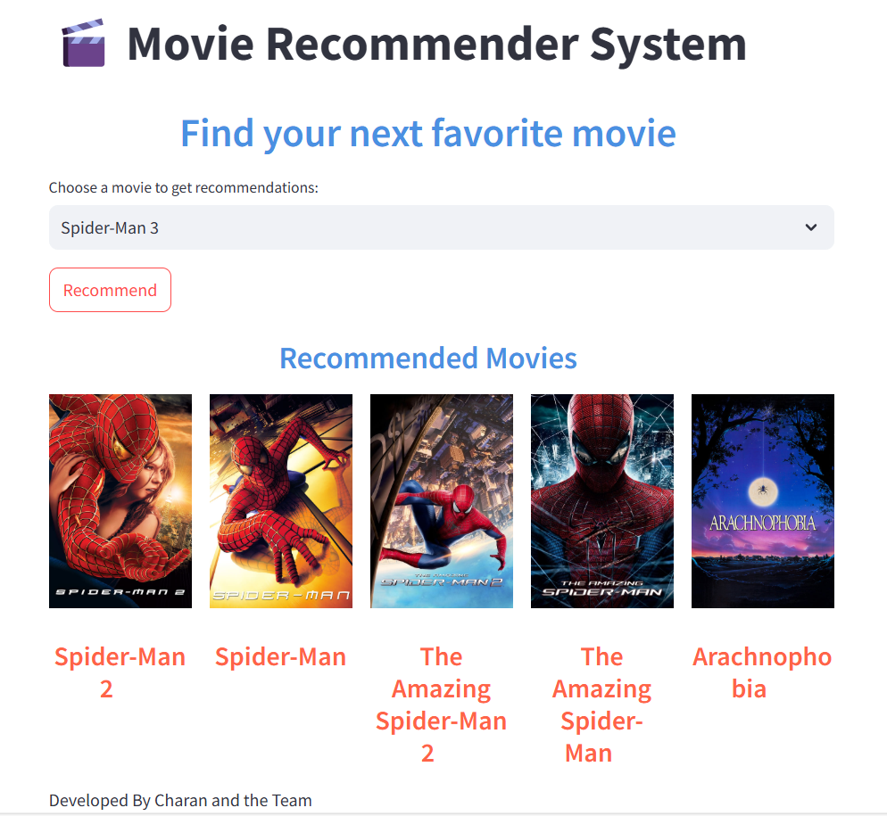
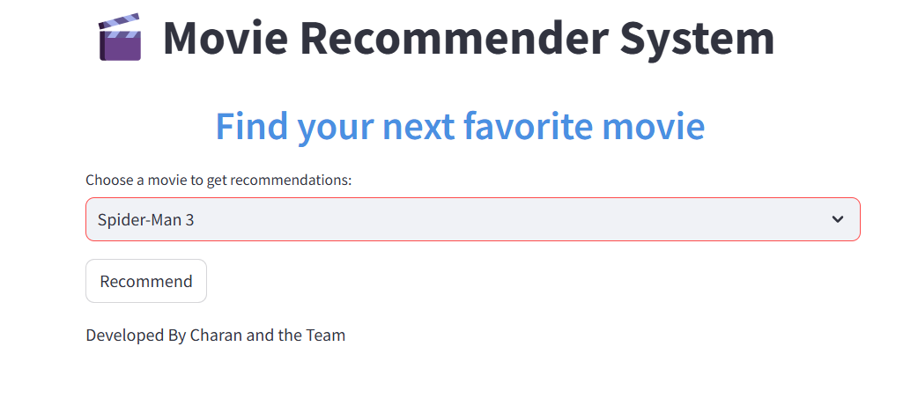
Live Demo of Project : Click Here
Movie Recommendation System

Slide 8
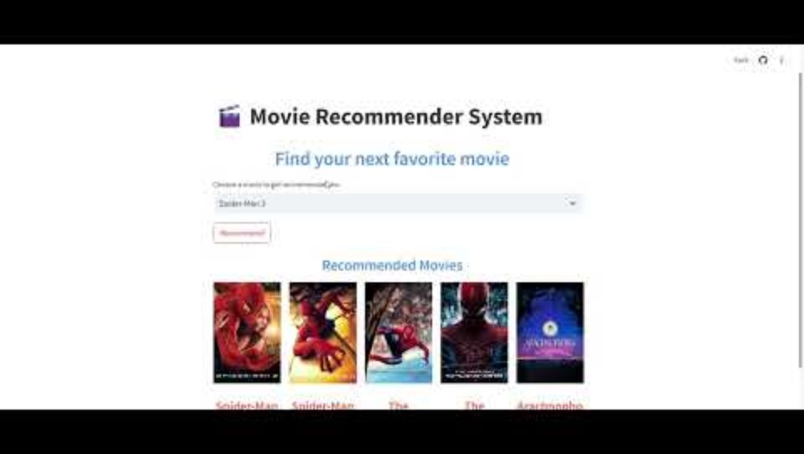
Movie Recommendation System
Video of Project Demo

Slide 9
Conclusion
Movie Recommendation System
The Movie Recommendation System project successfully integrates a machine learning model with a web interface for real-time movie suggestions. By using Collaborative Filtering and Content-Based Filtering algorithms, the model accurately recommends movies based on user preferences, viewing history, and ratings.
Key Achievements:
Developed an intuitive web interface using Streamlit for easy user input and interaction.
Implemented Collaborative Filtering and Content-Based Filtering to generate personalized movie recommendations.
Deployed the recommendation model for real-time movie suggestions on a live website, enhancing user experience by providing tailored movie recommendations.

Slide 10
Future Scope
Movie Recommendation System
The future scope of your Heart Attack Risk Prediction project includes:
Wearable Device Integration: Real-time health monitoring with smart devices.
Advanced ML Algorithms: Using deep learning and ensemble methods for better predictions.
Big Data & Cloud Computing: Scaling and integrating large datasets for more robust predictions.
Explainable AI: Making predictions transparent and understandable for users and doctors.
Personalized Recommendations: Providing tailored health advice and alerts.
Data Privacy & Security: Ensuring encrypted data handling and compliance with health regulations.
Health Network Integration: Connecting with EHR systems and collaborating with healthcare professionals.
Continuous Learning: Allowing the model to adapt and improve over time with new data.
These areas will enhance the project's capabilities and real-world applications.

Slide 11
Movie Recommendation System
Thank you!
Notes:
thank you very much for joining this PPT, keep learning.
11

