Slide 1

ArgusAim
A camera that finds you and keeps you in frame - on its own.
Real-time person tracking on a self-aiming camera mount
Ebrahim Maki | General Assembly - Data Science Capstone | September 2, 2026

Slide 2
AGENDA
What we'll cover
1
The idea, in one line
5
Built for trust - engineering & safety
2
The problem it answers
6
Live demo
3
Where this fits - real-world uses
7
Results
4
How it works
8
What's next
02

Slide 3



THE IDEA
The idea, in one line
ArgusAim is a camera that watches for a person, works out exactly where they are, and physically turns to keep them centred - by itself, in real time.
→
→
SEES
MEASURES
MOVES
Scans the video feed
Turns pixels into a real angle
Turns two motors to re-centre
03

Slide 4
THE PROBLEM
Cameras watch everything.
They don't pay attention to anyone.
A fixed camera only covers what's directly in front of it. The moment a person steps to the side, they're gone from frame.
Following someone well needs a person at the controls. Manually panning and tilting a camera all day is tiring, and it doesn't scale.
The off-the-shelf alternative is closed and expensive. Commercial auto-tracking camera systems are sealed hardware, and pricing runs well into the thousands - out of reach for a classroom, a small studio, or a single security post.
Note: cost figures are illustrative, based on publicly advertised pricing for commercial auto-tracking PTZ camera systems.

Slide 5

THE VISION
So we built ArgusAim.
A small, self-aiming camera platform that watches a scene, locks onto a person, and turns to follow them - running entirely on inexpensive, off-the-shelf hardware.
On-device, no cloud
No GPU required
Open, low-cost hardware

Slide 6






WHERE THIS FITS
One tracking engine, many places to point it.
Security & facilities
Live content & creators
Interactive play
Keeps a person in frame across a store aisle, a lobby, or a work floor - unmanned.
A camera operator that never gets tired, for streamers, coaches, and solo presenters.
Games and attractions that react to where a player actually stands - arcades, kids' play areas.
Defense & perimeter watch
Wildlife & field research
Accessibility
Situational-awareness cameras that hold watch on a boundary without a hand on the joystick.
Auto-follow cameras for behaviour studies, without a researcher steering by hand.
Hands-free video calls and monitoring for people with limited mobility.
06

Slide 7

DATA & APPROACH
What it learns from - and what “working” means
THE DATA
SUCCESS LOOKED LIKE
ArgusAim doesn't train on a fixed folder of photos - it works from a live video feed. Underneath, it's built on a modern object-detection model that already knows what a person looks like, from millions of labelled real-world photos - the same public benchmark used across computer vision.
Our job was proving that model could run fast enough, and precisely enough, to drive a physical motor in real time - a different problem from training the model in the first place.
Smooth enough to feel alive, not jerky - targeting 15+ frames a second
Accurate enough to keep a person centred within a couple of degrees
Working the same way on a laptop and on an inexpensive single-board computer, with no GPU
07

Slide 8
THE MODEL - IN PLAIN TERMS
What's actually doing the “seeing”?
Every video frame - up to 30 times a second - a vision model scans the picture and answers one question: is there a person here, and exactly where? It's the same category of technology behind a phone camera auto-focusing on a face, tuned to run without a graphics card.
30x
CHECKS MADE EVERY SECOND
From there, ArgusAim does the part most AI demos skip: it turns a box of pixels into a real physical direction - an angle in degrees, the same way your own eyes judge where to look - and hands that number straight to a motor.
0
GPUS REQUIRED
08

Slide 9


HOW IT WORKS
Follow one frame through the system
1
2
3
4
5
CAMERA
DETECT
TRACK
MEASURE
MOVE
Grabs the newest frame, 30x a second
Finds every person in the picture
Keeps the same identity, frame to frame
Turns position into a real angle & distance
Two motors turn the camera to re-centre
09

Slide 10


BUILDING TRUST
Built to behave - not just to work once
Runs entirely on the device
No video ever leaves the machine, and no internet connection is needed to track.
Hard mechanical limits
The mount is software-limited to its safe range of motion - it physically cannot be pushed past what the hardware allows.
Tuned, then measured - not guessed
On real hardware, ArgusAim holds a person centred to a median of about 2° side to side and under 1° up and down.
Proven on two different machines
The same code runs at nearly the same speed on a full laptop and on a low-cost embedded computer.
10

Slide 11
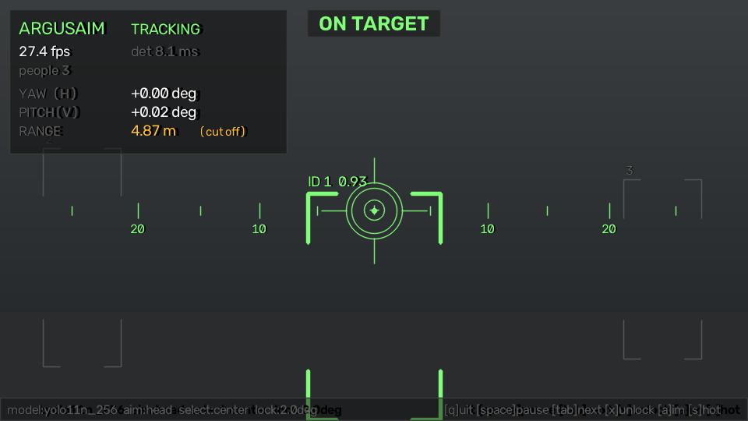
THE PROOF
See it live.
Opens straight in a browser - nothing to install
Anyone on the network can watch it lock on and follow, live
What you're about to see is the real, running system
Actual on-screen output from the running system

Slide 12
RESULTS
What we actually got working
≈ 2° / < 1°
median left-right / up-down tracking error
2
hardware platforms proven - laptop and embedded board
Runs fully offline, with zero ongoing cloud cost per camera.
12

Slide 13
RECOMMENDATIONS
Where we'd point this next
1
Pilot one real use case first
A single demo-booth or security-post camera, rather than building every feature at once.
2
Add a simple recording & alerting layer
Before scaling to multiple units, wrap the tracking with basic logging so it's useful on its own.
3
Treat the engine as reusable
The same detect-track-aim pipeline can point a camera, a light, or a different sensor entirely.
13

Slide 14


HONEST ABOUT LIMITS
Where it stands today - and what's next, insha'Allah
TODAY
NEXT, INSHA'ALLAH
Distance is estimated from a person's apparent height - a guide, not a measured depth.
A depth sensor for true distance, instead of an estimate.
One camera, one field of view - it can't see around a corner from a single fixed post.
Smarter automatic choice of who to follow when several people are in frame.
Follows one person at a time; choosing between several is a manual step today.
A weatherproof, higher-torque build for outdoor and longer-duty use.
14

Slide 15
Thank you.
Questions, and then - let's watch it track.
Ebrahim Maki | ArgusAim

