Slide 1
Bahraini Food Detector
Teaching an AI to see local cuisine — YOLO26 object detection
10 Bahraini dishes · 527 labelled images · fine-tuned YOLO26
Object Detection Lab — results summary

Slide 2
THE PROBLEM
Name the dish from a photo
A tourist photographs a meal — the model finds and labels the local Bahraini dishes, live.
Built end-to-end: collect → label → fine-tune → evaluate → find failures → improve → deploy
The challenge: many dishes look alike (Nakhi vs Luqaimat), plates hold several items, and there was no ready-made dataset — it was built from scratch.
THE 10 CLASSES
Luqaimat
Kebab
Fried Fish
Balaleet
Nakhi
Mattai
Samboosa
Machboos
Halwa
Harees

Slide 3
DATASET & METHOD
Built from scratch, trained on our own data
527
10
70/20/10
original images
dish classes
train / val / test
Collection & labelling
Photos gathered from around the web, with angles and lighting variation, then bounding-boxed in Roboflow.
Training
YOLO26 fine-tuned on our own labelled dataset - the training set only,
with a completely unseen test set kept aside for the final scores below.

Slide 4
RESULTS — UNSEEN TEST SET
Strong out of the box
0.93
0.69
0.91
0.74
mAP@50
mAP@50-95
Recall
Precision
WHAT THE SHORTCUTS MEAN
mAP = mean Average Precision — overall detection score (0–1).
IoU = overlap between a predicted box and the true box.
@50 = boxes overlap ≥ 50%; @50–95 = averaged 50–95%.
Recall = real dishes found. Precision = detections correct.
In short:
the detector finds ~91% of the dishes and localizes them well (mAP@50 0.93) on photos it never saw.
Averaged across all 10 classes on the held-out test set.

Slide 5
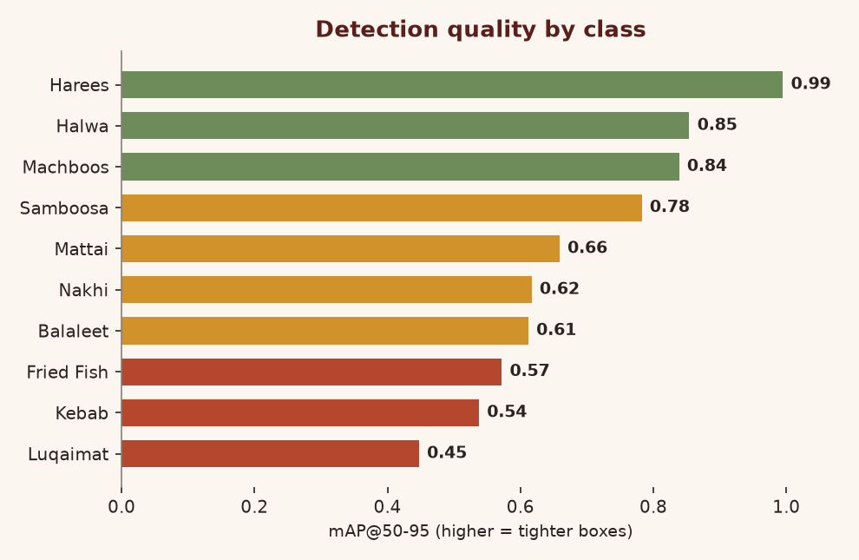
PER-CLASS PERFORMANCE
Some dishes are easier than others
READING IT
Easiest – Harees, Halwa, Machboos
distinct colour & texture, near-perfect boxes.
Hardest – Luqaimat
Because it is very similar to a different class which is Nakhi.
Every class clears mAP@50 ≥ 0.70.

Slide 6
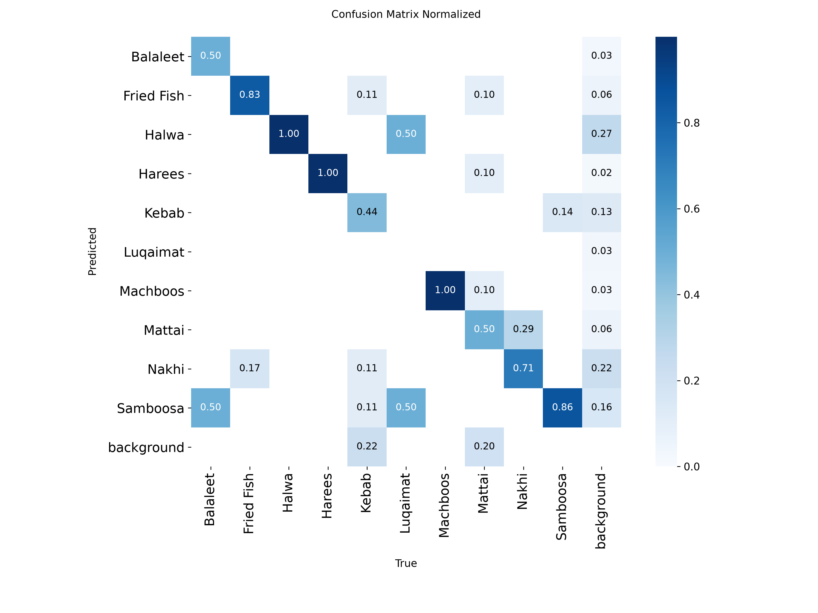
CONFUSION MATRIX
Where the predictions land
HOW TO READ IT
X = the true dish · Y = what the model predicted.
A bright diagonal = correct calls. Ours is strongly diagonal — most dishes are named right.
The “background” row & column just mean “no object”:
• background column — the model saw a dish that wasn’t there (false positive)
• background row — the model missed a real dish (false negative)

Slide 7
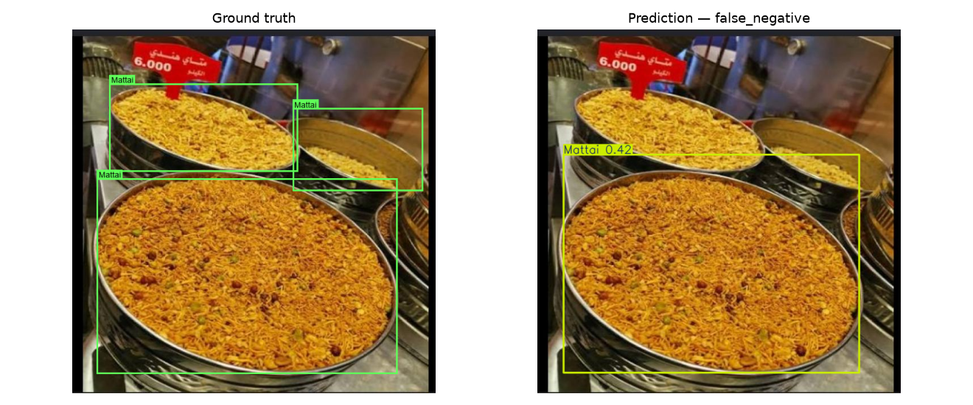
WHERE IT FAILS
12 documented failure cases
FAILURE BREAKDOWN
12
Missed items (false negative)
1
Wrong class
2
Loose box (poor localization)
2
False alarm (false positive)
The pattern:
most misses are extra pieces on a crowded plate, plus the occasional
Nakhi ↔ Luqaimat mix-up — two visually similar dishes.
Ground truth (left) vs prediction (right): missed pieces on a crowded plate.

Slide 8
NEXT ROUND (V2)
Let the failures decide the data
1
Crowded / multi-item plates
fixes the missed pieces (the #1 failure)
2
More Nakhi & Luqaimat
clearer, balanced examples to end the mix-ups
3
More Kebab variety
different shapes & servings to tighten its boxes
Then: re-label as Roboflow v2 → retrain → compare v1 vs v2.
v1 is complete; this targeted second collection is the next step.

