Slide 1
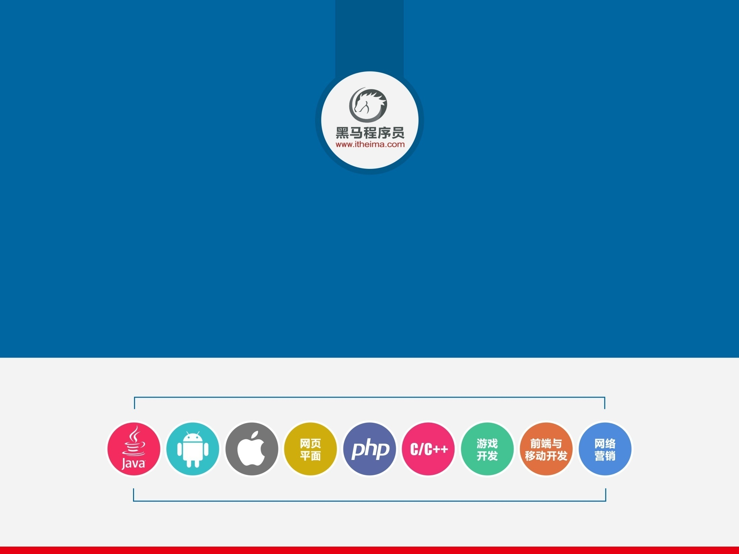
Docker基本概念介绍

Slide 2
1
Docker是什么
2
Docker的主要组件
3
Docker镜像如何工作
4
Docker容器如何工作

Slide 3
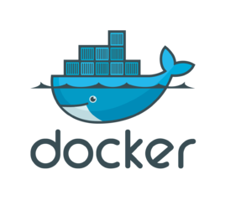
1
Docker是什么
Docker is the world’s leading software container platform.
Developers use Docker to eliminate “works on my machine” problems when collaborating on code with co-workers.
Operators use Docker to run and manage apps side-by-side in isolated containers to get better compute density.
Enterprises use Docker to build agile software delivery pipelines to ship new features faster, more securely and with confidence for both Linux and Windows Server apps.

Slide 4
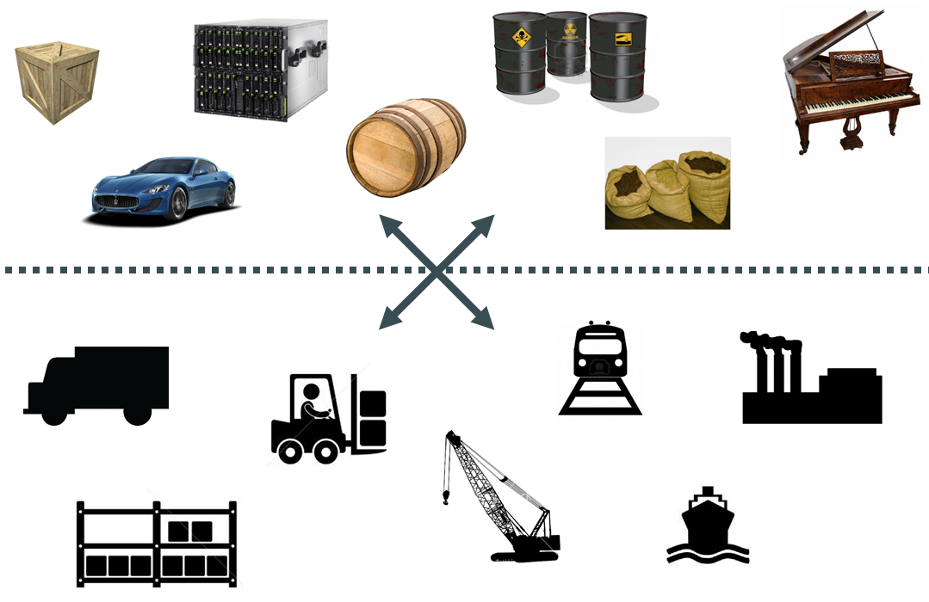

Slide 5
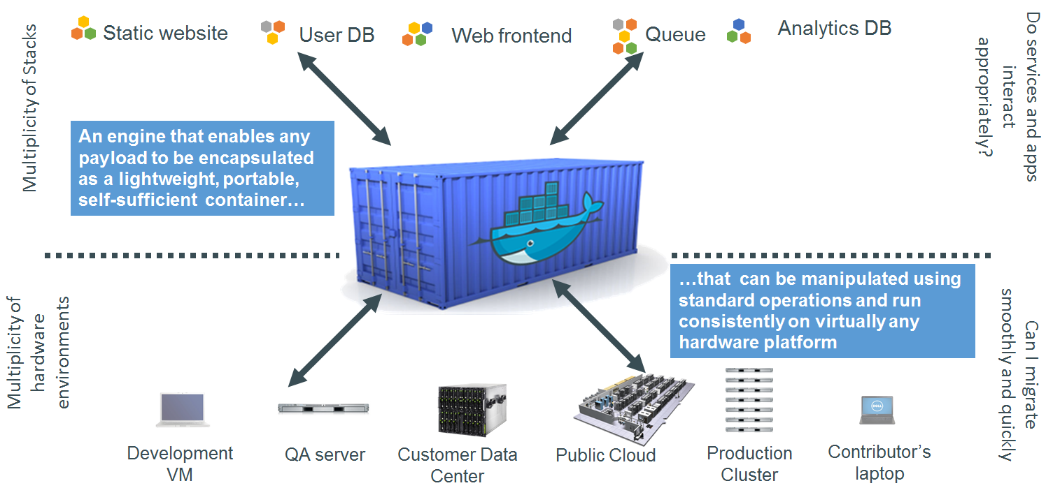

Slide 6
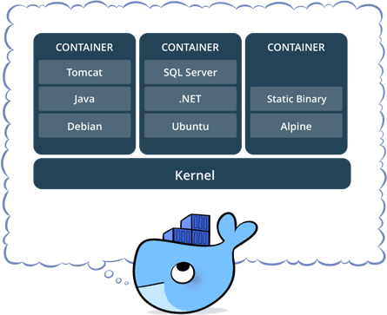

Slide 7
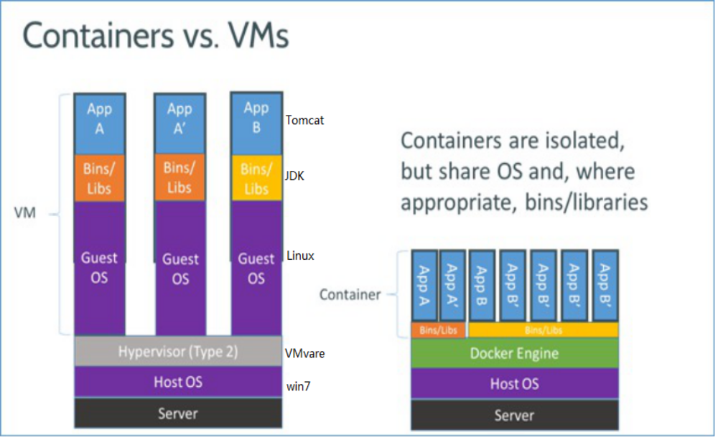
Docker容器和传统虚拟机的对比

Slide 8
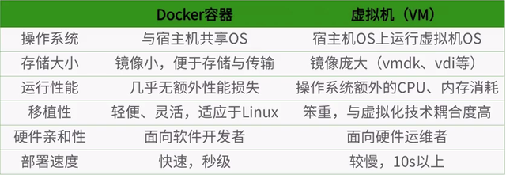
Docker容器和传统虚拟机的对比

Slide 9
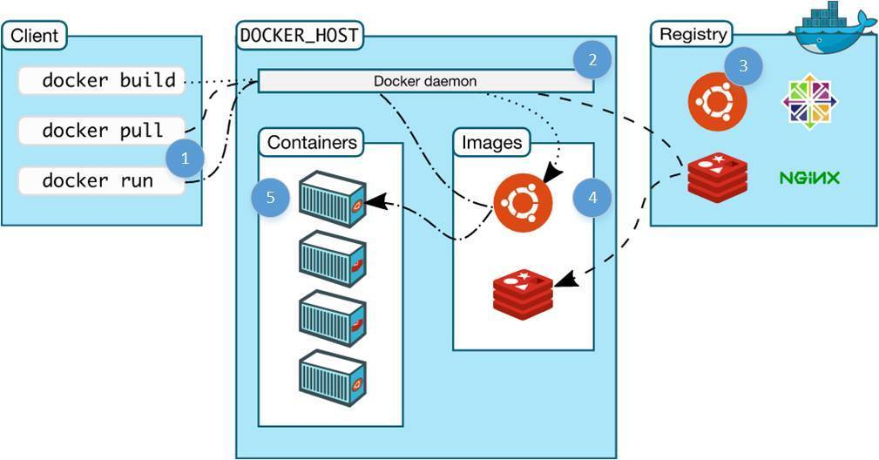
Docker的主要组件:
Docker Client
Docker daemon(引擎)
Docker Containers(容器)
Docker Images(镜像)
Docker Registry(仓库)

Slide 10
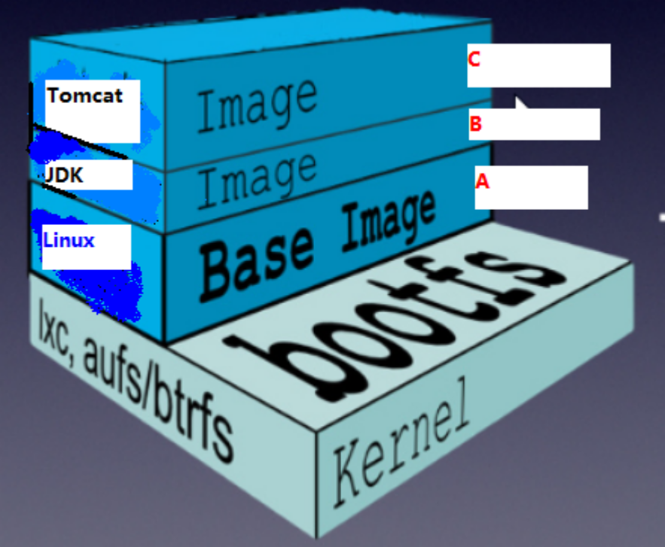
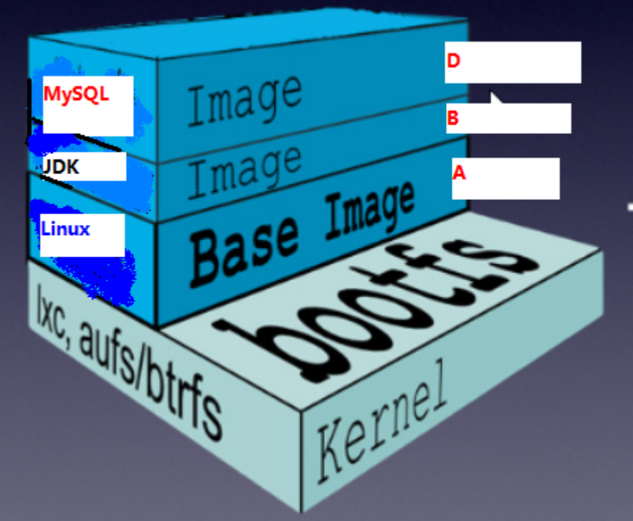
镜像文件层级结构,使镜像文件层实现了复用 , 极大的减少了磁盘的开销
镜像A
镜像B

Slide 11
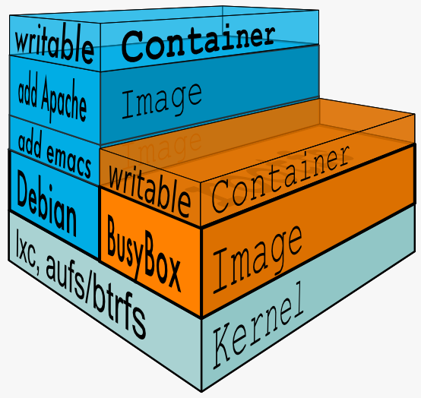
容器(Container) : 动态文件 , 镜像的运行实例

Slide 12
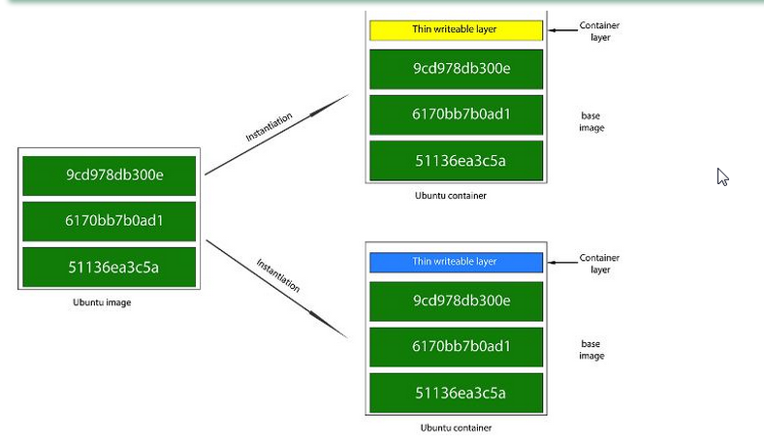

Slide 14
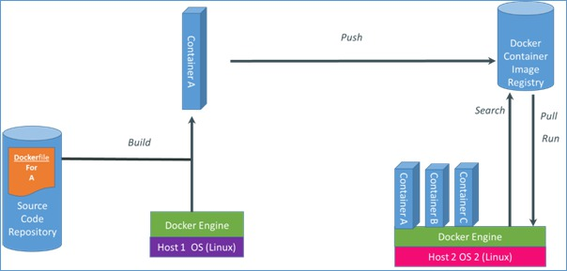

Slide 15
