Slide 1
Internships

Slide 2
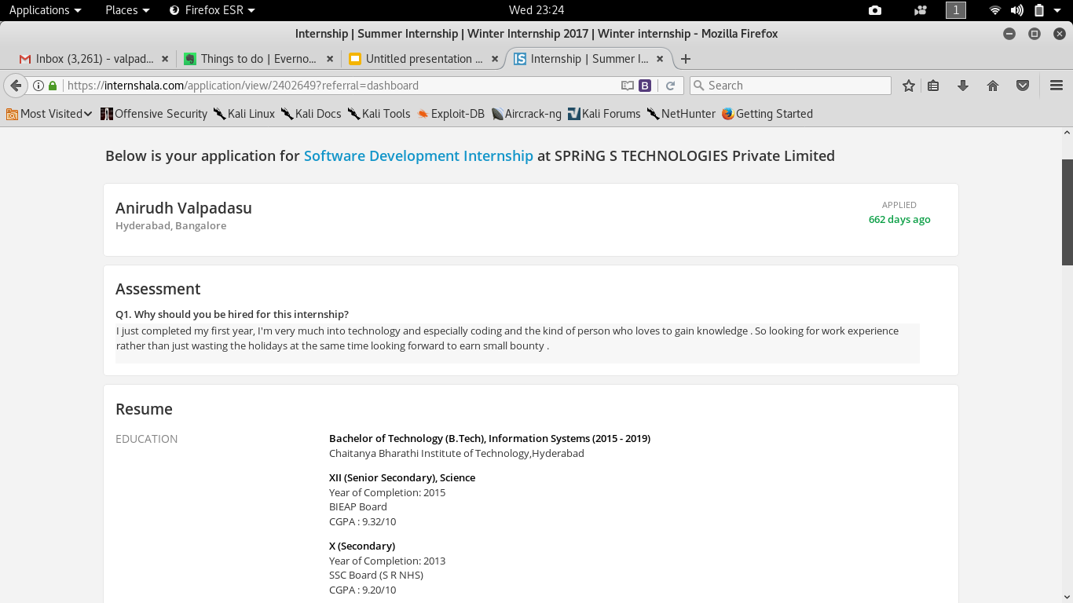

How to not get selected for an internship

Slide 3
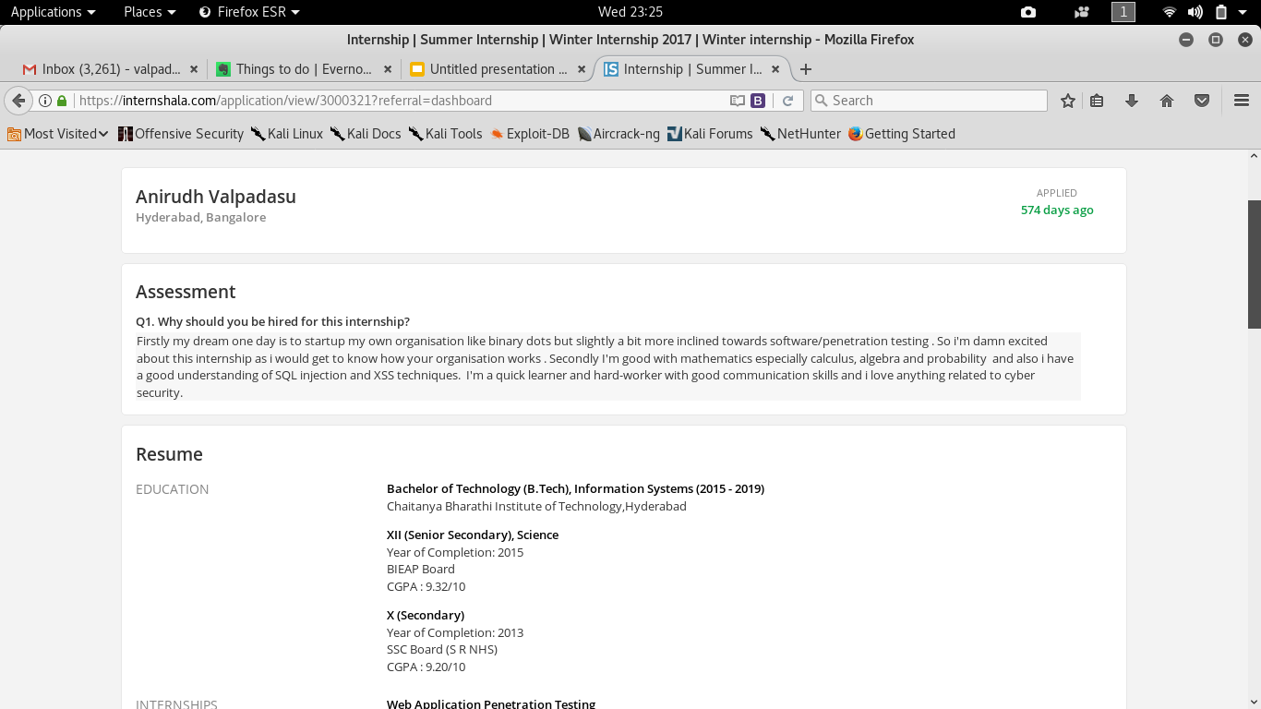
Contd…

Slide 4
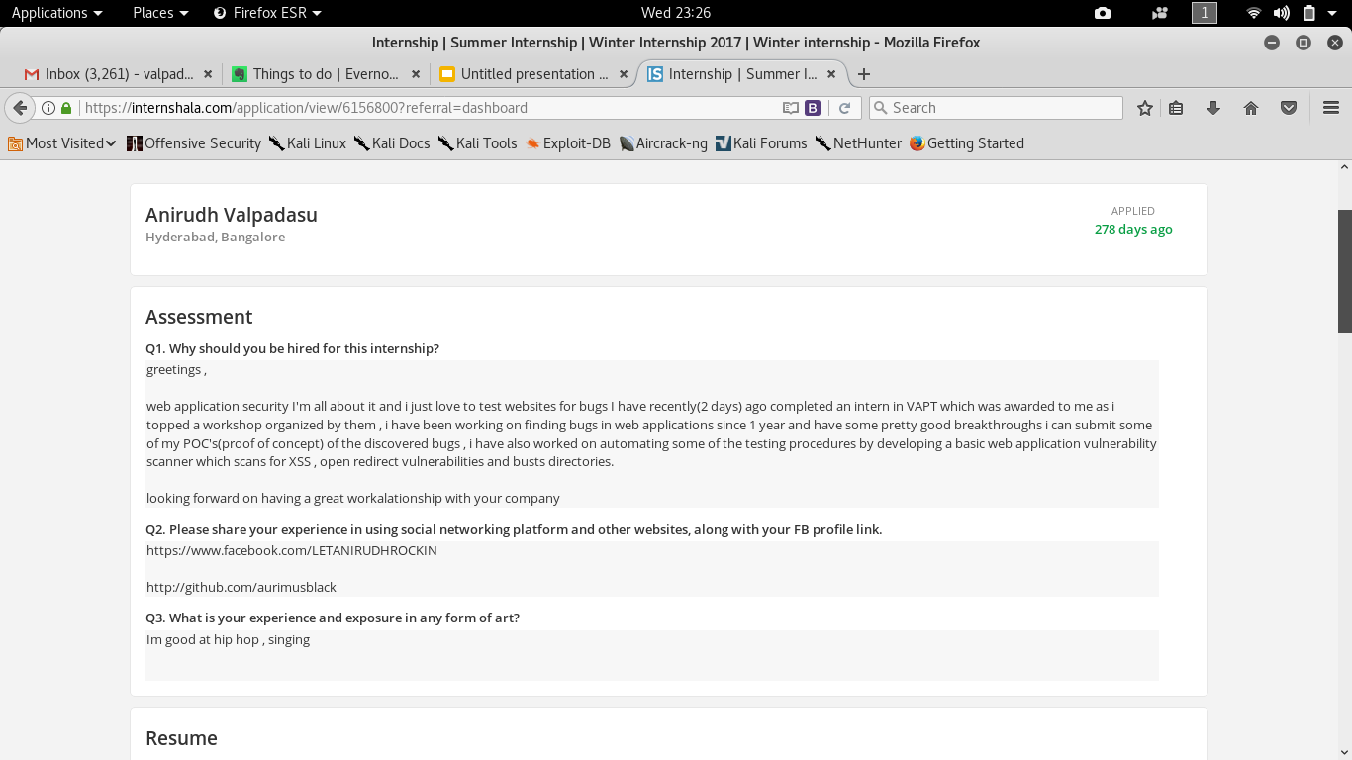

How to almost get selected for an internship

Slide 5
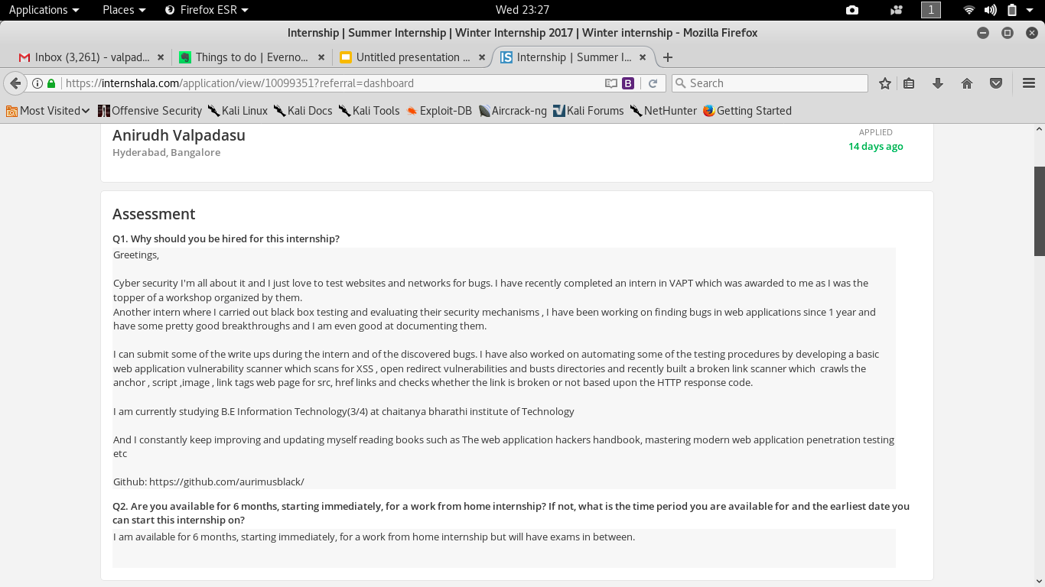
How to get selected for an internship !

Slide 6

How to get through the selection process !
Be polite and formal in your application
Make sure you express yourself

Slide 7
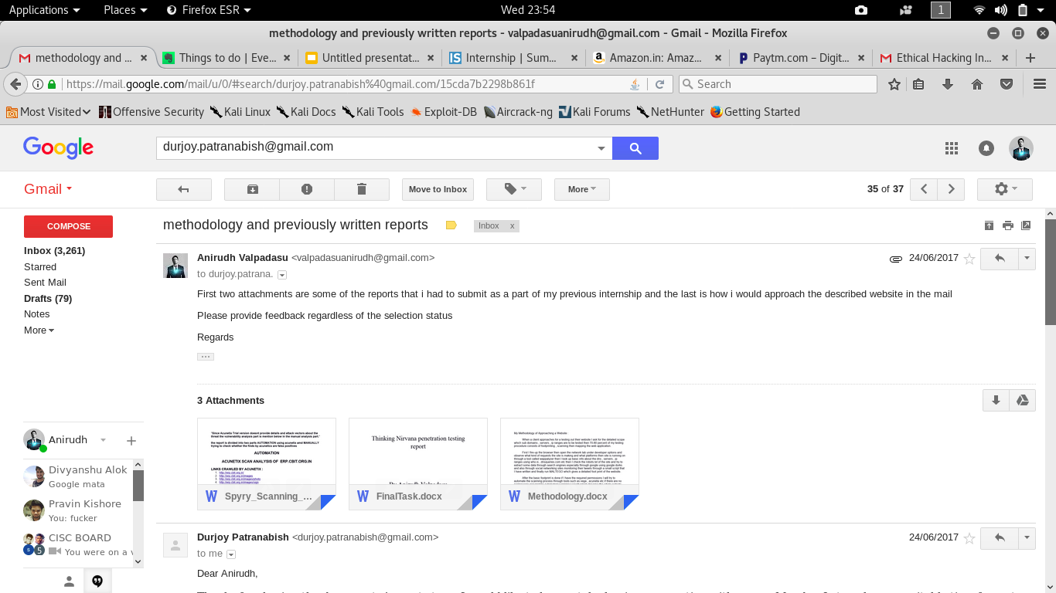
How to get through the selection process !

Slide 8
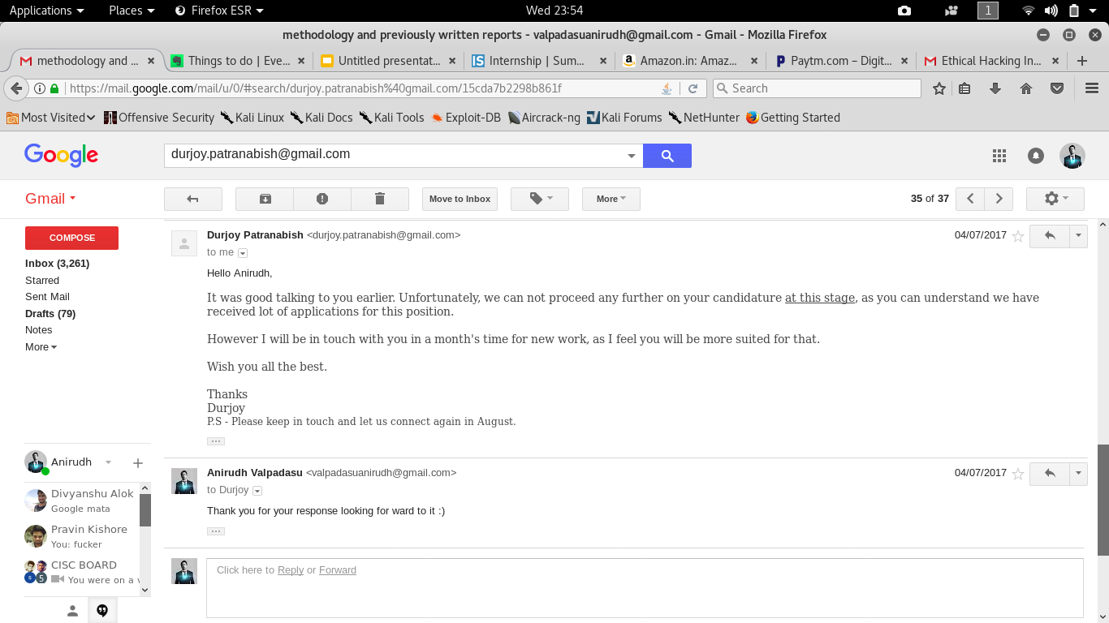
How to get through the selection process !

Slide 9
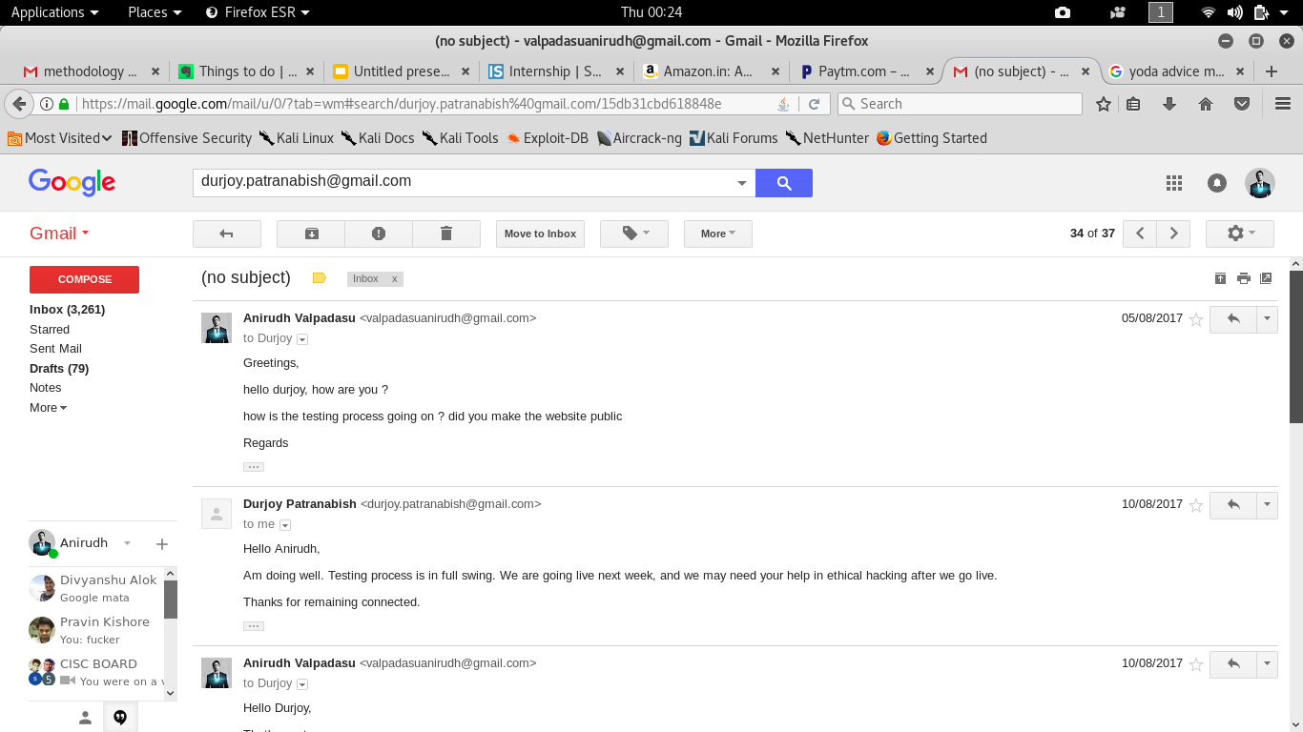
How to get through the selection process !

Slide 10
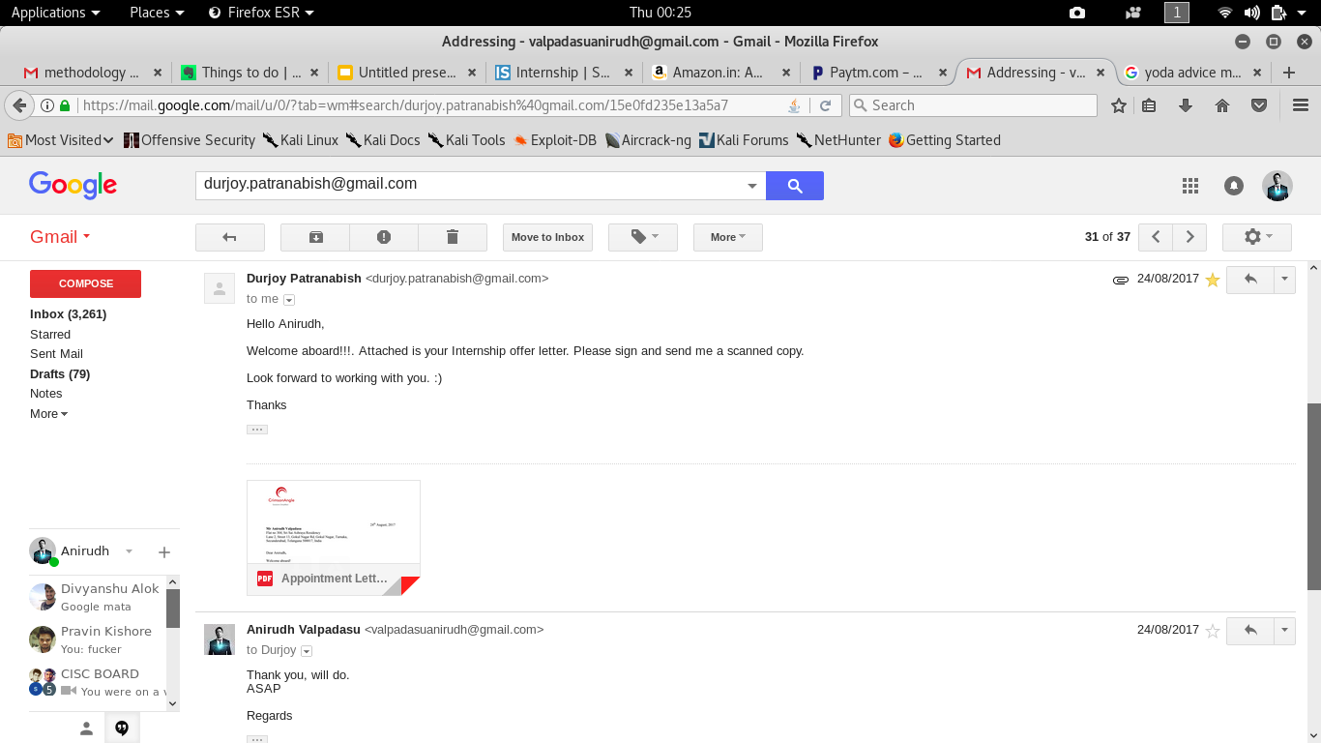
Voilá !

Slide 11


