Slide 1
Natural language processing
End-to-end Sequence Labeling via Bi-directional LSTM-CNNs-CRF
-Yunong He

Slide 2
Overview:
A novel neutral network architecture that benefits from both word- and character-level representations automatically, by using combination of bidirectional LSTM, CNN and CRF.
Truly end-to-end, requiring no task-specific resources, feature engineering, or data pre-processing beyond pre-trained word embeddings on unlabeled corpora
Evaluate the system on two data sets for two sequence labeling tasks
Penn Treebank WSJ corpus for part-of-speech (POS) tagging
CoNLL 2003 corpus for named entity recognition (NER)
Obtain state-of-the-art performance on both datasets
97.55% accuracy for POS tagging
91.21% F1 for NER.

Slide 3
Baseline systems:
Traditional high performance sequence labeling model
Linear statistical models: HMM, CRF
Shortcoming:
Rely heavily on hand-crafted features and task-specific resources
Difficult to adapt to new tasks or new domains
Non-linear neural networks: word embeddings
Recurrent neural networks(RNN), long-short term memory(LSTM), gated recurrent unit(GRU)
Shortcoming:
Performance drops rapidly when the models solely depend on neural embeddings
Notes:
introduction to some baseline systems and their shortcomings

Slide 4
Method: BLSTM-CNNs-CRF
First use convolutional neural networks (CNNs) (LeCun et al., 1989) to encode character-level information of a word into its character-level representation.
Then combine character- and word-level representations and feed them into bi-directional LSTM (BLSTM) to model context information of each word.
On top of BLSTM, we use a sequential CRF to jointly decode labels for the whole sentence.

Slide 5
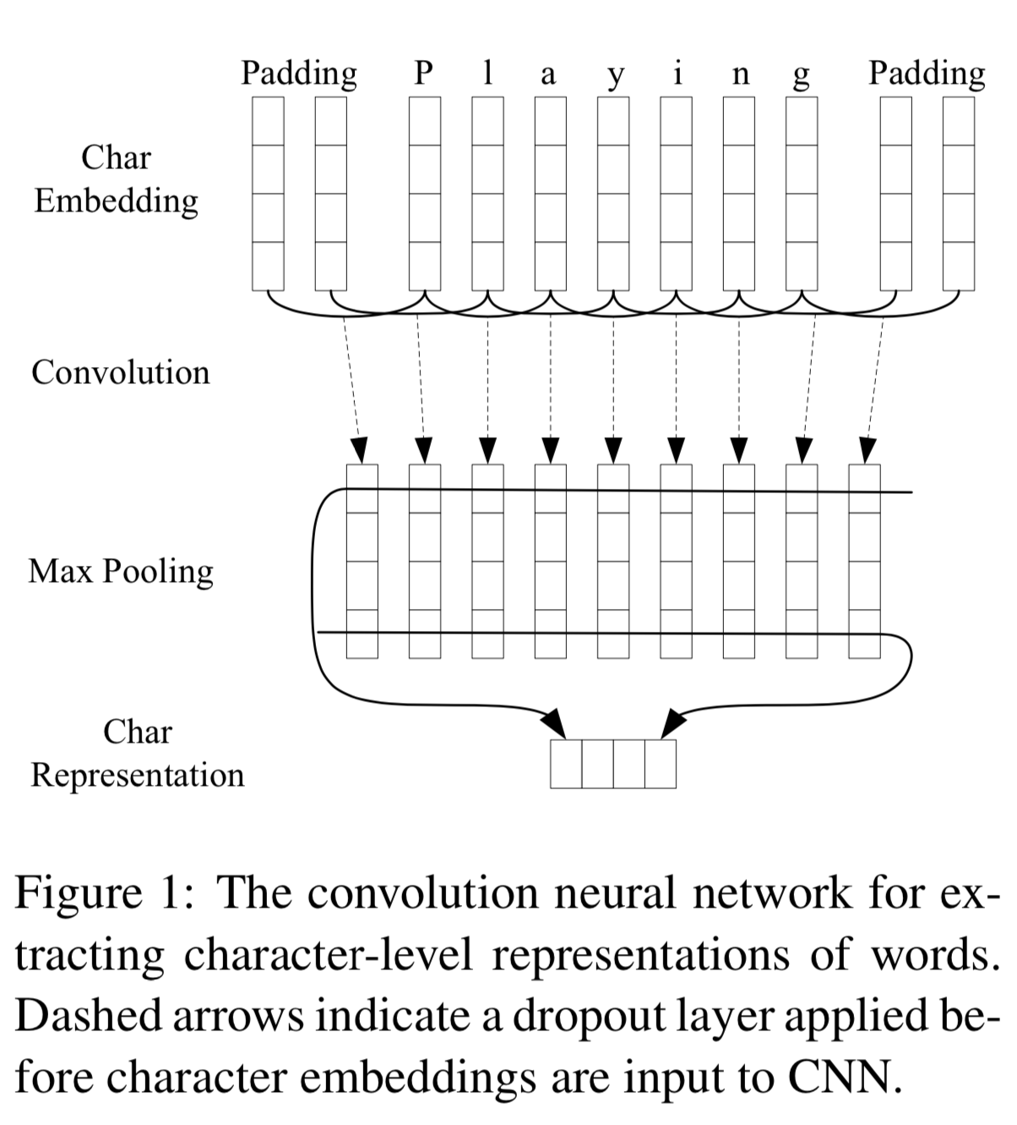
CNN for Character-level Representation:
Use only character embeddings as the inputs to CNN, without character type features. A dropout layer (Srivastava et al., 2014) is applied before character embeddings are input to CNN.
http://jmlr.org/papers/volume15/srivastava14a.old/srivastava14a.pdf
Notes:
Dropout: A Simple Way to Prevent Neural Networks from Overfitting

Slide 6
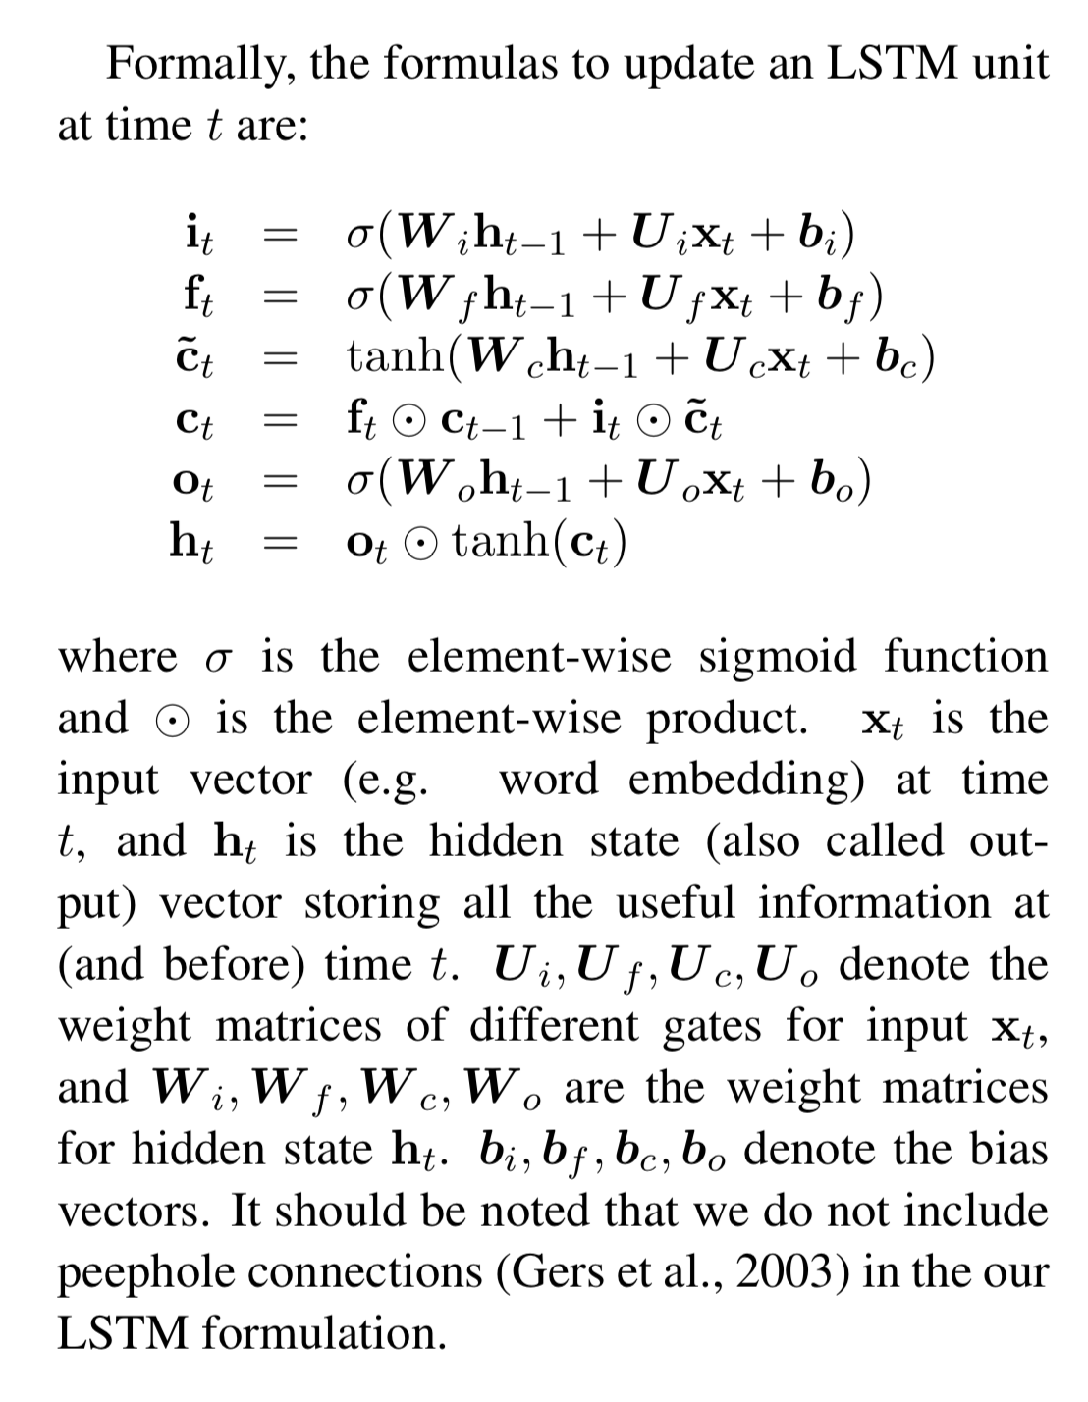
Bi-directional LSTM:
The basic idea is to present each sequence forwards and backwards to two separate hidden states to capture past and future information, respectively. Then the two hidden states are concatenated to form the final output.
Notes:
update some formula to traditional lstm to form the bi-lstm

Slide 7
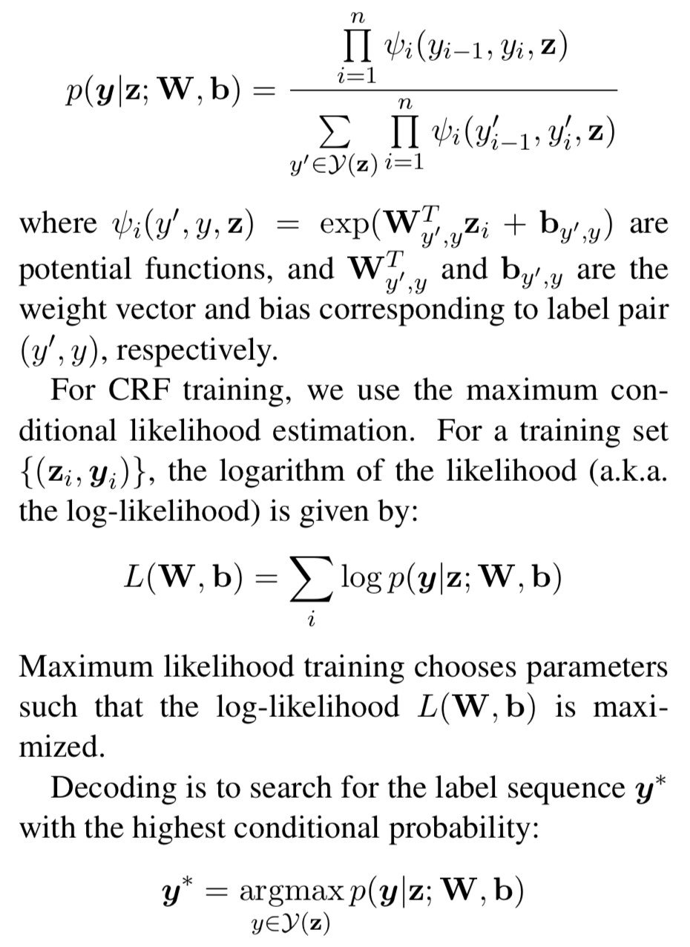
Conditional random fields:
Consider the correlations between labels in neighborhoods and jointly decode the best chain of labels for a given input sentence.
use z = {z₁,··· ,z_{n}} to represent a generic input sequence. y = {y₁,··· ,y_{n}} represents a generic sequence of labels for z. Y(z) denotes the set of possible label sequences for z.
For a sequence CRF model (only interactions between two successive labels are considered), training and decoding can be solved efficiently by adopting the Viterbi algorithm.
Notes:
weight matrix
bias vector used in blstm

Slide 8
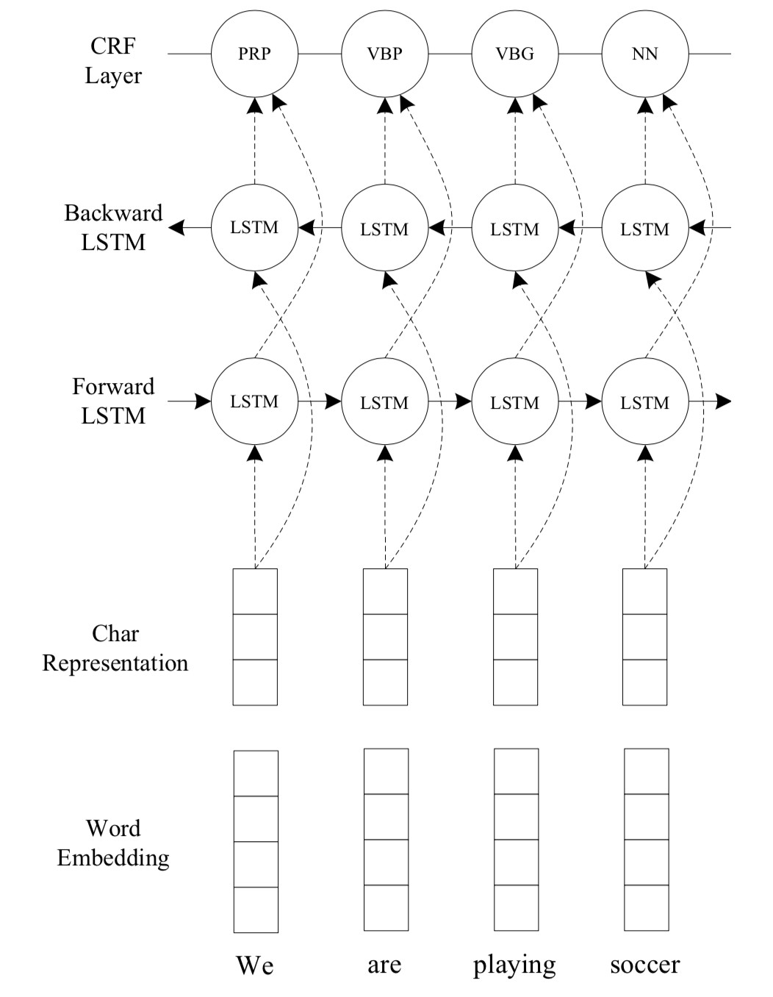
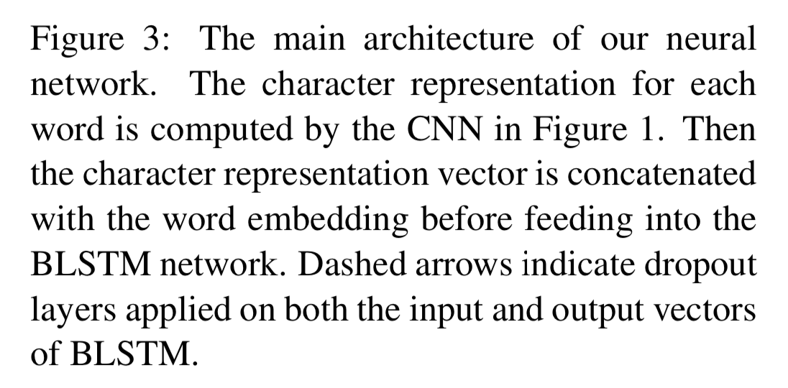
BLSTM-CNNs-CRF:

Slide 9
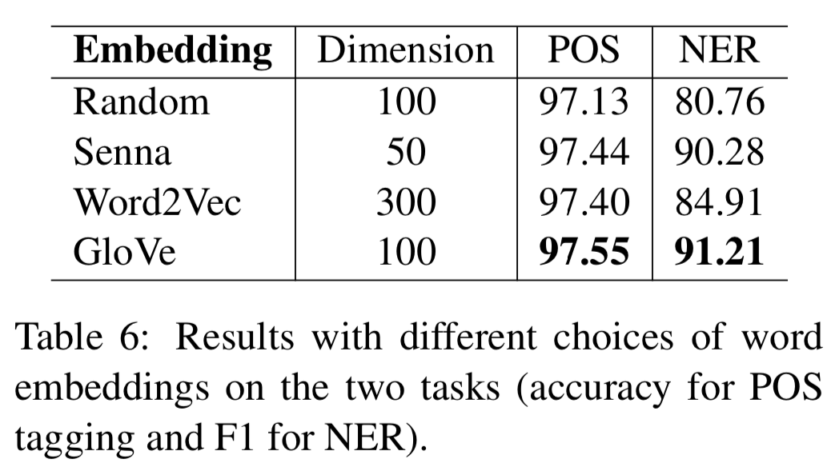
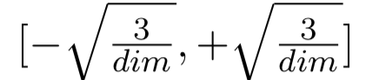
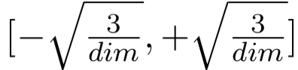
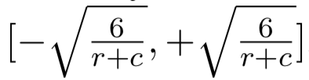
Network training: parameter initialization
Word embeddings:
Glove: 100-dimensional embeddings trained on 6 billion words from Wikipedia and web text (Pennington et al., 2014)
Senna: 50-dimensional embeddings trained on Wikipedia and Reuters RCV-1 corpus (Collobert et al., 2011)
Word2Vec: 300-dimensional embeddings trained on 100 billion words from Google News (Mikolov et al., 2013)
Random: 100-dimensional embeddings uniformly sampled from range where dim is the dimension of embeddings. (He et al., 2015)
Character embeddings: Character embeddings are initialized with uniform samples from range where we set dim=30
Weight Matrices and Bias Vectors:
Matrix parameters are randomly initialized with uniform sample from
Bias vectors are initialized to zero, except the bias b_{f} for the forget gate in LSTM , which is initialized to 1.0 (Jozefowicz et al., 2015).
Notes:
R and c are the number of of rows and columns in the structure

Slide 10
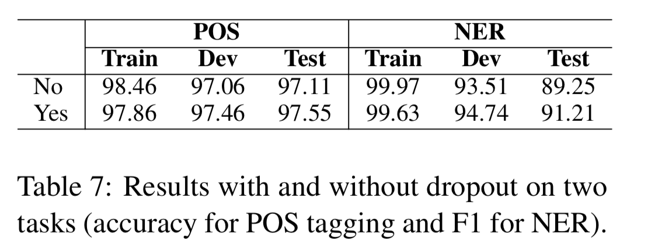
Optimization Algorithm:
Parameter optimization is performed with mini-batch stochastic gradient descent (SGD) with batch size 10 and momentum 0.9.
Early Stopping: Use early stopping (Giles, 2001; Graves et al., 2013) based on performance on validation sets. The “best” parameters appear at around 50 epochs according to the experiments.
Fine Tuning: For each of the embeddings, fine-tune initial embeddings, modifying them during gradient updates of the neural network model by back-propagating gradients. (Collobert et al., 2011; Peng and Dredze, 2015).
Dropout Training: To mitigate overfitting, apply the dropout method (Srivastava et al., 2014) to regularize our model. Fix dropout rate at 0.5 for all dropout layers through all the experiments.

Slide 11
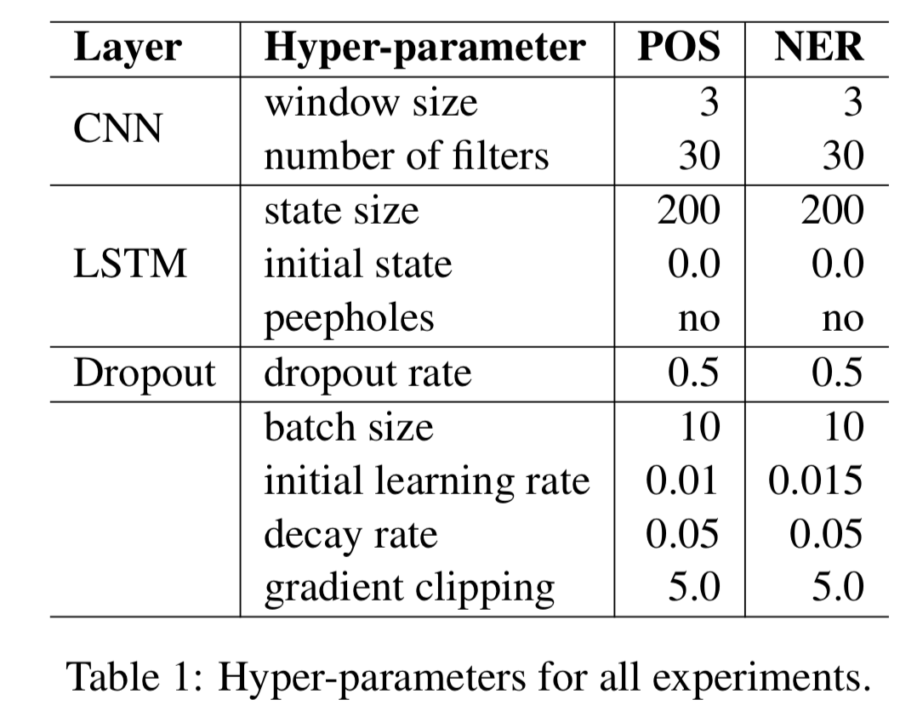
Tuning Hyper-Parameters:
Tune the hyper-parameters on the development sets by random search.

Slide 12
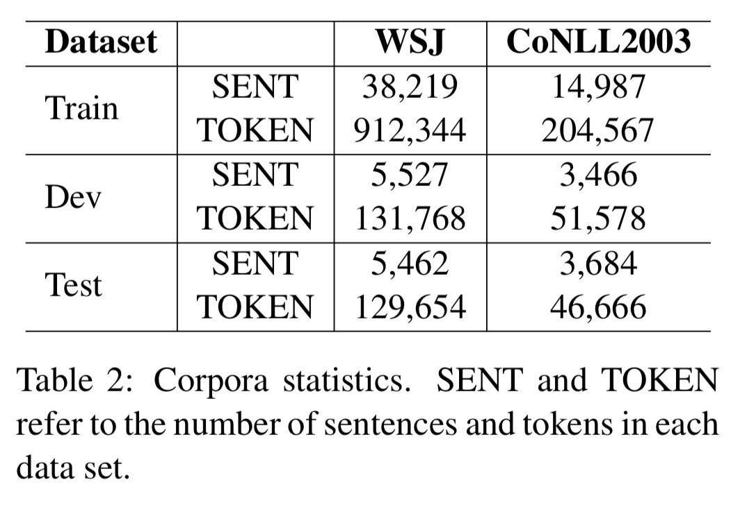
Experiment:
Data sets:
POS Tagging: Wall Street Journal (WSJ) portion of Penn Treebank (PTB) (Marcus et al., 1993)
NER: English data from CoNLL 2003 shared task (Tjong Kim Sang and De Meulder, 2003)

Slide 13
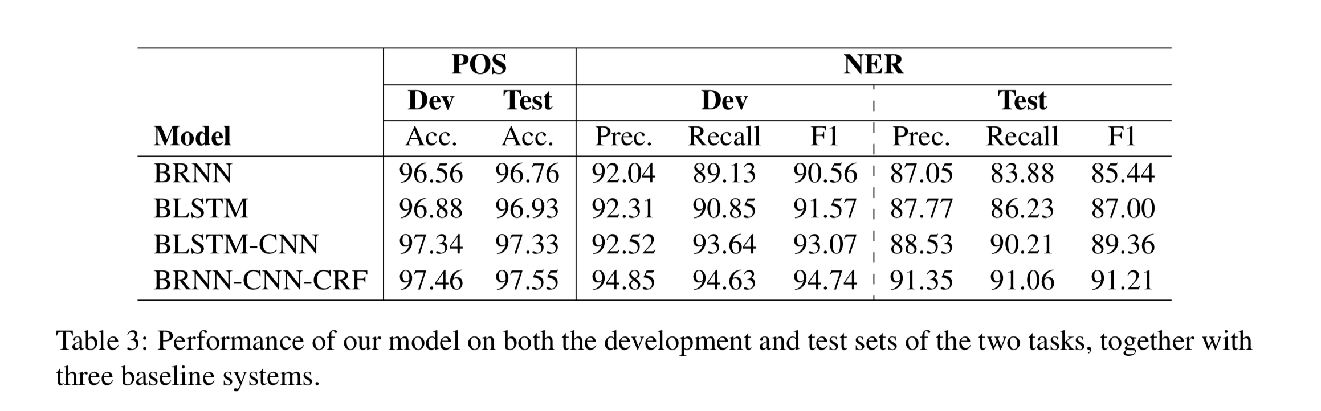
Main result:
Notes:
typo of the paper: BLSTM - CNN - CRF

Slide 14
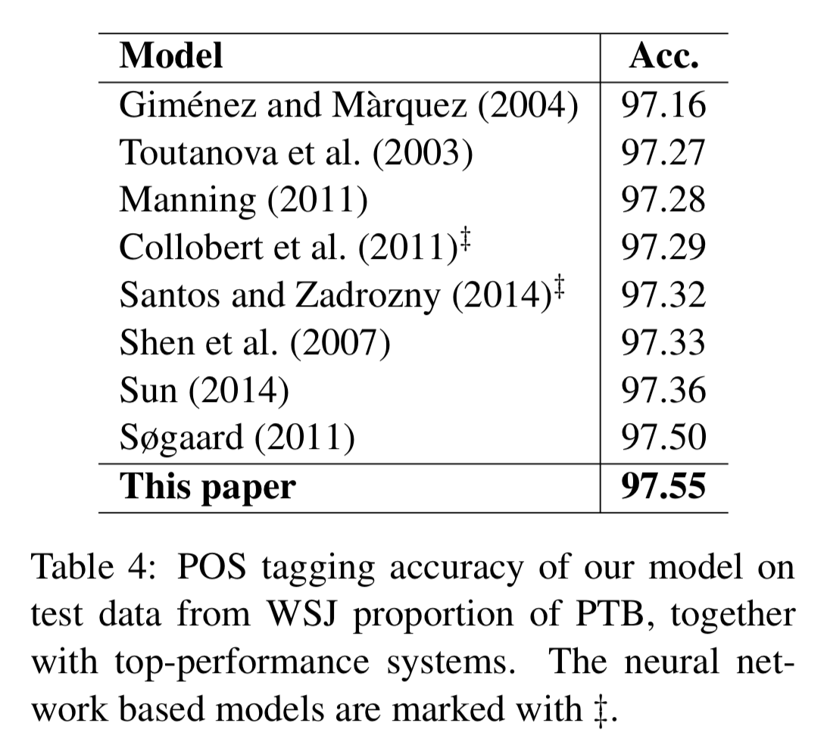
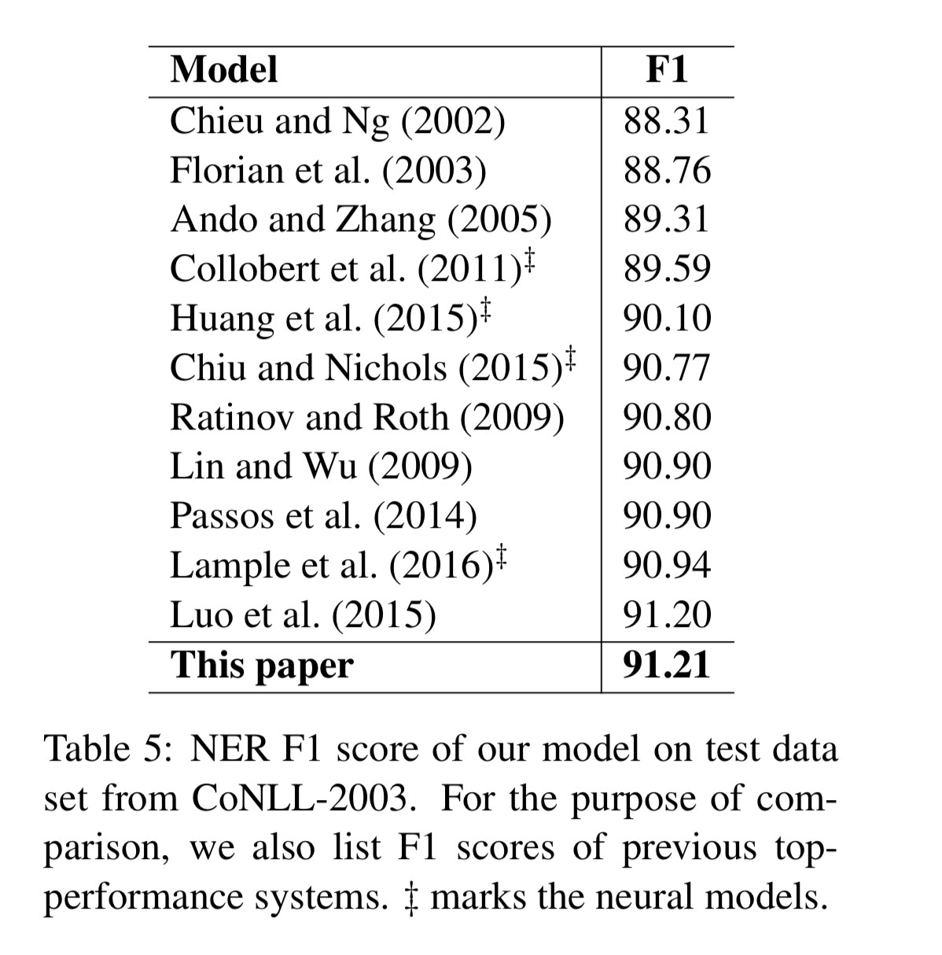
Comparison with previous work:

Slide 15
Contributions of the paper:
Proposing a novel neural network architecture for linguistic sequence labeling.
Giving empirical evaluations of this model on benchmark data sets for two classic NLP tasks.
Achieving state-of-the-art performance with this truly end-to-end system.

Slide 16
Thanks:
Reference:
https://www.aclweb.org/anthology/P16-1101
https://github.com/jayavardhanr/End-to-end-Sequence-Labeling-via-Bi-directional-LSTM-CNNs-CRF-Tutorial

