Slide 1
JMIR DERMATOLOGY
원형탈모
오늘 나온 최신 연구를 정리했습니다
2026 Sep 21 | 매일 아침 탈모 연구 한 편
Notes:
[hook] 약 4초
대본: 원형탈모 오늘 나온 최신 연구를 정리했습니다
연출 노트: 0.5초 안에 스크롤을 멈추게 하는 구간. 숫자를 크게 읽어준다.

Slide 2
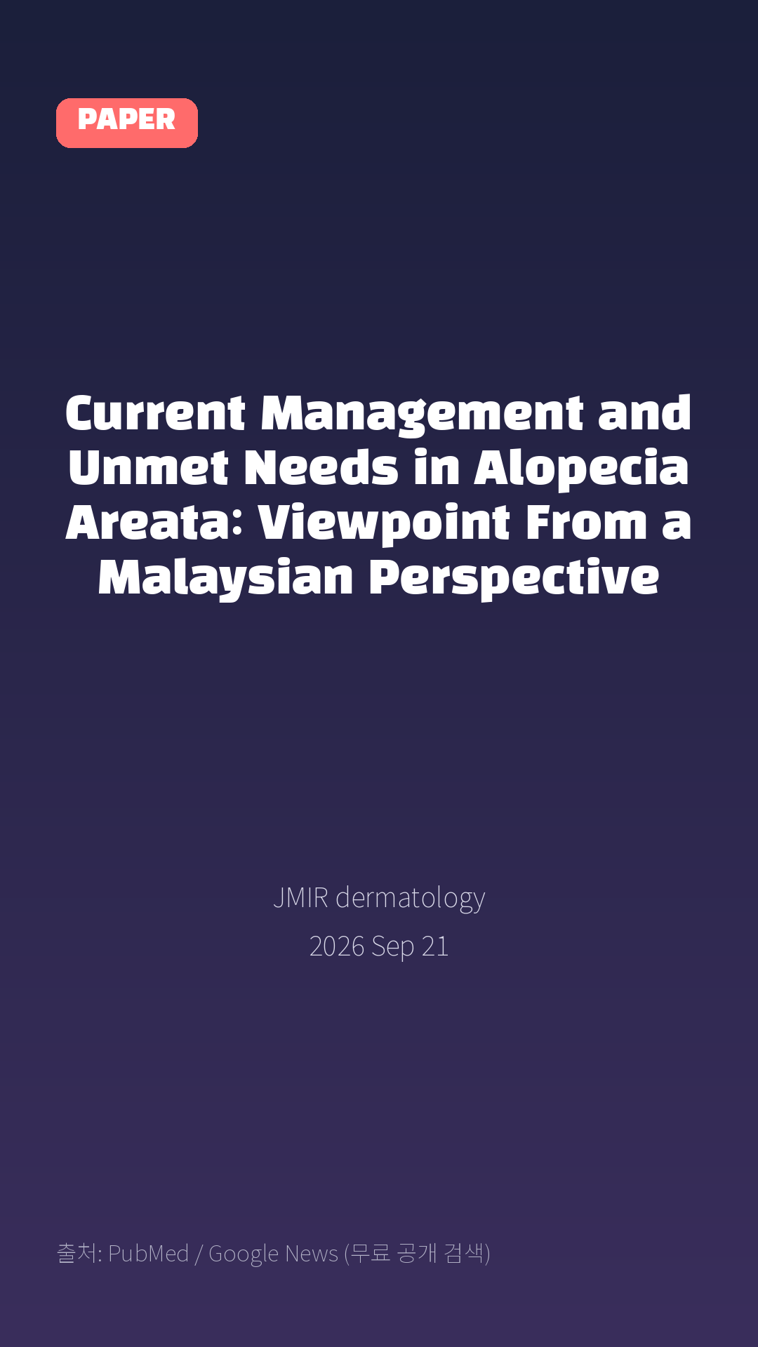
Current Management and Unmet Needs in Alopecia Areata: Viewpoint From a Malaysian Perspective
JMIR dermatology · 2026 Sep 21
Notes:
[paper_intro] 약 8초
대본: 《JMIR dermatology》 - Current Management and Unmet Needs in Alopecia Areata: Viewpoint From a Malaysian Perspective
연출 노트: 출처를 분명히 밝혀 신뢰를 준다.

Slide 3

Alopecia areata (AA) is a chronic, immune-mediated disease characterized by nonscarring hair loss and a substantial clinical and psychosocial burden, yet it is still widely perceived as a purely cosmetic concern.
Notes:
[key_finding_1] 약 10초
대본: Alopecia areata (AA) is a chronic, immune-mediated disease characterized by nonscarring hair loss and a substantial clinical and psychosocial burden, yet it is still widely perceived as a purely cosmetic concern.
연출 노트: 핵심 포인트 1. 자막을 끊어 읽는다.

Slide 4

In this viewpoint, we draw on the available Malaysian studies, selected international evidence, and our collective clinical experience to propose that AA warrants greater clinical, research, and policy attention in Malaysia.
Notes:
[key_finding_2] 약 10초
대본: In this viewpoint, we draw on the available Malaysian studies, selected international evidence, and our collective clinical experience to propose that AA warrants greater clinical, research, and policy attention in Malaysia.
연출 노트: 핵심 포인트 2.

Slide 5

탈모 연구, 매일 쉽게 정리해드립니다 🙂
Notes:
[my_take] 약 10초
대본: 탈모 연구, 매일 쉽게 정리해드립니다 🙂
연출 노트: 본인 사진 + 코멘트. 문구를 직접 바꿔 쓰세요.

Slide 6
더 자세한 내용은 원문 링크에서 확인하세요. 매일 새로운 탈모 연구, 팔로우하고 놓치지 마세요!
Notes:
[cta] 약 8초
대본: 더 자세한 내용은 원문 링크에서 확인하세요. 매일 새로운 탈모 연구, 팔로우하고 놓치지 마세요!
연출 노트: 원문 링크는 고정 댓글로 안내.

Slide 7
본문 요약 (편집용)
◆ 배경 — Background (자동 구분)
· Alopecia areata (AA) is a chronic, immune-mediated disease characterized by nonscarring hair loss and a substantial clinical and psychosocial burden, yet it is still widely perceived as a purely cosmetic concern.
◆ 연구 방법 — Methods (자동 구분)
· In this viewpoint, we draw on the available Malaysian studies, selected international evidence, and our collective clinical experience to propose that AA warrants greater clinical, research, and policy attention in Malaysia.
Notes:
편집 참고용 슬라이드입니다. 영상에는 쓰지 않아도 됩니다.
원문 영어 문장을 그대로 발췌했으므로 번역·검수 후 사용하세요.

Slide 8
본문 요약 (편집용)
◆ 주요 결과 — Results (자동 구분)
· Malaysia-specific evidence remains limited and is derived largely from retrospective, single-center studies; nonetheless, the available data point to variable disease presentation, inconsistent use of standardized severity assessment, reliance on conventional therapies, substantial loss to follow-up, and a meaningful psychosocial impact among affected patients.
· Current local management appears to rely mainly on conventional therapies, while access to advanced therapies such as Janus kinase inhibitors remains constrained by affordability and reimbursement challenges.
· We therefore call for 5 priorities: strengthening Malaysia-specific epidemiological and real-world evidence, including through a national AA registry; adopting standardized disease-assessment tools in clinical studies and routine practice; integrating psychosocial support into AA care pathways; developing locally relevant clinical guidance; and improving public, clinician, and policymaker awareness that AA is a medical condition rather than a cosmetic concern.
· Together, these steps would support earlier diagnosis, more equitable access to effective treatment, and holistic, patient-centered care for adults and children living with AA in Malaysia.
Notes:
편집 참고용 슬라이드입니다. 영상에는 쓰지 않아도 됩니다.
원문 영어 문장을 그대로 발췌했으므로 번역·검수 후 사용하세요.

Slide 9
출처
[출처]
논문: Current Management and Unmet Needs in Alopecia Areata: Viewpoint From a Malaysian Perspective
게재: JMIR dermatology
원문: https://pubmed.ncbi.nlm.nih.gov/42766724/
[이미지 출처]
- Male pattern baldness.jpg / Originally uploaded by Lkinkade (Transferred by XenonX3) / CC BY-SA 2.5
https://commons.wikimedia.org/wiki/File:Male_pattern_baldness.jpg
- Male-pattern hair loss.jpg / BlaiserPascal / CC BY-SA 4.0
https://commons.wikimedia.org/wiki/File:Male-pattern_hair_loss.jpg
※ CC BY-SA 이미지가 포함되어 있습니다. 저작자 표시가 필수이며,
동일조건변경허락(ShareAlike) 조항이 영상 전체에 적용될 수 있으니
상업적 이용 시 해당 이미지를 교체하는 편이 안전합니다.

