Slide 1
CLINICAL, COSMETIC AND INVESTIGATIONAL D
95%
이 숫자, 탈모 연구가 새로 내놨습니다
2026 | 매일 아침 탈모 연구 한 편
Notes:
[hook] 약 4초
대본: 95% 이 숫자, 탈모 연구가 새로 내놨습니다
연출 노트: 0.5초 안에 스크롤을 멈추게 하는 구간. 숫자를 크게 읽어준다.

Slide 2
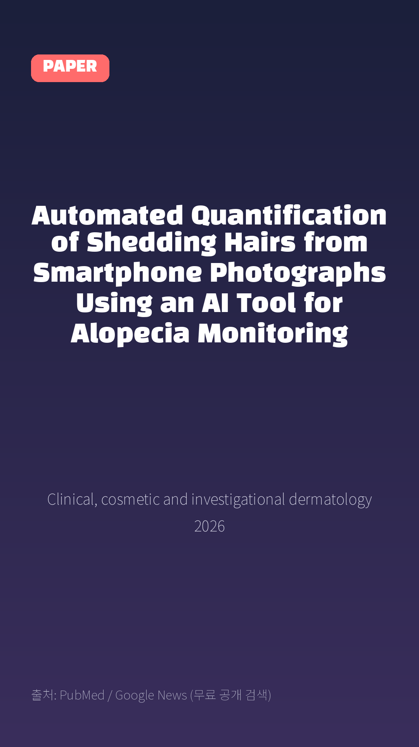
Automated Quantification of Shedding Hairs from Smartphone Photographs Using an AI Tool for Alopecia Monitoring
Clinical, cosmetic and investigational dermatology · 2026
Notes:
[paper_intro] 약 8초
대본: 《Clinical, cosmetic and investigational dermatology》 - Automated Quantification of Shedding Hairs from Smartphone Photographs Using an AI Tool for Alopecia Monitoring
연출 노트: 출처를 분명히 밝혀 신뢰를 준다.

Slide 3

Images were assigned by participant into training/internal validation (24 volunteers, 4509 images) and independent testing (6 volunteers, 1121 images).
Notes:
[key_finding_1] 약 10초
대본: Images were assigned by participant into training/internal validation (24 volunteers, 4509 images) and independent testing (6 volunteers, 1121 images).
연출 노트: 핵심 포인트 1. 자막을 끊어 읽는다.

Slide 4
논문 Table 1
Independent-Test Performance Stratified by Reference Hair-Count Range
Reference Count, Hairs | Images, n | MAE, hairs | MAPE, %
1–50 | 391 | 1.9 | 10.4
51–100 | 274 | 4.3 | 5.8
101–200 | 258 | 7.8 | 5.8
>200 | 198 | 10.6 | 3.6
Notes:
[paper_table] 약 8초
대본: 표로 보면 이렇습니다. Independent-Test Performance Stratified by Reference Hair-Count Range
연출 노트: 핵심 숫자 한 칸만 짚어준다. 표는 셀을 직접 수정할 수 있다.

Slide 5

The mean model-minus-reference bias was -0.8 hairs (95% LoA, -17.0 to 15.4 hairs).
Notes:
[key_finding_2] 약 10초
대본: The mean model-minus-reference bias was -0.8 hairs (95% LoA, -17.0 to 15.4 hairs).
연출 노트: 핵심 포인트 2.

Slide 6

탈모 연구, 매일 쉽게 정리해드립니다 🙂
Notes:
[my_take] 약 10초
대본: 탈모 연구, 매일 쉽게 정리해드립니다 🙂
연출 노트: 본인 사진 + 코멘트. 문구를 직접 바꿔 쓰세요.

Slide 7
더 자세한 내용은 원문 링크에서 확인하세요. 매일 새로운 탈모 연구, 팔로우하고 놓치지 마세요!
Notes:
[cta] 약 8초
대본: 더 자세한 내용은 원문 링크에서 확인하세요. 매일 새로운 탈모 연구, 팔로우하고 놓치지 마세요!
연출 노트: 원문 링크는 고정 댓글로 안내.

Slide 8
본문 요약 (편집용)
◆ 배경 — Introduction
· Hair shedding is a common concern in dermatology and a clinically relevant feature of androgenetic alopecia (AGA) and telogen effluvium (TE).1–3 Objective counts of shedding hairs can support differential assessment, longitudinal monitoring, treatment counselling, and evaluation of treatment response.4,5 Reliable measurement also matters because perceived hair loss is closely associated with anxiety, altered self-image, impaired coping, and reduced quality of life.6–11
· Visual shedding scales are faster and easier to use, but they provide only subjective, semi-quantitative estimates.12,13 Variation between observers can complicate longitudinal comparison, communication with patients, and interpretation of apparent changes in shedding.
· Smartphone images are already used in teledermatology, where image quality and clinical usefulness have been evaluated.14–16 However, although artificial intelligence performs well in some dermatological tasks, such as dermoscopy image classification,17,18 clinical use depends on generalizability and on whether the output addresses a defined need.19–21 Because shedding hairs are fine, curved, overlapping, and often tangled, automated counting still faces unique and unresolved challenges.
◆ 연구 방법 — Material and Methods
· Images were partitioned by participant into training (18 participants, 3396 images), internal validation (6 participants, 1113 images), and independent testing (6 participants, 1121 images).
· The model combined an EfficientNet-B0 encoder,22 a U-Net-style decoder,23 and a feature module based on strip pooling and deformable convolution.24,25 These operations were used to represent long, thin, curved, and tangled hair structures.
· Independent-test performance was stratified by reference-count range (1–50, 51–100, 101–200, and >200 hairs).
Notes:
편집 참고용 슬라이드입니다. 영상에는 쓰지 않아도 됩니다.
원문 영어 문장을 그대로 발췌했으므로 번역·검수 후 사용하세요.

Slide 9
본문 요약 (편집용)
◆ 주요 결과 — Results
· In stratified performance analysis, MAE increased from 1.9 hairs for counts of 1–50 to 10.6 hairs for counts >200, whereas MAPE decreased from 10.4% to 3.6%.Table 1Independent-Test Performance Stratified by Reference Hair-Count RangeReference Count, HairsImages, nMAE, hairsMAPE, %Mean Signed Error, Hairs1–503911.910.40.251–1002744.35.8−0.1101–2002587.85.8−1.0>20019810.63.6−3.3 Figure 2Independent test set performance.
· The model predicted 174.8 hairs for a reference count of 134 (absolute error, 40.8; 30.4%) and 97.0 hairs for a reference count of 149 (absolute error, 52.0; 34.9%).Figure 3Model visualization and qualitative error analysis.
· The model overestimated 134 hairs as 174.8 (absolute error, 40.8 hairs; 30.4%) and underestimated 149 hairs as 97.0 (absolute error, 52.0 hairs; 34.9%).Two panels show model error analysis with density maps and count comparisons for hair predictions.Image A shows two accurate model predictions.
· The model overestimated 134 hairs as 174.8 (absolute error, 40.8 hairs; 30.4%) and underestimated 149 hairs as 97.0 (absolute error, 52.0 hairs; 34.9%).
· AI had an MAE of 6.99 hairs (95% CI, 5.75–8.23) and an MAPE of 6.15% (95% CI, 5.18–7.12).
· Inter-reader reliability was moderate to good and was higher for clustered images, particularly among healthy participants and dermatologists.Table 2Performance of AI and Human Visual Estimation in the Blinded Reader StudyEstimatorMAE (95% CI)MAPE, % (95% CI)Bias (95% CI)Overestimation, % (95% CI)AI model6.99 (5.75–8.23)6.15 (5.18–7.12)2.35 (0.18–4.52)60.71 (47.52–73.91)Healthy participant/Scatter57.62 (45.53–69.72)40.56 (37.66–43.46)−33.08 (−45.12 to −21.05)26.43 (21.21–31.65)Healthy participant /Cluster50.89 (40.35–61.43)39.35 (34.63–44.07)14.73 (4.88–24.59)56.43 (49.72–63.13)Patient/Scatter61.21 (46.38–76.04)41.05 (36.76–45.35)38.14 (27.10–49.18)71.07 (65.77–76.37)Patient/Cluster68.38 (54.88–81.87)52.79 (46.61–58.97)49.16 (36.15–62.17)73.21 (67.59–78.83)Dermatologist/Scatter49.56 (40.94–58.18)40.95 (36.41–45.48)−16.88 (−24.52 to −9.24)31.79 (27.36–36.21)Dermatologist/Cluster46.21 (37.65–54.77)38.73 (34.04–43.41)17.52 (9.91–25.12)55.71 (49.04–62.39) Table 3Inter-Reader Reliability by Reader Group and Estimation MethodGroupMethodInter-Reader ICC (2,1), 95% CIHealthy participantScatter0.617 (0.506–0.725)Healthy participantCluster0.754 (0.667–0.831)PatientScatter0.699 (0.599–0.790)PatientCluster0.781 (0.699–0.851)DermatologistScatter0.707 (0.610–0.796)DermatologistCluster0.788 (0.709–0.855) Figure 4Reader study performance comparison.
· The between-cohort difference in completion was 22.5 percentage points (P = 0.056), and the difference in usable quantitative data was 47.5 percentage points (P < 0.001).Table 4RWT Completion and Usable Quantitative Data in the Historical Manual and Subsequent AI-Assisted CohortsWorkflowTotal Instructed, nCompleted RWT, n (%)Usable Quantitative Data, n (%)Historical manual workflow4826 (54.2%)14 (29.2%)Subsequent AI-assisted photograph-upload workflow3023 (76.7%)23 (76.7%)
◆ 고찰 — Discussion
· Patients reporting increased hair loss tended to overestimate hair numbers, possibly reflecting the psychosocial burden of alopecia.6,8,10 Automated counting may therefore provide a more consistent reference for consultations in which perceived and measured shedding diverge.
· Usable quantitative data were more frequent in the subsequent AI-assisted cohort than in the historical manual cohort (76.7% versus 29.2%), while RWT completion was 22.5 percentage points higher, although this difference was not statistically significant (P = 0.056).
· The model MAE of 5.4 hairs was small relative to both population-level differences reported in previous RWT studies3,4 and the count ranges represented by existing semi-quantitative visual shedding scales,12,13 while remaining close in magnitude to the mean absolute disagreement of 3.8 hairs between independent manual counters.
· Repeated time-separated collection sessions and paired adjudicated counts strengthened the reference standard, while the 56 naturally collected samples from 10 additional participants provided complementary evaluation outside the sequence-construction paradigm and broadened participant representation, thus validation remains limited in scale and diversity.
Notes:
편집 참고용 슬라이드입니다. 영상에는 쓰지 않아도 됩니다.
원문 영어 문장을 그대로 발췌했으므로 번역·검수 후 사용하세요.

Slide 10
본문 요약 (편집용)
◆ 결론 — Conclusions
· AI analysis of ordinary smartphone photographs quantified dark brown or black shedding hairs on white or light-colored backgrounds rapidly and with low error under the evaluated conditions.
· It had lower error than human visual estimation and was associated with a higher proportion of usable quantitative RWT data in the subsequent AI-assisted cohort.
· This photograph-based method has the potential to support objective hair-shedding assessment in clinical care and research, with further validation needed across broader populations and settings.
Notes:
편집 참고용 슬라이드입니다. 영상에는 쓰지 않아도 됩니다.
원문 영어 문장을 그대로 발췌했으므로 번역·검수 후 사용하세요.

Slide 11
출처
[출처]
논문: Automated Quantification of Shedding Hairs from Smartphone Photographs Using an AI Tool for Alopecia Monitoring
게재: Clinical, cosmetic and investigational dermatology
원문: https://pubmed.ncbi.nlm.nih.gov/42763653/
[이미지 출처]
- Male pattern baldness.jpg / Originally uploaded by Lkinkade (Transferred by XenonX3) / CC BY-SA 2.5
https://commons.wikimedia.org/wiki/File:Male_pattern_baldness.jpg
- Male-pattern hair loss.jpg / BlaiserPascal / CC BY-SA 4.0
https://commons.wikimedia.org/wiki/File:Male-pattern_hair_loss.jpg
※ CC BY-SA 이미지가 포함되어 있습니다. 저작자 표시가 필수이며,
동일조건변경허락(ShareAlike) 조항이 영상 전체에 적용될 수 있으니
상업적 이용 시 해당 이미지를 교체하는 편이 안전합니다.
[논문 본문 그림·표]
- PubMed Central PMC13589520 (CC BY-NC(비상업 한정) - 수익화 채널에서는 사용 주의)
https://www.ncbi.nlm.nih.gov/pmc/articles/PMC13589520/
· Table 1
※ 오픈액세스 논문의 그림·표이며, 위 원문 출처를 함께 표기하세요.

