Slide 1
PROBLEMY ENDOKRINOLOGII
오늘의 논문
Problemy endokrinologii에 실린 새 연구입니다
2026 Sep 8 | 매일 아침 탈모 연구 한 편
Notes:
[hook] 약 4초
대본: 오늘의 논문 Problemy endokrinologii에 실린 새 연구입니다
연출 노트: 0.5초 안에 스크롤을 멈추게 하는 구간. 숫자를 크게 읽어준다.

Slide 2
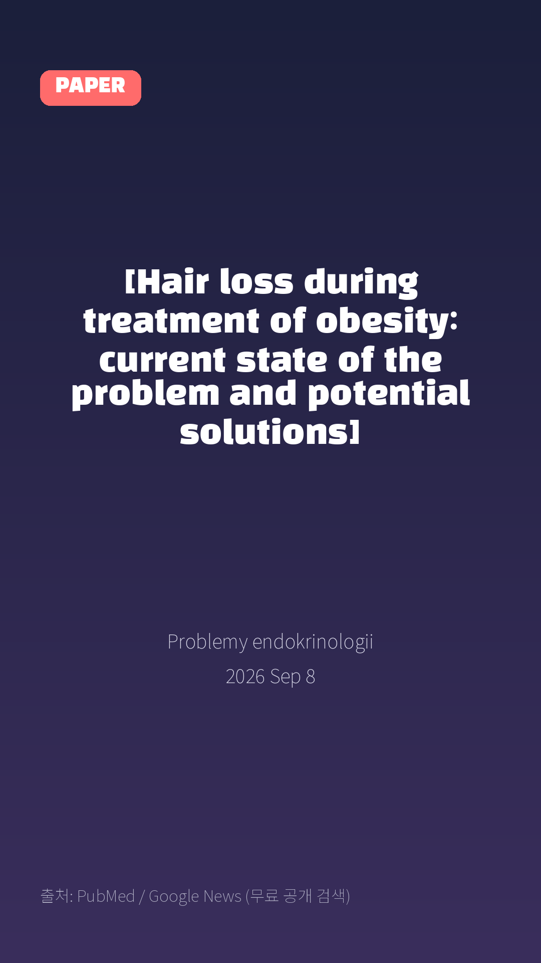
[Hair loss during treatment of obesity: current state of the problem and potential solutions]
Problemy endokrinologii · 2026 Sep 8
Notes:
[paper_intro] 약 8초
대본: 《Problemy endokrinologii》 - [Hair loss during treatment of obesity: current state of the problem and potential solutions]
연출 노트: 출처를 분명히 밝혀 신뢰를 준다.

Slide 3

Obesity and overweight are significant medical and social problems, and current approaches to their treatment, including hypocaloric diets, bariatric interventions, and pharmacotherapy, including incretin drugs (e.g., glucagon-like peptide-1 receptor agonists), can be accompanied by the development of diffuse hair loss.
Notes:
[key_finding_1] 약 10초
대본: Obesity and overweight are significant medical and social problems, and current approaches to their treatment, including hypocaloric diets, bariatric interventions, and pharmacotherapy, including incretin drugs (e.g., glucagon-like peptide-1 receptor agonists), can be accompanied by the development of diffuse hair loss.
연출 노트: 핵심 포인트 1. 자막을 끊어 읽는다.

Slide 4

This article, prepared following a discussion at an expert council, systematizes current data on the prevalence and clinical and morphological variants of alopecia associated with weight loss.
Notes:
[key_finding_2] 약 10초
대본: This article, prepared following a discussion at an expert council, systematizes current data on the prevalence and clinical and morphological variants of alopecia associated with weight loss.
연출 노트: 핵심 포인트 2.

Slide 5

탈모 연구, 매일 쉽게 정리해드립니다 🙂
Notes:
[my_take] 약 10초
대본: 탈모 연구, 매일 쉽게 정리해드립니다 🙂
연출 노트: 본인 사진 + 코멘트. 문구를 직접 바꿔 쓰세요.

Slide 6
더 자세한 내용은 원문 링크에서 확인하세요. 매일 새로운 탈모 연구, 팔로우하고 놓치지 마세요!
Notes:
[cta] 약 8초
대본: 더 자세한 내용은 원문 링크에서 확인하세요. 매일 새로운 탈모 연구, 팔로우하고 놓치지 마세요!
연출 노트: 원문 링크는 고정 댓글로 안내.

Slide 7
본문 요약 (편집용)
◆ 배경 — Background (자동 구분)
· Obesity and overweight are significant medical and social problems, and current approaches to their treatment, including hypocaloric diets, bariatric interventions, and pharmacotherapy, including incretin drugs (e.g., glucagon-like peptide-1 receptor agonists), can be accompanied by the development of diffuse hair loss.
· This article, prepared following a discussion at an expert council, systematizes current data on the prevalence and clinical and morphological variants of alopecia associated with weight loss.
◆ 주요 결과 — Results (자동 구분)
· The main pathogenic mechanisms are discussed, including metabolic stress, protein-energy malnutrition, and micronutrient deficiencies.Special attention is paid to the role of biotin and vitamin D in maintaining hair follicle function, as well as to risk groups for alopecia in patients undergoing treatment for obesity.
· Approaches to the prevention, monitoring, and comprehensive management of such patients are presented, taking into account the need to maintain adherence to the main therapy.This article systematizes current data on the prevalence and clinical and morphological variants of alopecia associated with weight loss.
· It examines the main pathogenic mechanisms, including metabolic stress, protein-energy malnutrition, and micronutrient deficiencies.
· Special attention is paid to the role of biotin and vitamin D in maintaining hair follicle function, as well as to risk groups for alopecia in patients undergoing treatment for obesity.
· Approaches to prevention, monitoring, and comprehensive management of these patients are presented, taking into account the need to maintain adherence to the primary therapy.
Notes:
편집 참고용 슬라이드입니다. 영상에는 쓰지 않아도 됩니다.
원문 영어 문장을 그대로 발췌했으므로 번역·검수 후 사용하세요.

Slide 8
출처
[출처]
논문: [Hair loss during treatment of obesity: current state of the problem and potential solutions]
게재: Problemy endokrinologii
원문: https://pubmed.ncbi.nlm.nih.gov/42733368/
[이미지 출처]
- Male pattern baldness.jpg / Originally uploaded by Lkinkade (Transferred by XenonX3) / CC BY-SA 2.5
https://commons.wikimedia.org/wiki/File:Male_pattern_baldness.jpg
- Male-pattern hair loss.jpg / BlaiserPascal / CC BY-SA 4.0
https://commons.wikimedia.org/wiki/File:Male-pattern_hair_loss.jpg
※ CC BY-SA 이미지가 포함되어 있습니다. 저작자 표시가 필수이며,
동일조건변경허락(ShareAlike) 조항이 영상 전체에 적용될 수 있으니
상업적 이용 시 해당 이미지를 교체하는 편이 안전합니다.

