Slide 1
DERMATOLOGY AND THERAPY
86.5%
이 숫자, 탈모 연구가 새로 내놨습니다
2026 Oct 2 | 매일 아침 탈모 연구 한 편
Notes:
[hook] 약 4초
대본: 86.5% 이 숫자, 탈모 연구가 새로 내놨습니다
연출 노트: 0.5초 안에 스크롤을 멈추게 하는 구간. 숫자를 크게 읽어준다.

Slide 2
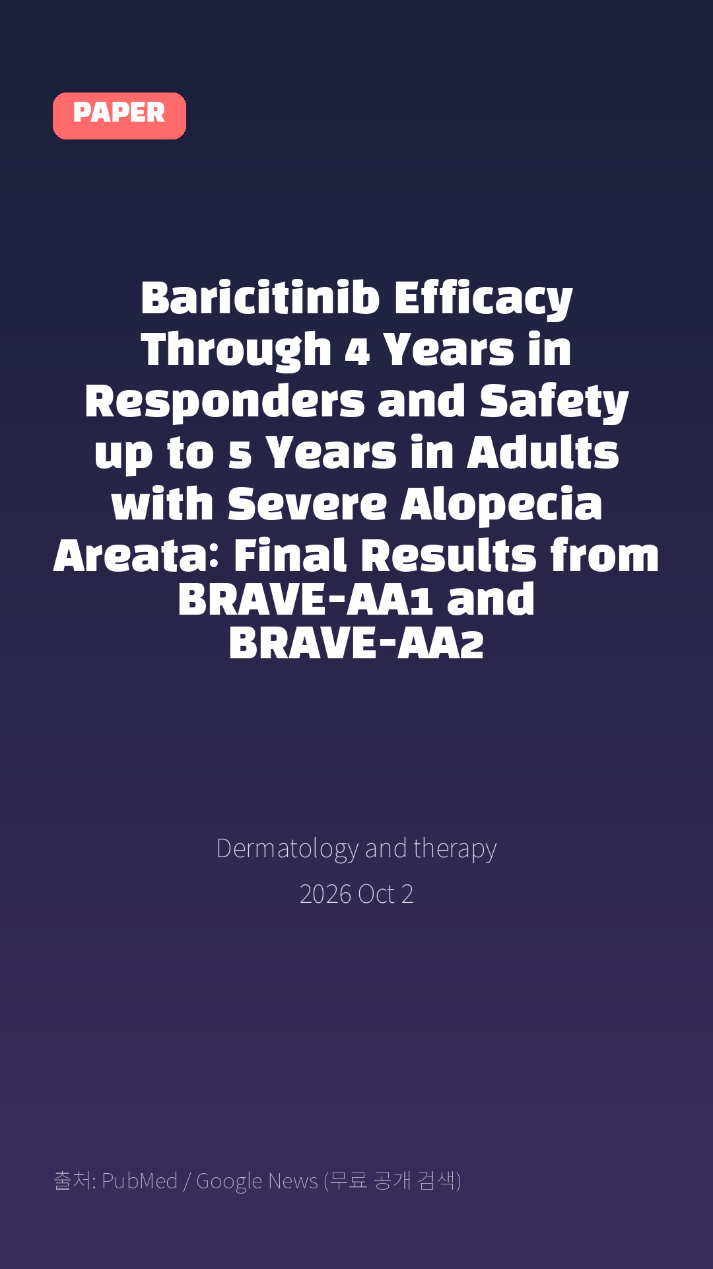
Baricitinib Efficacy Through 4 Years in Responders and Safety up to 5 Years in Adults with Severe Alopecia Areata: Final Results from BRAVE-AA1 and BRAVE-AA2
Dermatology and therapy · 2026 Oct 2
Notes:
[paper_intro] 약 8초
대본: 《Dermatology and therapy》 - Baricitinib Efficacy Through 4 Years in Responders and Safety up to 5 Years in Adults with Severe Alopecia Areata: Final Results from BRAVE-AA1 and BRAVE-AA2
연출 노트: 출처를 분명히 밝혀 신뢰를 준다.

Slide 3

Methods: Efficacy was assessed for patients randomized to baricitinib 4 mg or 2 mg who achieved response (Severity of Alopecia Tool [SALT] score ≤ 20) at Week 52 (4 mg, N = 133; 2 mg, N = 72) and stayed on the same dose through Week 200.
Notes:
[key_finding_1] 약 10초
대본: Methods: Efficacy was assessed for patients randomized to baricitinib 4 mg or 2 mg who achieved response (Severity of Alopecia Tool [SALT] score ≤ 20) at Week 52 (4 mg, N = 133; 2 mg, N = 72) and stayed on the same dose through Week 200.
연출 노트: 핵심 포인트 1. 자막을 끊어 읽는다.

Slide 4

Proportions of patients maintaining a SALT score ≤ 20 and achieving a Clinician-Reported Outcome Measure for Eyebrow/Eyelash (EB/EL) Hair Loss™ score of 0 or 1 with ≥ 2-point improvement from baseline were reported using the modified last-observation-carried-forward method.
Notes:
[key_finding_2] 약 10초
대본: Proportions of patients maintaining a SALT score ≤ 20 and achieving a Clinician-Reported Outcome Measure for Eyebrow/Eyelash (EB/EL) Hair Loss™ score of 0 or 1 with ≥ 2-point improvement from baseline were reported using the modified last-observation-carried-forward method.
연출 노트: 핵심 포인트 2.

Slide 5

탈모 연구, 매일 쉽게 정리해드립니다 🙂
Notes:
[my_take] 약 10초
대본: 탈모 연구, 매일 쉽게 정리해드립니다 🙂
연출 노트: 본인 사진 + 코멘트. 문구를 직접 바꿔 쓰세요.

Slide 6
더 자세한 내용은 원문 링크에서 확인하세요. 매일 새로운 탈모 연구, 팔로우하고 놓치지 마세요!
Notes:
[cta] 약 8초
대본: 더 자세한 내용은 원문 링크에서 확인하세요. 매일 새로운 탈모 연구, 팔로우하고 놓치지 마세요!
연출 노트: 원문 링크는 고정 댓글로 안내.

Slide 7
본문 요약 (편집용)
◆ 배경 — Introduction
· Long-term efficacy and safety data are imperative for therapies used to treat severe alopecia areata (AA) because the disease is chronic, loss of response can be devastating to patients, and the safety profile needs to support long-term therapy.
· Baricitinib, a selective JAK inhibitor, has been approved for severe AA in adults and is being studied in pediatric patients.
· This study evaluates the final long-term efficacy and safety of baricitinib in adults with severe AA.
◆ 연구 방법 — Methods
· Efficacy was assessed for patients randomized to baricitinib 4 mg or 2 mg who achieved response (Severity of Alopecia Tool [SALT] score ≤ 20) at Week 52 (4 mg, N = 133; 2 mg, N = 72) and stayed on the same dose through Week 200.
· Proportions of patients maintaining a SALT score ≤ 20 and achieving a Clinician-Reported Outcome Measure for Eyebrow/Eyelash (EB/EL) Hair Loss™ score of 0 or 1 with ≥ 2-point improvement from baseline were reported using the modified last-observation-carried-forward method.
· Safety is reported as incidence rates (IR) per 100 patient-years at risk for the All BARI AA group (N = 1303) and Extended BARI AA group (N = 948) through 248 weeks of exposure
Notes:
편집 참고용 슬라이드입니다. 영상에는 쓰지 않아도 됩니다.
원문 영어 문장을 그대로 발췌했으므로 번역·검수 후 사용하세요.

Slide 8
본문 요약 (편집용)
◆ 주요 결과 — Results
· For baricitinib 4 mg and 2 mg, respectively, among Week 52 responders, 115/133 (86.5%) and 61/72 (84.7%) maintained a SALT score ≤ 20 at Week 200.
· Regrowth of EB/EL hair continued beyond Week 52 and was maintained through Week 200.
· In up to 5 years of exposure with baricitinib, the IR for serious infections, nonmelanoma skin cancer malignancies, deep vein thrombosis/pulmonary embolism, and major adverse cardiovascular events remained low relative to background rates.
· No deaths occurred, and adverse event rates remained stable over time.
◆ 결론 — Conclusions
· Within this population, ~ 85% of responders maintained SALT scores ≤ 20 through approximately 4 years with continued benefit for EB/EL.
· Baricitinib's safety profile remained consistent over 5 years of treatment, in line with prior BRAVE program findings.
· Trial registration number: BRAVE-AA1, ClinicalTrials.gov number, NCT03570749, start date, September 24, 2018; BRAVE-AA2, ClinicalTrials.gov number, NCT03899259, start date, July 8, 2019.
Notes:
편집 참고용 슬라이드입니다. 영상에는 쓰지 않아도 됩니다.
원문 영어 문장을 그대로 발췌했으므로 번역·검수 후 사용하세요.

Slide 9
출처
[출처]
논문: Baricitinib Efficacy Through 4 Years in Responders and Safety up to 5 Years in Adults with Severe Alopecia Areata: Final Results from BRAVE-AA1 and BRAVE-AA2
게재: Dermatology and therapy
원문: https://pubmed.ncbi.nlm.nih.gov/42825995/
[이미지 출처]
- Male pattern baldness.jpg / Originally uploaded by Lkinkade (Transferred by XenonX3) / CC BY-SA 2.5
https://commons.wikimedia.org/wiki/File:Male_pattern_baldness.jpg
- Male-pattern hair loss.jpg / BlaiserPascal / CC BY-SA 4.0
https://commons.wikimedia.org/wiki/File:Male-pattern_hair_loss.jpg
※ CC BY-SA 이미지가 포함되어 있습니다. 저작자 표시가 필수이며,
동일조건변경허락(ShareAlike) 조항이 영상 전체에 적용될 수 있으니
상업적 이용 시 해당 이미지를 교체하는 편이 안전합니다.

