Slide 1
SUPPORTIVE CARE IN CANCER : OFFICIAL JOU
97%
이 숫자, 탈모 연구가 새로 내놨습니다
2026 Oct 19 | 매일 아침 탈모 연구 한 편
Notes:
[hook] 약 4초
대본: 97% 이 숫자, 탈모 연구가 새로 내놨습니다
연출 노트: 0.5초 안에 스크롤을 멈추게 하는 구간. 숫자를 크게 읽어준다.

Slide 2
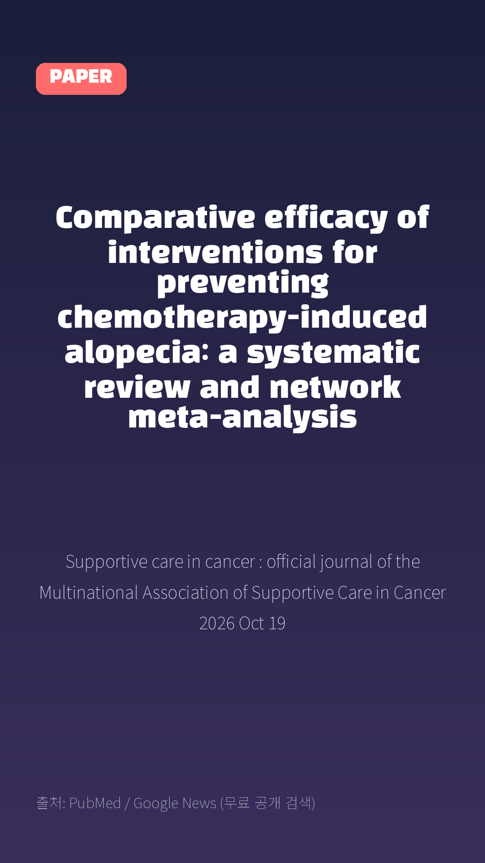
Comparative efficacy of interventions for preventing chemotherapy-induced alopecia: a systematic review and network meta-analysis
Supportive care in cancer : official journal of the Multinational Association of Supportive Care in Cancer · 2026 Oct 19
Notes:
[paper_intro] 약 8초
대본: 《Supportive care in cancer : official journal of the Multinational Association of Supportive Care in Cancer》 - Comparative efficacy of interventions for preventing chemotherapy-induced alopecia: a systematic review and network meta-analysis
연출 노트: 출처를 분명히 밝혀 신뢰를 준다.

Slide 3

Randomized controlled trials evaluating interventions to prevent CIA in cancer patients and reporting hair preservation outcomes (as defined by individual trials, including CTCAE grade < 2, < 30 to < 50% hair loss, or WHO grade 0-2) were included.
Notes:
[key_finding_1] 약 10초
대본: Randomized controlled trials evaluating interventions to prevent CIA in cancer patients and reporting hair preservation outcomes (as defined by individual trials, including CTCAE grade < 2, < 30 to < 50% hair loss, or WHO grade 0-2) were included.
연출 노트: 핵심 포인트 1. 자막을 끊어 읽는다.

Slide 4

Scalp hypothermia was divided into three groups based on duration post-chemotherapy: short (0-45 min), traditional (46-90 min), and prolonged (> 90 min).
Notes:
[key_finding_2] 약 10초
대본: Scalp hypothermia was divided into three groups based on duration post-chemotherapy: short (0-45 min), traditional (46-90 min), and prolonged (> 90 min).
연출 노트: 핵심 포인트 2.

Slide 5

탈모 연구, 매일 쉽게 정리해드립니다 🙂
Notes:
[my_take] 약 10초
대본: 탈모 연구, 매일 쉽게 정리해드립니다 🙂
연출 노트: 본인 사진 + 코멘트. 문구를 직접 바꿔 쓰세요.

Slide 6
더 자세한 내용은 원문 링크에서 확인하세요. 매일 새로운 탈모 연구, 팔로우하고 놓치지 마세요!
Notes:
[cta] 약 8초
대본: 더 자세한 내용은 원문 링크에서 확인하세요. 매일 새로운 탈모 연구, 팔로우하고 놓치지 마세요!
연출 노트: 원문 링크는 고정 댓글로 안내.

Slide 7
본문 요약 (편집용)
◆ 배경 — Purpose
· Chemotherapy-induced alopecia (CIA) negatively affects patients' appearance and emotional well-being.
· This network meta-analysis aimed to compare the efficacy of different preventive interventions for CIA.
◆ 연구 방법 — Methods
· We searched PubMed, Embase, CENTRAL, and EBSCO Open Dissertations from inception to March 2025.
· Randomized controlled trials evaluating interventions to prevent CIA in cancer patients and reporting hair preservation outcomes (as defined by individual trials, including CTCAE grade < 2, < 30 to < 50% hair loss, or WHO grade 0-2) were included.
· Scalp hypothermia was divided into three groups based on duration post-chemotherapy: short (0-45 min), traditional (46-90 min), and prolonged (> 90 min).
· Risk of bias was assessed using Cochrane RoB2.
· Risk ratios (RRs) with 95% confidence intervals (CIs) were pooled using a random-effects model.
· Interventions were ranked with surface under the cumulative ranking curve (SUCRA), and certainty of evidence was evaluated using CINeMA.
Notes:
편집 참고용 슬라이드입니다. 영상에는 쓰지 않아도 됩니다.
원문 영어 문장을 그대로 발췌했으므로 번역·검수 후 사용하세요.

Slide 8
본문 요약 (편집용)
◆ 주요 결과 — Results
· Of 6696 articles identified, 12 (n = 736) evaluating nine interventions (three scalp hypothermia durations, scalp compression, four pharmacological agents, and usual care) were included.
· Network meta-analysis indicated that prolonged-scalp hypothermia significantly improved hair preservation compared with usual care (RR = 24.66; 95%CI = 7.07-86.05; low certainty of evidence) and traditional scalp hypothermia (RR = 2.13; 95%CI = 1.15-3.93; very low certainty of evidence), and pharmacological agents (RRs ranging from 14.06 to 23.83; low certainty).
· However, prolonged-scalp hypothermia tended to show better hair preservation than short duration, though not statistically significant (RR = 2.06, 95%CI = 0.78-5.39).
· Based on SUCRA, prolonged-scalp hypothermia (97.0%) had the highest ranking, followed by short scalp hypothermia (78.6%) and traditional scalp hypothermia (76.8%).
· Most studies were rated as having high risk of bias, and the certainty of evidence was graded as low to very low.
◆ 결론 — Conclusion
· Current low certainty evidence suggests that scalp hypothermia could prevent CIA.
· Prolonged-scalp hypothermia provides a higher degree of protection, whereas a short duration demonstrates a weaker protective effect.
· However, this difference was not statistically significant.
Notes:
편집 참고용 슬라이드입니다. 영상에는 쓰지 않아도 됩니다.
원문 영어 문장을 그대로 발췌했으므로 번역·검수 후 사용하세요.

Slide 9
출처
[출처]
논문: Comparative efficacy of interventions for preventing chemotherapy-induced alopecia: a systematic review and network meta-analysis
게재: Supportive care in cancer : official journal of the Multinational Association of Supportive Care in Cancer
원문: https://pubmed.ncbi.nlm.nih.gov/42895661/
[이미지 출처]
- Male pattern baldness.jpg / Originally uploaded by Lkinkade (Transferred by XenonX3) / CC BY-SA 2.5
https://commons.wikimedia.org/wiki/File:Male_pattern_baldness.jpg
- Male-pattern hair loss.jpg / BlaiserPascal / CC BY-SA 4.0
https://commons.wikimedia.org/wiki/File:Male-pattern_hair_loss.jpg
※ CC BY-SA 이미지가 포함되어 있습니다. 저작자 표시가 필수이며,
동일조건변경허락(ShareAlike) 조항이 영상 전체에 적용될 수 있으니
상업적 이용 시 해당 이미지를 교체하는 편이 안전합니다.

