Slide 1
CLINICAL, COSMETIC AND INVESTIGATIONAL D
오늘의 논문
Clinical, cosmetic and investigational dermatology에 실린 새 연구입니다
2026 | 매일 아침 탈모 연구 한 편
Notes:
[hook] 약 4초
대본: 오늘의 논문 Clinical, cosmetic and investigational dermatology에 실린 새 연구입니다
연출 노트: 0.5초 안에 스크롤을 멈추게 하는 구간. 숫자를 크게 읽어준다.

Slide 2
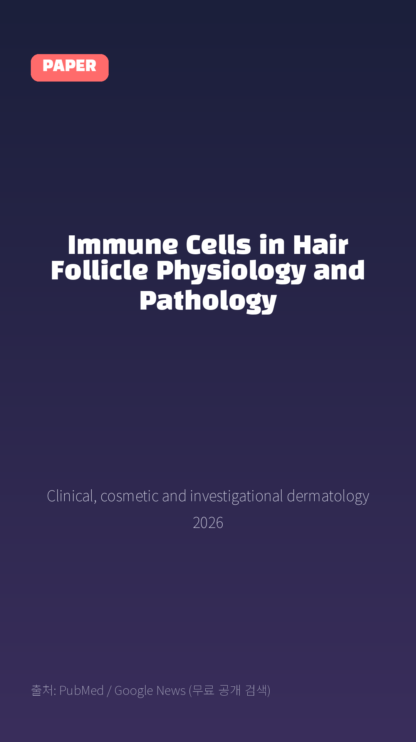
Immune Cells in Hair Follicle Physiology and Pathology
Clinical, cosmetic and investigational dermatology · 2026
Notes:
[paper_intro] 약 8초
대본: 《Clinical, cosmetic and investigational dermatology》 - Immune Cells in Hair Follicle Physiology and Pathology
연출 노트: 출처를 분명히 밝혀 신뢰를 준다.

Slide 3

The hair follicle (HF) is a sophisticated mini-organ with intrinsic cyclic activity that generates hair shafts.
Notes:
[key_finding_1] 약 10초
대본: The hair follicle (HF) is a sophisticated mini-organ with intrinsic cyclic activity that generates hair shafts.
연출 노트: 핵심 포인트 1. 자막을 끊어 읽는다.

Slide 4
논문 Table 1
Hair Follicle-Related Immune Cell Functions and Mechanisms
Type of Action | Immune Cell | Specific Functions and Mechanisms | Sample Source
Regulate hair follicle cycle | Macrophages | Castellana D et al demonstrated that apo | Mouse
Perifollicular macrophages act as the co | Mouse | Castellana D et al demonstrated that apo | Mouse
Hardman et al reported that during the t | Human | Castellana D et al demonstrated that apo | Mouse
Wang E et al found that TREM2⁺ dermal ma | Mouse | Castellana D et al demonstrated that apo | Mouse
Liu M et al proposed that endogenous rea | Mouse | Castellana D et al demonstrated that apo | Mouse
Mast cells | Paus R et al firstly confirmed that mast | Mouse | Mouse
Notes:
[paper_table] 약 8초
대본: 표로 보면 이렇습니다. Hair Follicle-Related Immune Cell Functions and Mechanisms
연출 노트: 핵심 숫자 한 칸만 짚어준다. 표는 셀을 직접 수정할 수 있다.

Slide 5

A variety of immune cells, including macrophages, mast cells, T cells, and Langerhans cells, reside around HFs, collectively forming a delicate and intricate immune microenvironment.
Notes:
[key_finding_2] 약 10초
대본: A variety of immune cells, including macrophages, mast cells, T cells, and Langerhans cells, reside around HFs, collectively forming a delicate and intricate immune microenvironment.
연출 노트: 핵심 포인트 2.

Slide 6

탈모 연구, 매일 쉽게 정리해드립니다 🙂
Notes:
[my_take] 약 10초
대본: 탈모 연구, 매일 쉽게 정리해드립니다 🙂
연출 노트: 본인 사진 + 코멘트. 문구를 직접 바꿔 쓰세요.

Slide 7
더 자세한 내용은 원문 링크에서 확인하세요. 매일 새로운 탈모 연구, 팔로우하고 놓치지 마세요!
Notes:
[cta] 약 8초
대본: 더 자세한 내용은 원문 링크에서 확인하세요. 매일 새로운 탈모 연구, 팔로우하고 놓치지 마세요!
연출 노트: 원문 링크는 고정 댓글로 안내.

Slide 8
본문 요약 (편집용)
◆ 배경 — Introduction
· As a crucial cutaneous appendage, the hair follicle (HF) executes multiple physiological functions, including sebum and sweat secretion, hair shaft production, cutaneous barrier protection, and thermoregulation.
· Anatomically, the HF is divided into four distinct regions from superficial to deep: the infundibulum, the isthmus, the suprabulbar region, and the hair bulb.1 The infundibulum is located above the sebaceous gland duct opening and communicates directly with the follicular orifice.
· The isthmus is demarcated superiorly by the sebaceous gland duct opening and inferiorly by the arrector pili muscle insertion site, which is adjacent to the bulge region where HFSCs reside.
◆ 그 밖의 내용 — Composition of Immune Cells Surrounding Hair Follicles
· The distribution pattern of immune cells differs significantly between the epidermis and HFs, with each immune cell type exhibiting unique localization characteristics in the perifollicular region.
· Approximately 10% of cutaneous CD4⁺ T cells in human skin are FoxP3⁺ regulatory T cells (Treg cells) with potent immunosuppressive properties, which are enriched in HF-rich skin regions.6,7 Accumulating evidence indicates that cutaneous FoxP3⁺ Treg cells preferentially colonize the HF bulge region.8,9 In healthy human scalp skin, a small number of tissue-resident γδ T cells (primarily the Vδ1⁺ subset) are predominantly confined to the HF infundibulum.10,11
Notes:
편집 참고용 슬라이드입니다. 영상에는 쓰지 않아도 됩니다.
원문 영어 문장을 그대로 발췌했으므로 번역·검수 후 사용하세요.

Slide 9
본문 요약 (편집용)
◆ 그 밖의 내용 — Functions of Perifollicular Immune Cells
· Type 2 ILCs upregulate IL‑13 expression to restrict mite colonization and invasion within HFs and maintain follicular structural integrity.33 During Staphylococcus aureus infection of HFs, neutrophils migrate to perifollicular regions to phagocytose bacteria and trigger localized chronic inflammation.34 CCR6⁺ Treg cells abundantly migrate into neonatal skin and colonize HFs under the chemotactic induction of CCL20, mediating host immune tolerance to skin commensal microbes.35 Microbial colonization in HFs drives physiological Treg accumulation in neonatal skin.
◆ 그 밖의 내용 — Immunopathogenesis of Hair Follicle-Associated Diseases
· AA is a representative autoimmune alopecia driven by dysregulated immune responses that specifically target autologous HFs, leading to premature anagen termination, arrested hair shaft growth, and localized hair loss.60–62 Accumulating studies have confirmed that massive expansion and aberrant activation of cytotoxic CD8⁺ T cells, which specifically infiltrate and damage HF epithelia, are the core initiating events of AA pathogenesis.49,63–66 Specific depletion of CD8⁺ T cells, rather than CD4⁺ T cells, NK cells, B cells, or γδ T cells, can effectively prevent and reverse AA pathological lesions.46 Clearance of infiltrating CD8⁺ T cells from affected HFs restores follicular structural integrity and promotes hair regrowth.47 Cytotoxic CD8⁺NKG2D⁺ T lymphocytes have been identified as the pivotal drivers of AA immunopathogenesis.48 A clinical study of 331 patients with chronic AA demonstrated compartmentalized infiltration of CD4⁺ Th17 cells and CD8⁺ cytotoxic T lymphocytes (CTLs) in the hair bulb and bulge region, which synergistically promote disease progression.45 CCR6⁺ Th17 cells predominantly accumulate around the hair bulb, disrupt HF immune privilege, and facilitate CTL recruitment and activation via secretion of IL‑17 and IFN‑γ.
Notes:
편집 참고용 슬라이드입니다. 영상에는 쓰지 않아도 됩니다.
원문 영어 문장을 그대로 발췌했으므로 번역·검수 후 사용하세요.

Slide 10
본문 요약 (편집용)
◆ 결론 — Conclusion
· The HF immune system exhibits distinct characteristics different from that of interfollicular skin.
· The unique perifollicular immune microenvironment is indispensable for maintaining HF physiological homeostasis and normal biological functions.
· Under physiological conditions, specialized perifollicular immune cells precisely modulate HFSC proliferation and differentiation to ensure orderly hair cycle progression.
Notes:
편집 참고용 슬라이드입니다. 영상에는 쓰지 않아도 됩니다.
원문 영어 문장을 그대로 발췌했으므로 번역·검수 후 사용하세요.

Slide 11
출처
[출처]
논문: Immune Cells in Hair Follicle Physiology and Pathology
게재: Clinical, cosmetic and investigational dermatology
원문: https://pubmed.ncbi.nlm.nih.gov/42927355/
[이미지 출처]
- Male pattern baldness.jpg / Originally uploaded by Lkinkade (Transferred by XenonX3) / CC BY-SA 2.5
https://commons.wikimedia.org/wiki/File:Male_pattern_baldness.jpg
- Male-pattern hair loss.jpg / BlaiserPascal / CC BY-SA 4.0
https://commons.wikimedia.org/wiki/File:Male-pattern_hair_loss.jpg
※ CC BY-SA 이미지가 포함되어 있습니다. 저작자 표시가 필수이며,
동일조건변경허락(ShareAlike) 조항이 영상 전체에 적용될 수 있으니
상업적 이용 시 해당 이미지를 교체하는 편이 안전합니다.
[논문 본문 그림·표]
- PubMed Central PMC13695359 (CC BY-NC(비상업 한정) - 수익화 채널에서는 사용 주의)
https://www.ncbi.nlm.nih.gov/pmc/articles/PMC13695359/
· Table 1
※ 오픈액세스 논문의 그림·표이며, 위 원문 출처를 함께 표기하세요.

