Slide 1
EXPERIMENTAL CELL RESEARCH
줄기세포
오늘 나온 최신 연구를 정리했습니다
2026 Sep 22 | 매일 아침 탈모 연구 한 편
Notes:
[hook] 약 4초
대본: 줄기세포 오늘 나온 최신 연구를 정리했습니다
연출 노트: 0.5초 안에 스크롤을 멈추게 하는 구간. 숫자를 크게 읽어준다.

Slide 2
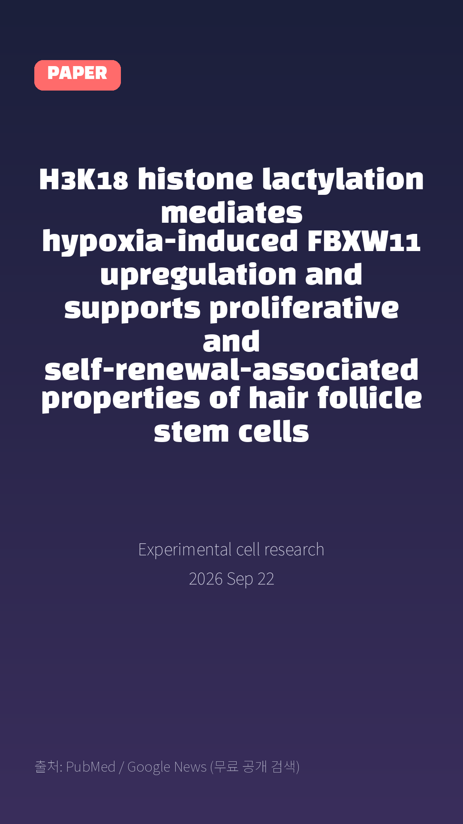
H3K18 histone lactylation mediates hypoxia-induced FBXW11 upregulation and supports proliferative and self-renewal-associated properties of hair follicle stem cells
Experimental cell research · 2026 Sep 22
Notes:
[paper_intro] 약 8초
대본: 《Experimental cell research》 - H3K18 histone lactylation mediates hypoxia-induced FBXW11 upregulation and supports proliferative and self-renewal-associated properties of hair follicle stem cells
연출 노트: 출처를 분명히 밝혀 신뢰를 준다.

Slide 3

Here, cultured human HFSCs were exposed to 2%O2.
Notes:
[key_finding_1] 약 10초
대본: Here, cultured human HFSCs were exposed to 2%O2.
연출 노트: 핵심 포인트 1. 자막을 끊어 읽는다.

Slide 4

Separate treatment with the glycolysis inhibitors 2-deoxy-D-glucose (2-DG) or oxamate reduced lactate accumulation, H3K18la, and HFSC-associated marker expression.
Notes:
[key_finding_2] 약 10초
대본: Separate treatment with the glycolysis inhibitors 2-deoxy-D-glucose (2-DG) or oxamate reduced lactate accumulation, H3K18la, and HFSC-associated marker expression.
연출 노트: 핵심 포인트 2.

Slide 5

탈모 연구, 매일 쉽게 정리해드립니다 🙂
Notes:
[my_take] 약 10초
대본: 탈모 연구, 매일 쉽게 정리해드립니다 🙂
연출 노트: 본인 사진 + 코멘트. 문구를 직접 바꿔 쓰세요.

Slide 6
더 자세한 내용은 원문 링크에서 확인하세요. 매일 새로운 탈모 연구, 팔로우하고 놓치지 마세요!
Notes:
[cta] 약 8초
대본: 더 자세한 내용은 원문 링크에서 확인하세요. 매일 새로운 탈모 연구, 팔로우하고 놓치지 마세요!
연출 노트: 원문 링크는 고정 댓글로 안내.

Slide 7
본문 요약 (편집용)
◆ 배경 — Background (자동 구분)
· Hair follicle stem cells (HFSCs) reside in a relatively hypoxic niche and preferentially use glycolytic metabolism, but how metabolic adaptation is coupled to epigenetic regulation of HFSC function remains incompletely understood.
· Since oxidative phosphorylation produces more reactive oxygen species (ROS) than glycolysis, and excessive ROS production eliminates various stem cell properties including quiescence and self-renewal.
· Stem cells prefer glycolysis as their main energy source.
◆ 주요 결과 — Results (자동 구분)
· Here, cultured human HFSCs were exposed to 2%O2.
· Hypoxia increased HIF-1α expression, glycolysis-related gene expression, intracellular H3K18 histone lactylation (H3K18la), EdU incorporation, colony-forming efficiency, and HFSC-associated markers CK15, CK19, and CD34 expression.
· Separate treatment with the glycolysis inhibitors 2-deoxy-D-glucose (2-DG) or oxamate reduced lactate accumulation, H3K18la, and HFSC-associated marker expression.
· Integrated H3K18la CUT&Tag and RNA sequencing identified 822 genes with concordantly increased H3K18la peaks and mRNA levels, with ubiquitin-mediated proteolysis among the enriched pathways.
· FBXW11 was prioritized as a candidate E3 ubiquitin ligase target.
· IGV visualization and H3K18la ChIP-qPCR showed increased H3K18la enrichment at the FBXW11 locus under hypoxia, whereas 2-DG or the p300 inhibitor C646 attenuated H3K18la enrichment and FBXW11 expression.
Notes:
편집 참고용 슬라이드입니다. 영상에는 쓰지 않아도 됩니다.
원문 영어 문장을 그대로 발췌했으므로 번역·검수 후 사용하세요.

Slide 8
출처
[출처]
논문: H3K18 histone lactylation mediates hypoxia-induced FBXW11 upregulation and supports proliferative and self-renewal-associated properties of hair follicle stem cells
게재: Experimental cell research
원문: https://pubmed.ncbi.nlm.nih.gov/42772662/
[이미지 출처]
- Male pattern baldness.jpg / Originally uploaded by Lkinkade (Transferred by XenonX3) / CC BY-SA 2.5
https://commons.wikimedia.org/wiki/File:Male_pattern_baldness.jpg
- Male-pattern hair loss.jpg / BlaiserPascal / CC BY-SA 4.0
https://commons.wikimedia.org/wiki/File:Male-pattern_hair_loss.jpg
※ CC BY-SA 이미지가 포함되어 있습니다. 저작자 표시가 필수이며,
동일조건변경허락(ShareAlike) 조항이 영상 전체에 적용될 수 있으니
상업적 이용 시 해당 이미지를 교체하는 편이 안전합니다.

