Slide 1
JOURNAL OF PUBLIC HEALTH (OXFORD, ENGLAN
피나스테리드
오늘 나온 최신 연구를 정리했습니다
2026 Oct 15 | 매일 아침 탈모 연구 한 편
Notes:
[hook] 약 4초
대본: 피나스테리드 오늘 나온 최신 연구를 정리했습니다
연출 노트: 0.5초 안에 스크롤을 멈추게 하는 구간. 숫자를 크게 읽어준다.

Slide 2
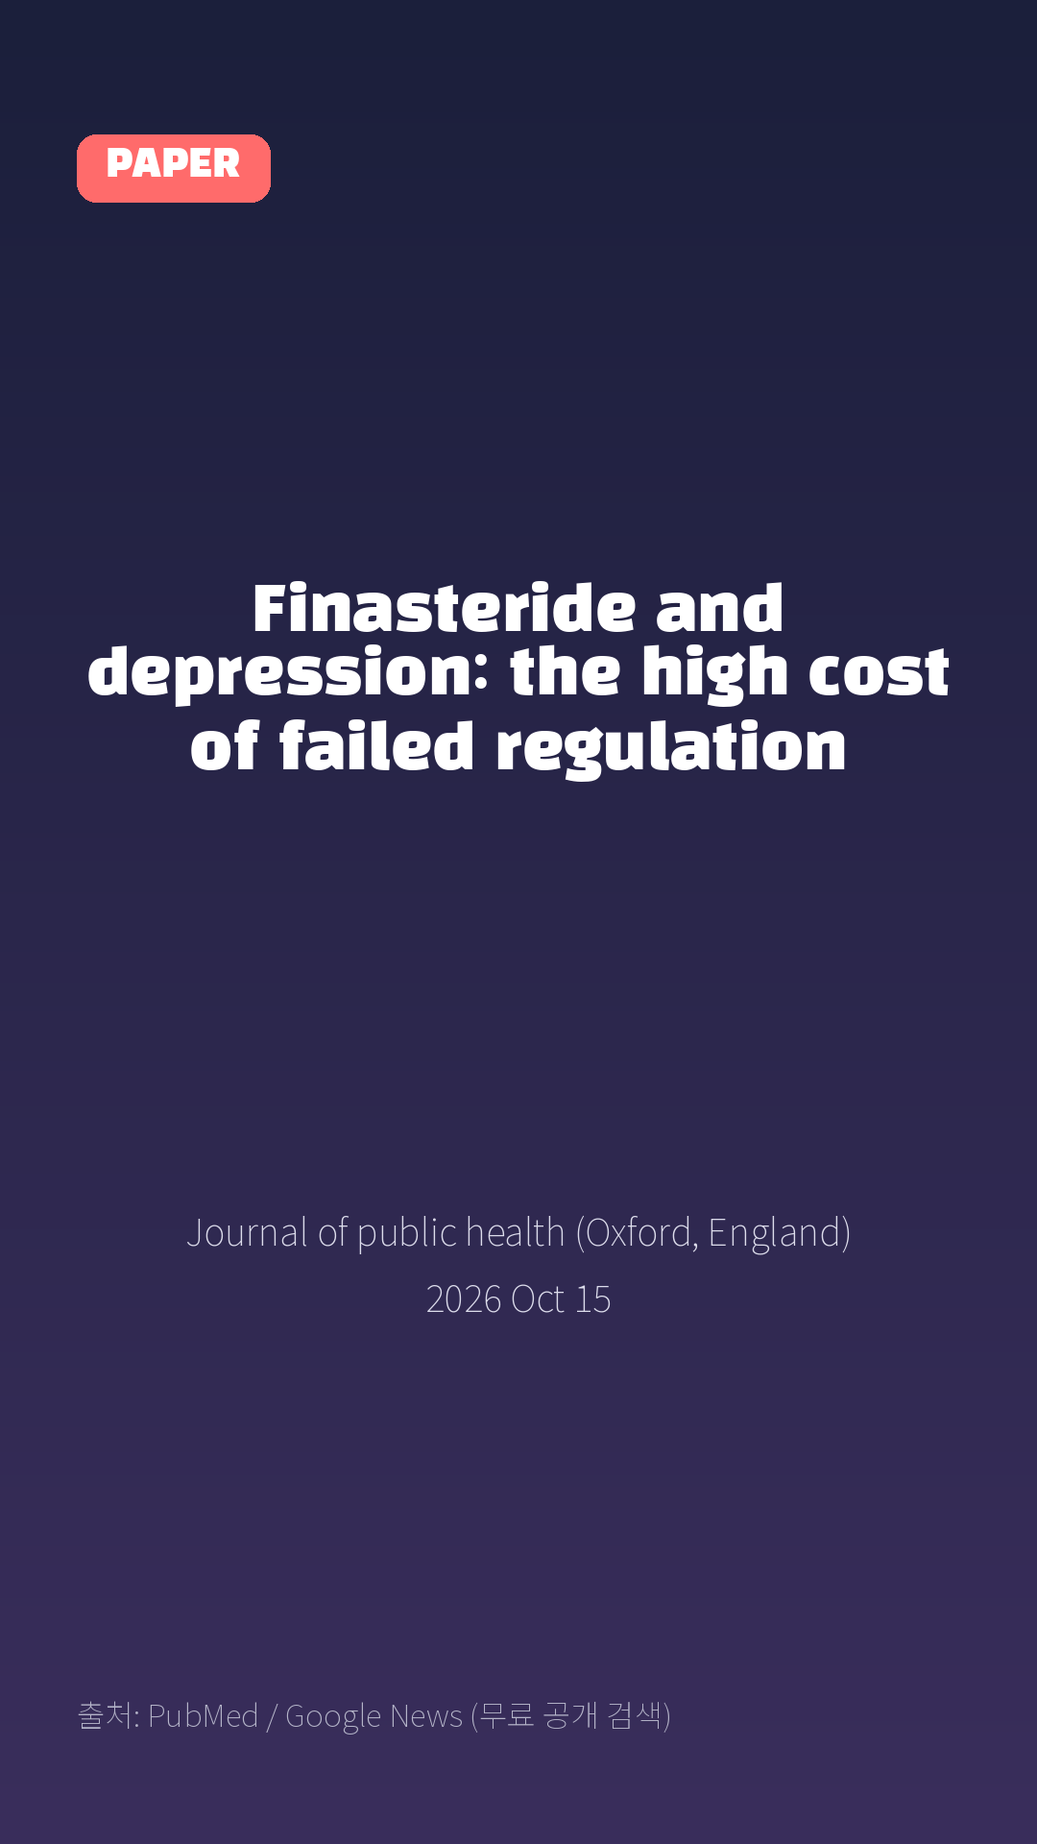
Finasteride and depression: the high cost of failed regulation
Journal of public health (Oxford, England) · 2026 Oct 15
Notes:
[paper_intro] 약 8초
대본: 《Journal of public health (Oxford, England)》 - Finasteride and depression: the high cost of failed regulation
연출 노트: 출처를 분명히 밝혀 신뢰를 준다.

Slide 3

This essay examines the costs of regulatory failure by highlighting the serious neuropsychiatric risks associated with finasteride, a popular hair-loss medication that can cause long-lasting depression and suicidal thoughts.
Notes:
[key_finding_1] 약 10초
대본: This essay examines the costs of regulatory failure by highlighting the serious neuropsychiatric risks associated with finasteride, a popular hair-loss medication that can cause long-lasting depression and suicidal thoughts.
연출 노트: 핵심 포인트 1. 자막을 끊어 읽는다.

Slide 4

In the United States, illustrative estimates suggest that hundreds of thousands of users may experience depression, over a thousand may die by suicide, and the associated societal costs may approach several billion dollars annually.
Notes:
[key_finding_2] 약 10초
대본: In the United States, illustrative estimates suggest that hundreds of thousands of users may experience depression, over a thousand may die by suicide, and the associated societal costs may approach several billion dollars annually.
연출 노트: 핵심 포인트 2.

Slide 5

탈모 연구, 매일 쉽게 정리해드립니다 🙂
Notes:
[my_take] 약 10초
대본: 탈모 연구, 매일 쉽게 정리해드립니다 🙂
연출 노트: 본인 사진 + 코멘트. 문구를 직접 바꿔 쓰세요.

Slide 6
더 자세한 내용은 원문 링크에서 확인하세요. 매일 새로운 탈모 연구, 팔로우하고 놓치지 마세요!
Notes:
[cta] 약 8초
대본: 더 자세한 내용은 원문 링크에서 확인하세요. 매일 새로운 탈모 연구, 팔로우하고 놓치지 마세요!
연출 노트: 원문 링크는 고정 댓글로 안내.

Slide 7
본문 요약 (편집용)
◆ 배경 — Background (자동 구분)
· This essay examines the costs of regulatory failure by highlighting the serious neuropsychiatric risks associated with finasteride, a popular hair-loss medication that can cause long-lasting depression and suicidal thoughts.
· In the United States, illustrative estimates suggest that hundreds of thousands of users may experience depression, over a thousand may die by suicide, and the associated societal costs may approach several billion dollars annually.
◆ 주요 결과 — Results (자동 구분)
· The article criticizes the FDA and the pharmaceutical industry for failing to conduct or require thorough post-marketing safety studies despite early warning signs.
· The author concludes that public health must take precedence over corporate interests and shareholder duties.
· To prevent future similar events, the article proposes regulatory reform that mandates ongoing surveillance.
· Regulators must require manufacturers to commit to continuous safety monitoring and formal studies after a medication is approved.
· Regulators must enforce these post-approval study requirements with clear timelines, rather than relying on industry self-discipline, to rebuild public trust and protect citizens from drug safety failures.
Notes:
편집 참고용 슬라이드입니다. 영상에는 쓰지 않아도 됩니다.
원문 영어 문장을 그대로 발췌했으므로 번역·검수 후 사용하세요.

Slide 8
출처
[출처]
논문: Finasteride and depression: the high cost of failed regulation
게재: Journal of public health (Oxford, England)
원문: https://pubmed.ncbi.nlm.nih.gov/42878119/
[이미지 출처]
- Male pattern baldness.jpg / Originally uploaded by Lkinkade (Transferred by XenonX3) / CC BY-SA 2.5
https://commons.wikimedia.org/wiki/File:Male_pattern_baldness.jpg
- Male-pattern hair loss.jpg / BlaiserPascal / CC BY-SA 4.0
https://commons.wikimedia.org/wiki/File:Male-pattern_hair_loss.jpg
※ CC BY-SA 이미지가 포함되어 있습니다. 저작자 표시가 필수이며,
동일조건변경허락(ShareAlike) 조항이 영상 전체에 적용될 수 있으니
상업적 이용 시 해당 이미지를 교체하는 편이 안전합니다.

