Slide 1
EXPERT REVIEW OF CLINICAL PHARMACOLOGY
남성형 탈모
오늘 나온 최신 연구를 정리했습니다
2026 Nov 6 | 매일 아침 탈모 연구 한 편
Notes:
[hook] 약 4초
대본: 남성형 탈모 오늘 나온 최신 연구를 정리했습니다
연출 노트: 0.5초 안에 스크롤을 멈추게 하는 구간. 숫자를 크게 읽어준다.

Slide 2
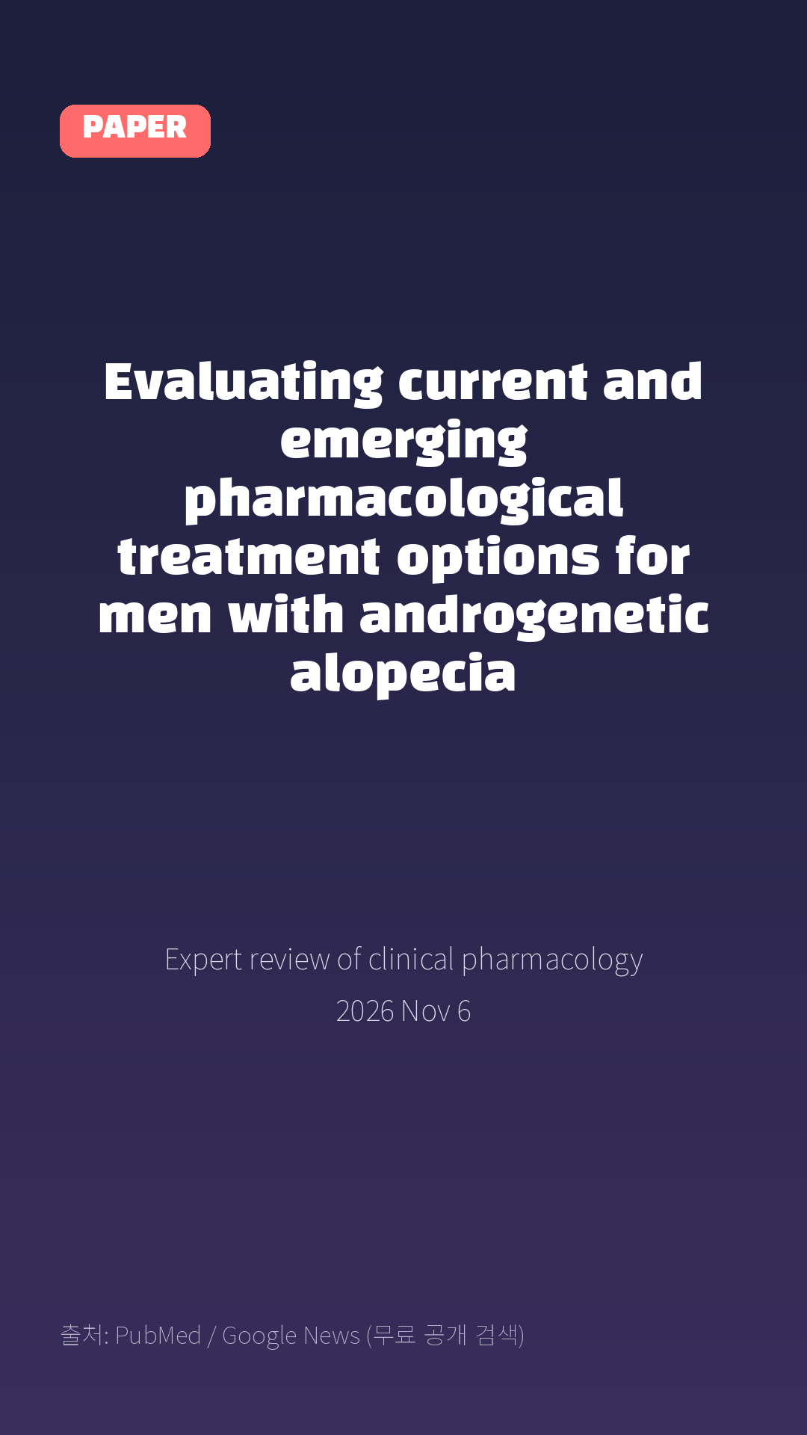
Evaluating current and emerging pharmacological treatment options for men with androgenetic alopecia
Expert review of clinical pharmacology · 2026 Nov 6
Notes:
[paper_intro] 약 8초
대본: 《Expert review of clinical pharmacology》 - Evaluating current and emerging pharmacological treatment options for men with androgenetic alopecia
연출 노트: 출처를 분명히 밝혀 신뢰를 준다.

Slide 3

Introduction: Androgenetic alopecia (AGA), also known as male pattern hair loss (MPHL), is the most common cause of hair loss in men.
Notes:
[key_finding_1] 약 10초
대본: Introduction: Androgenetic alopecia (AGA), also known as male pattern hair loss (MPHL), is the most common cause of hair loss in men.
연출 노트: 핵심 포인트 1. 자막을 끊어 읽는다.

Slide 4

Treatment response to approved therapies varies, adherence remains challenging, and discontinuation results in progressive hair loss.
Notes:
[key_finding_2] 약 10초
대본: Treatment response to approved therapies varies, adherence remains challenging, and discontinuation results in progressive hair loss.
연출 노트: 핵심 포인트 2.

Slide 5

탈모 연구, 매일 쉽게 정리해드립니다 🙂
Notes:
[my_take] 약 10초
대본: 탈모 연구, 매일 쉽게 정리해드립니다 🙂
연출 노트: 본인 사진 + 코멘트. 문구를 직접 바꿔 쓰세요.

Slide 6
더 자세한 내용은 원문 링크에서 확인하세요. 매일 새로운 탈모 연구, 팔로우하고 놓치지 마세요!
Notes:
[cta] 약 8초
대본: 더 자세한 내용은 원문 링크에서 확인하세요. 매일 새로운 탈모 연구, 팔로우하고 놓치지 마세요!
연출 노트: 원문 링크는 고정 댓글로 안내.

Slide 7
본문 요약 (편집용)
◆ 배경 — Background (자동 구분)
· Introduction: Androgenetic alopecia (AGA), also known as male pattern hair loss (MPHL), is the most common cause of hair loss in men.
· Treatment response to approved therapies varies, adherence remains challenging, and discontinuation results in progressive hair loss.
◆ 주요 결과 — Results (자동 구분)
· Recent advances have identified new pathways, accelerating a new generation of mechanism-based therapies.
· Areas covered: PubMed and Google Scholar were searched for publications available through 18 July 2026, supplemented by Google searches.
· This review evaluates the mechanisms, efficacy, safety, and clinical relevance of current and emerging pharmacological therapies for MPHL.
· Expert opinion: Current medical treatments for MPHL are most effective in early disease stages, primarily preventing further miniaturization and increasing the diameter of existing hairs; however, patient expectations often exceed achievable outcomes, and hair transplantation remains the only reliable option for restoring hair in areas where terminal follicles have been lost.
· Advances in hair follicle biology, stem cell activation, and regenerative medicine are driving therapies aimed at preserving existing follicles and improving follicular regeneration, and personalized combinations of conventional and regenerative strategies may eventually provide more effective and durable outcomes than either approach alone.
Notes:
편집 참고용 슬라이드입니다. 영상에는 쓰지 않아도 됩니다.
원문 영어 문장을 그대로 발췌했으므로 번역·검수 후 사용하세요.

Slide 8
출처
[출처]
논문: Evaluating current and emerging pharmacological treatment options for men with androgenetic alopecia
게재: Expert review of clinical pharmacology
원문: https://pubmed.ncbi.nlm.nih.gov/42993878/
[이미지 출처]
- Male pattern baldness.jpg / Originally uploaded by Lkinkade (Transferred by XenonX3) / CC BY-SA 2.5
https://commons.wikimedia.org/wiki/File:Male_pattern_baldness.jpg
- Male-pattern hair loss.jpg / BlaiserPascal / CC BY-SA 4.0
https://commons.wikimedia.org/wiki/File:Male-pattern_hair_loss.jpg
※ CC BY-SA 이미지가 포함되어 있습니다. 저작자 표시가 필수이며,
동일조건변경허락(ShareAlike) 조항이 영상 전체에 적용될 수 있으니
상업적 이용 시 해당 이미지를 교체하는 편이 안전합니다.

