Slide 1
ADVANCES IN CLINICAL AND EXPERIMENTAL ME
55.9%
이 숫자, 탈모 연구가 새로 내놨습니다
2026 Sep 28 | 매일 아침 탈모 연구 한 편
Notes:
[hook] 약 4초
대본: 55.9% 이 숫자, 탈모 연구가 새로 내놨습니다
연출 노트: 0.5초 안에 스크롤을 멈추게 하는 구간. 숫자를 크게 읽어준다.

Slide 2
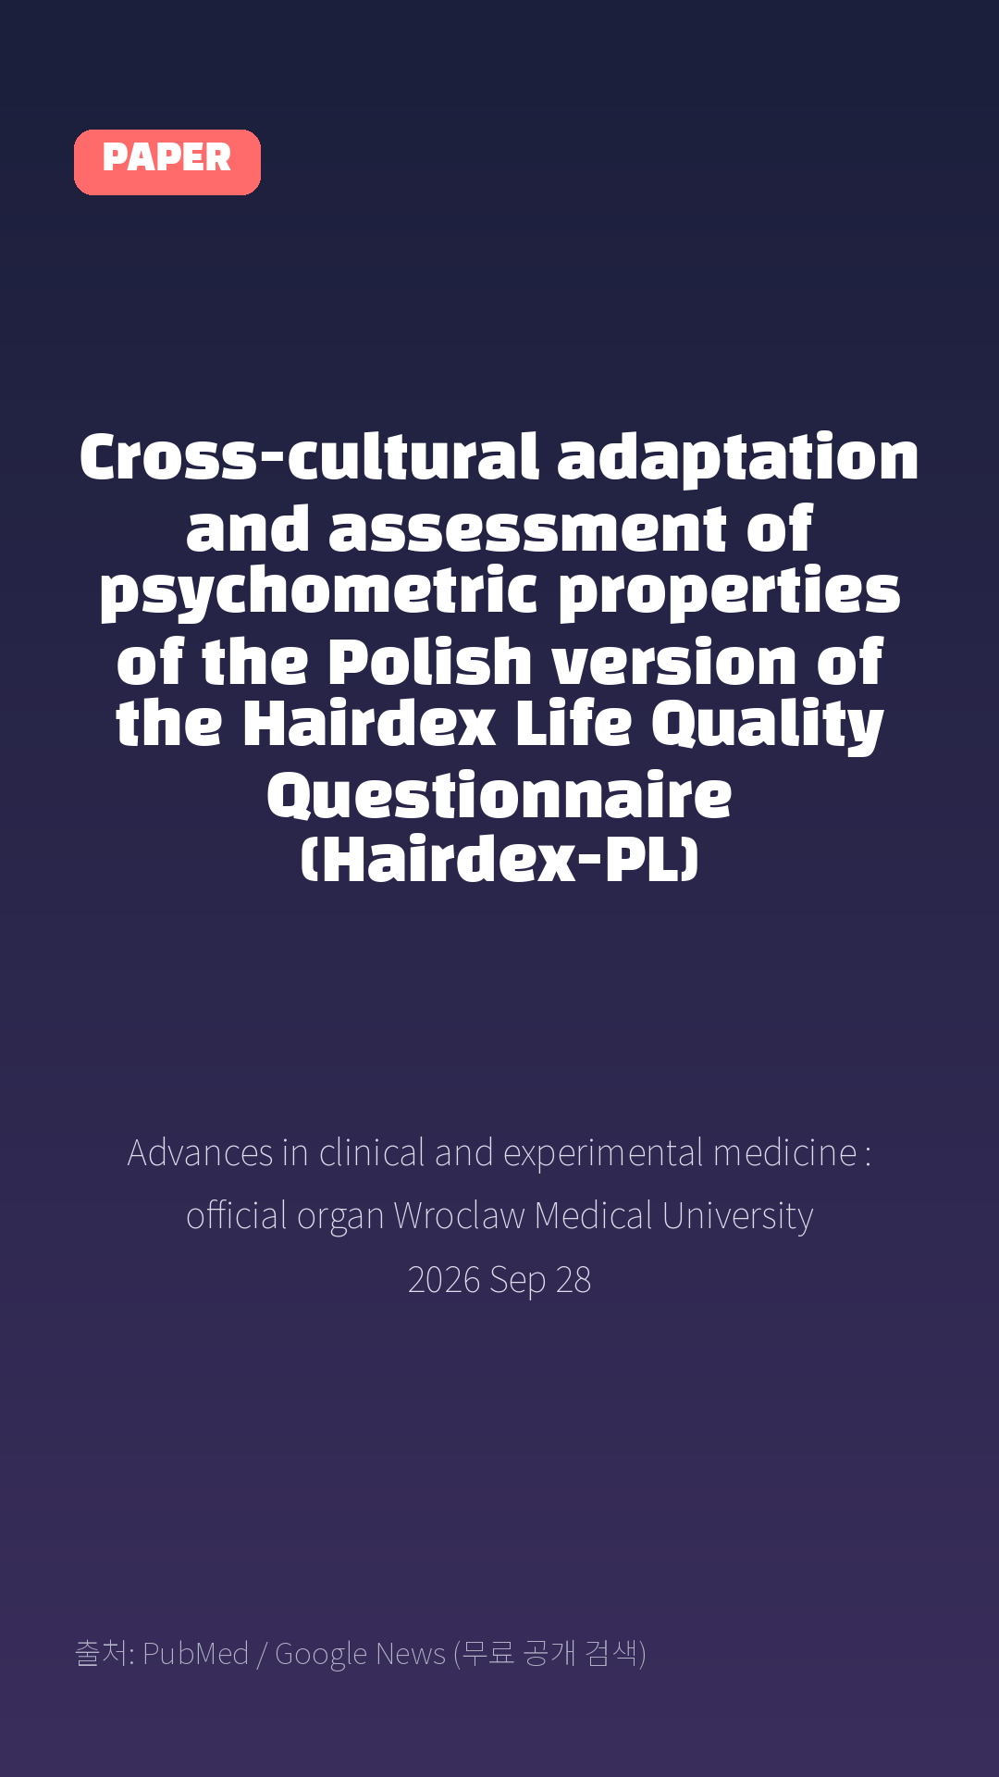
Cross-cultural adaptation and assessment of psychometric properties of the Polish version of the Hairdex Life Quality Questionnaire (Hairdex-PL)
Advances in clinical and experimental medicine : official organ Wroclaw Medical University · 2026 Sep 28
Notes:
[paper_intro] 약 8초
대본: 《Advances in clinical and experimental medicine : official organ Wroclaw Medical University》 - Cross-cultural adaptation and assessment of psychometric properties of the Polish version of the Hairdex Life Quality Questionnaire (Hairdex-PL)
연출 노트: 출처를 분명히 밝혀 신뢰를 준다.

Slide 3

Results: A total of 245 participants (55.9% women; 44.1% men; mean age 35.8 ±9.7 years) were included in the final analysis.
Notes:
[key_finding_1] 약 10초
대본: Results: A total of 245 participants (55.9% women; 44.1% men; mean age 35.8 ±9.7 years) were included in the final analysis.
연출 노트: 핵심 포인트 1. 자막을 끊어 읽는다.

Slide 4

Confirmatory factor analysis did not confirm the original 5-factor structure (root mean square error of approximation (RMSEA) = 0.234; comparative fit index (CFI) = 0.744; Tucker-Lewis index (TLI) = 0.749; standardized root mean square residual (SRMR) = 0.192).
Notes:
[key_finding_2] 약 10초
대본: Confirmatory factor analysis did not confirm the original 5-factor structure (root mean square error of approximation (RMSEA) = 0.234; comparative fit index (CFI) = 0.744; Tucker-Lewis index (TLI) = 0.749; standardized root mean square residual (SRMR) = 0.192).
연출 노트: 핵심 포인트 2.

Slide 5

탈모 연구, 매일 쉽게 정리해드립니다 🙂
Notes:
[my_take] 약 10초
대본: 탈모 연구, 매일 쉽게 정리해드립니다 🙂
연출 노트: 본인 사진 + 코멘트. 문구를 직접 바꿔 쓰세요.

Slide 6
더 자세한 내용은 원문 링크에서 확인하세요. 매일 새로운 탈모 연구, 팔로우하고 놓치지 마세요!
Notes:
[cta] 약 8초
대본: 더 자세한 내용은 원문 링크에서 확인하세요. 매일 새로운 탈모 연구, 팔로우하고 놓치지 마세요!
연출 노트: 원문 링크는 고정 댓글로 안내.

Slide 7
본문 요약 (편집용)
◆ 배경 — Background
· Hair and scalp disorders substantially impair health-related quality of life (HRQoL), yet no validated Polish-language disease-specific instrument is currently available to assess this burden.
◆ 배경 — Objectives
· This study aimed to translate, cross-culturally adapt, and assess the structural validity and internal consistency of the Polish version of the Hairdex questionnaire (Hairdex-PL).
Notes:
편집 참고용 슬라이드입니다. 영상에는 쓰지 않아도 됩니다.
원문 영어 문장을 그대로 발췌했으므로 번역·검수 후 사용하세요.

Slide 8
본문 요약 (편집용)
◆ 연구 방법 — Methods
· The original 48-item German Hairdex questionnaire was translated and culturally adapted according to the Beaton guidelines.
· Psychometric evaluation was performed in 245 adults with hair loss or scalp disorders recruited through an online survey.
· Structural validity was assessed using confirmatory factor analysis (CFA), followed by exploratory factor analysis (EFA) when the predefined model demonstrated inadequate fit.
· Internal consistency was assessed using Cronbach's α and McDonald's ω.
◆ 주요 결과 — Results
· A total of 245 participants (55.9% women; 44.1% men; mean age 35.8 ±9.7 years) were included in the final analysis.
· Confirmatory factor analysis did not confirm the original 5-factor structure (root mean square error of approximation (RMSEA) = 0.234; comparative fit index (CFI) = 0.744; Tucker-Lewis index (TLI) = 0.749; standardized root mean square residual (SRMR) = 0.192).
· Exploratory factor analysis retained a single factor explaining 38.2% of the total variance.
· The greatest impairment in HRQoL was observed in the Self-confidence and Emotions domains, corresponding to the greatest impairment in the same items in the original Hairdex, whereas Functioning and Symptoms were the least affected.
· Stigmatization had an intermediate mean score.
· Internal consistency was high (Cronbach's α = 0.960; McDonald's ω = 0.963).
Notes:
편집 참고용 슬라이드입니다. 영상에는 쓰지 않아도 됩니다.
원문 영어 문장을 그대로 발췌했으므로 번역·검수 후 사용하세요.

Slide 9
본문 요약 (편집용)
◆ 결론 — Conclusions
· Hairdex-PL showed high internal consistency and provided preliminary psychometric evidence supporting its use to assess disease-specific HRQoL in Polish-speaking individuals with hair and scalp disorders.
· Although confirmatory factor analysis did not support the original 5-factor structure, exploratory factor analysis identified a single factor in the present sample; this exploratory finding requires confirmation in an independent population.
· This study provides new evidence regarding its underlying measurement structure and supports further evaluation of the instrument in clinical and research settings.
Notes:
편집 참고용 슬라이드입니다. 영상에는 쓰지 않아도 됩니다.
원문 영어 문장을 그대로 발췌했으므로 번역·검수 후 사용하세요.

Slide 10
출처
[출처]
논문: Cross-cultural adaptation and assessment of psychometric properties of the Polish version of the Hairdex Life Quality Questionnaire (Hairdex-PL)
게재: Advances in clinical and experimental medicine : official organ Wroclaw Medical University
원문: https://pubmed.ncbi.nlm.nih.gov/42803085/
[이미지 출처]
- Male pattern baldness.jpg / Originally uploaded by Lkinkade (Transferred by XenonX3) / CC BY-SA 2.5
https://commons.wikimedia.org/wiki/File:Male_pattern_baldness.jpg
- Male-pattern hair loss.jpg / BlaiserPascal / CC BY-SA 4.0
https://commons.wikimedia.org/wiki/File:Male-pattern_hair_loss.jpg
※ CC BY-SA 이미지가 포함되어 있습니다. 저작자 표시가 필수이며,
동일조건변경허락(ShareAlike) 조항이 영상 전체에 적용될 수 있으니
상업적 이용 시 해당 이미지를 교체하는 편이 안전합니다.

