Slide 1
FRONTIERS IN IMMUNOLOGY
오늘의 논문
Frontiers in immunology에 실린 새 연구입니다
2026 | 매일 아침 탈모 연구 한 편
Notes:
[hook] 약 4초
대본: 오늘의 논문 Frontiers in immunology에 실린 새 연구입니다
연출 노트: 0.5초 안에 스크롤을 멈추게 하는 구간. 숫자를 크게 읽어준다.

Slide 2
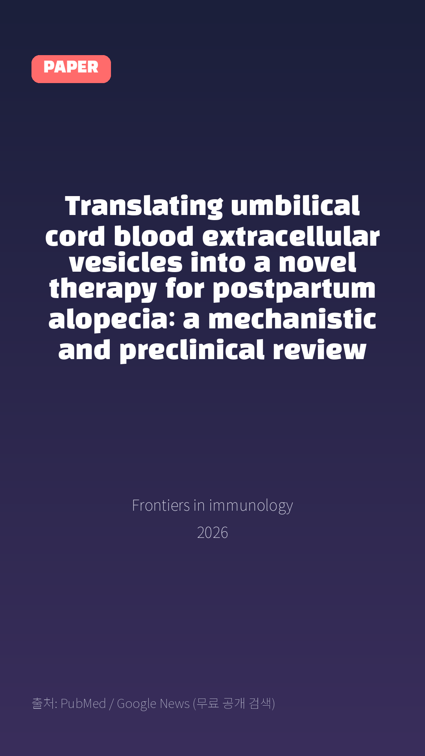
Translating umbilical cord blood extracellular vesicles into a novel therapy for postpartum alopecia: a mechanistic and preclinical review
Frontiers in immunology · 2026
Notes:
[paper_intro] 약 8초
대본: 《Frontiers in immunology》 - Translating umbilical cord blood extracellular vesicles into a novel therapy for postpartum alopecia: a mechanistic and preclinical review
연출 노트: 출처를 분명히 밝혀 신뢰를 준다.

Slide 3

Postpartum alopecia (PPA) is a common physiological hair loss in women, characterized by complex pathogenesis involving abrupt postpartum hormonal withdrawal, disrupted hair follicle cycling, local microenvironmental inflammation, and oxidative stress.
Notes:
[key_finding_1] 약 10초
대본: Postpartum alopecia (PPA) is a common physiological hair loss in women, characterized by complex pathogenesis involving abrupt postpartum hormonal withdrawal, disrupted hair follicle cycling, local microenvironmental inflammation, and oxidative stress.
연출 노트: 핵심 포인트 1. 자막을 끊어 읽는다.

Slide 4
논문 Table 1
Summary of UCB-EV studies for hair regeneration with categorized evidence levels.
EV source | Model | Intervention main mechanism/outcome | Evidence level
UCB-EVs | HumanDPC/HFK coculture | 50 μg/mL for 48 h | Proliferation ↑45%, apoptosis ↓35%, Vers
UCB-EVs | Cortisol/DHT-inducedtelogen cell model | In vitro treatment | Hair shaft elongation ↑30%, restoration
UCB-EVs | C57BL/6 PPA mouse model | Intradermal injection every 3 days ×4 | Hair coverage ≈80% vs 30%, hair density
UCB-EVs | vs 2%minoxidilMouse model | Local injectionComparable hair coverage | hUCMSC-derived exosomes AGA animal model
UCB-MSC-EVs | Mouse wound healing model | Local treatment | Angiogenesis, ECM remodeling Indirect (w
Notes:
[paper_table] 약 8초
대본: 표로 보면 이렇습니다. Summary of UCB-EV studies for hair regeneration with categorized evidence levels.
연출 노트: 핵심 숫자 한 칸만 짚어준다. 표는 셀을 직접 수정할 수 있다.

Slide 5

Umbilical cord blood-derived extracellular vesicles (UCB-EVs)-nanosized, lipid-bilayer-enclosed particles enriched with microRNAs, growth factors, and proteins-have shown considerable promise in regenerative medicine owing to their low immunogenicity, high biocompatibility, and tissue-repair capacity.
Notes:
[key_finding_2] 약 10초
대본: Umbilical cord blood-derived extracellular vesicles (UCB-EVs)-nanosized, lipid-bilayer-enclosed particles enriched with microRNAs, growth factors, and proteins-have shown considerable promise in regenerative medicine owing to their low immunogenicity, high biocompatibility, and tissue-repair capacity.
연출 노트: 핵심 포인트 2.

Slide 6

탈모 연구, 매일 쉽게 정리해드립니다 🙂
Notes:
[my_take] 약 10초
대본: 탈모 연구, 매일 쉽게 정리해드립니다 🙂
연출 노트: 본인 사진 + 코멘트. 문구를 직접 바꿔 쓰세요.

Slide 7
더 자세한 내용은 원문 링크에서 확인하세요. 매일 새로운 탈모 연구, 팔로우하고 놓치지 마세요!
Notes:
[cta] 약 8초
대본: 더 자세한 내용은 원문 링크에서 확인하세요. 매일 새로운 탈모 연구, 팔로우하고 놓치지 마세요!
연출 노트: 원문 링크는 고정 댓글로 안내.

Slide 8
본문 요약 (편집용)
◆ 배경 — Introduction
· Female postpartum alopecia (PPA) represents a significant clinical and psychosocial challenge, emerging as one of the most common dermatological conditions affecting women in the postpartum period.
· Epidemiological data indicates that the prevalence of PPA is remarkably high, with studies suggesting that over 90% of postpartum women experience some degree of hair loss (3).
· At the molecular level, UCB-EVs are enriched with specific miRNAs, such as miR-21-5p and let-7b-5p, which are capable of targeting and modulating key signaling pathways critical for hair follicle biology (2).
◆ 그 밖의 내용 — Biological characteristics and preparation of UCB-EVs
· They are broadly classified into exosomes (30–150 nm), microvesicles (100–1000 nm), and apoptotic bodies (>1000 nm) based on their biogenesis and size (9).
· This typically involves a combination of techniques: This typically involves a combination of techniques: dynamic light scattering (DLS), also known as photon correlation spectroscopy, which measures time-dependent fluctuations in scattered light caused by Brownian motion of particles to determine the hydrodynamic diameter and polydispersity index (PDI) of EVs (21); Nanoparticle tracking analysis (NTA) to determine particle size distribution and concentration (13, 14); Western blot analysis to confirm the presence of EV protein markers such as CD63, CD81, and TSG101 (13, 15); and transmission electron microscopy (TEM) or cryo-electron microscopy (cryo-EM) to verify the characteristic spherical, lipid bilayer morphology of the vesicles (14, 22).
Notes:
편집 참고용 슬라이드입니다. 영상에는 쓰지 않아도 됩니다.
원문 영어 문장을 그대로 발췌했으므로 번역·검수 후 사용하세요.

Slide 9
본문 요약 (편집용)
◆ 고찰 — Pathogenesis of postpartum hair loss in women and limitations of current treatments
· In fact, the prevalence of thyroid abnormalities in patients with telogen effluvium has been documented to be between 5.7% and 17%, underscoring the importance of screening for postpartum thyroiditis in patients presenting with persistent postpartum hair loss (30).
· Studies show that low ferritin is significantly associated with telogen effluvium, and vitamin D, which acts as a hormone, is crucial for proper hair follicle cycling through its involvement in signaling pathways of growth and differentiation (33–35).
· Evidence from other forms of alopecia, such as that seen in COVID-19, suggests that severe systemic inflammation can dramatically increase the risk of telogen effluvium, with patients exhibiting higher levels of inflammatory biomarkers like C-reactive protein and IL-1β correlating with increased hair shedding (36).
· These cytokines directly inhibit the proliferation of hair follicle stem cells and keratinocytes, by activating signaling cascades, most notably the JAK-STAT pathway (38–40).
◆ 그 밖의 내용 — Molecular mechanisms of UCB-EVs in promoting hair follicle regeneration
· Table 1Summary of UCB-EV studies for hair regeneration with categorized evidence levels.EV sourceModelIntervention main mechanism/outcomeEvidence levelUCB-EVsHumanDPC/HFK coculture50 μg/mL for 48 hProliferation ↑45%, apoptosis ↓35%, Versican/ALP ↑,Wnt/β- catenin activation Direct (in vitro, PPA-related cells)UCB-EVsCortisol/DHT-inducedtelogen cell modelIn vitro treatmentHair shaft elongation ↑30%, restoration of Ki67/PCNA Direct (in vitro, hormonal/stress-induced telogen)UCB-EVsC57BL/6 PPA mouse modelIntradermal injection every 3 days ×4Hair coverage ≈80% vs 30%, hair density ↑2-fold, follicle number ↑50%, anagen 20%→65%, CD31 ↑ Direct (in vivo, PPA model)UCB-EVsvs 2%minoxidilMouse modelLocal injectionComparable hair coverage at day 14; at day 21, anagen60% (UCB-EVs) vs 40% (minoxidil)Direct comparative (model type to be specified)hUCMSC-derived exosomes AGA animal model Local administration Rescue from DHT damage, enlarged follicles, telogen→anagen, Wnt/β-catenin activation Indirect (other EV source, AGA model)Macrophage-derived EVs Balb/c mice Injection Wnt3a/7b activation, DPC proliferation/migration ↑, VEGF/KGF ↑ Indirect (other EV source, generic hair growth)Fibroblast-derived EVs Ex vivo human hair follicles In vitro culture Hair shaft elongation, Wnt/βcatenin activationIndirect (other EV source, follicle culture)UCB-MSC-EVsMouse wound healing modelLocal treatmentAngiogenesis, ECM remodeling Indirect (wound healing model)Direct evidence indicates that the intervention was UCB-EV and the model was PPA or PPA-related; indirect evidence indicates other EV sources or non-PPA models.
Notes:
편집 참고용 슬라이드입니다. 영상에는 쓰지 않아도 됩니다.
원문 영어 문장을 그대로 발췌했으므로 번역·검수 후 사용하세요.

Slide 10
본문 요약 (편집용)
◆ 그 밖의 내용 — Preclinical evidence for UCB-EVs in treating postpartum hair loss
· When DPCs, the master regulators of hair follicle cycling, were treated with UCB-EVs at a concentration of 50 μg/mL for 48 hours, significant cellular responses were observed, including a 45% increase in proliferation and a 35% reduction in apoptosis (55).
◆ 결론 — Clinical translation challenges and future directions of UCB-EVs for postpartum hair loss
· A primary hurdle is the limited volume of UCB obtainable per unit, as a single cord blood donation yields only approximately 10^10 to 10^11 EV particles.
· For instance, the use of a chemically defined, xeno- and blood-free culture medium, such as Oxium™EXO, has been shown to increase small EV (sEV) secretion from MSCs by three-fold, consistently across multiple harvest time points and different cell sources, yielding an enrichment of particles within the 51–200 nm range (71).
· Preclinical safety evaluations using non-human primates have shown that high-dose intravenous administration of human UCB-MSC-derived exosomes (3.85 × 10^12 particles) did not cause significant adverse effects on general clinical conditions, hematology, coagulation, or immune organs, and did not induce major changes in immunoglobulins or cytokines (79).
Notes:
편집 참고용 슬라이드입니다. 영상에는 쓰지 않아도 됩니다.
원문 영어 문장을 그대로 발췌했으므로 번역·검수 후 사용하세요.

Slide 11
본문 요약 (편집용)
◆ 결론 — Conclusion
· Transcriptomic analyses have revealed the involvement of immune cells and ferroptosis in frontal fibrosing alopecia (81).
Notes:
편집 참고용 슬라이드입니다. 영상에는 쓰지 않아도 됩니다.
원문 영어 문장을 그대로 발췌했으므로 번역·검수 후 사용하세요.

Slide 12
출처
[출처]
논문: Translating umbilical cord blood extracellular vesicles into a novel therapy for postpartum alopecia: a mechanistic and preclinical review
게재: Frontiers in immunology
원문: https://pubmed.ncbi.nlm.nih.gov/42857222/
[이미지 출처]
- Male pattern baldness.jpg / Originally uploaded by Lkinkade (Transferred by XenonX3) / CC BY-SA 2.5
https://commons.wikimedia.org/wiki/File:Male_pattern_baldness.jpg
- Male-pattern hair loss.jpg / BlaiserPascal / CC BY-SA 4.0
https://commons.wikimedia.org/wiki/File:Male-pattern_hair_loss.jpg
※ CC BY-SA 이미지가 포함되어 있습니다. 저작자 표시가 필수이며,
동일조건변경허락(ShareAlike) 조항이 영상 전체에 적용될 수 있으니
상업적 이용 시 해당 이미지를 교체하는 편이 안전합니다.
[논문 본문 그림·표]
- PubMed Central PMC13651770 (재사용 가능 라이선스)
https://www.ncbi.nlm.nih.gov/pmc/articles/PMC13651770/
· Table 1
※ 오픈액세스 논문의 그림·표이며, 위 원문 출처를 함께 표기하세요.

