Slide 1
RESEARCH (WASHINGTON, D.C.)
모발 재생
오늘 나온 최신 연구를 정리했습니다
2026 | 매일 아침 탈모 연구 한 편
Notes:
[hook] 약 4초
대본: 모발 재생 오늘 나온 최신 연구를 정리했습니다
연출 노트: 0.5초 안에 스크롤을 멈추게 하는 구간. 숫자를 크게 읽어준다.

Slide 2
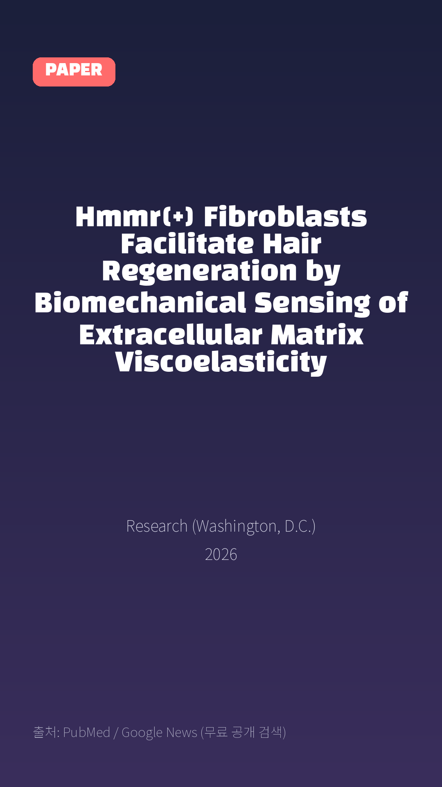
Hmmr(+) Fibroblasts Facilitate Hair Regeneration by Biomechanical Sensing of Extracellular Matrix Viscoelasticity
Research (Washington, D.C.) · 2026
Notes:
[paper_intro] 약 8초
대본: 《Research (Washington, D.C.)》 - Hmmr(+) Fibroblasts Facilitate Hair Regeneration by Biomechanical Sensing of Extracellular Matrix Viscoelasticity
연출 노트: 출처를 분명히 밝혀 신뢰를 준다.

Slide 3

How fibroblast heterogeneity orchestrates tissue regeneration by remodeling tissue mechanical properties that guide stem cell function is not well understood.
Notes:
[key_finding_1] 약 10초
대본: How fibroblast heterogeneity orchestrates tissue regeneration by remodeling tissue mechanical properties that guide stem cell function is not well understood.
연출 노트: 핵심 포인트 1. 자막을 끊어 읽는다.

Slide 4

Although fibroblasts are increasingly recognized as key regulators of tissue homeostasis, the specific subpopulations and molecular pathways through which they remodel the mechanical niche during hair follicle regeneration are not fully defined.
Notes:
[key_finding_2] 약 10초
대본: Although fibroblasts are increasingly recognized as key regulators of tissue homeostasis, the specific subpopulations and molecular pathways through which they remodel the mechanical niche during hair follicle regeneration are not fully defined.
연출 노트: 핵심 포인트 2.

Slide 5

탈모 연구, 매일 쉽게 정리해드립니다 🙂
Notes:
[my_take] 약 10초
대본: 탈모 연구, 매일 쉽게 정리해드립니다 🙂
연출 노트: 본인 사진 + 코멘트. 문구를 직접 바꿔 쓰세요.

Slide 6
더 자세한 내용은 원문 링크에서 확인하세요. 매일 새로운 탈모 연구, 팔로우하고 놓치지 마세요!
Notes:
[cta] 약 8초
대본: 더 자세한 내용은 원문 링크에서 확인하세요. 매일 새로운 탈모 연구, 팔로우하고 놓치지 마세요!
연출 노트: 원문 링크는 고정 댓글로 안내.

Slide 7
본문 요약 (편집용)
◆ 배경 — Introduction
· Tissue regeneration is orchestrated by a dynamic exchange of biochemical and mechanical instructions between cells and their local microenvironment.
· Within these mechanical cues, the viscoelasticity of the extracellular matrix (ECM), its ability to simultaneously exhibit energy storage as an elastic solid and energy dissipation as a viscous fluid, has emerged as a key physical cue that regulates cellular behaviors such as spreading, proliferation, and invasion.
· In addition, microRNA-205 promotes regeneration by targeting cytoskeletal and junctional components to alter tissue mechanics.
◆ 주요 결과 — Results
· Unpaired 2-tailed t test or one-way ANOVA with Tukey’s post hoc test. *P < 0.05, **P < 0.01, ***P < 0.001.
· One-way ANOVA with Tukey’s post hoc test. *P < 0.05, **P < 0.01, ***P < 0.001.
· (B) AFM-based quantitative analysis of ECM adhesion force in HMMR+ fibroblast regions at telogen and early anagen stages (n = 16; P < 0.05, **P < 0.01, ***P < 0.001).
· (D) AFM-based quantitative analysis of ECM adhesion force in HMMR+ fibroblast regions following subcutaneous Eln treatment (n = 16; P < 0.05, **P < 0.01, ***P < 0.001).
· Unpaired 2-tailed t test. *P < 0.05, **P < 0.01, ***P < 0.001.
· Unpaired 2-tailed t test or one-way ANOVA with Tukey’s post hoc test. *P < 0.05, **P < 0.01, ***P < 0.001.
· Unpaired 2-tailed t test or one-way ANOVA with Tukey’s post hoc test. *P < 0.05, **P < 0.01, ***P < 0.001.
· One-way ANOVA with Tukey’s post hoc test. *P < 0.05, **P < 0.01, ***P < 0.001.
Notes:
편집 참고용 슬라이드입니다. 영상에는 쓰지 않아도 됩니다.
원문 영어 문장을 그대로 발췌했으므로 번역·검수 후 사용하세요.

Slide 8
본문 요약 (편집용)
◆ 고찰 — Discussion
· Tissue regeneration is not merely linearly driven by genetic programs, but rather represents an adaptive process dynamically encoded by the biomechanical properties of the microenvironment, decoded through cellular perception, and reshaped via signal transduction.
· For instance, PIEZO1-mediated calcium signaling senses mechanical forces through E-cadherin to reinforce the mechanical properties of hair follicle stem cells (HFSCs) and maintain their quiescence, while microRNA-205 fine-tunes actomyosin contractility and cell mechanics by targeting cytoskeletal and adhesion genes to promote hair regeneration.
· In this study, we focus on the dynamic viscoelastic remodeling of the ECM during the telogen-to-anagen transition and identifies a novel tripartite biomechanical regulatory module consisting of ECM mechanical effectors, Hmmr+ fibroblast mechanical sensors, and DP signal executors, which collaboratively drives hair follicle regeneration.
· In particular, we verified the dynamic biomechanical alterations of the peri-follicular microenvironment via AFM.
◆ 연구 방법 — Materials and Methods
· Each nude mouse, weighing 20 g, is administered an intraperitoneal injection of 140 μl of 1% sodium pentobarbital solution and 25 μl of 25% flunixin meglumine for pain relief.
· The following reagents and concentrations were used: 50 μl of HA solution (2 mg/ml, CAS# HY-B0633A, MCE), 50 μl of Ncam1 solution (1 μg/ml, CAS# HY-P78764, MCE), 50 μl of 4-MU solution (5 mM, CAS# HY-N0187, MCE), 50 μl of triptolide (10 μM, CAS# M3985, Abmole), 50 μl of Eln solution (1 μg/ml, CAS# P1577, FineTest), and 50 μl of PD173074 solution (100 μM, CAS# HY-10321, MCE).
· For 8-μm paraffin sections, deparaffinization was performed twice with xylene for 15 min each, followed by hydration using a graded series of alcohol (100%, 100%, 95%, 85%, 75%, and 50%).
Notes:
편집 참고용 슬라이드입니다. 영상에는 쓰지 않아도 됩니다.
원문 영어 문장을 그대로 발췌했으므로 번역·검수 후 사용하세요.

Slide 9
출처
[출처]
논문: Hmmr(+) Fibroblasts Facilitate Hair Regeneration by Biomechanical Sensing of Extracellular Matrix Viscoelasticity
게재: Research (Washington, D.C.)
원문: https://pubmed.ncbi.nlm.nih.gov/42741478/
[이미지 출처]
- Male pattern baldness.jpg / Originally uploaded by Lkinkade (Transferred by XenonX3) / CC BY-SA 2.5
https://commons.wikimedia.org/wiki/File:Male_pattern_baldness.jpg
- Male-pattern hair loss.jpg / BlaiserPascal / CC BY-SA 4.0
https://commons.wikimedia.org/wiki/File:Male-pattern_hair_loss.jpg
※ CC BY-SA 이미지가 포함되어 있습니다. 저작자 표시가 필수이며,
동일조건변경허락(ShareAlike) 조항이 영상 전체에 적용될 수 있으니
상업적 이용 시 해당 이미지를 교체하는 편이 안전합니다.
[논문 본문 그림·표]
- PubMed Central PMC13572799 (재사용 가능 라이선스)
https://www.ncbi.nlm.nih.gov/pmc/articles/PMC13572799/
※ 오픈액세스 논문의 그림·표이며, 위 원문 출처를 함께 표기하세요.

