Slide 1
DERMATOLOGY AND THERAPY
95%
이 숫자, 탈모 연구가 새로 내놨습니다
2026 Nov 11 | 매일 아침 탈모 연구 한 편
Notes:
[hook] 약 4초
대본: 95% 이 숫자, 탈모 연구가 새로 내놨습니다
연출 노트: 0.5초 안에 스크롤을 멈추게 하는 구간. 숫자를 크게 읽어준다.

Slide 2
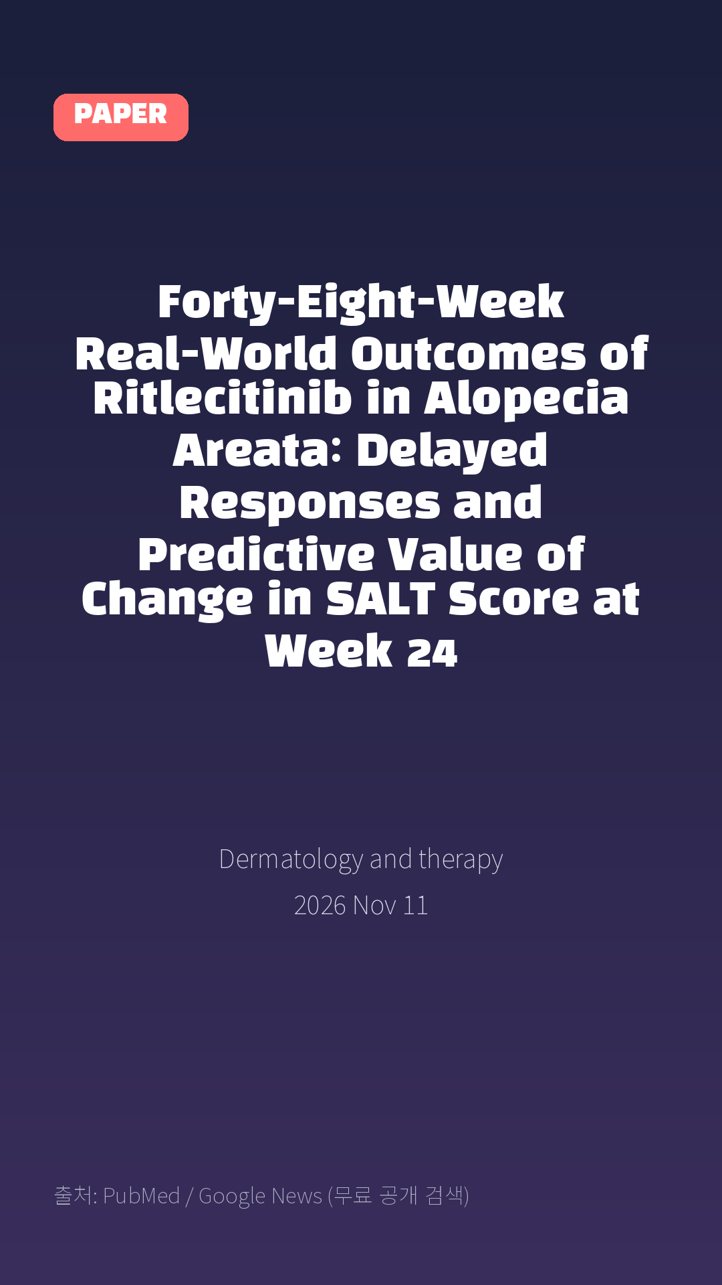
Forty-Eight-Week Real-World Outcomes of Ritlecitinib in Alopecia Areata: Delayed Responses and Predictive Value of Change in SALT Score at Week 24
Dermatology and therapy · 2026 Nov 11
Notes:
[paper_intro] 약 8초
대본: 《Dermatology and therapy》 - Forty-Eight-Week Real-World Outcomes of Ritlecitinib in Alopecia Areata: Delayed Responses and Predictive Value of Change in SALT Score at Week 24
연출 노트: 출처를 분명히 밝혀 신뢰를 준다.

Slide 3

Results: At week 48, 39.3% (11/28) and 35.7% (10/28) of patients achieved SALT scores ≤ 20 and ≤ 10, respectively.
Notes:
[key_finding_1] 약 10초
대본: Results: At week 48, 39.3% (11/28) and 35.7% (10/28) of patients achieved SALT scores ≤ 20 and ≤ 10, respectively.
연출 노트: 핵심 포인트 1. 자막을 끊어 읽는다.

Slide 4

Responders at week 48 (week-48 responders) showed greater improvement in ΔSALT at week 24 (week-24 ΔSALT) than non-responders (median: - 50.0 vs.
Notes:
[key_finding_2] 약 10초
대본: Responders at week 48 (week-48 responders) showed greater improvement in ΔSALT at week 24 (week-24 ΔSALT) than non-responders (median: - 50.0 vs.
연출 노트: 핵심 포인트 2.

Slide 5

탈모 연구, 매일 쉽게 정리해드립니다 🙂
Notes:
[my_take] 약 10초
대본: 탈모 연구, 매일 쉽게 정리해드립니다 🙂
연출 노트: 본인 사진 + 코멘트. 문구를 직접 바꿔 쓰세요.

Slide 6
더 자세한 내용은 원문 링크에서 확인하세요. 매일 새로운 탈모 연구, 팔로우하고 놓치지 마세요!
Notes:
[cta] 약 8초
대본: 더 자세한 내용은 원문 링크에서 확인하세요. 매일 새로운 탈모 연구, 팔로우하고 놓치지 마세요!
연출 노트: 원문 링크는 고정 댓글로 안내.

Slide 7
본문 요약 (편집용)
◆ 배경 — Introduction
· Alopecia areata (AA) is an autoimmune disease characterized by non-scarring hair loss.
· Although ritlecitinib has demonstrated efficacy in moderate-to-severe AA, real-world data on 48-week outcomes and predictors of longer-term response remain limited.
◆ 연구 방법 — Methods
· We conducted a retrospective, single-center, observational study of 41 patients with moderate-to-severe AA who received ritlecitinib (50 mg/day) at Osaka Metropolitan University Hospital, Japan.
· Effectiveness and safety were evaluated for up to 48 weeks.
· Patients evaluable at week 48 were classified as responders (Severity of Alopecia Tool [SALT] score ≤ 20) or non-responders (SALT score > 20).
· The predictive value of the change in SALT score from baseline (ΔSALT) for response at week 48 was assessed using receiver operating characteristic (ROC) analysis.
Notes:
편집 참고용 슬라이드입니다. 영상에는 쓰지 않아도 됩니다.
원문 영어 문장을 그대로 발췌했으므로 번역·검수 후 사용하세요.

Slide 8
본문 요약 (편집용)
◆ 주요 결과 — Results
· At week 48, 39.3% (11/28) and 35.7% (10/28) of patients achieved SALT scores ≤ 20 and ≤ 10, respectively.
· Responders at week 48 (week-48 responders) showed greater improvement in ΔSALT at week 24 (week-24 ΔSALT) than non-responders (median: - 50.0 vs. 0.0; P = 0.006).
· Of the 21 patients who had not achieved a SALT score ≤ 20 at week 24, five subsequently achieved this outcome at week 48.
· ROC analysis showed that week-24 ΔSALT had predictive value for week-48 response (area under the curve [AUC] 0.81; 95% confidence interval 0.619-1.000), with a cutoff of - 40 yielding 81.8% sensitivity and 88.2% specificity.
· Two patients (4.9%) discontinued ritlecitinib because of adverse events; all other adverse events were mild and did not require treatment discontinuation.
◆ 결론 — Conclusions
· Ritlecitinib showed real-world effectiveness through 48 weeks in patients with moderate-to-severe AA.
· Delayed responses beyond week 24 were observed, and week-24 ΔSALT may have potential value in predicting response at week 48, although these findings require validation in larger cohorts.
Notes:
편집 참고용 슬라이드입니다. 영상에는 쓰지 않아도 됩니다.
원문 영어 문장을 그대로 발췌했으므로 번역·검수 후 사용하세요.

Slide 9
출처
[출처]
논문: Forty-Eight-Week Real-World Outcomes of Ritlecitinib in Alopecia Areata: Delayed Responses and Predictive Value of Change in SALT Score at Week 24
게재: Dermatology and therapy
원문: https://pubmed.ncbi.nlm.nih.gov/43015456/
[이미지 출처]
- Male pattern baldness.jpg / Originally uploaded by Lkinkade (Transferred by XenonX3) / CC BY-SA 2.5
https://commons.wikimedia.org/wiki/File:Male_pattern_baldness.jpg
- Male-pattern hair loss.jpg / BlaiserPascal / CC BY-SA 4.0
https://commons.wikimedia.org/wiki/File:Male-pattern_hair_loss.jpg
※ CC BY-SA 이미지가 포함되어 있습니다. 저작자 표시가 필수이며,
동일조건변경허락(ShareAlike) 조항이 영상 전체에 적용될 수 있으니
상업적 이용 시 해당 이미지를 교체하는 편이 안전합니다.

