Slide 1
PHARMACEUTICS
미녹시딜
오늘 나온 최신 연구를 정리했습니다
2026 Oct 15 | 매일 아침 탈모 연구 한 편
Notes:
[hook] 약 4초
대본: 미녹시딜 오늘 나온 최신 연구를 정리했습니다
연출 노트: 0.5초 안에 스크롤을 멈추게 하는 구간. 숫자를 크게 읽어준다.

Slide 2
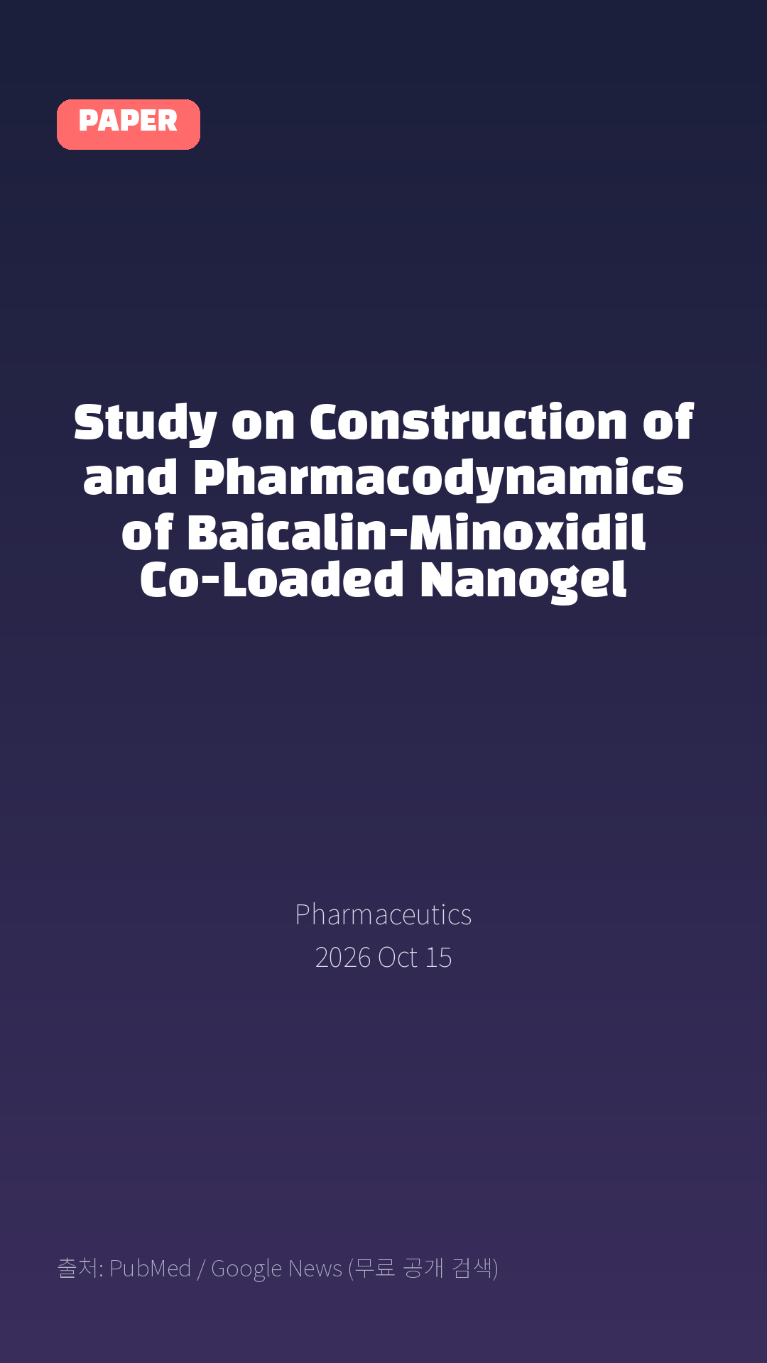
Study on Construction of and Pharmacodynamics of Baicalin-Minoxidil Co-Loaded Nanogel
Pharmaceutics · 2026 Oct 15
Notes:
[paper_intro] 약 8초
대본: 《Pharmaceutics》 - Study on Construction of and Pharmacodynamics of Baicalin-Minoxidil Co-Loaded Nanogel
연출 노트: 출처를 분명히 밝혀 신뢰를 준다.

Slide 3

Androgenetic alopecia (AGA) is a chronic and highly prevalent hair loss disorder for which current topical therapies are limited by undesirable side effects, dose-dependent efficacy, and poor skin penetration.
Notes:
[key_finding_1] 약 10초
대본: Androgenetic alopecia (AGA) is a chronic and highly prevalent hair loss disorder for which current topical therapies are limited by undesirable side effects, dose-dependent efficacy, and poor skin penetration.
연출 노트: 핵심 포인트 1. 자막을 끊어 읽는다.

Slide 4
논문 Table 1
In vitro release kinetic parameters and model fitting of Baicalin and Minoxidil from Bai-Min-NGs.
Kinetic Models | Mathematical Equation | Active Drug | Fitted Equation
Zero -order | Q = k0·t + a | Min in NGsBai in NGs | Q = 3.9713t − 4.7891Q = 0.7751t − 0.6348
First-order model | ln(100 − Q) = −k1·t + a | Min in NGsBai in NGs | ln(100 − Q) = −0.1011t + 4.8715ln(100 −
Higuchi model | Q = kH·t1/2 + a | Min in NGsBai in NGs | Q = 19.7883t1/2 − 22.7026Q = 3.8855t1/2
Korsmeyer-Peppas model(Mt/M∞ ≤ 0.60) | ln(Mt/M∞) = n·ln(t) + ln(kKP) | Min in NGsBai in NGs | ln(Mt/M∞) = 1.2429ln(t) − 4.1131ln(Mt/M∞
Notes:
[paper_table] 약 8초
대본: 표로 보면 이렇습니다. In vitro release kinetic parameters and model fitting of Baicalin and Minoxidil from Bai-Min-NGs.
연출 노트: 핵심 숫자 한 칸만 짚어준다. 표는 셀을 직접 수정할 수 있다.

Slide 5

Objective: Here, we developed a baicalin-minoxidil co-loaded nanogel (Bai-Min-NGs) to synergistically enhance transdermal drug delivery and promote hair regeneration.
Notes:
[key_finding_2] 약 10초
대본: Objective: Here, we developed a baicalin-minoxidil co-loaded nanogel (Bai-Min-NGs) to synergistically enhance transdermal drug delivery and promote hair regeneration.
연출 노트: 핵심 포인트 2.

Slide 6

탈모 연구, 매일 쉽게 정리해드립니다 🙂
Notes:
[my_take] 약 10초
대본: 탈모 연구, 매일 쉽게 정리해드립니다 🙂
연출 노트: 본인 사진 + 코멘트. 문구를 직접 바꿔 쓰세요.

Slide 7
더 자세한 내용은 원문 링크에서 확인하세요. 매일 새로운 탈모 연구, 팔로우하고 놓치지 마세요!
Notes:
[cta] 약 8초
대본: 더 자세한 내용은 원문 링크에서 확인하세요. 매일 새로운 탈모 연구, 팔로우하고 놓치지 마세요!
연출 노트: 원문 링크는 고정 댓글로 안내.

Slide 8
본문 요약 (편집용)
◆ 배경 — 1. Introduction
· Androgenetic alopecia (AGA) is a pervasive dermatological condition affecting hundreds of millions of people worldwide, characterized by progressive follicular miniaturization and disrupted hair growth cycles.
· Despite the availability of various therapeutic modalities, minoxidil (Min), the first-line clinical drug, still faces formidable challenges in practical application.
· On one hand, commercially available formulations typically contain high concentrations of ethanol and propylene glycol, which frequently lead to severe allergic contact dermatitis and scalp dryness upon long-term use.
◆ 연구 방법 — 2. Materials and Methods
· Cells were cultured in the medium supplemented with 10% fetal bovine serum (FBS) and 1% penicillin-streptomycin at 37 °C in a humidified atmosphere containing 5% CO2.
· After treatment, cells were incubated with 50 μM LysoTracker Red DND-99 for 90 min to label lysosomes, followed by fixation with 4% paraformaldehyde for 15 min.
· Statistical significance was defined as follows: ns, not significant; * p < 0.05, ** p < 0.01, *** p < 0.001, and **** p < 0.0001 (vs. model group); # p < 0.05 and ## p < 0.01 (vs. normal group).
Notes:
편집 참고용 슬라이드입니다. 영상에는 쓰지 않아도 됩니다.
원문 영어 문장을 그대로 발췌했으므로 번역·검수 후 사용하세요.

Slide 9
본문 요약 (편집용)
◆ 주요 결과 — 3. Results
· The measurement results demonstrated that Bai-Min-NEs possessed an average hydrodynamic diameter of 156 ± 3.62 nm, and the size distribution curve exhibited a symmetrical unimodal distribution, indicating a homogeneous dispersion of the system.
· Regarding the drug-loading performance, the EE of Bai-Min-NEs for baicalin and minoxidil reached 95.863 ±1.338% and 82.158 ± 2.495%, respectively, which is beneficial for the subsequent drug delivery into the deep layers of the skin.
· As shown in Figure 2A, the crude baicalin spectrum exhibited representative characteristic absorption peaks at 3490 cm−1, 3390 cm−1, 1661 cm−1 and 1609 cm−1, corresponding to intermolecular hydroxyl groups, free hydroxyl groups, C=C double bonds, and benzene ring C-H stretching vibrations, respectively.
· The spectrum of minoxidil showed characteristic absorption peaks at 3411 cm−1 (-NH2), 1644 cm−1 (C=C) and 1555 cm−1 (C=N).
· Furthermore, Korsmeyer–Peppas fitting yielded release exponents (n) of 1.2429 (R2 = 0.9200) for minoxidil and 1.4553 (R2 = 0.9875) for baicalin.
· The combination index (CI) values across all tested concentrations remained well below 1.0 (ranging from 0.100 to 0.405), reaching 0.271 at the optimal concentration of 5.0 μg/mL.
· (* p < 0.05, ** p < 0.01, *** p < 0.001, and **** p < 0.0001 (vs. model group); # p < 0.05 and ## p < 0.01 (vs. normal group)).
◆ 고찰 — 4. Discussion
· The prepared Bai-Min-NEs exhibited a uniform size distribution (droplet diameter < 200 nm) and stable negative zeta potential.
· Sub-micron particles are known to enhance skin penetration via intercellular and follicular routes, while surfactants within the nanoemulsion system disrupt stratum corneum lipid bilayers to improve transdermal delivery.
· Although the negative surface charge limits non-specific adsorption, it supports colloidal stability and particle diffusion within the skin.
· Specifically, the mathematical fitting confirmed a Super Case-II transport mechanism (n > 0.89), verifying that the swelling-controlled matrix relaxation guarantees constant zero-order release kinetics, thereby preventing rapid local drug depletion.
Notes:
편집 참고용 슬라이드입니다. 영상에는 쓰지 않아도 됩니다.
원문 영어 문장을 그대로 발췌했으므로 번역·검수 후 사용하세요.

Slide 10
본문 요약 (편집용)
◆ 결론 — 5. Conclusions
· In summary, this study successfully developed a novel dual-drug-loaded nanogel delivery system: Bai-Min-NGs, providing a highly promising and innovative strategy to overcome the bottlenecks of poor transdermal permeability and low bioavailability associated with traditional topical treatments for AGA.
· Leveraging the three-dimensional synergistic effect between the high-pressure homogenized nanoemulsion core and the gel network, Bai-Min-NGs effectively overcome the robust physical barrier of the stratum corneum.
· This system not only achieves prolonged retention and controlled release of Baicalin and Minoxidil within the deep layers of the skin but also targets DPCs via efficient endocytic pathways.
Notes:
편집 참고용 슬라이드입니다. 영상에는 쓰지 않아도 됩니다.
원문 영어 문장을 그대로 발췌했으므로 번역·검수 후 사용하세요.

Slide 11
출처
[출처]
논문: Study on Construction of and Pharmacodynamics of Baicalin-Minoxidil Co-Loaded Nanogel
게재: Pharmaceutics
원문: https://pubmed.ncbi.nlm.nih.gov/42942839/
[이미지 출처]
- Male pattern baldness.jpg / Originally uploaded by Lkinkade (Transferred by XenonX3) / CC BY-SA 2.5
https://commons.wikimedia.org/wiki/File:Male_pattern_baldness.jpg
- Male-pattern hair loss.jpg / BlaiserPascal / CC BY-SA 4.0
https://commons.wikimedia.org/wiki/File:Male-pattern_hair_loss.jpg
※ CC BY-SA 이미지가 포함되어 있습니다. 저작자 표시가 필수이며,
동일조건변경허락(ShareAlike) 조항이 영상 전체에 적용될 수 있으니
상업적 이용 시 해당 이미지를 교체하는 편이 안전합니다.
[논문 본문 그림·표]
- PubMed Central PMC13708190 (재사용 가능 라이선스)
https://www.ncbi.nlm.nih.gov/pmc/articles/PMC13708190/
· Table 1
※ 오픈액세스 논문의 그림·표이며, 위 원문 출처를 함께 표기하세요.

