Slide 1
JAMA DERMATOLOGY
100%
이 숫자, 탈모 연구가 새로 내놨습니다
2026 Sep 30 | 매일 아침 탈모 연구 한 편
Notes:
[hook] 약 4초
대본: 100% 이 숫자, 탈모 연구가 새로 내놨습니다
연출 노트: 0.5초 안에 스크롤을 멈추게 하는 구간. 숫자를 크게 읽어준다.

Slide 2
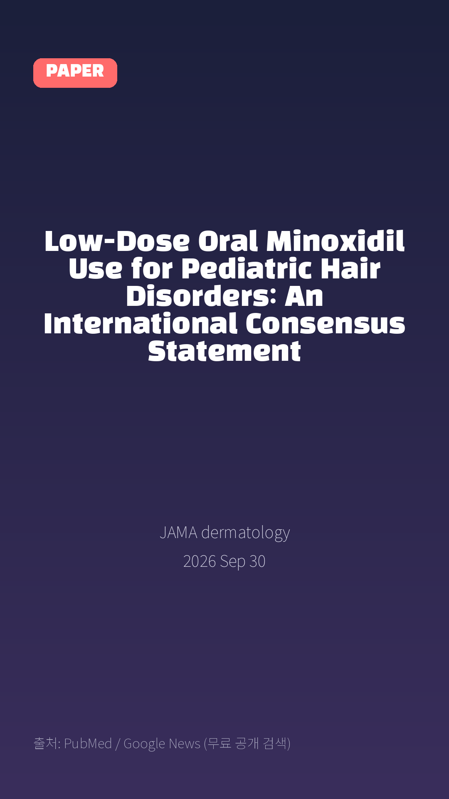
Low-Dose Oral Minoxidil Use for Pediatric Hair Disorders: An International Consensus Statement
JAMA dermatology · 2026 Sep 30
Notes:
[paper_intro] 약 8초
대본: 《JAMA dermatology》 - Low-Dose Oral Minoxidil Use for Pediatric Hair Disorders: An International Consensus Statement
연출 노트: 출처를 분명히 밝혀 신뢰를 준다.

Slide 3

Findings: Of 51 experts, 50 from 9 countries completed rounds 1 and 2, and 49 (98.0% retention rate) completed round 3, reflecting broad international representation.
Notes:
[key_finding_1] 약 10초
대본: Findings: Of 51 experts, 50 from 9 countries completed rounds 1 and 2, and 49 (98.0% retention rate) completed round 3, reflecting broad international representation.
연출 노트: 핵심 포인트 1. 자막을 끊어 읽는다.

Slide 4

LDOM is supported for pediatric patients (aged ≥4 to <12 years) for hair follicle miniaturization (100%), hair cycle abnormalities (100%), and hair shaft disorders (84%), with adjunctive use in select scarring alopecia (98%).
Notes:
[key_finding_2] 약 10초
대본: LDOM is supported for pediatric patients (aged ≥4 to <12 years) for hair follicle miniaturization (100%), hair cycle abnormalities (100%), and hair shaft disorders (84%), with adjunctive use in select scarring alopecia (98%).
연출 노트: 핵심 포인트 2.

Slide 5

탈모 연구, 매일 쉽게 정리해드립니다 🙂
Notes:
[my_take] 약 10초
대본: 탈모 연구, 매일 쉽게 정리해드립니다 🙂
연출 노트: 본인 사진 + 코멘트. 문구를 직접 바꿔 쓰세요.

Slide 6
더 자세한 내용은 원문 링크에서 확인하세요. 매일 새로운 탈모 연구, 팔로우하고 놓치지 마세요!
Notes:
[cta] 약 8초
대본: 더 자세한 내용은 원문 링크에서 확인하세요. 매일 새로운 탈모 연구, 팔로우하고 놓치지 마세요!
연출 노트: 원문 링크는 고정 댓글로 안내.

Slide 7
본문 요약 (편집용)
◆ 배경 — Importance
· Low-dose oral minoxidil (LDOM) is increasingly used off-label to treat pediatric hair disorders; however, standardized guidance for patient selection, dosing, safety, and monitoring in patients younger than 12 years is lacking.
◆ 배경 — Objective
· To establish expert consensus recommendations for LDOM use in pediatric patients (age <12 years) with hair disorders.
· Evidence review: Survey development was informed by a review of the literature on LDOM pharmacology, safety, and clinical use, with emphasis on pediatric populations.
· A modified Delphi process was conducted from June 30, 2025, to March 7, 2026.
· Of 98 clinicians completing a prescreening survey, 51 met eligibility criteria (>10 pediatric patients treated with LDOM) and were invited to participate.
· Three iterative survey rounds were conducted using REDCap with multidisciplinary input.
· Consensus was defined as 70% or greater agreement on a 5-point Likert scale.
Notes:
편집 참고용 슬라이드입니다. 영상에는 쓰지 않아도 됩니다.
원문 영어 문장을 그대로 발췌했으므로 번역·검수 후 사용하세요.

Slide 8
본문 요약 (편집용)
◆ 주요 결과 — Findings
· Of 51 experts, 50 from 9 countries completed rounds 1 and 2, and 49 (98.0% retention rate) completed round 3, reflecting broad international representation.
· Of 127 initial items considered, 84 achieved consensus.
· LDOM is supported for pediatric patients (aged ≥4 to <12 years) for hair follicle miniaturization (100%), hair cycle abnormalities (100%), and hair shaft disorders (84%), with adjunctive use in select scarring alopecia (98%).
· Preference for LDOM over topical minoxidil included concerns for logistical difficulty, poor tolerability, inadequate efficacy, caregiver preference, diffuse hair loss, sensory sensitivities, or risk of toxic effects in domestic animals (pets) (74%-96%).
· Both fixed weight-based and mg/kg dosing strategies met consensus.
· Fixed dosing aligned with available tablet formulations (weight <20 kg, 0.250-0.625 mg; 20-40 kg, 1.250 mg; >40 kg, 1.875 mg [ 80%]), while a starting dosage of 0.01 to 0.02 mg/kg/d (73.5%) provided a flexible alternative.
◆ 결론 — Relevance
· This international consensus statement provides a structured, pediatric-specific framework for LDOM use, supporting it as a flexible, nonimmunosuppressive therapeutic strategy and addressing key gaps in dosing, safety, and monitoring.
Notes:
편집 참고용 슬라이드입니다. 영상에는 쓰지 않아도 됩니다.
원문 영어 문장을 그대로 발췌했으므로 번역·검수 후 사용하세요.

Slide 9
출처
[출처]
논문: Low-Dose Oral Minoxidil Use for Pediatric Hair Disorders: An International Consensus Statement
게재: JAMA dermatology
원문: https://pubmed.ncbi.nlm.nih.gov/42814435/
[이미지 출처]
- Male pattern baldness.jpg / Originally uploaded by Lkinkade (Transferred by XenonX3) / CC BY-SA 2.5
https://commons.wikimedia.org/wiki/File:Male_pattern_baldness.jpg
- Male-pattern hair loss.jpg / BlaiserPascal / CC BY-SA 4.0
https://commons.wikimedia.org/wiki/File:Male-pattern_hair_loss.jpg
※ CC BY-SA 이미지가 포함되어 있습니다. 저작자 표시가 필수이며,
동일조건변경허락(ShareAlike) 조항이 영상 전체에 적용될 수 있으니
상업적 이용 시 해당 이미지를 교체하는 편이 안전합니다.

