Slide 1
PLASTIC AND RECONSTRUCTIVE SURGERY
오늘의 논문
Plastic and reconstructive surgery에 실린 새 연구입니다
2026 Sep 16 | 매일 아침 탈모 연구 한 편
Notes:
[hook] 약 4초
대본: 오늘의 논문 Plastic and reconstructive surgery에 실린 새 연구입니다
연출 노트: 0.5초 안에 스크롤을 멈추게 하는 구간. 숫자를 크게 읽어준다.

Slide 2
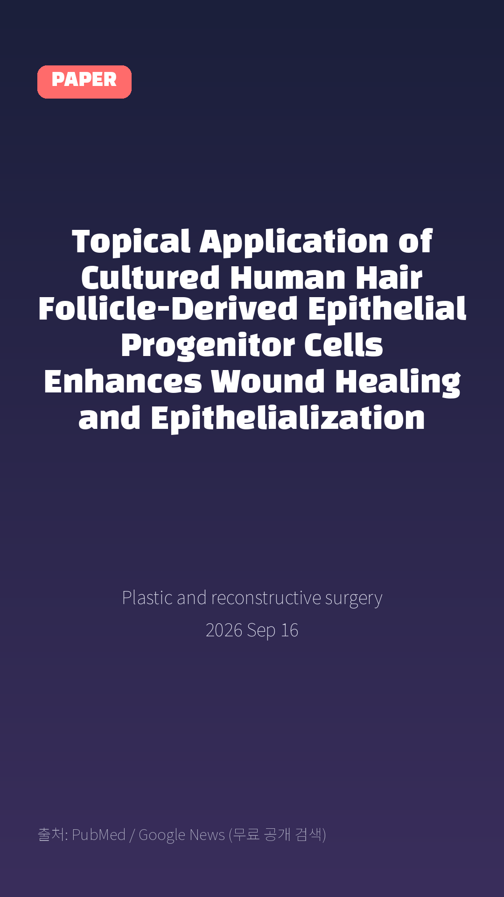
Topical Application of Cultured Human Hair Follicle-Derived Epithelial Progenitor Cells Enhances Wound Healing and Epithelialization
Plastic and reconstructive surgery · 2026 Sep 16
Notes:
[paper_intro] 약 8초
대본: 《Plastic and reconstructive surgery》 - Topical Application of Cultured Human Hair Follicle-Derived Epithelial Progenitor Cells Enhances Wound Healing and Epithelialization
연출 노트: 출처를 분명히 밝혀 신뢰를 준다.

Slide 3

Background: Epithelial cell-based approaches - including cultured keratinocyte sheets, bilayered skin substitutes, and cell-enriched wound dressings derived from epidermal cells - have been explored to enhance wound epithelialization; however, most studies have focused on epidermis-derived cells.
Notes:
[key_finding_1] 약 10초
대본: Background: Epithelial cell-based approaches - including cultured keratinocyte sheets, bilayered skin substitutes, and cell-enriched wound dressings derived from epidermal cells - have been explored to enhance wound epithelialization; however, most studies have focused on epidermis-derived cells.
연출 노트: 핵심 포인트 1. 자막을 끊어 읽는다.

Slide 4

Wound-healing potential of epithelial cells originating from different regions of human hair follicle remains insufficiently characterized.
Notes:
[key_finding_2] 약 10초
대본: Wound-healing potential of epithelial cells originating from different regions of human hair follicle remains insufficiently characterized.
연출 노트: 핵심 포인트 2.

Slide 5

탈모 연구, 매일 쉽게 정리해드립니다 🙂
Notes:
[my_take] 약 10초
대본: 탈모 연구, 매일 쉽게 정리해드립니다 🙂
연출 노트: 본인 사진 + 코멘트. 문구를 직접 바꿔 쓰세요.

Slide 6
더 자세한 내용은 원문 링크에서 확인하세요. 매일 새로운 탈모 연구, 팔로우하고 놓치지 마세요!
Notes:
[cta] 약 8초
대본: 더 자세한 내용은 원문 링크에서 확인하세요. 매일 새로운 탈모 연구, 팔로우하고 놓치지 마세요!
연출 노트: 원문 링크는 고정 댓글로 안내.

Slide 7
본문 요약 (편집용)
◆ 배경 — Background
· Epithelial cell-based approaches - including cultured keratinocyte sheets, bilayered skin substitutes, and cell-enriched wound dressings derived from epidermal cells - have been explored to enhance wound epithelialization; however, most studies have focused on epidermis-derived cells.
· Wound-healing potential of epithelial cells originating from different regions of human hair follicle remains insufficiently characterized.
◆ 연구 방법 — Methods
· Epithelial cells were isolated from distinct regions of human scalp hair follicles, including upper root epithelial cells (UECs), lower root epithelial cells (LECs), and bulb epithelial cells (BECs), and were compared with epidermal keratinocytes.
· Cell viability, proliferation, and phenotypic characteristics were evaluated in vitro.
· In vivo epithelialization was assessed using a full-thickness wound model in immunodeficient mice following topical application of each cell population.
· Histological analyses were performed on healed tissue, and donor-site outcomes were explored using a rat whisker model.
Notes:
편집 참고용 슬라이드입니다. 영상에는 쓰지 않아도 됩니다.
원문 영어 문장을 그대로 발췌했으므로 번역·검수 후 사용하세요.

Slide 8
본문 요약 (편집용)
◆ 주요 결과 — Results
· BECs exhibited the highest viability and proliferative capacity, along with a lower proportion of differentiated keratinocytes.
· All cell-treated groups enhanced epithelialization compared to controls, with BECs-treated wounds showing the most pronounced improvement.
· Histological analysis demonstrated reduced scar formation and increased retention of human-derived cells in regenerated epidermis following BECs treatment.
· In rat model, hair follicle regeneration was observed after bulb removal, although regenerated whiskers exhibited reduced thickness and length.
◆ 결론 — Conclusion
· These findings provide proof-of-concept evidence that epithelial cells derived from the human hair follicle bulb possess favorable biological properties and enhance epithelialization in preclinical wound model.
· Hair follicle-derived epithelial cells may represent promising cell source for cutaneous regeneration, although further investigation is required to establish clinical applicability.
Notes:
편집 참고용 슬라이드입니다. 영상에는 쓰지 않아도 됩니다.
원문 영어 문장을 그대로 발췌했으므로 번역·검수 후 사용하세요.

Slide 9
출처
[출처]
논문: Topical Application of Cultured Human Hair Follicle-Derived Epithelial Progenitor Cells Enhances Wound Healing and Epithelialization
게재: Plastic and reconstructive surgery
원문: https://pubmed.ncbi.nlm.nih.gov/42747264/
[이미지 출처]
- Male pattern baldness.jpg / Originally uploaded by Lkinkade (Transferred by XenonX3) / CC BY-SA 2.5
https://commons.wikimedia.org/wiki/File:Male_pattern_baldness.jpg
- Male-pattern hair loss.jpg / BlaiserPascal / CC BY-SA 4.0
https://commons.wikimedia.org/wiki/File:Male-pattern_hair_loss.jpg
※ CC BY-SA 이미지가 포함되어 있습니다. 저작자 표시가 필수이며,
동일조건변경허락(ShareAlike) 조항이 영상 전체에 적용될 수 있으니
상업적 이용 시 해당 이미지를 교체하는 편이 안전합니다.

