Slide 1
DERMATOLOGY AND THERAPY
60.6%
이 숫자, 탈모 연구가 새로 내놨습니다
2026 Oct 7 | 매일 아침 탈모 연구 한 편
Notes:
[hook] 약 4초
대본: 60.6% 이 숫자, 탈모 연구가 새로 내놨습니다
연출 노트: 0.5초 안에 스크롤을 멈추게 하는 구간. 숫자를 크게 읽어준다.

Slide 2
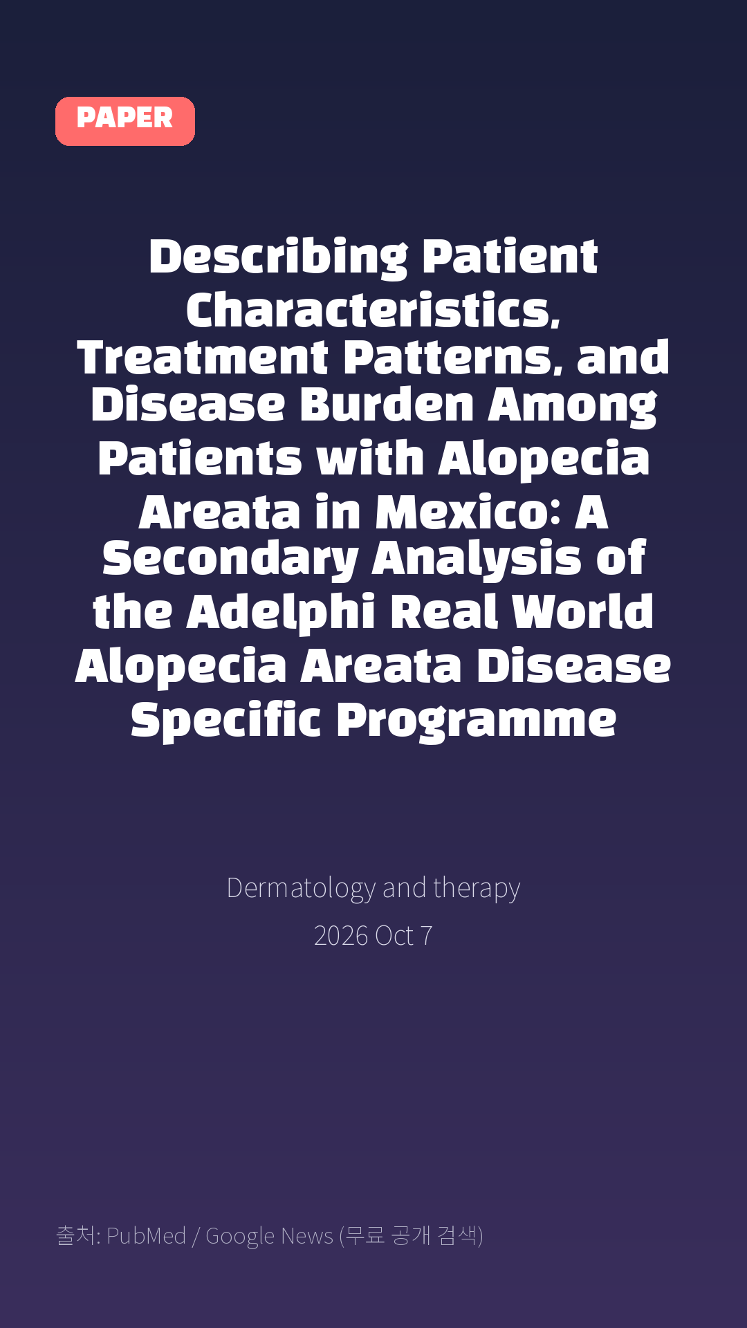
Describing Patient Characteristics, Treatment Patterns, and Disease Burden Among Patients with Alopecia Areata in Mexico: A Secondary Analysis of the Adelphi Real World Alopecia Areata Disease Specific Programme
Dermatology and therapy · 2026 Oct 7
Notes:
[paper_intro] 약 8초
대본: 《Dermatology and therapy》 - Describing Patient Characteristics, Treatment Patterns, and Disease Burden Among Patients with Alopecia Areata in Mexico: A Secondary Analysis of the Adelphi Real World Alopecia Areata Disease Specific Programme
연출 노트: 출처를 분명히 밝혀 신뢰를 준다.

Slide 3

Methods: Clinical data were analyzed from Adelphi Real World's AA II Mexico Disease Specific Programme™ (October 2024-April 2025), a linked physician and patient cross-sectional survey with retrospective elements.
Notes:
[key_finding_1] 약 10초
대본: Methods: Clinical data were analyzed from Adelphi Real World's AA II Mexico Disease Specific Programme™ (October 2024-April 2025), a linked physician and patient cross-sectional survey with retrospective elements.
연출 노트: 핵심 포인트 1. 자막을 끊어 읽는다.

Slide 4

Results: Of the 319 patients included, 123 had mild, 112 moderate, and 84 severe/very severe AA.
Notes:
[key_finding_2] 약 10초
대본: Results: Of the 319 patients included, 123 had mild, 112 moderate, and 84 severe/very severe AA.
연출 노트: 핵심 포인트 2.

Slide 5

탈모 연구, 매일 쉽게 정리해드립니다 🙂
Notes:
[my_take] 약 10초
대본: 탈모 연구, 매일 쉽게 정리해드립니다 🙂
연출 노트: 본인 사진 + 코멘트. 문구를 직접 바꿔 쓰세요.

Slide 6
더 자세한 내용은 원문 링크에서 확인하세요. 매일 새로운 탈모 연구, 팔로우하고 놓치지 마세요!
Notes:
[cta] 약 8초
대본: 더 자세한 내용은 원문 링크에서 확인하세요. 매일 새로운 탈모 연구, 팔로우하고 놓치지 마세요!
연출 노트: 원문 링크는 고정 댓글로 안내.

Slide 7
본문 요약 (편집용)
◆ 배경 — Introduction
· Alopecia areata (AA) is a common autoimmune disease characterized by nonscarring hair loss, yet real-world data on AA in Mexico are sparse.
· This study aimed to characterize disease burden and identify unmet treatment needs among patients with AA in Mexico.
◆ 연구 방법 — Methods
· Clinical data were analyzed from Adelphi Real World's AA II Mexico Disease Specific Programme™ (October 2024-April 2025), a linked physician and patient cross-sectional survey with retrospective elements.
· Dermatologists provided clinical and treatment information for eight consecutive patients with AA within prespecified severity quotas (three mild, three moderate, and two severe/very severe).
· Patients completed the Hospital Anxiety and Depression Scale, the Alopecia Areata Patient Priority Outcomes instrument, and the Skindex-16 AA questionnaire.
· Analyses were stratified by physician-assessed AA severity (mild, moderate, severe/very severe).
Notes:
편집 참고용 슬라이드입니다. 영상에는 쓰지 않아도 됩니다.
원문 영어 문장을 그대로 발췌했으므로 번역·검수 후 사용하세요.

Slide 8
본문 요약 (편집용)
◆ 주요 결과 — Results
· Of the 319 patients included, 123 had mild, 112 moderate, and 84 severe/very severe AA.
· Disease duration, percent scalp hair loss, nonscalp hair loss (eyebrow, eyelash, and body), and hair regrowth at consultation differed significantly across severity groups.
· Traditional medications, such as intralesional, topical, and oral corticosteroids, were the most frequently prescribed treatments across all severity groups.
· Physician-reported satisfaction with current treatment decreased with increasing AA severity and was significantly different across severity groups (P < 0.0001).
· Overall, 23.0% of patients with moderate AA and 29.0% with severe/very severe AA reported satisfaction with their current treatment and believed the best control had been achieved compared with 60.6% of patients with mild AA (P < 0.0001).
· Patients with severe/very severe AA experienced greater quality-of-life impairment and higher rates of anxiety and depression.
◆ 결론 — Conclusion
· This study helps address the gap in real-world evidence on AA in Mexico.
· The reliance on traditional therapies, combined with low treatment satisfaction among physicians and patients with moderate to very severe AA, suggests a need for improved access to advanced therapies within the Mexican healthcare system.
Notes:
편집 참고용 슬라이드입니다. 영상에는 쓰지 않아도 됩니다.
원문 영어 문장을 그대로 발췌했으므로 번역·검수 후 사용하세요.

Slide 9
출처
[출처]
논문: Describing Patient Characteristics, Treatment Patterns, and Disease Burden Among Patients with Alopecia Areata in Mexico: A Secondary Analysis of the Adelphi Real World Alopecia Areata Disease Specific Programme
게재: Dermatology and therapy
원문: https://pubmed.ncbi.nlm.nih.gov/42842111/
[이미지 출처]
- Male pattern baldness.jpg / Originally uploaded by Lkinkade (Transferred by XenonX3) / CC BY-SA 2.5
https://commons.wikimedia.org/wiki/File:Male_pattern_baldness.jpg
- Male-pattern hair loss.jpg / BlaiserPascal / CC BY-SA 4.0
https://commons.wikimedia.org/wiki/File:Male-pattern_hair_loss.jpg
※ CC BY-SA 이미지가 포함되어 있습니다. 저작자 표시가 필수이며,
동일조건변경허락(ShareAlike) 조항이 영상 전체에 적용될 수 있으니
상업적 이용 시 해당 이미지를 교체하는 편이 안전합니다.

