Slide 1
DERMATOLOGY AND THERAPY
85%
이 숫자, 탈모 연구가 새로 내놨습니다
2026 Oct 2 | 매일 아침 탈모 연구 한 편
Notes:
[hook] 약 4초
대본: 85% 이 숫자, 탈모 연구가 새로 내놨습니다
연출 노트: 0.5초 안에 스크롤을 멈추게 하는 구간. 숫자를 크게 읽어준다.

Slide 2
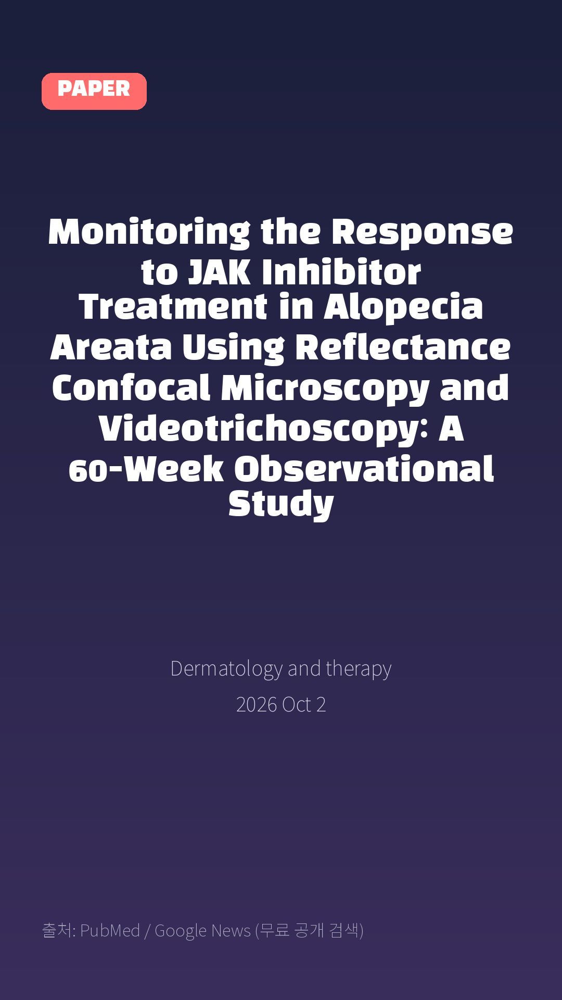
Monitoring the Response to JAK Inhibitor Treatment in Alopecia Areata Using Reflectance Confocal Microscopy and Videotrichoscopy: A 60-Week Observational Study
Dermatology and therapy · 2026 Oct 2
Notes:
[paper_intro] 약 8초
대본: 《Dermatology and therapy》 - Monitoring the Response to JAK Inhibitor Treatment in Alopecia Areata Using Reflectance Confocal Microscopy and Videotrichoscopy: A 60-Week Observational Study
연출 노트: 출처를 분명히 밝혀 신뢰를 준다.

Slide 3

Results: Mean Severity of Alopecia Tool (SALT) decreased from 85% at baseline to 17% at week 60.
Notes:
[key_finding_1] 약 10초
대본: Results: Mean Severity of Alopecia Tool (SALT) decreased from 85% at baseline to 17% at week 60.
연출 노트: 핵심 포인트 1. 자막을 끊어 읽는다.

Slide 4

5.2% increase with baricitinib), though both groups achieved comparable outcomes by week 60 (SALT 17%).
Notes:
[key_finding_2] 약 10초
대본: 5.2% increase with baricitinib), though both groups achieved comparable outcomes by week 60 (SALT 17%).
연출 노트: 핵심 포인트 2.

Slide 5

탈모 연구, 매일 쉽게 정리해드립니다 🙂
Notes:
[my_take] 약 10초
대본: 탈모 연구, 매일 쉽게 정리해드립니다 🙂
연출 노트: 본인 사진 + 코멘트. 문구를 직접 바꿔 쓰세요.

Slide 6
더 자세한 내용은 원문 링크에서 확인하세요. 매일 새로운 탈모 연구, 팔로우하고 놓치지 마세요!
Notes:
[cta] 약 8초
대본: 더 자세한 내용은 원문 링크에서 확인하세요. 매일 새로운 탈모 연구, 팔로우하고 놓치지 마세요!
연출 노트: 원문 링크는 고정 댓글로 안내.

Slide 7
본문 요약 (편집용)
◆ 배경 — Introduction
· Alopecia areata (AA) is an autoimmune disease affecting approximately 2.1% of the population.
· JAK inhibitors represent a therapeutic breakthrough for severe AA, yet objective tools for monitoring treatment response remain limited.
· The objective of this study was to correlate trichoscopic and reflectance confocal microscopy (RCM) features with clinical changes in patients with severe AA treated with JAK inhibitors (upadacitinib and baricitinib) over 60 weeks.
◆ 연구 방법 — Methods
· Twenty patients with severe AA were enrolled.
· Patients were treated with upadacitinib 15 mg/day or baricitinib 4 mg/day.
· Clinical (Severity of Alopecia Tool score), trichoscopic, and RCM evaluations were performed at baseline and every 12 weeks thereafter.
Notes:
편집 참고용 슬라이드입니다. 영상에는 쓰지 않아도 됩니다.
원문 영어 문장을 그대로 발췌했으므로 번역·검수 후 사용하세요.

Slide 8
본문 요약 (편집용)
◆ 주요 결과 — Results
· Mean Severity of Alopecia Tool (SALT) decreased from 85% at baseline to 17% at week 60.
· Upadacitinib treated patients showed faster early response (32.6%% SALT reduction at week 12 vs. 5.2% increase with baricitinib), though both groups achieved comparable outcomes by week 60 (SALT 17%).
· Trichoscopy showed progressive reduction of activity markers: (yellow dots, black dots, broken hairs, and exclamation mark hairs) with characteristic regrowth sequence: short vellus hairs, upright regrowing hairs, terminal hairs.
· RCM identified three parameter categories: (1) inflammatory activity markers (epidermal infiltration, bright rimming, luminal bright material, cadaverised hairs), with persistent diffuse follicular inflammation and perifollicular muffle; (2) transient collagen remodelling features without fibrosis; and (3) recovery markers, including follicular normalisation (strongest RCM predictor of response) and vellus-to-terminal transition.
◆ 결론 — Conclusions
· JAK inhibitors demonstrated sustained efficacy in severe AA.
· Multimodal assessment combining SALT, trichoscopy, and RCM enables precise biological response monitoring.
· RCM uniquely detects subclinical perifollicular inflammation persisting despite clinical improvement, potentially predicting relapse risk after treatment discontinuation.
Notes:
편집 참고용 슬라이드입니다. 영상에는 쓰지 않아도 됩니다.
원문 영어 문장을 그대로 발췌했으므로 번역·검수 후 사용하세요.

Slide 9
출처
[출처]
논문: Monitoring the Response to JAK Inhibitor Treatment in Alopecia Areata Using Reflectance Confocal Microscopy and Videotrichoscopy: A 60-Week Observational Study
게재: Dermatology and therapy
원문: https://pubmed.ncbi.nlm.nih.gov/42825997/
[이미지 출처]
- Male pattern baldness.jpg / Originally uploaded by Lkinkade (Transferred by XenonX3) / CC BY-SA 2.5
https://commons.wikimedia.org/wiki/File:Male_pattern_baldness.jpg
- Male-pattern hair loss.jpg / BlaiserPascal / CC BY-SA 4.0
https://commons.wikimedia.org/wiki/File:Male-pattern_hair_loss.jpg
※ CC BY-SA 이미지가 포함되어 있습니다. 저작자 표시가 필수이며,
동일조건변경허락(ShareAlike) 조항이 영상 전체에 적용될 수 있으니
상업적 이용 시 해당 이미지를 교체하는 편이 안전합니다.

