Slide 1
PHARMACEUTICALS (BASEL, SWITZERLAND)
오늘의 논문
Pharmaceuticals (Basel, Switzerland)에 실린 새 연구입니다
2026 Sep 10 | 매일 아침 탈모 연구 한 편
Notes:
[hook] 약 4초
대본: 오늘의 논문 Pharmaceuticals (Basel, Switzerland)에 실린 새 연구입니다
연출 노트: 0.5초 안에 스크롤을 멈추게 하는 구간. 숫자를 크게 읽어준다.

Slide 2
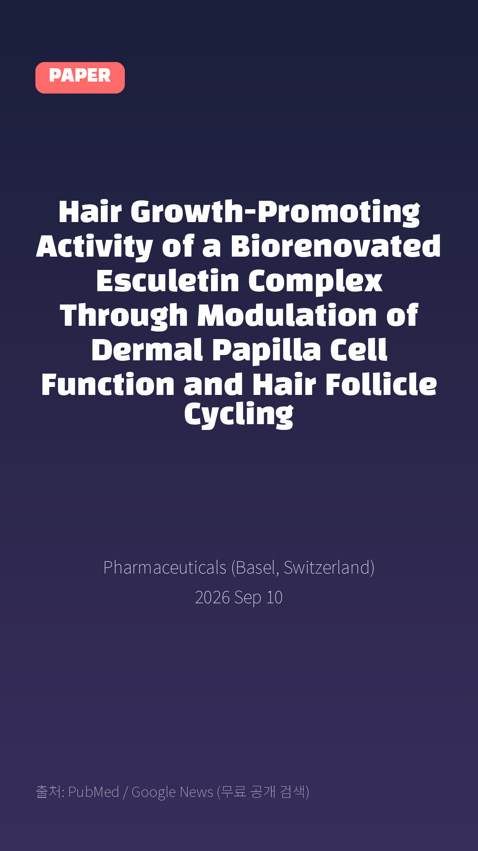
Hair Growth-Promoting Activity of a Biorenovated Esculetin Complex Through Modulation of Dermal Papilla Cell Function and Hair Follicle Cycling
Pharmaceuticals (Basel, Switzerland) · 2026 Sep 10
Notes:
[paper_intro] 약 8초
대본: 《Pharmaceuticals (Basel, Switzerland)》 - Hair Growth-Promoting Activity of a Biorenovated Esculetin Complex Through Modulation of Dermal Papilla Cell Function and Hair Follicle Cycling
연출 노트: 출처를 분명히 밝혀 신뢰를 준다.

Slide 3

Objectives: Hair loss is a prevalent condition influenced by genetic, hormonal, and environmental factors, and effective therapies with minimal side effects are highly desired.
Notes:
[key_finding_1] 약 10초
대본: Objectives: Hair loss is a prevalent condition influenced by genetic, hormonal, and environmental factors, and effective therapies with minimal side effects are highly desired.
연출 노트: 핵심 포인트 1. 자막을 끊어 읽는다.

Slide 4

In this study, the hair growth-promoting potential of a biorenovated esculetin complex (BEC) was evaluated in a C57BL/6N mouse model.
Notes:
[key_finding_2] 약 10초
대본: In this study, the hair growth-promoting potential of a biorenovated esculetin complex (BEC) was evaluated in a C57BL/6N mouse model.
연출 노트: 핵심 포인트 2.

Slide 5

탈모 연구, 매일 쉽게 정리해드립니다 🙂
Notes:
[my_take] 약 10초
대본: 탈모 연구, 매일 쉽게 정리해드립니다 🙂
연출 노트: 본인 사진 + 코멘트. 문구를 직접 바꿔 쓰세요.

Slide 6
더 자세한 내용은 원문 링크에서 확인하세요. 매일 새로운 탈모 연구, 팔로우하고 놓치지 마세요!
Notes:
[cta] 약 8초
대본: 더 자세한 내용은 원문 링크에서 확인하세요. 매일 새로운 탈모 연구, 팔로우하고 놓치지 마세요!
연출 노트: 원문 링크는 고정 댓글로 안내.

Slide 7
본문 요약 (편집용)
◆ 배경 — Objectives
· Hair loss is a prevalent condition influenced by genetic, hormonal, and environmental factors, and effective therapies with minimal side effects are highly desired.
· In this study, the hair growth-promoting potential of a biorenovated esculetin complex (BEC) was evaluated in a C57BL/6N mouse model.
◆ 연구 방법 — Methods
· BEC was topically applied to the depilated dorsal skin of mice once daily for 24 days.
· Hair growth was evaluated by measuring hair length, thickness, and weight, together with histological assessment of hair follicle number, follicle depth, and dermal thickness.
· Protein expression associated with Wnt/β-catenin and AKT signaling was evaluated by Western blot analysis.
Notes:
편집 참고용 슬라이드입니다. 영상에는 쓰지 않아도 됩니다.
원문 영어 문장을 그대로 발췌했으므로 번역·검수 후 사용하세요.

Slide 8
본문 요약 (편집용)
◆ 주요 결과 — Results
· BEC treatment accelerated hair regrowth and increased hair length, thickness, and weight compared with the vehicle control under the present experimental conditions.
· Histological analysis of hematoxylin-and-eosin-stained skin sections showed increased hair follicle number and greater follicle depth in the BEC-treated group, whereas dermal thickness was not significantly altered.
· Western blot analysis showed changes in β-catenin, phospho-GSK-3β (Ser9), and PCNA levels following BEC treatment.
· The p-AKT/AKT ratio also showed an increasing trend, although the difference was not statistically significant.
◆ 결론 — Conclusions
· These findings demonstrate the hair growth-promoting activity of the BEC preparation in this short-term murine model and suggest that these effects are associated with changes in Wnt/β-catenin- and AKT-related signaling.
· Further studies are warranted to characterize the active components, dose dependence, mechanism of action, and safety profile of BEC.
Notes:
편집 참고용 슬라이드입니다. 영상에는 쓰지 않아도 됩니다.
원문 영어 문장을 그대로 발췌했으므로 번역·검수 후 사용하세요.

Slide 9
출처
[출처]
논문: Hair Growth-Promoting Activity of a Biorenovated Esculetin Complex Through Modulation of Dermal Papilla Cell Function and Hair Follicle Cycling
게재: Pharmaceuticals (Basel, Switzerland)
원문: https://pubmed.ncbi.nlm.nih.gov/42797475/
[이미지 출처]
- Male pattern baldness.jpg / Originally uploaded by Lkinkade (Transferred by XenonX3) / CC BY-SA 2.5
https://commons.wikimedia.org/wiki/File:Male_pattern_baldness.jpg
- Male-pattern hair loss.jpg / BlaiserPascal / CC BY-SA 4.0
https://commons.wikimedia.org/wiki/File:Male-pattern_hair_loss.jpg
※ CC BY-SA 이미지가 포함되어 있습니다. 저작자 표시가 필수이며,
동일조건변경허락(ShareAlike) 조항이 영상 전체에 적용될 수 있으니
상업적 이용 시 해당 이미지를 교체하는 편이 안전합니다.

