Slide 1
JOURNAL OF CUTANEOUS PATHOLOGY
91%
이 숫자, 탈모 연구가 새로 내놨습니다
2026 Oct 20 | 매일 아침 탈모 연구 한 편
Notes:
[hook] 약 4초
대본: 91% 이 숫자, 탈모 연구가 새로 내놨습니다
연출 노트: 0.5초 안에 스크롤을 멈추게 하는 구간. 숫자를 크게 읽어준다.

Slide 2
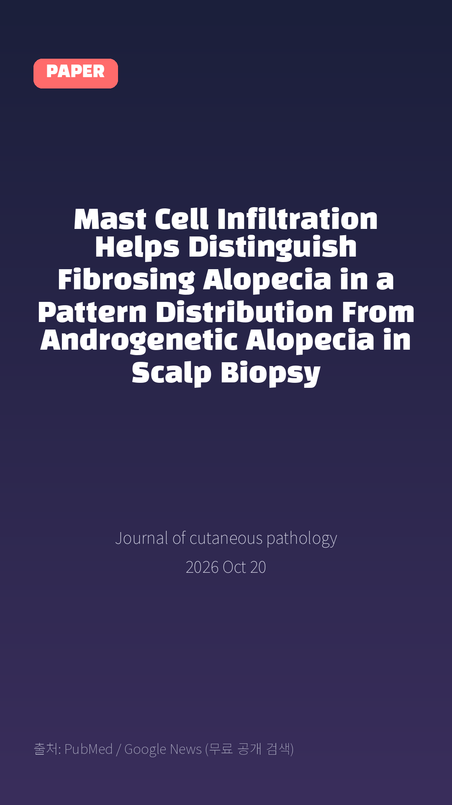
Mast Cell Infiltration Helps Distinguish Fibrosing Alopecia in a Pattern Distribution From Androgenetic Alopecia in Scalp Biopsy
Journal of cutaneous pathology · 2026 Oct 20
Notes:
[paper_intro] 약 8초
대본: 《Journal of cutaneous pathology》 - Mast Cell Infiltration Helps Distinguish Fibrosing Alopecia in a Pattern Distribution From Androgenetic Alopecia in Scalp Biopsy
연출 노트: 출처를 분명히 밝혀 신뢰를 준다.

Slide 3

Method: A total of 56 patients diagnosed with AGA, FAPD, or LPP were enrolled.
Notes:
[key_finding_1] 약 10초
대본: Method: A total of 56 patients diagnosed with AGA, FAPD, or LPP were enrolled.
연출 노트: 핵심 포인트 1. 자막을 끊어 읽는다.

Slide 4

Result: The majority of participants (91%) were female, with a mean age of 44.3 years.
Notes:
[key_finding_2] 약 10초
대본: Result: The majority of participants (91%) were female, with a mean age of 44.3 years.
연출 노트: 핵심 포인트 2.

Slide 5

탈모 연구, 매일 쉽게 정리해드립니다 🙂
Notes:
[my_take] 약 10초
대본: 탈모 연구, 매일 쉽게 정리해드립니다 🙂
연출 노트: 본인 사진 + 코멘트. 문구를 직접 바꿔 쓰세요.

Slide 6
더 자세한 내용은 원문 링크에서 확인하세요. 매일 새로운 탈모 연구, 팔로우하고 놓치지 마세요!
Notes:
[cta] 약 8초
대본: 더 자세한 내용은 원문 링크에서 확인하세요. 매일 새로운 탈모 연구, 팔로우하고 놓치지 마세요!
연출 노트: 원문 링크는 고정 댓글로 안내.

Slide 7
본문 요약 (편집용)
◆ 배경 — Background
· Mast cells are key regulators of cutaneous inflammation and are known to accumulate in response to various immunological stimuli.
· Although their role in several dermatological conditions has been established, their specific contribution to different forms of alopecia-particularly scarring versus nonscarring types-remains incompletely understood.
· This study aimed to compare the degree of mast cell infiltration across three distinct types of alopecia: androgenetic alopecia (AGA), fibrosing alopecia in a pattern distribution (FAPD), and lichen planopilaris (LPP).
◆ 연구 방법 — Method
· A total of 56 patients diagnosed with AGA, FAPD, or LPP were enrolled.
· Scalp biopsies were obtained from all participants, and diagnoses were confirmed through histopathological examination.
· Mast cell distribution and infiltration density were quantified and analyzed using SPSS and Stata software.
· The study was conducted with full ethical approval.
Notes:
편집 참고용 슬라이드입니다. 영상에는 쓰지 않아도 됩니다.
원문 영어 문장을 그대로 발췌했으므로 번역·검수 후 사용하세요.

Slide 8
본문 요약 (편집용)
◆ 주요 결과 — Result
· The majority of participants (91%) were female, with a mean age of 44.3 years.
· FAPD was the most prevalent diagnosis (42.9%).
· LPP demonstrated the highest degree of mast cell infiltration, while AGA exhibited the lowest (ANOVA, p < 0.001).
· Post hoc analysis revealed significant differences between AGA and FAPD (-17.7%, p = 0.001) and between AGA and LPP (-20.1%, p = 0.001).
· Although mast cell infiltration was higher in patients over 40 years of age, this difference did not reach statistical significance.
· No significant association was identified between mast cell infiltration and patient sex.
◆ 결론 — Conclusion
· Mast cell infiltration is significantly more pronounced in scarring alopecias (LPP and FAPD) compared to non-scarring AGA, suggesting a shared immunopathological mechanism underlying follicular destruction in scarring subtypes.
· These findings also raise important questions regarding the potential inflammatory contribution of mast cells to AGA pathogenesis.
Notes:
편집 참고용 슬라이드입니다. 영상에는 쓰지 않아도 됩니다.
원문 영어 문장을 그대로 발췌했으므로 번역·검수 후 사용하세요.

Slide 9
출처
[출처]
논문: Mast Cell Infiltration Helps Distinguish Fibrosing Alopecia in a Pattern Distribution From Androgenetic Alopecia in Scalp Biopsy
게재: Journal of cutaneous pathology
원문: https://pubmed.ncbi.nlm.nih.gov/42902517/
[이미지 출처]
- Male pattern baldness.jpg / Originally uploaded by Lkinkade (Transferred by XenonX3) / CC BY-SA 2.5
https://commons.wikimedia.org/wiki/File:Male_pattern_baldness.jpg
- Male-pattern hair loss.jpg / BlaiserPascal / CC BY-SA 4.0
https://commons.wikimedia.org/wiki/File:Male-pattern_hair_loss.jpg
※ CC BY-SA 이미지가 포함되어 있습니다. 저작자 표시가 필수이며,
동일조건변경허락(ShareAlike) 조항이 영상 전체에 적용될 수 있으니
상업적 이용 시 해당 이미지를 교체하는 편이 안전합니다.

