Slide 1
DERMATOLOGIC SURGERY : OFFICIAL PUBLICAT
모발이식
오늘 나온 최신 연구를 정리했습니다
2026 Oct 9 | 매일 아침 탈모 연구 한 편
Notes:
[hook] 약 4초
대본: 모발이식 오늘 나온 최신 연구를 정리했습니다
연출 노트: 0.5초 안에 스크롤을 멈추게 하는 구간. 숫자를 크게 읽어준다.

Slide 2
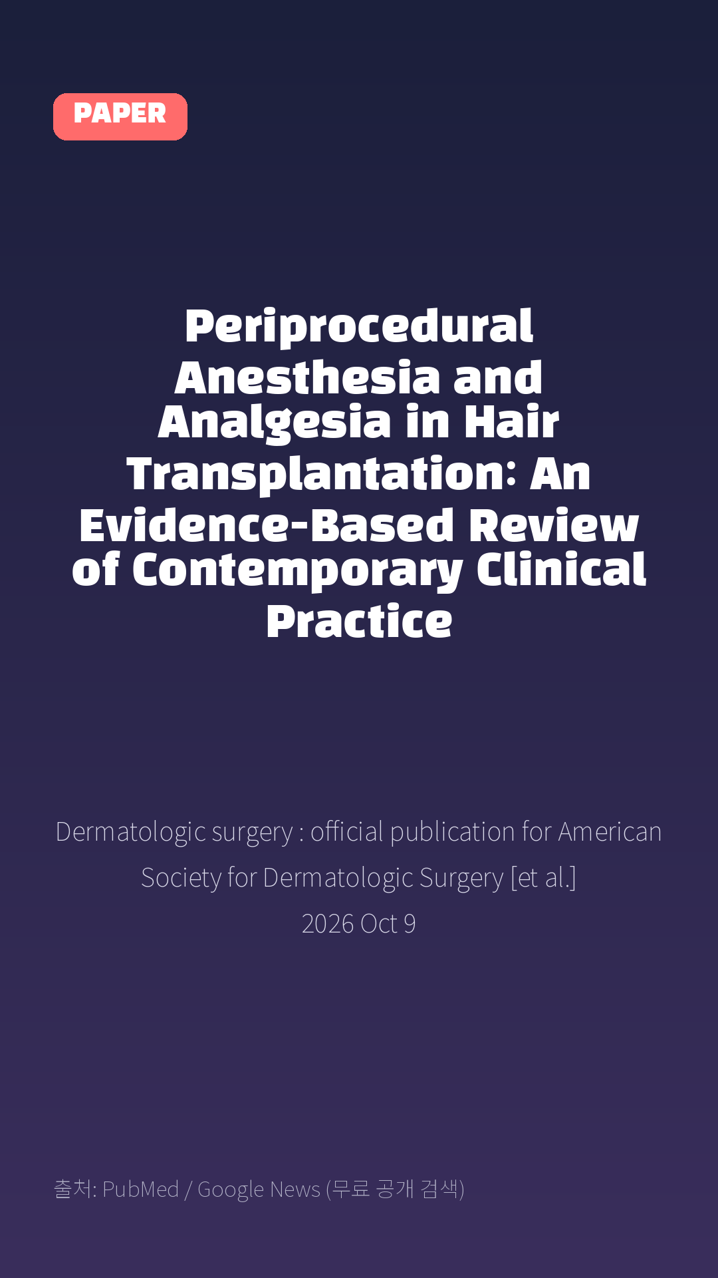
Periprocedural Anesthesia and Analgesia in Hair Transplantation: An Evidence-Based Review of Contemporary Clinical Practice
Dermatologic surgery : official publication for American Society for Dermatologic Surgery [et al.] · 2026 Oct 9
Notes:
[paper_intro] 약 8초
대본: 《Dermatologic surgery : official publication for American Society for Dermatologic Surgery [et al.]》 - Periprocedural Anesthesia and Analgesia in Hair Transplantation: An Evidence-Based Review of Contemporary Clinical Practice
연출 노트: 출처를 분명히 밝혀 신뢰를 준다.

Slide 3

Background: Hair transplantation is a widely performed office-based aesthetic procedure characterized by prolonged procedural duration, cumulative local anesthetic exposure, and reliance on sustained patient cooperation.
Notes:
[key_finding_1] 약 10초
대본: Background: Hair transplantation is a widely performed office-based aesthetic procedure characterized by prolonged procedural duration, cumulative local anesthetic exposure, and reliance on sustained patient cooperation.
연출 노트: 핵심 포인트 1. 자막을 끊어 읽는다.

Slide 4

Despite extensive literature on surgical technique and aesthetic outcomes, periprocedural anesthetic and analgesic considerations remain comparatively undersynthesized.
Notes:
[key_finding_2] 약 10초
대본: Despite extensive literature on surgical technique and aesthetic outcomes, periprocedural anesthetic and analgesic considerations remain comparatively undersynthesized.
연출 노트: 핵심 포인트 2.

Slide 5

탈모 연구, 매일 쉽게 정리해드립니다 🙂
Notes:
[my_take] 약 10초
대본: 탈모 연구, 매일 쉽게 정리해드립니다 🙂
연출 노트: 본인 사진 + 코멘트. 문구를 직접 바꿔 쓰세요.

Slide 6
더 자세한 내용은 원문 링크에서 확인하세요. 매일 새로운 탈모 연구, 팔로우하고 놓치지 마세요!
Notes:
[cta] 약 8초
대본: 더 자세한 내용은 원문 링크에서 확인하세요. 매일 새로운 탈모 연구, 팔로우하고 놓치지 마세요!
연출 노트: 원문 링크는 고정 댓글로 안내.

Slide 7
본문 요약 (편집용)
◆ 배경 — Background
· Hair transplantation is a widely performed office-based aesthetic procedure characterized by prolonged procedural duration, cumulative local anesthetic exposure, and reliance on sustained patient cooperation.
· Despite extensive literature on surgical technique and aesthetic outcomes, periprocedural anesthetic and analgesic considerations remain comparatively undersynthesized.
◆ 배경 — Objective
· The aims of this study were to review periprocedural anesthesia and analgesia strategies in hair transplantation and highlight practical considerations related to patient safety, procedural workflow, and intraoperative management.
Notes:
편집 참고용 슬라이드입니다. 영상에는 쓰지 않아도 됩니다.
원문 영어 문장을 그대로 발췌했으므로 번역·검수 후 사용하세요.

Slide 8
본문 요약 (편집용)
◆ 연구 방법 — Methods
· A structured literature review was conducted using PubMed/MEDLINE and Embase from database inception through January 2026.
· Studies evaluating anesthetic techniques, analgesic strategies, periprocedural pain management, and anesthesia-related safety considerations in hair transplantation and comparable office-based dermatologic surgical procedures were included.
· Evidence was synthesized qualitatively according to predefined clinical domains.
◆ 주요 결과 — Results
· Available evidence supports multimodal anesthetic strategies incorporating individualized local anesthetic selection, tumescence, regional nerve blocks, adjunctive analgesia, and structured intraoperative monitoring to optimize patient comfort, procedural efficiency, and safety.
· However, available evidence consists predominantly of observational studies, case series, and expert consensus, with limited high-quality comparative data.
Notes:
편집 참고용 슬라이드입니다. 영상에는 쓰지 않아도 됩니다.
원문 영어 문장을 그대로 발췌했으므로 번역·검수 후 사용하세요.

Slide 9
본문 요약 (편집용)
◆ 결론 — Conclusion
· Individualized multimodal anesthetic strategies represent the current evidence-informed approach to periprocedural management in hair transplantation.
· Prospective comparative studies are needed to strengthen the evidence base and inform future clinical recommendations.
Notes:
편집 참고용 슬라이드입니다. 영상에는 쓰지 않아도 됩니다.
원문 영어 문장을 그대로 발췌했으므로 번역·검수 후 사용하세요.

Slide 10
출처
[출처]
논문: Periprocedural Anesthesia and Analgesia in Hair Transplantation: An Evidence-Based Review of Contemporary Clinical Practice
게재: Dermatologic surgery : official publication for American Society for Dermatologic Surgery [et al.]
원문: https://pubmed.ncbi.nlm.nih.gov/42847986/
[이미지 출처]
- Male pattern baldness.jpg / Originally uploaded by Lkinkade (Transferred by XenonX3) / CC BY-SA 2.5
https://commons.wikimedia.org/wiki/File:Male_pattern_baldness.jpg
- Male-pattern hair loss.jpg / BlaiserPascal / CC BY-SA 4.0
https://commons.wikimedia.org/wiki/File:Male-pattern_hair_loss.jpg
※ CC BY-SA 이미지가 포함되어 있습니다. 저작자 표시가 필수이며,
동일조건변경허락(ShareAlike) 조항이 영상 전체에 적용될 수 있으니
상업적 이용 시 해당 이미지를 교체하는 편이 안전합니다.

