Slide 1
HDF Performance Framework
  Hyo-Kyung Lee
  The HDF Group

Slide 2
Introduction
Software benchmarking framework
Measure time of benchmarks
Web-based GUI

Slide 3
Goals
Easy to Use for Various Benchmarks
Multiple Platforms and Versions
Long Term Regression Test
Help Debugging

Slide 4
Background
Backend: Cron job / DB Storage
Core: Performance C/C++ Library
Frontend: PHP / jpgraph

Slide 5


Solution
Easy to Use
HDF5 1.6
HDF5 1.8
Database
cron
A User’s Benchmark
Performance Library
PHP
www
Web Server
Graph/Text

Slide 6
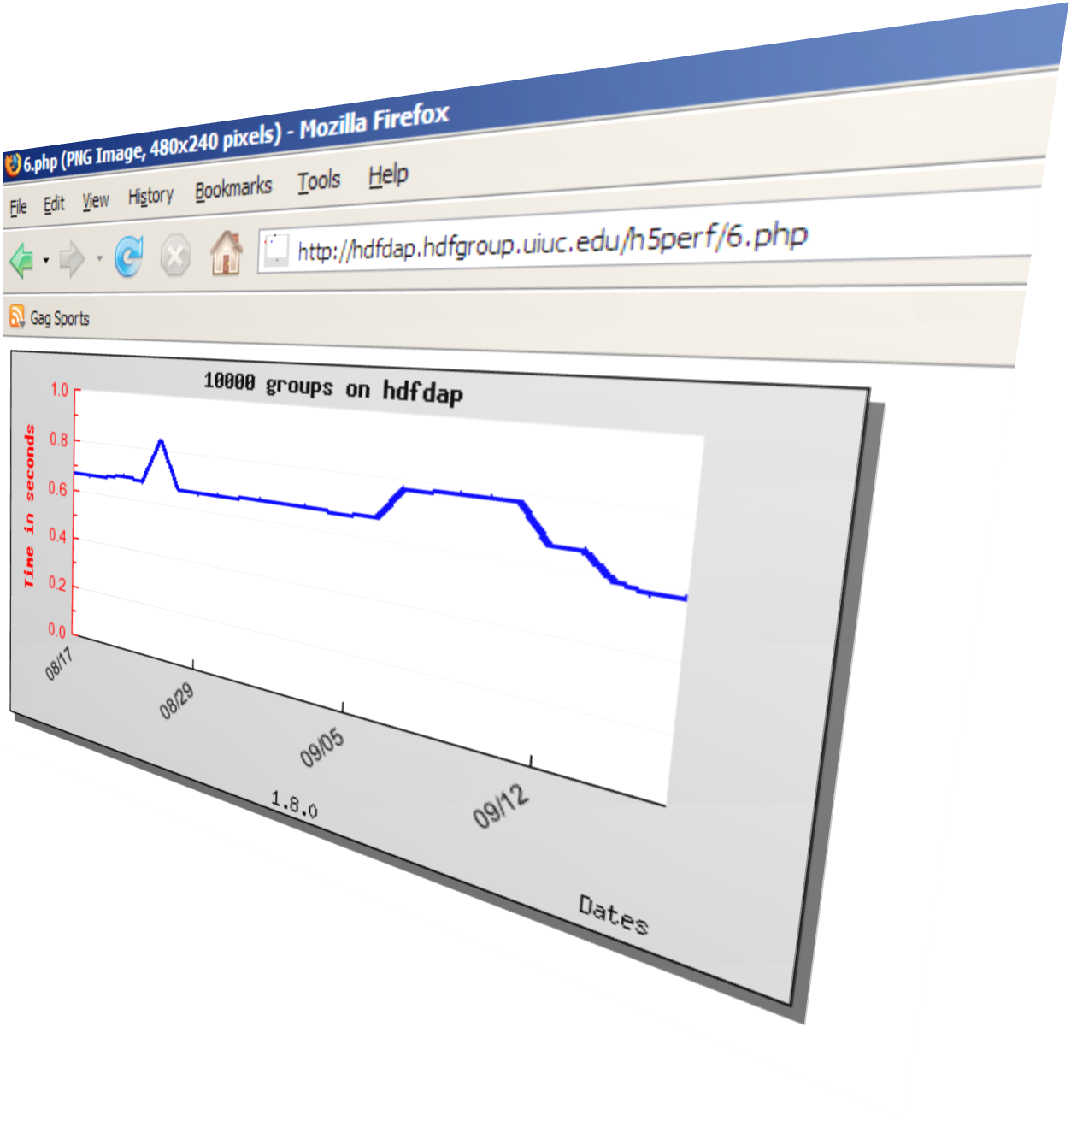
Example Usage
H5Perf_startTimer(&time);
for(i=0;i<1000 ;i++) {
H5Gcreate(fileid,group_name,(size_t)0));
// Add groups
}
H5Perf_endTimer(&time);
H5Perf_addInstance(db_host, date, time);
00 21 * * * /home/local/hyoklee/src/chicago/test-perf-hdfdap-3.sh
| 178820 | 2007-08-17 21:51:14 | 10000 groups | creating 10000 empty groups | 1.8.0 | hdfdap | 0.670198 | 4384 |
Timestamp
Instance Name
Version
Platform
Time

Slide 7
Solution
Various Benchmarks: Hierarchical Model
H5Perf_setRoutine(…)
Caterpillar
Test Routine
Motorola
H5Perf_addAction(…)
Group
Compound Data Type
Test Action
H5Perf_addInstance(…)
Write 1,000 Compound Records
Write 1,000,000 Groups
Test Instance

Slide 8
Solution
Support Multiple Platforms & Versions
    Portable C/C++ API Library
    Use of HDF5 Static Library
    Shell Script / PHP Script

Slide 9
Solution
Measure Long-Term Performance
  Two Storage Option
  MySQL DB / Local TXT File
  Daily Cron job

Slide 10
Solution
Help Debugging
  Graphical Output
  Daily Warning E-mail Report
  SVN diff

Slide 11
Experiment
3 Sample / 2 Real Tests
3 Platforms / 4 Hosts
  Solaris / Linux / Linux 64
2 HDF5 Versions
  1.6.6 / 1.8.0

Slide 12

Demo
http://hdfdap.hdfgroup.uiuc.edu/h5perf/index.html

Slide 13
Results
Inconsistency
    Up to +20%
    Run 3 times if +20%
DB Failure
  Connection error / 10 trials
  Reliability issue / DB Backup

Slide 14
Discussion
Accuracy and consistency?
  Use Averages
  More Random Intervals
DB Reliability?
  Mandatory local storage
  Upload Script

Slide 15
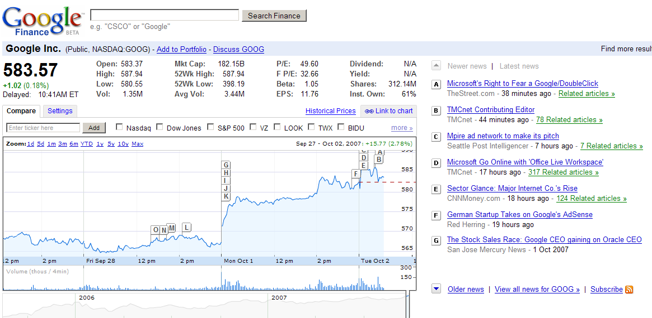
Future Work
Long Term Statistics Reports
Better GUI
Journal Entry DB

