Slide 1
HDF Performance Framework
Hyo-Kyung Lee
The HDF Group

Slide 2
Introduction
Software benchmarking framework
Measure time of benchmarks
Web-based GUI

Slide 3
Goals
Easy to Use for Various Benchmarks
Multiple Platforms and Versions
Long Term Regression Test
Help Debugging

Slide 4
Background
Backend: Cron job / DB Storage
Core: Performance C/C++ Library
Frontend: PHP / jpgraph

Slide 5
Solution
Easy to Use
HDF5 1.6
HDF5 1.8
Database
cron
A User’s Benchmark
Performance Library
PHP
www
Web Server
Graph/Text

Slide 6
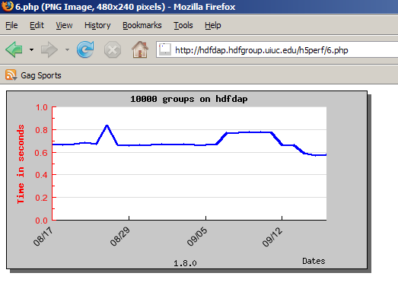
Example Usage
H5Perf_startTimer(&time);
for(i=0;i<1000 ;i++) {
H5Gcreate(fileid,group_name,(size_t)0));
// Add groups
}
H5Perf_endTimer(&time);
H5Perf_addInstance(db_host, date, time);
00 21 * * * /home/local/hyoklee/src/chicago/test-perf-hdfdap-3.sh
| 178820 | 2007-08-17 21:51:14 | 10000 groups | creating 10000 empty groups | 1.8.0 | hdfdap | 0.670198 | 4384 |
Timestamp
Instance Name
Version
Platform
Time

Slide 7
Solution
Various Benchmarks: Hierarchical Model
H5Perf_setRoutine(…)
Test Routine
Caterpillar
Motorola
H5Perf_addAction(…)
Group
Test Action
Compound Data Type
H5Perf_addInstance(…)
Test Instance
Write 1,000 Compound Records
Write 1,000,000 Groups

Slide 8
Solution
Support Multiple Platforms & Versions
Portable C/C++ API Library
Use of HDF5 Static Library
Shell Script / PHP Script

Slide 9
Solution
Measure Long-Term Performance
Two Storage Option
MySQL DB / Local TXT File
Daily Cron job

Slide 10
Solution
Help Debugging
Graphical Output
Daily Warning E-mail Report
SVN diff

Slide 11
Experiment
3 Sample / 2 Real Tests
3 Platforms / 4 Hosts
Solaris / Linux / Linux 64
2 HDF5 Versions
1.6.6 / 1.8.0

Slide 12
Demo
http://hdfdap.hdfgroup.uiuc.edu/h5perf/index.html

Slide 13
Results
Inconsistency
Up to +20%
Run 3 times if +20%
DB Failure
Connection error / 10 trials
Reliability issue / DB Backup

Slide 14
Discussion
Accuracy and consistency?
Use Averages
More Random Intervals
DB Reliability?
Mandatory local storage
Upload Script

Slide 15
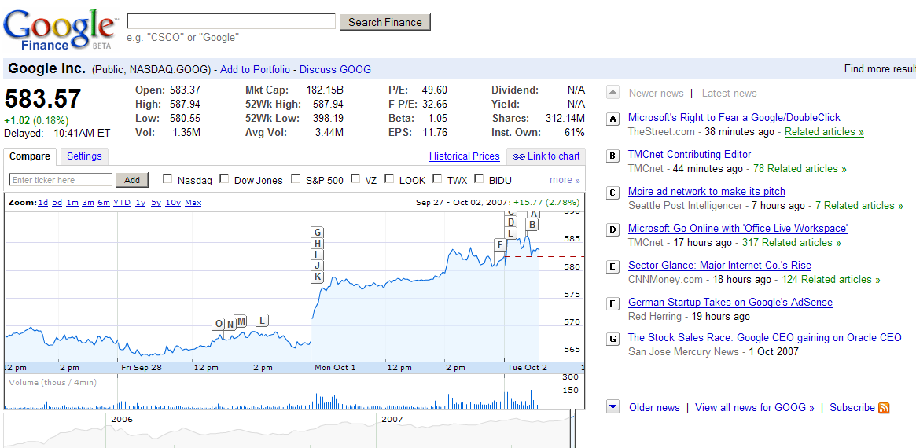
Future Work
Long Term Statistics Reports
Better GUI
Journal Entry DB

