Slide 1
Chik climate-immunity analysis
Impact of routine immunisation across different climate-transmission setting

Slide 2
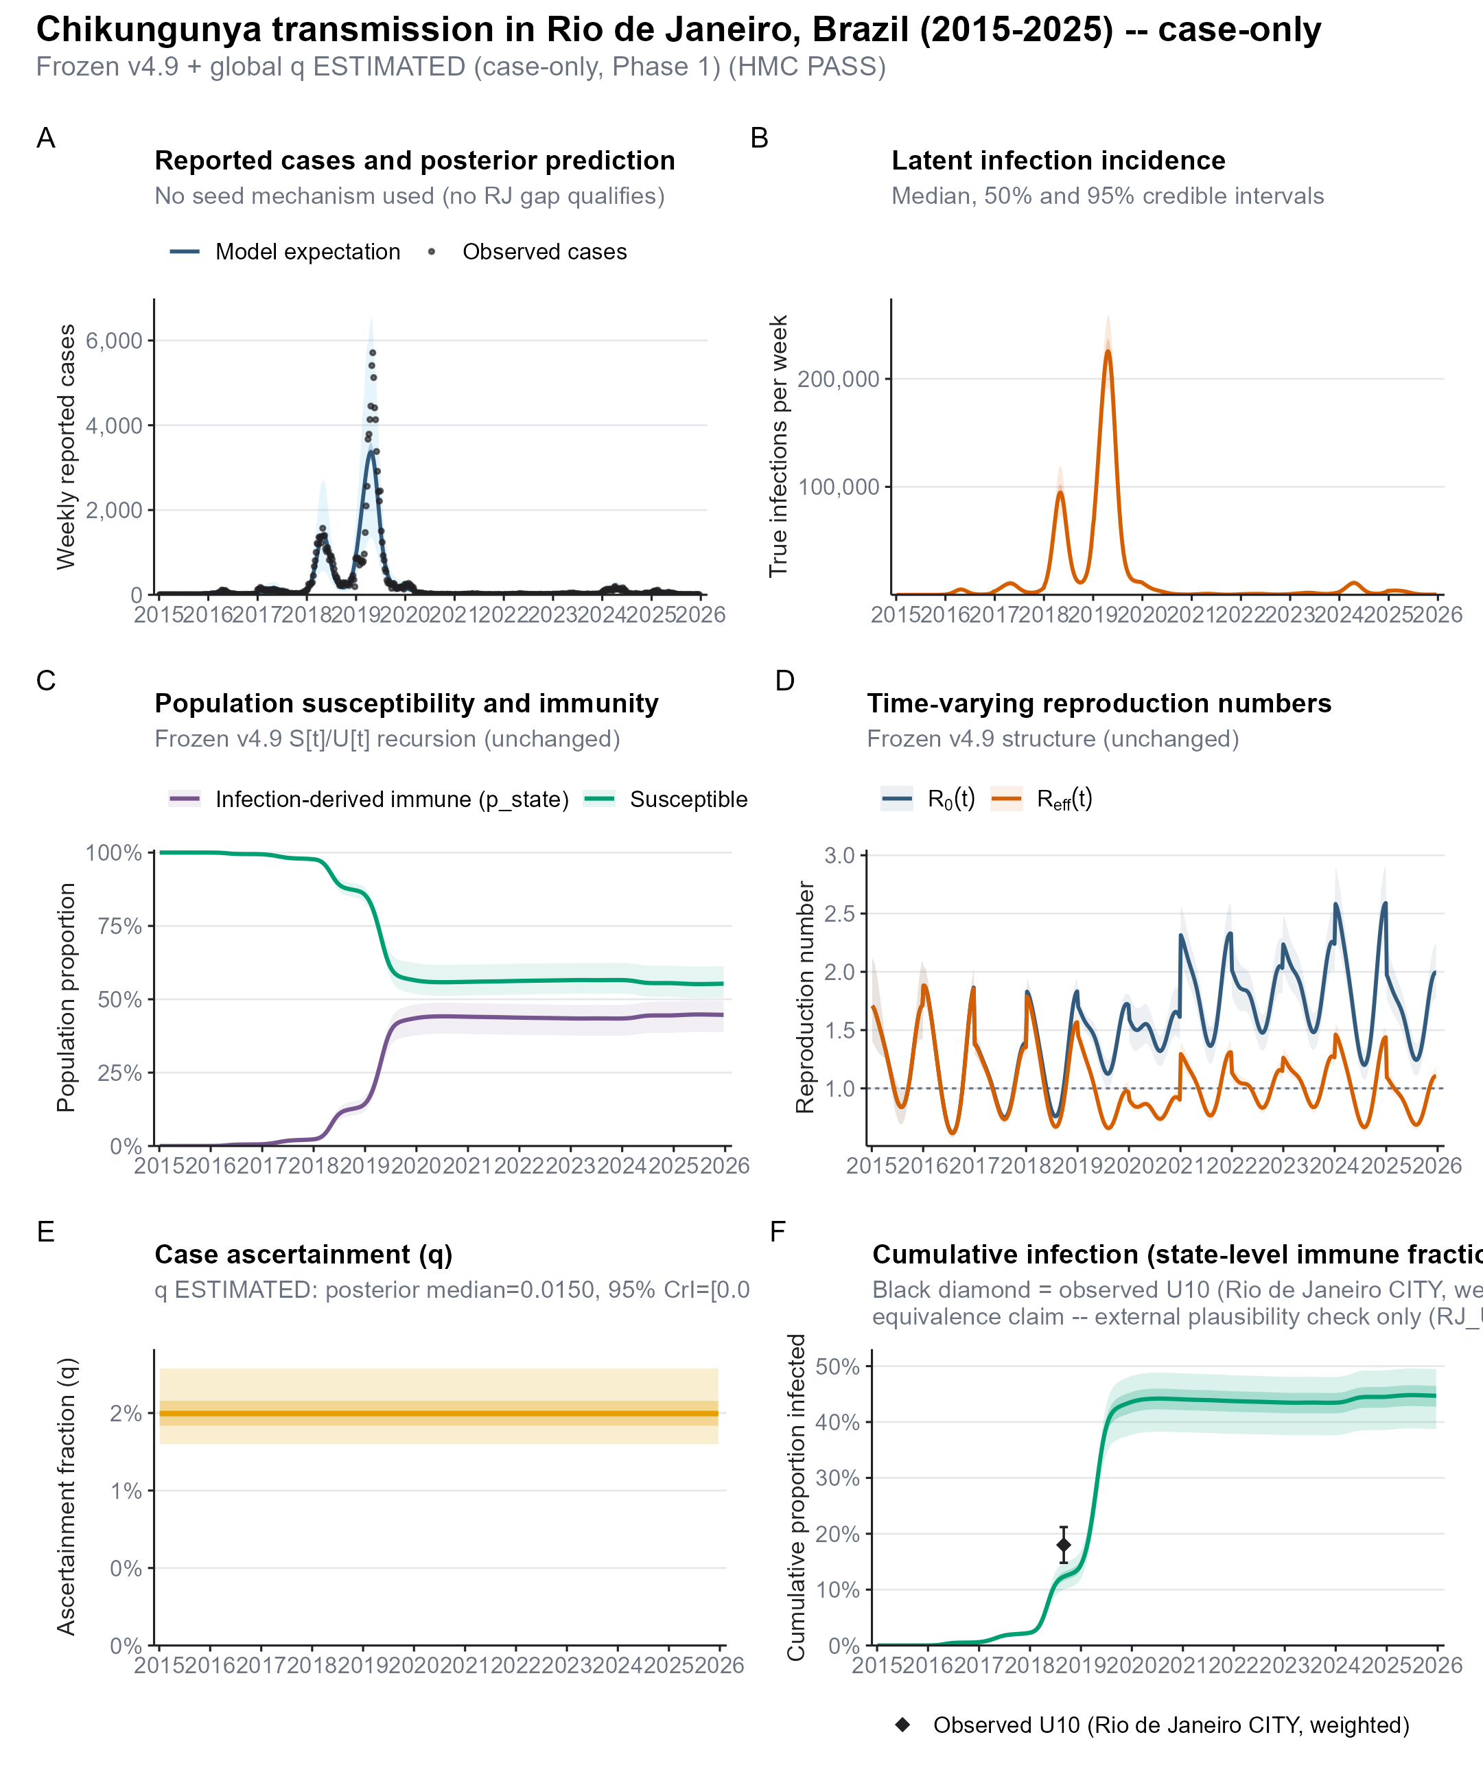

Slide 3
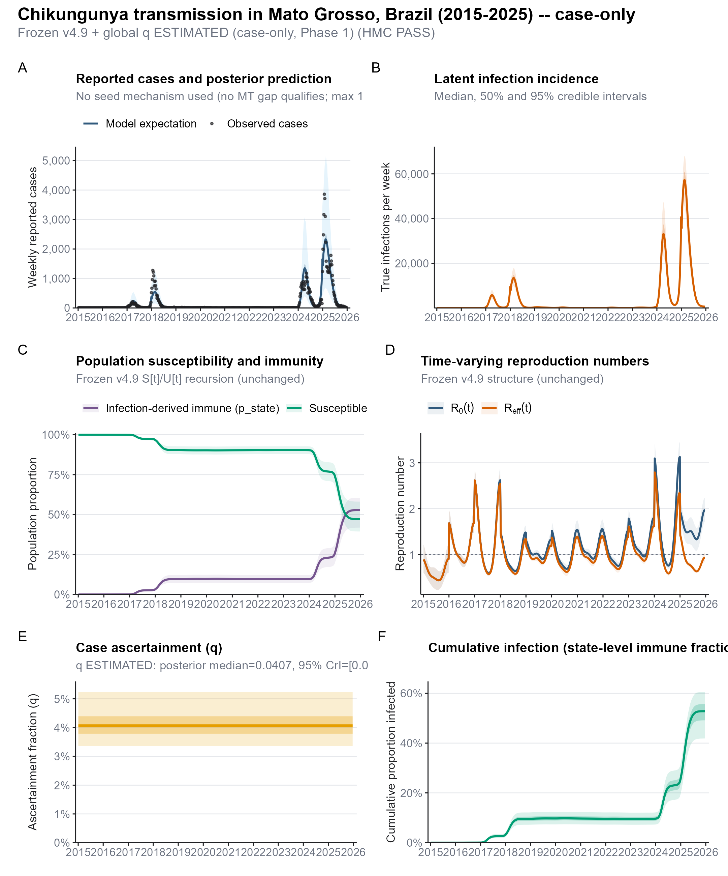

Slide 4
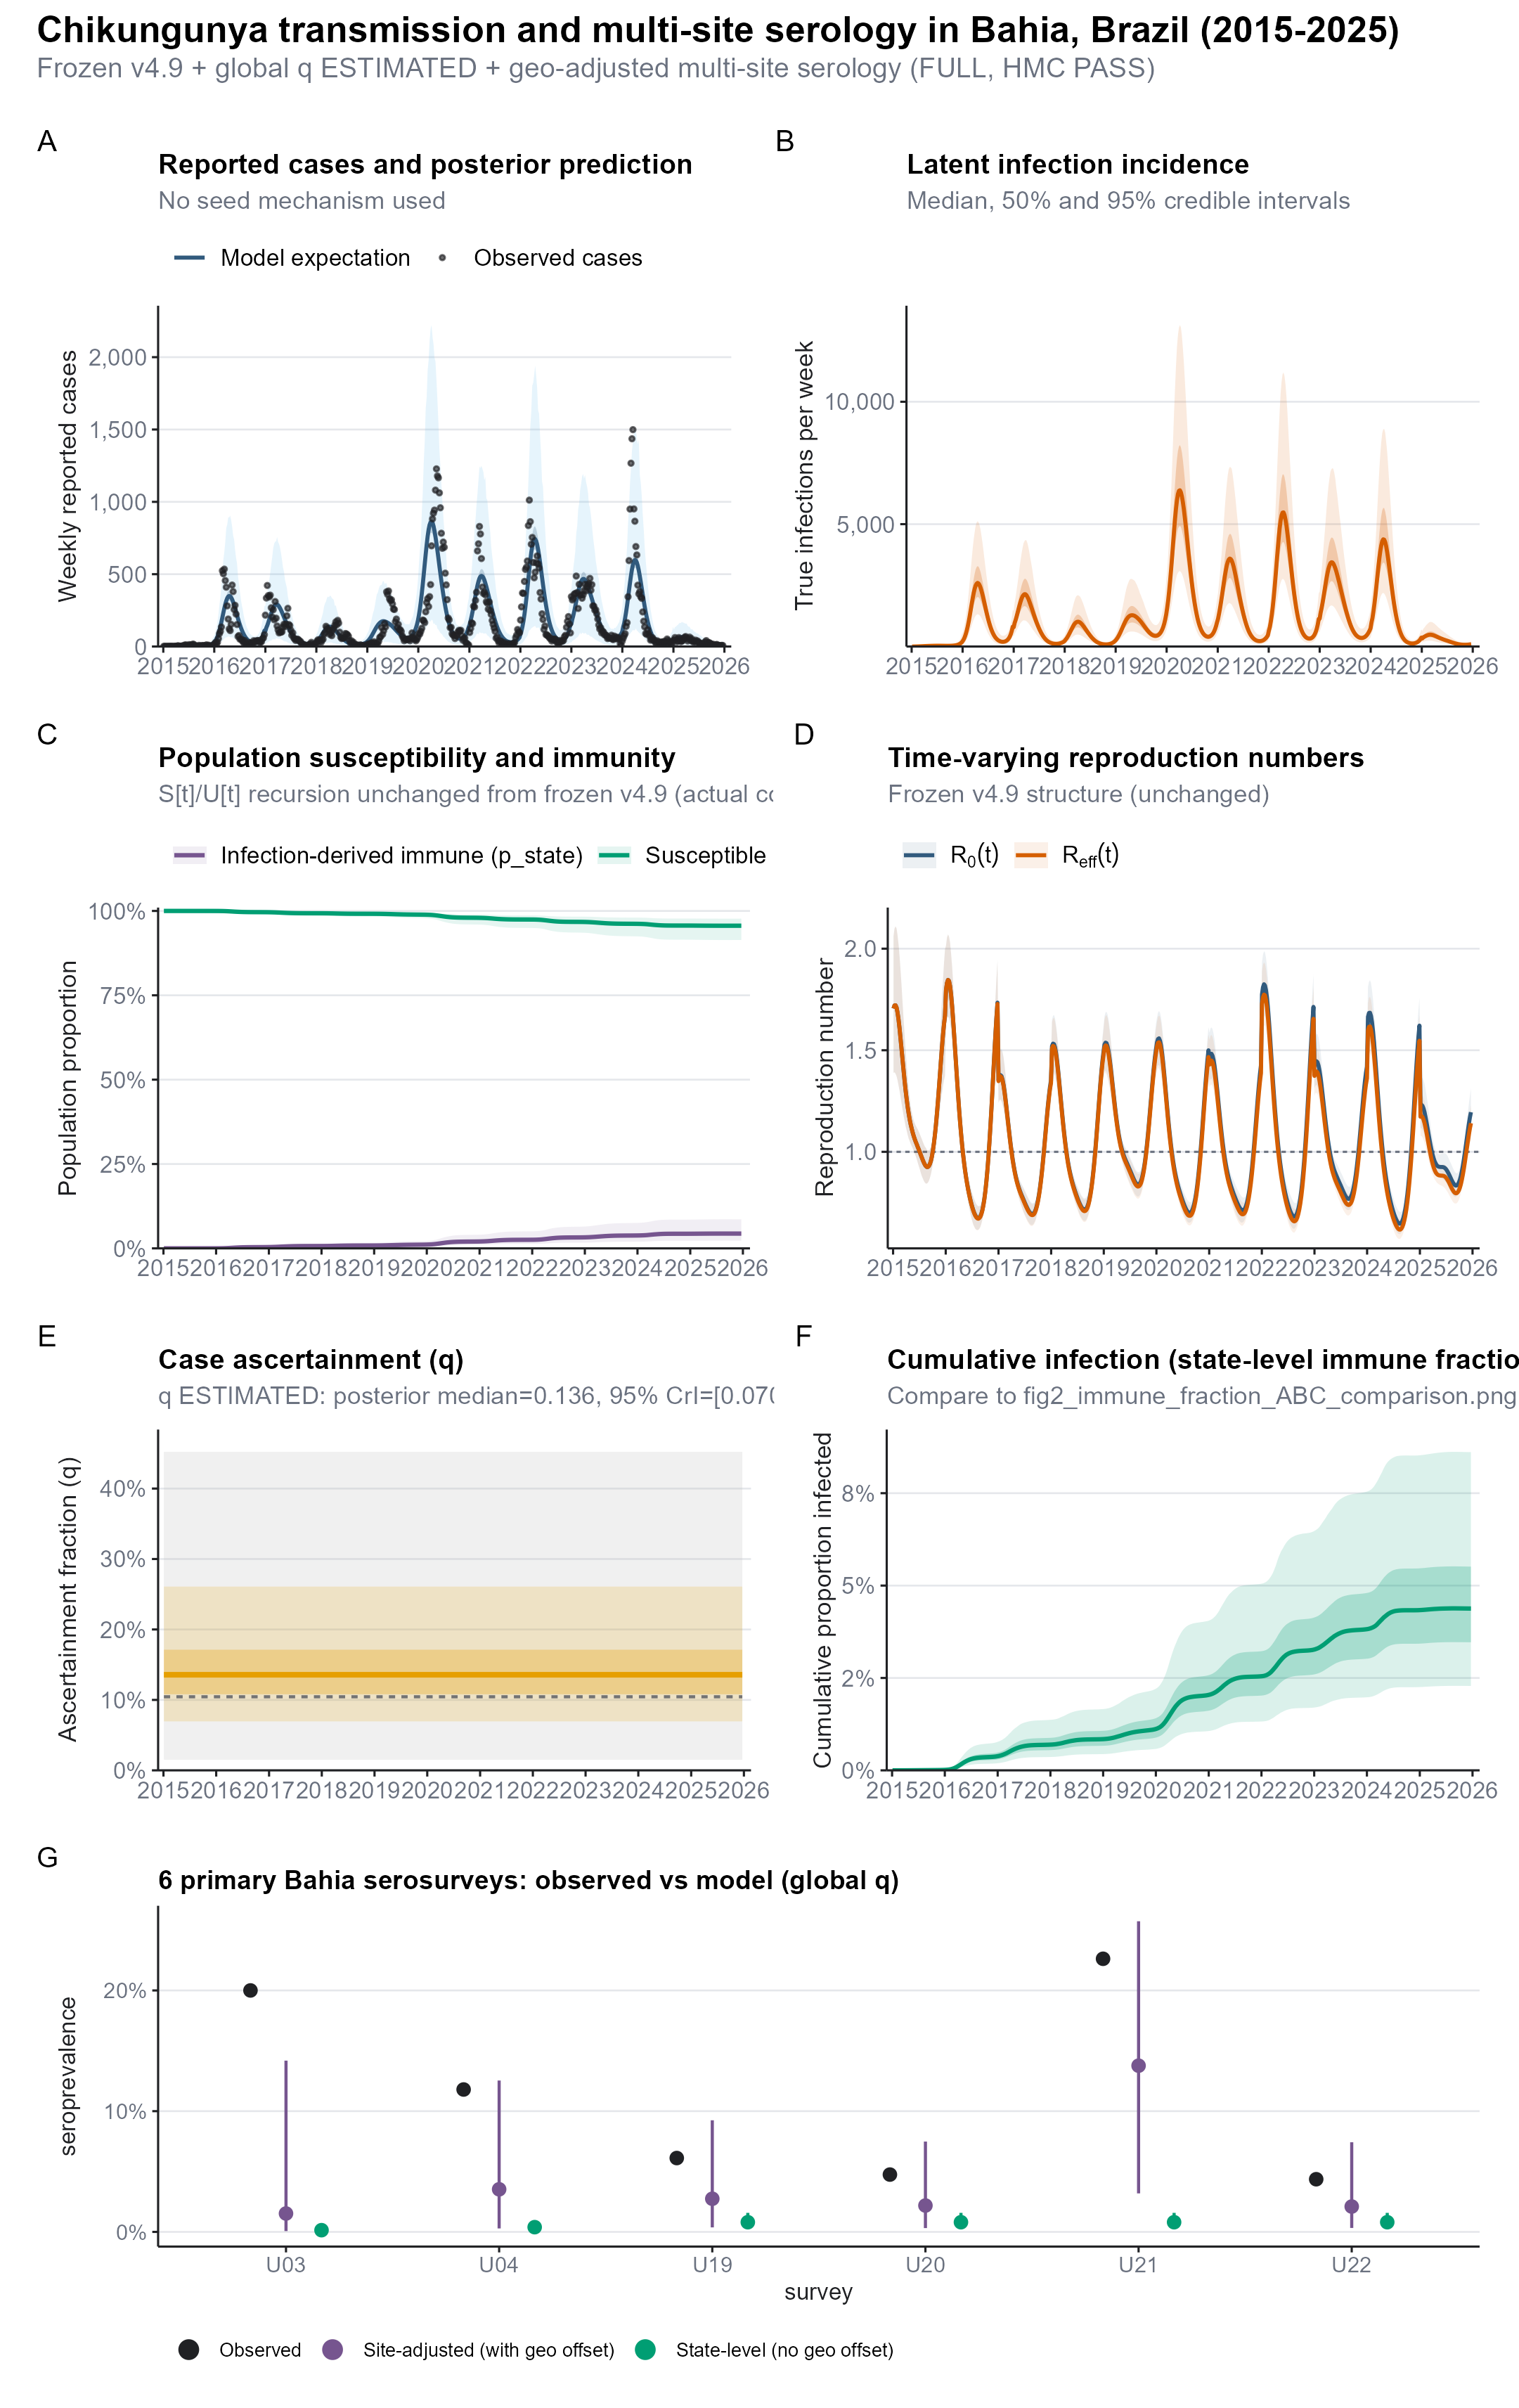

Slide 5
