Slide 1
Comorbidity-stratified burden model

Slide 2
How chikungunya hospitalisation and mortality risk differ by age and underlying conditions
  0, 1, and 2+ underlying conditions, with individual conditions as a secondary analysis
  Age- and comorbidity-specific disease burden and vaccine benefit–risk

Slide 3
$$H_{c,a,g}=I_{c,a} ∗P\left(symptomatic\right|infection) ∗ π_{c,a,g} ∗h_{c,a,g}$$
Determined by FOI (catalytic model)
Vary across age, country
Model predicted estimates
Constant across age, country
Prevalence of background comorbidity groups
- Determined by IHME data
Country-, age-, and comorbidity-specific hospitalisation probability among symptomatic CHIKV cases
If unavailable: calibrate country-specific overall age-specific hospitalisation rates using Brazil-derived comorbidity RRs.

Slide 4
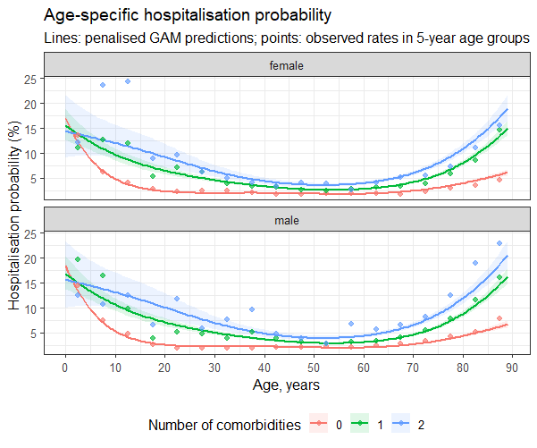
Estimating hospitalisation risk by age and comorbidity
Data: confirmed chikungunya surveillance records from Brazil, 2017–2024.
Outcome: hospitalisation among confirmed cases.
Predictors: age, sex, and comorbidity-count group.
Model: flexible age-specific risk with no-comorbidity as the reference group.

Slide 5
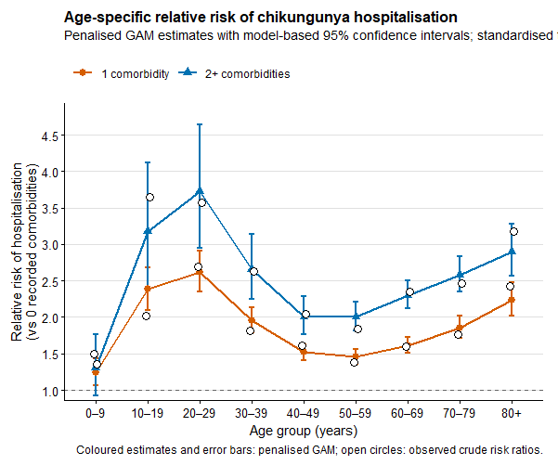
Standardised hospitalisation relative risks
Predicted hospitalisation risk is averaged across female and male patients within each age–comorbidity stratum.
Relative risks compare each comorbidity group to the no-comorbidity reference
Low baseline hospitalization probability among those who aged 20s

Slide 6
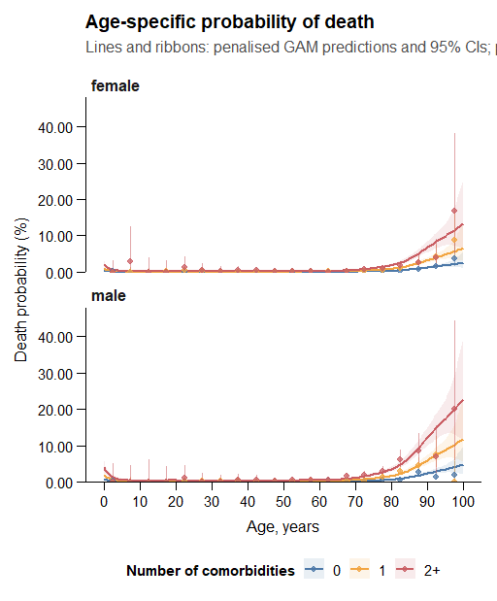
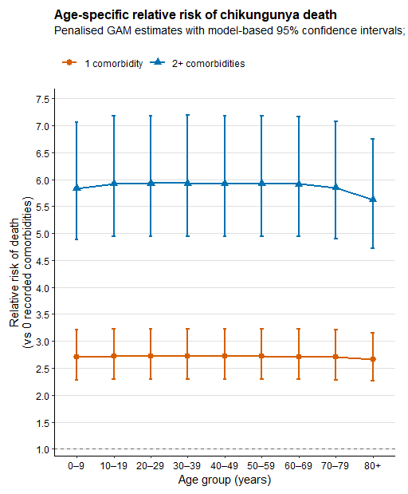
Fatality risk and death relative risks

Slide 7
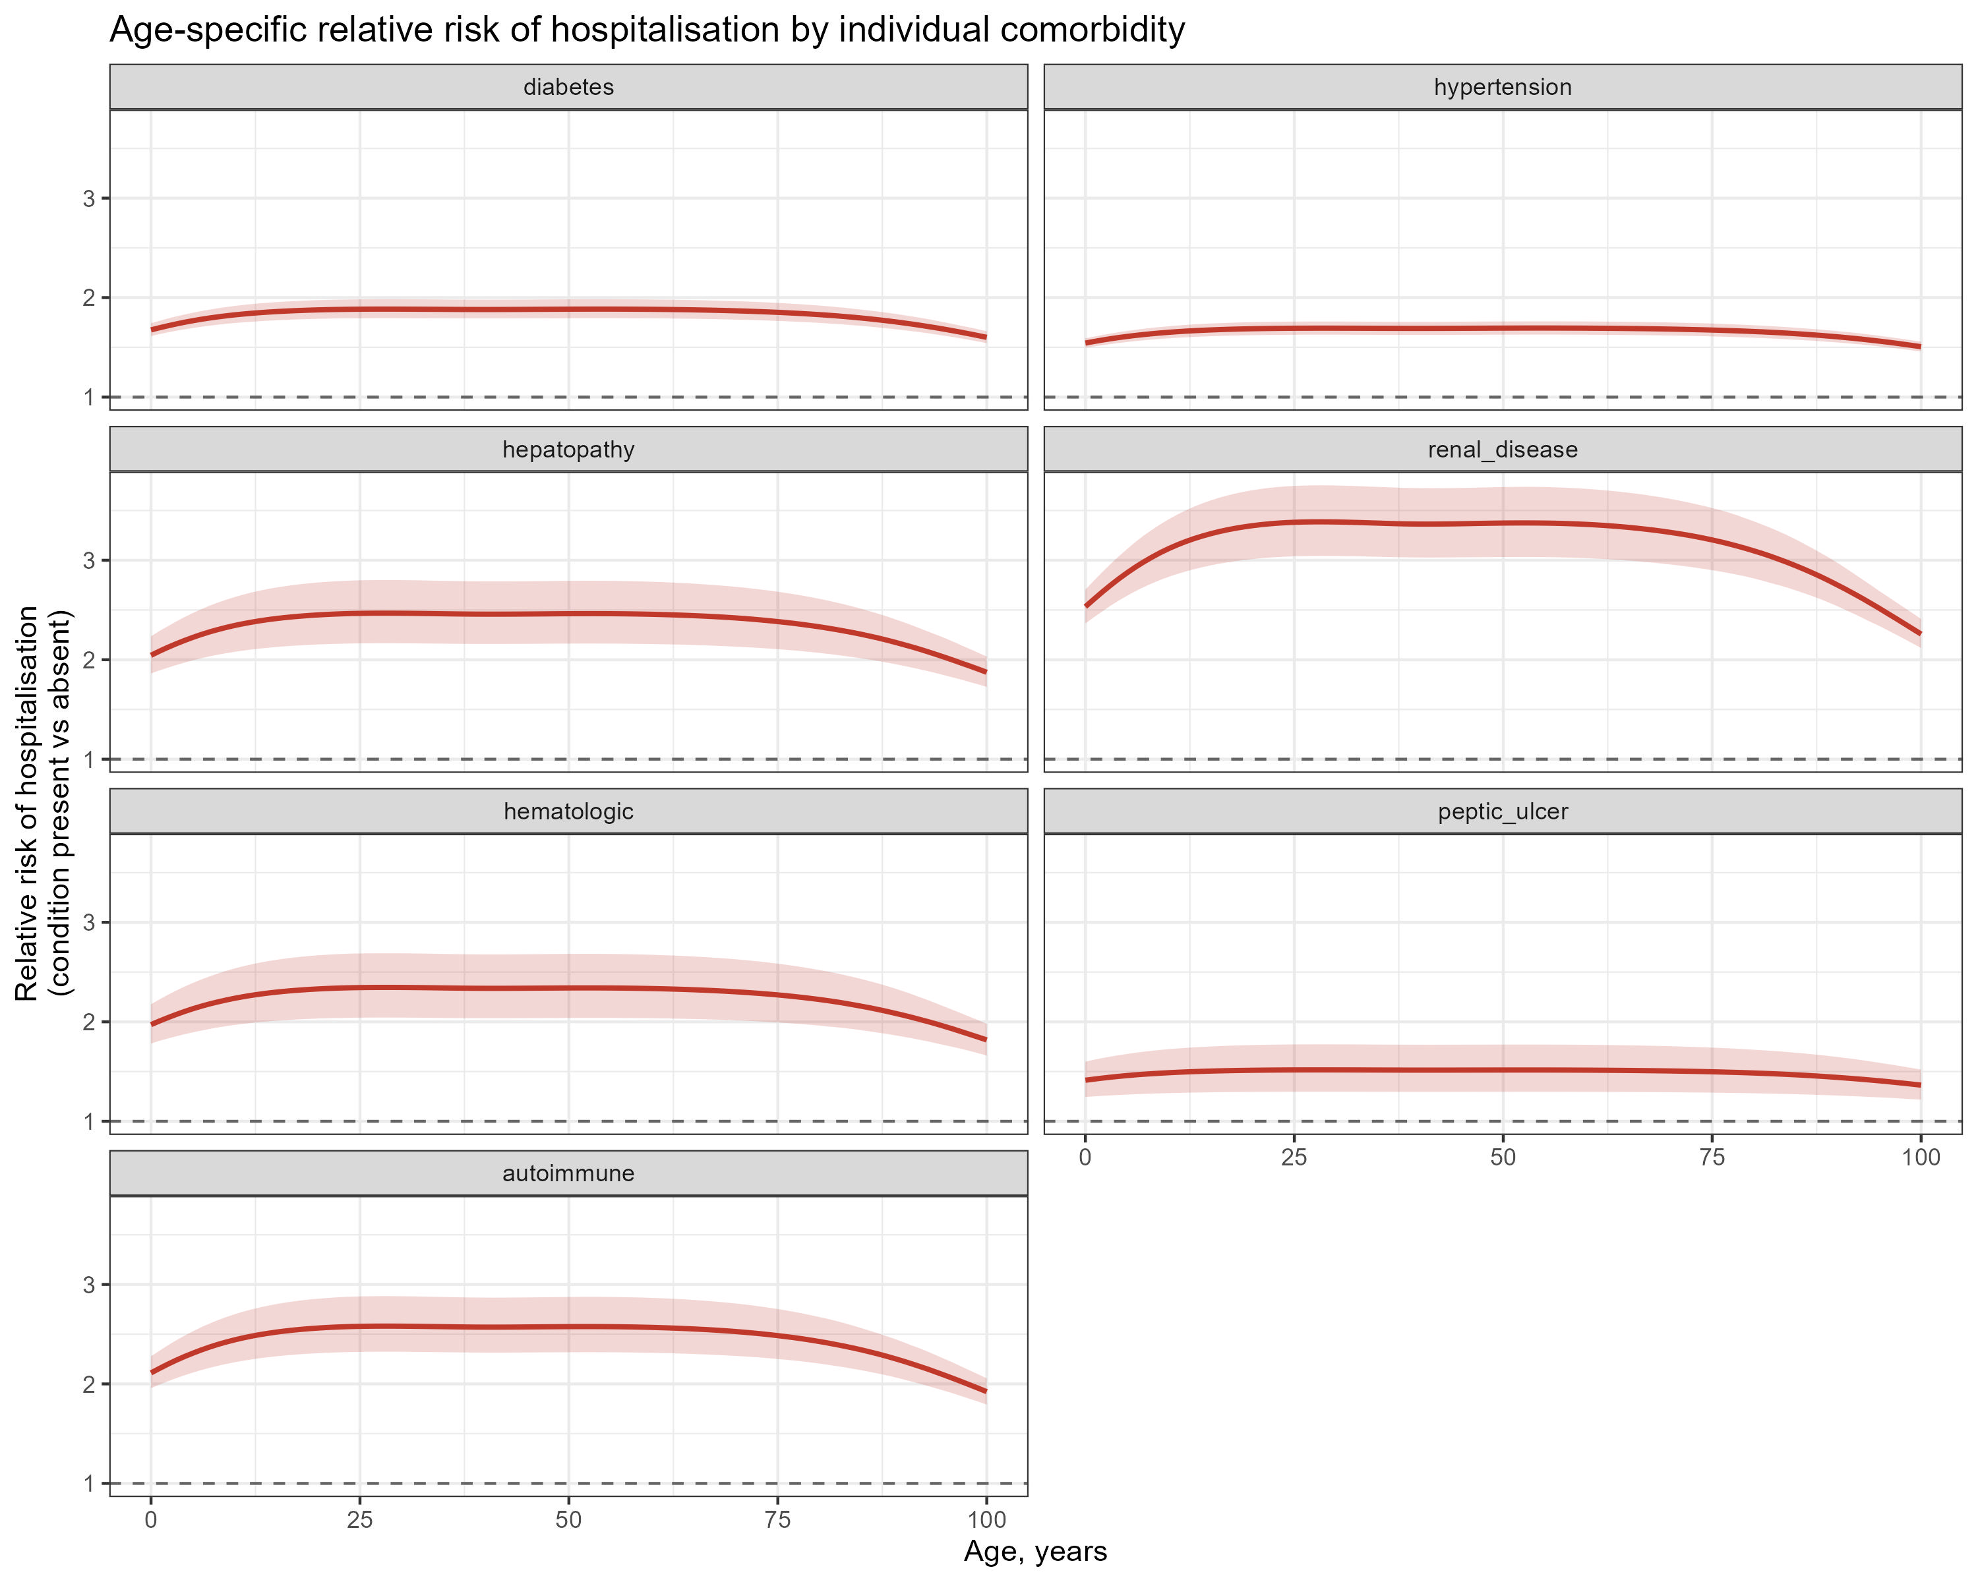
Relative risk of hospitalisation for each condition

Slide 8
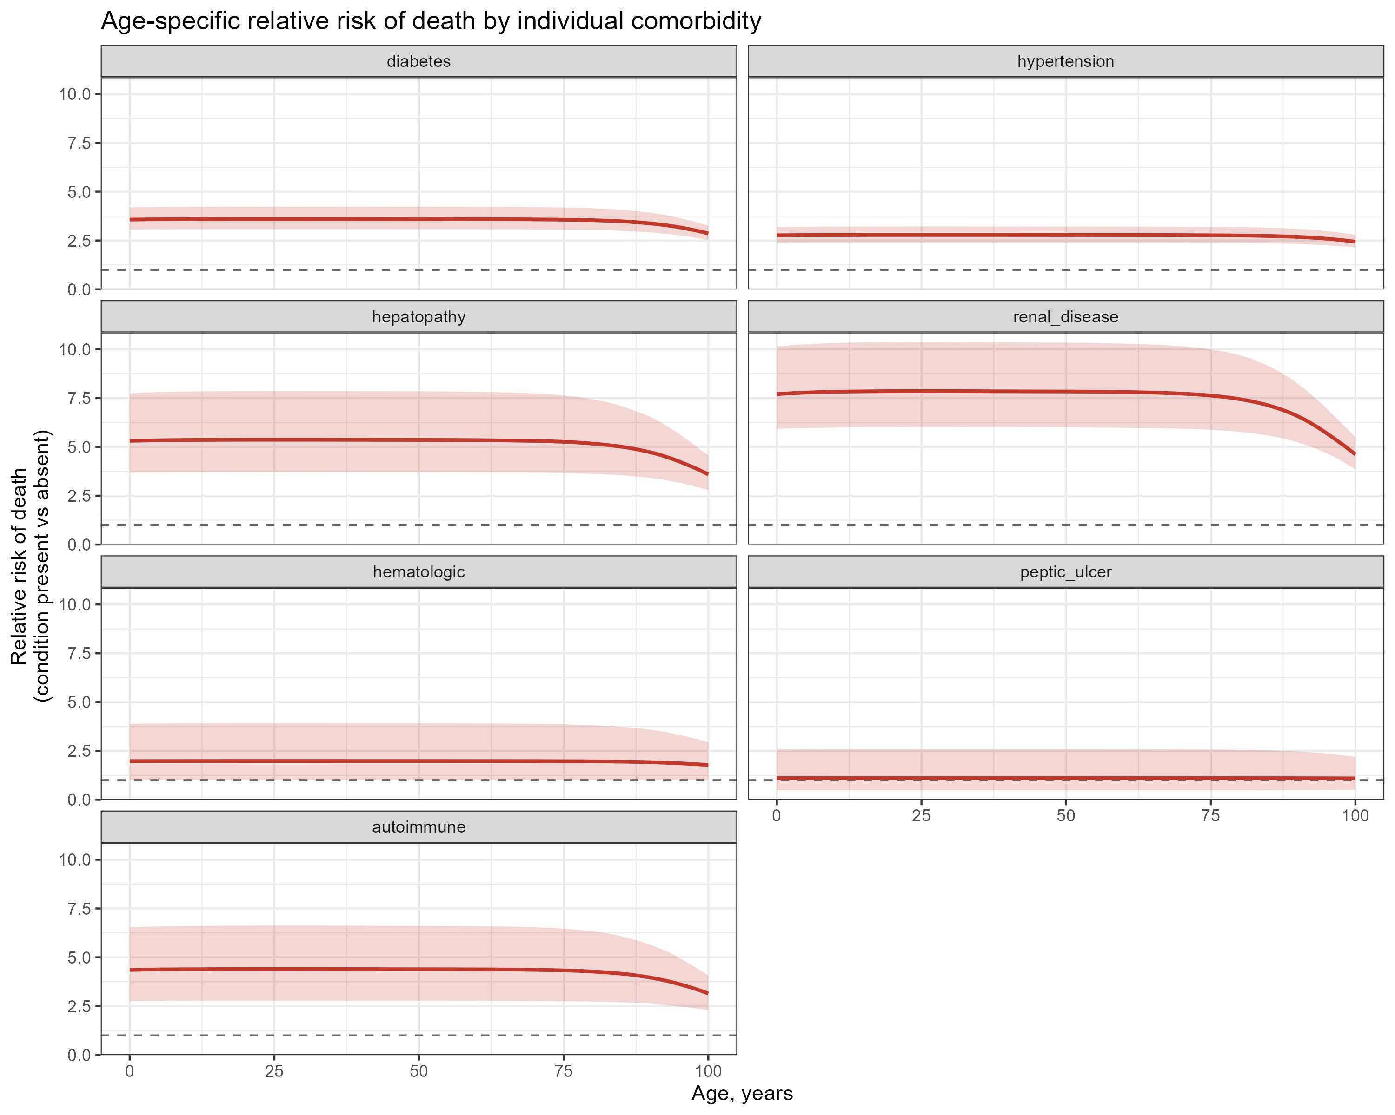
Relative risk of death for each condition

Slide 9
Age interaction:
Relative risks of hospitalisation and deaths by age, comorbidity group, and individual condition are based only on Brazil data – extrapolation to other countries
  How to improve transportability?
Age interaction:
  Is there any age-modifying effect on relative risk given that number of comorbidities are the same?
Severe or hospitalised cases are more likely to be captured in the surveillance system – selection bias
$$H_{c,a,g}=I_{c,a} ∗P\left(symptomatic\right|infection) ∗ π_{c,a,g} ∗h_{c,a,g}$$
Comorbidity and age specific chikungunya disease burden and benefit-risk of vaccine(s) across Latin American countries
  1. Country specific hospitalisation data (preferably age-specific)
  2. Country specific chikungunya case fatality data (preferably age-specific)
  3. (at least above two) will make strong evidence on CHIKVD burden across age/comorbid groups
  4. (if possible), country specific CHIKV case data along with their comorbidity status (as in Brazil)

Slide 10
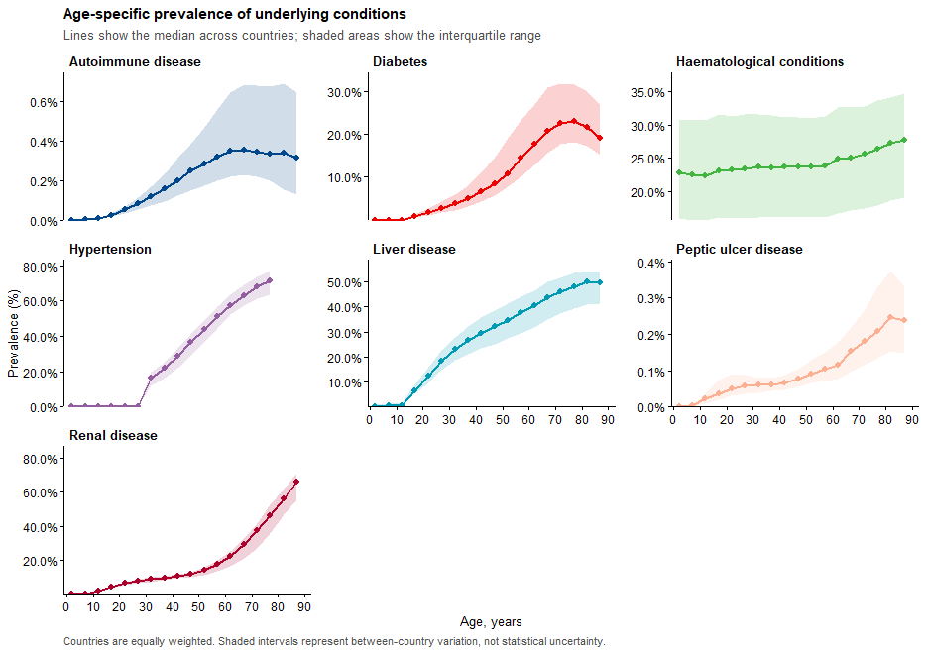
Global prevalence of underlying conditions by age
GBD prevalence of underlying conditions
Seven underlying conditions were aligned with variables observed in SINAN Brazil surveillance.
Prevalence is available by country and 5-year age group.

Slide 11
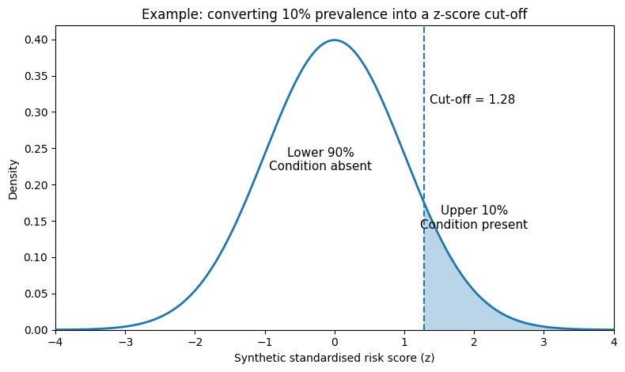
From disease prevalence to individual disease status
For each country × age group, create 10,000 synthetic individuals.
Each synthetic individual receives one standardised score for each of the seven conditions (randomly generated scores following normal distribution of N(0,1))
Thresholds for binary classification is defined based on observed prevalence of condition
Jointly combining 7x7 correlation matrix (corr score between 7 conditions) to updated scores
Prevalence determines the condition-specific cut-off
A 10% prevalence corresponds to a cut-off of 1.28 because 90% of the bell curve lies below 1.28.
Condition | Prevalence | Cut-off | Positive group
Diabetes | 10% | 1.28 | Highest 10%
Hypertension | 30% | 0.52 | Highest 30%
Renal disease | 5% | 1.64 | Highest 5%

Slide 12
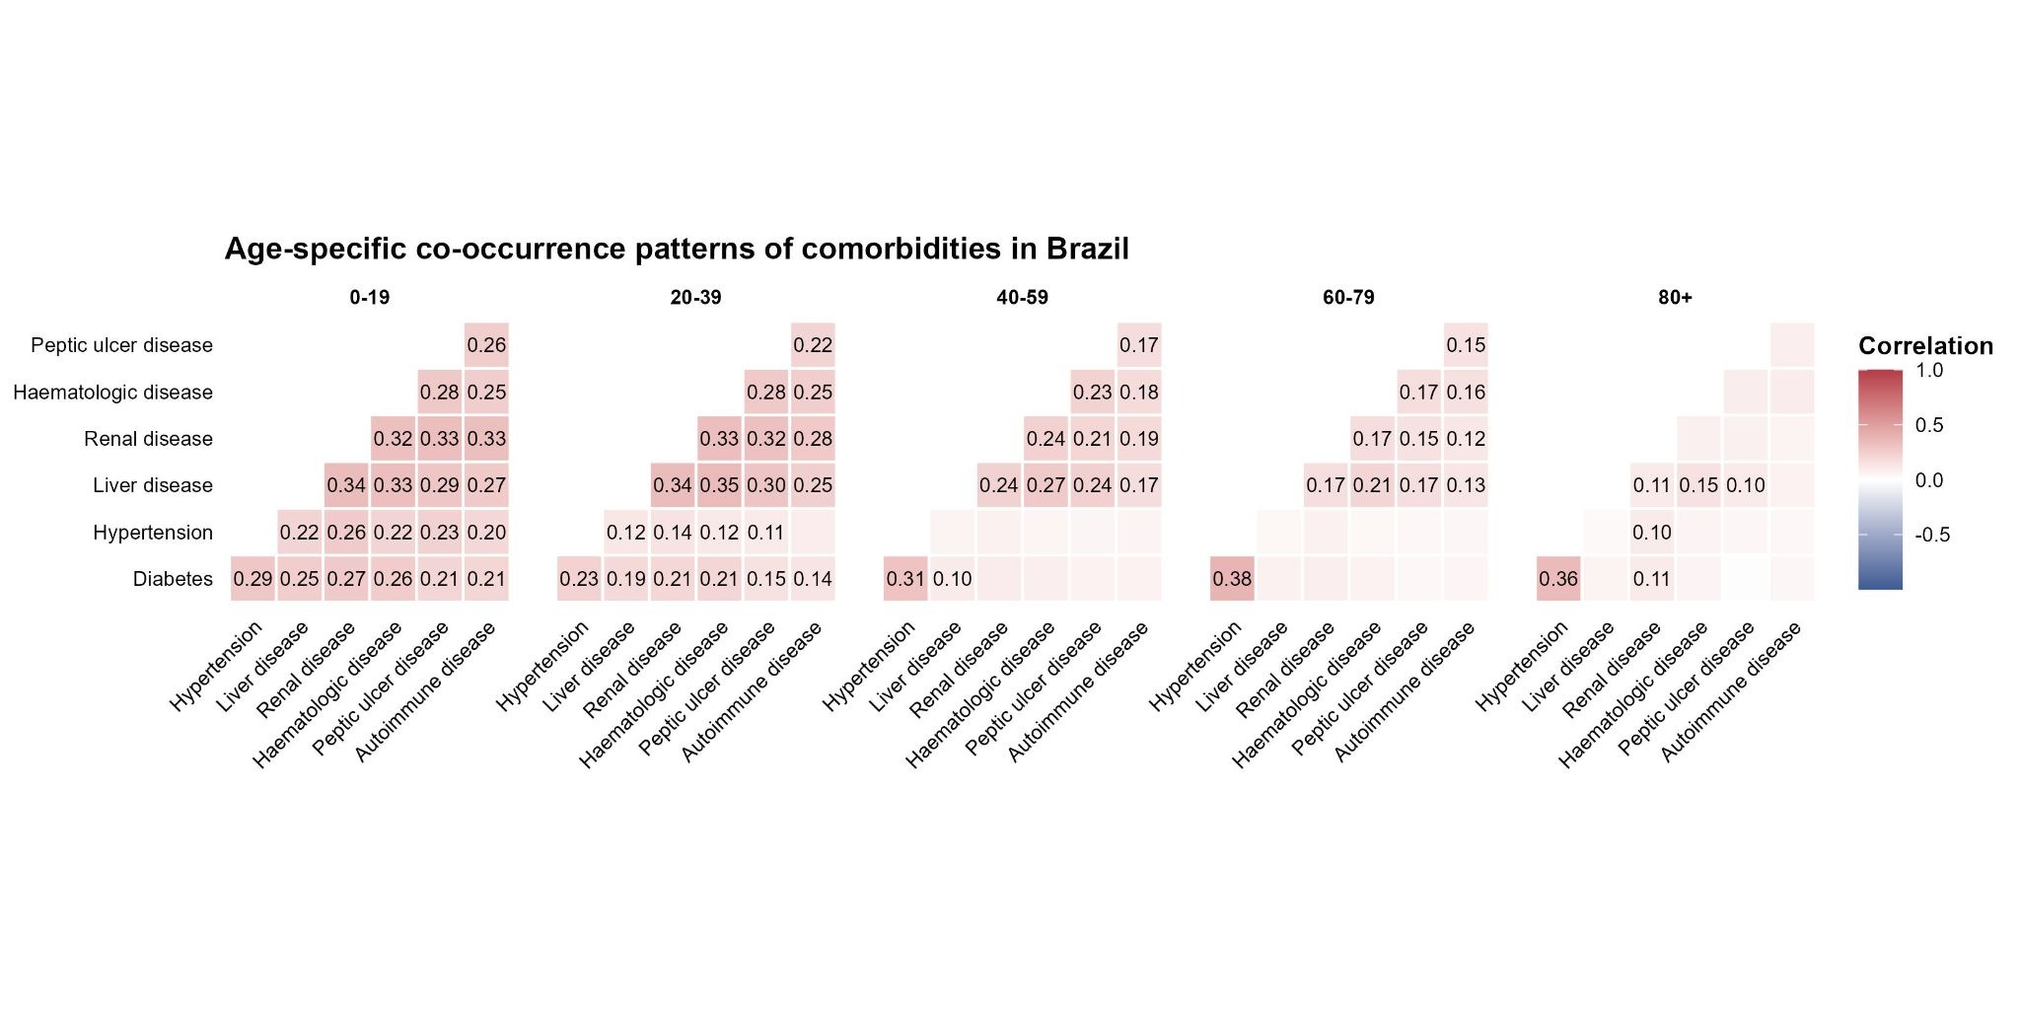
Disease correlations determine who receives overlapping conditions
The seven condition scores are first generated as standardised random scores.
The age-specific correlation matrix then links the scores so related conditions tend to be high in the same synthetic individuals.
Cut-offs are not changed by the correlation step
The same disease-specific thresholds are applied after the scores are linked.

Slide 13
Counting conditions within the synthetic population
After applying condition-specific cut-offs, each synthetic individual has seven binary disease indicators.
Individual | Diabetes | Hypertension | Renal | Liver | Other | Total
Person 1 | 0 | 0 | 0 | 0 | 0 | 0
Person 2 | 0 | 1 | 0 | 0 | 0 | 1
Person 3 | 1 | 1 | 0 | 0 | 0 | 2
Person 4 | 0 | 1 | 1 | 1 | 0 | 3
Person 5 | 1 | 0 | 0 | 0 | 0 | 1
The final output for each country × age group is mutually exclusive: P(0) + P(1) + P(2+) = 1.

Slide 14
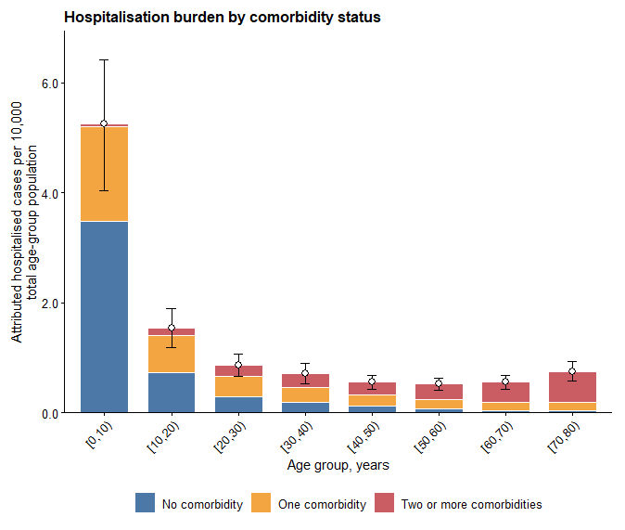
Hospitalisation burden by age and comorbidity status
Young age groups can contribute substantial hospitalisation burden even with lower comorbidity prevalence because infection incidence is high.

Slide 15
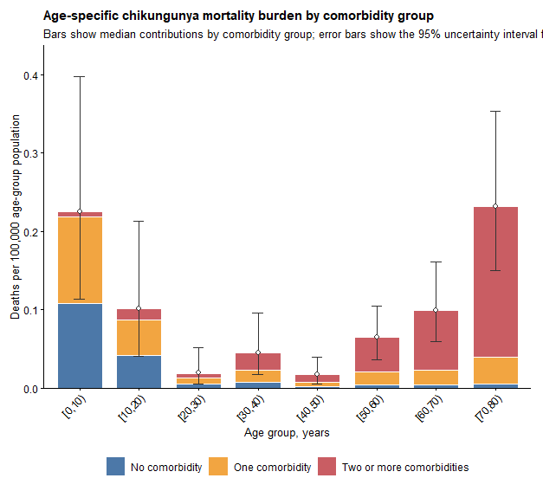
Mortality burden by age and comorbidity status
Young and older age groups can contribute substantial mortality burden.

Slide 16
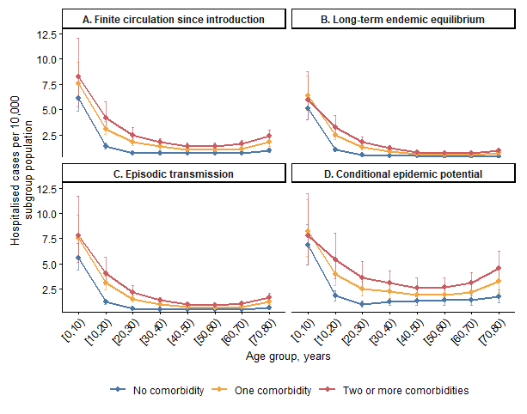
Hospitalisation burden differs by transmission archetype and comorbidity group
Long-term endemic equilibrium tends to have the lowest and most stable hospitalisation burden.
Conditional epidemic potential has the highest burden because susceptibility is high and risk is conditional on transmission
Comorbidity gradients persist across all archetypes.

Slide 17
Transmission archetype and
comorbidity-stratified burden model

Slide 18
Analysis step
1
Transmission history
Classify 103 countries into A–D archetypes based on sustained circulation, endemic equilibrium, episodic recurrence, or conditional potential.
2
Archetype-specific infection model
Replace lifelong continuous exposure with effective historical exposure duration and infection probability.
3
Comorbidity structure
Convert 7 underlying-condition prevalences into mutually exclusive 0, 1, and 2+ comorbidity groups.
4
Clinical risk and burden
Apply comorbidity-specific hospitalisation and death risks, then compute hospitalisations, deaths and DALYs.

Slide 19
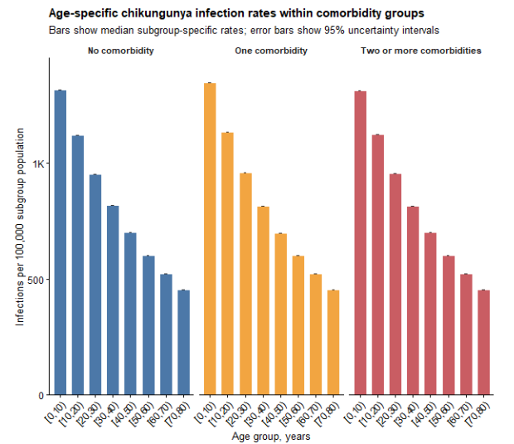
Motivation: move beyond a single long-term catalytic model?
A long-term average FOI can make all settings look as if exposure accumulated continuously throughout life.
This is problematic where chikungunya was introduced recently or occurs as episodic outbreaks.
A single catalytic model can therefore understate incidence and older-age burden in finite-history settings.

Slide 20
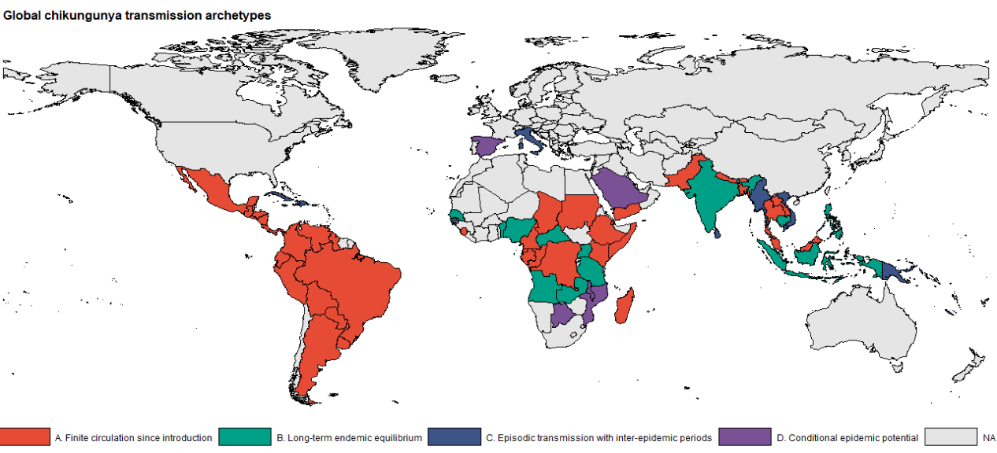
Countries are classified into 4 archetypes
103 countries classified
A
Finite circulation since introduction
39
B
Long-term endemic equilibrium
12
C
Episodic transmission
42
D
Conditional epidemic potential
10

Slide 21
Common infection model: separate past exposure from current risk
Historical immunity
Current burden year
E is an effective historical exposure duration.
It determines how much prior outbreaks have depleted susceptible population
E differs by archetype
q is the infection probability during the burden period.
For continuous annual risk, q = 1 − exp(−λ).
For episodic settings, q is annualised or conditional on an outbreak.

Slide 22
A. Finite circulation since introduction
A
Transmission history is capped by time since introduction.
T_c is years since sustained transmission began in country c.
Individuals younger than T_c accumulate exposure according to age.
Individuals older than T_c are capped at T_c years of exposure
  Different from assigning a lifetime of exposure to older adults as in endemic setting

Slide 23
B. Long-term endemic equilibrium
B
This retains the simple catalytic assumption of continuous exposure from birth.
Historical exposure grows linearly with age.
Older cohorts have progressively lower susceptibility.
Appropriate for countries where transmission is long established and repeatedly observed over time.

Slide 24
C. Episodic transmission with inter-epidemic periods
C
Historical exposure accumulates through discrete epidemic opportunities, not continuously every year.
τ_c is the inter-epidemic interval; in PSA, τ_c is sampled across 7–20 years.
n counts how many outbreak opportunities an age cohort has experienced.
h_out converts a long-term annual FOI into one outbreak-level cumulative hazard.
The annualised burden averages a larger outbreak-year risk over epidemic and non-epidemic years.

Slide 25
D. Conditional epidemic potential
D
D estimates burden conditional on epidemic transmission occurring; it is not an unconditional annual burden.
Base case assumes no prior sustained local transmission
  historical susceptibility is 1 for all ages.
If prior local transmission is later documented, E(D) can be replaced by known historical exposure.
Because P(outbreak) is not estimated here, D must be labelled as conditional epidemic potential.

Slide 26
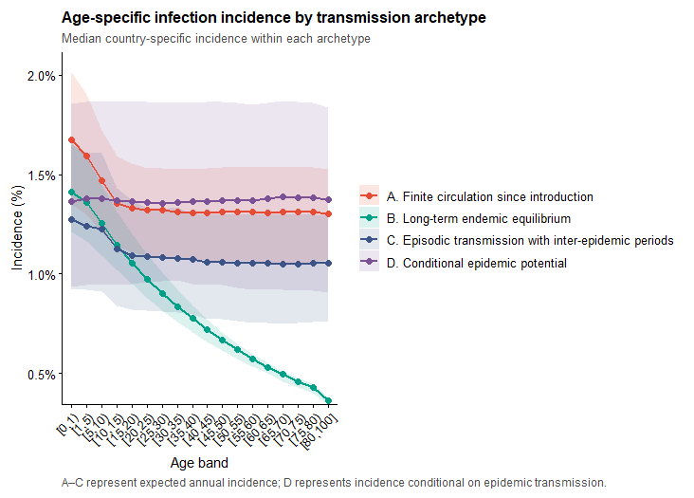
INFECTION RESULTS
Archetype-specific infection incidence
B declines most strongly with age because exposure accumulates continuously from birth.
A has flatter older-age incidence because exposure is capped by introduction history.
C depends on inter-epidemic timing and event hazard concentration.
D should be interpreted as potential burden if transmission occurs, not expected annual incidence.

Slide 27
Evidence of increased chikungunya disease risk by underlying conditions
18 Sep 2026

Slide 28
Evidence matrix: underlying conditions for the updated chikungunya risk model
Condition | Hosp. evidence | Severe / fatal evidence | Analysis role | Evidence refs | Remark
Diabetes | Supported | Supported | CORE | A, B, D, E, F, G | Consistent hospitalisation + mortality signal was associated with increased length of hospital stay
Hypertension | Supported | Limited | CORE | A, B, C, D, E | Strong hospitalisation signal Identified as a risk factor associated with the chronic phase of the disease
Chronic kidney disease | Supported | Supported | CORE | A, B, D, E, G | Largest risk signal; data mainly from Brazil
Liver disease / hepatopathy | Insufficient | Limited | SECONDARY | E | Outcome-specific death signal in national Brazil study Hospitalisation evidence (crude OR)
Autoimmune disease | Limited | Insufficient | SECONDARY | E | were associated with hospital admission
Hematologic disease | Insufficient | Insufficient | NOT PRIORITISED | G | Sparse and heterogeneous evidence
Peptic / acid- peptic disease | Insufficient | Insufficient | NOT PRIORITISED | G | Very limited prognostic evidence

Slide 29
Ref | Evidence source | Conditions | Outcome | How it maps to the matrix
A | Pinto et al. 2019 Ceará, 2016–17 https://doi.org/10.1590/0037-8682-0167-2019 | DM, HTN, CKD | Hospitalisation | Adjusted positive associations: Odds ratio CKD 4.56 (CI: 3.36-6.17) HTN 1.90 (1.69-2.14) DM 1.70 (1.44-1.99)
B | Ceará / Fortaleza mortality 2016–17 https://doi.org/10.1093/trstmh/try127 https://doi.org/10.1093/cid/ciaa1038 https://doi.org/10.1371/journal.pone.0260939 | DM, HTN, CKD | Mortality | Positive mortality signals De Lima et al HTN aOR 4.10 (0.62–26.9) DM aOR 7.70 (1.2–50.0) Silva Junior et al. 2019 DM OR 3.29 (2.35–4.60) HTN OR 3.74 (2.80–4.99) CKD OR 3.14 (1.82–5.42) Oliveira et al. 2022 DM crude OR 1.80 (0.9–3.1) HTN crude OR 2.20 (1.2–4.1) CKD aOR 12.77 (2.75–59.4)
C | Economopoulou et al. 2009 Réunion, 2005–06 https://doi.org/10.1017/S0950268808001167 | HTN | Severe disease | Independent non-Brazil setting Adjusted severe-disease RR 1.70 (1.2-2.4) for hypertension Diabetes mellitus, despite being commonly reported as an underlying condition, was not found to increase the risk of severe disease or death
D | Micheleto et al. 2025 https://doi.org/10.1111/tmi.14088 | DM, HTN, CKD | Mortality meta-analysis | Pooled mortality associations: DM OR 2.86 (1.75- 4.68) HTN OR 3.10 (2.02- 4.76) CKD OR 5.81 (1.30- 25.95)
E | Cerqueira-Silva et al. 2025 National Brazil, 2015–24 https://doi.org/10.1016/j.lana.2025.101177 | DM, HTN, CKD; Autoimmune; Liver | Hospitalisation; CHIK-attributed death | Hospitalisation signal for DM/HTN/CKD/autoimmune
F | Badawi et al. 2018 https://doi.org/10.1016/j.ijid.2017.12.018 | DM | Composite severe outcome | Supportive broader review evidence; DM association modest and not mutually adjusted.
G | Danielle Torres dos Santos Lopes 2023 https://doi.org/10.1371/journal.pone.0296131 | DM, CKD, autoimmune, hypertension, Hematological disease | Hospitalisation | Crude OR DM 1.331 (0.586–3.024) CKD 5.014 (0.644–39.053) HTN 0.808 (0.394–1.656) Autoimmune, Hematological diseases 0 Peptic disease 2.180 (0.291–16.344)

Slide 30
Research question
Condition-specific RR:
  “What is the risk contrast associated with one condition, averaging over the other conditions?”
Profile-specific RR:
  “What is the risk for this exact combination of conditions compared with having none of them?”

Slide 31
Recorded condition | Among cases with 1 recorded comorbidity | Among cases with 2 recorded comorbidities | Among cases with ≥3 recorded comorbidities
Autoimmune disease | 2,289 / 73,507 (3.1%) | 789 / 22,678 (3.5%) | 1,135 / 2,589 (43.8%)
Diabetes | 10,173 / 73,507 (13.8%) | 19,991 / 22,678 (88.2%) | 2,195 / 2,589 (84.8%)
Haematologic disease | 1,268 / 73,507 (1.7%) | 700 / 22,678 (3.1%) | 1,160 / 2,589 (44.8%)
Hepatopathy / chronic liver disease | 1,340 / 73,507 (1.8%) | 744 / 22,678 (3.3%) | 1,325 / 2,589 (51.2%)
Hypertension | 55,558 / 73,507 (75.6%) | 21,509 / 22,678 (94.8%) | 2,342 / 2,589 (90.5%)
Peptic ulcer disease | 1,846 / 73,507 (2.5%) | 809 / 22,678 (3.6%) | 1,115 / 2,589 (43.1%)
Renal disease | 1,033 / 73,507 (1.4%) | 814 / 22,678 (3.6%) | 1,394 / 2,589 (53.8%)
Underlying condition fields (diabetes, hypertension, chronic kidney disease, etc.) were introduced into the Brazilian SINAN chikungunya notification form in 2017.

Slide 32
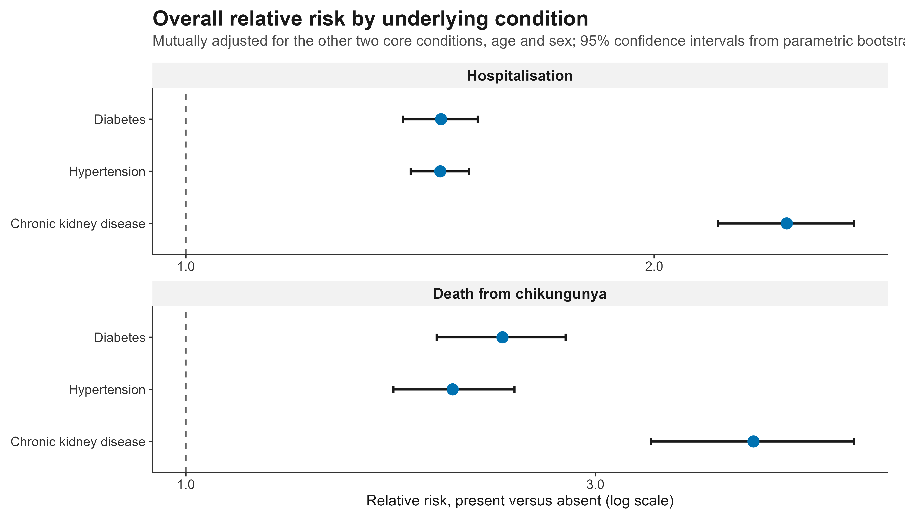
Condition-specific standardised RR: the ratio of the population-average predicted risk when the focal condition is set to present vs. absent, while retaining the observed distribution of the other core conditions and covariates (state, year, age, sex)

Slide 33
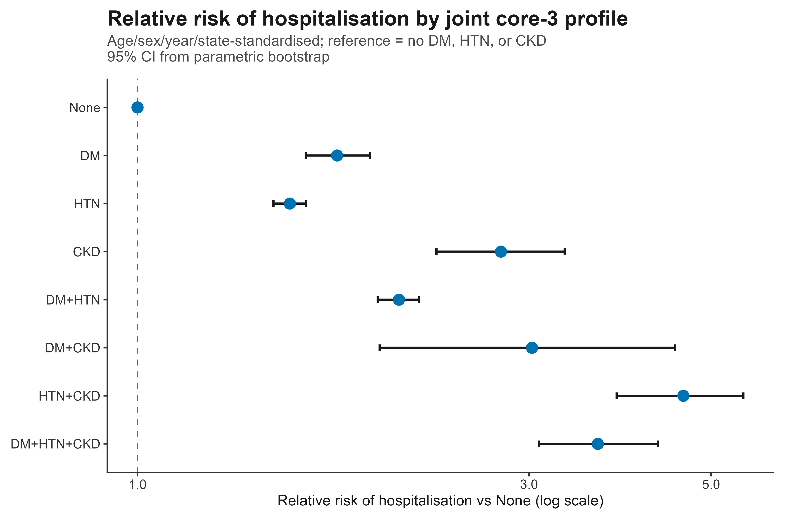
Profile specific standardised RR:
  The ratio of the population-average predicted risk for a specified mutually exclusive combination of diabetes, hypertension, and CKD to that for individuals with non of the three core conditions, standardised over the remaining covariates (age, state, sex, year)

Slide 34
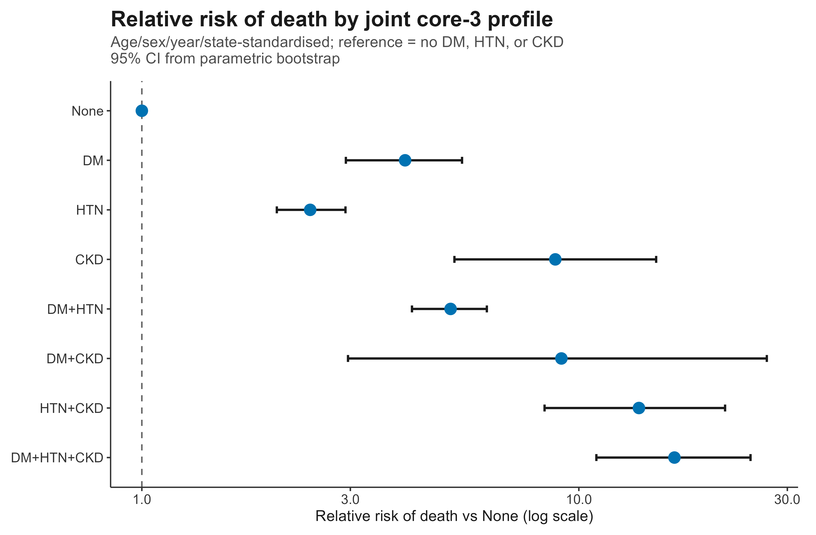

Slide 35
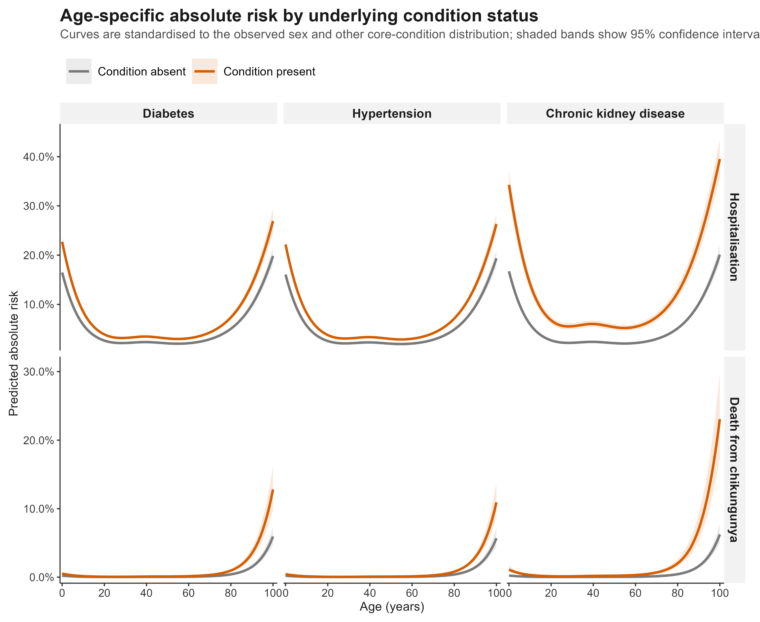

Slide 36
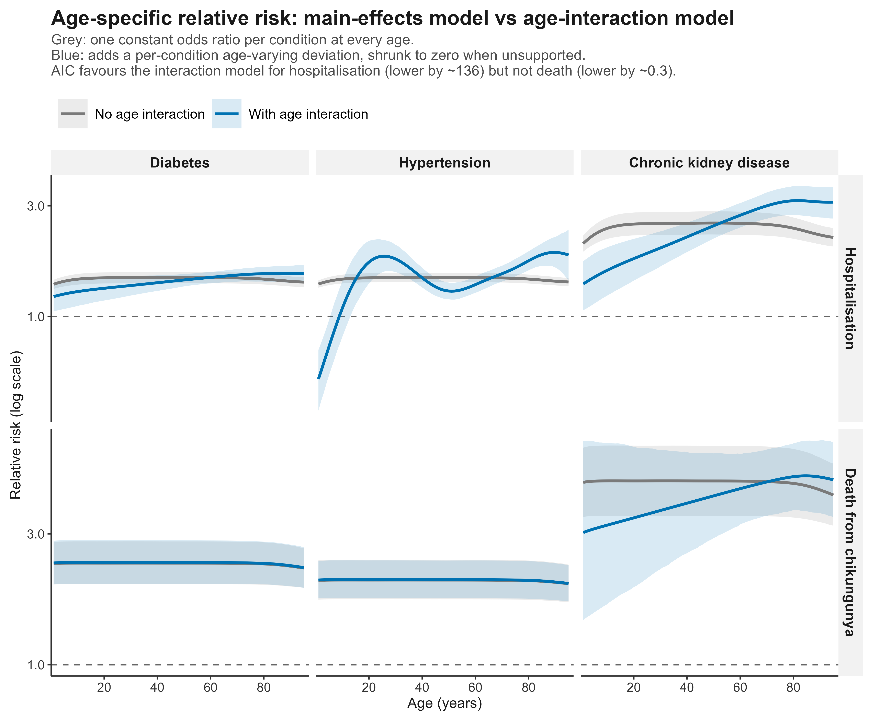

Slide 37
Discussion points
  Next step analysis
  Background underlying condition prevalence data across LAC countries

Slide 38
Prevalence of underlying conditions relevant to increased risk of severe chikungunya disease
9 Oct 2026

Slide 39
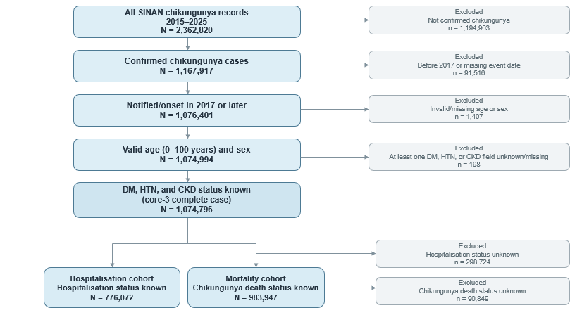
Flowchart of cohort selection from Brazilian SINAN chikungunya surveillance data, 2015–2025
~ 0.13%
~ 0.02%
~ 27.8%
~ 8.45%

Slide 40
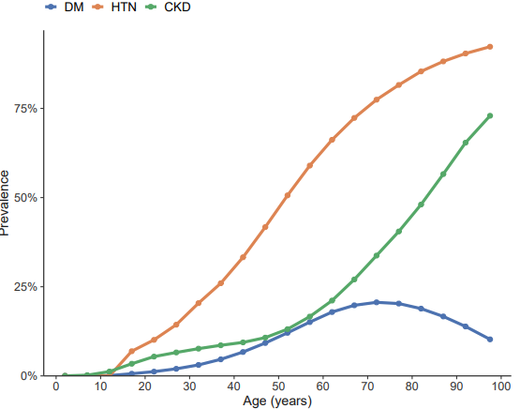
Age-specific marginal prevalence of core three conditions using GBD data (Brazil only): without knowing clustering structure

Slide 41
Identifying people with 1 or more conditions: (1) Independent (minimum clustering)
1) Venn diagram of the independent case
HTN
(30%)
HTN only | p_HTN × (1 − p_DM) × (1 − p_CKD)
DM only | p_DM × (1 − p_HTN) × (1 − p_CKD)
CKD only | p_CKD × (1 − p_HTN) × (1 − p_DM)
HTN + DM only | p_HTN × p_DM × (1 − p_CKD)
HTN + CKD only | p_HTN × p_CKD × (1 − p_DM)
DM + CKD only | p_DM × p_CKD × (1 − p_HTN)
All three | p_HTN × p_DM × p_CKD
None | (1 − p_HTN) × (1 − p_DM) × (1 − p_CKD)
Each circle shows
the marginal
prevalence:
None of the
three conditions
HTN: 30%
DM: 12%
HTN only
CKD: 6%
HTN + DM
only
HTN + CKD
only
All three
DM only
CKD only
DM + CKD
only
DM
(12%)
CKD
(6%)

Slide 42
Identifying people with 1 or more conditions: (2) maximum clustering
Each circle shows
the marginal
prevalence:
None
100% − pmax
100% − 30% = 70%
HTN: 30%
DM: 12%
None of the
three conditions
CKD: 6%
HTN only
pmax − pmid
30% − 12% = 18%
Maximum clustering
HTN
HTN + DM only
pmid − pmin
12% − 5% = 7%
DM
HTN + DM + CKD
pmin
5%
CKD
Other profiles
structurally impossible
0%

Slide 43
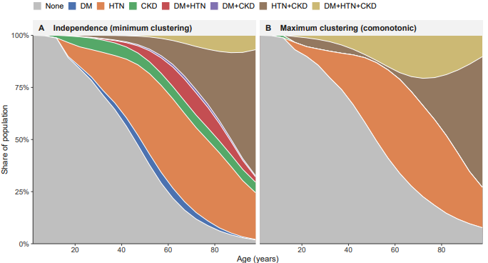
Scenario range under independence and maximum clustering– true prevalence lies between the two scenarios

Slide 44
Estimating age-specific clustering weight using SINAN data
Age band example: 60–79 years
SINAN based estimation
Observed − independence = 6.04 pp
Observed
P(≥2)=10.24%
Independence assumption
Maximum clustering assumption
P(≥2)=4.20%
P(≥2)=13.13%
GBD based estimation
Maximum − independence = 8.93 pp
GBD based estimation
λ = (Observed − Independence) / (Maximum − Independence)
λ = (10.24 − 4.20) / (13.13 − 4.20) = 0.676
Notes:
Interpretation: the observed multimorbidity clustering is 67.6% of the way from independence to maximum clustering, using P(≥2) as the calibration summary.
the fraction of the distance from independence toward maximum clustering

Slide 45
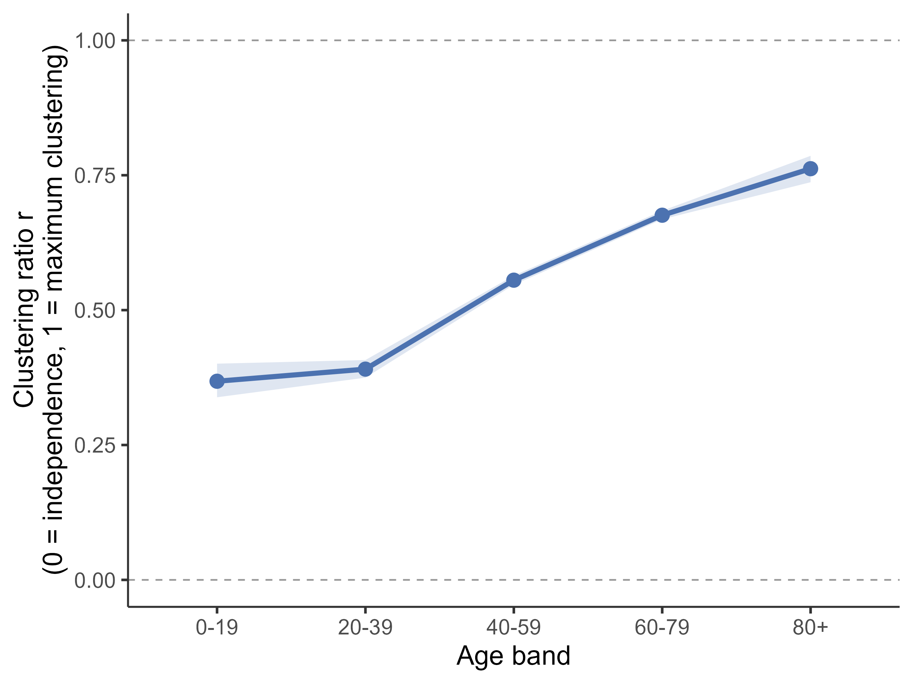
Clustering ratio: (currently) based on SINAN data – will be later replaced by survey data
Age-specific clustering weight derived from the prevalence of ≥2 conditions in Brazil SINAN

Slide 46
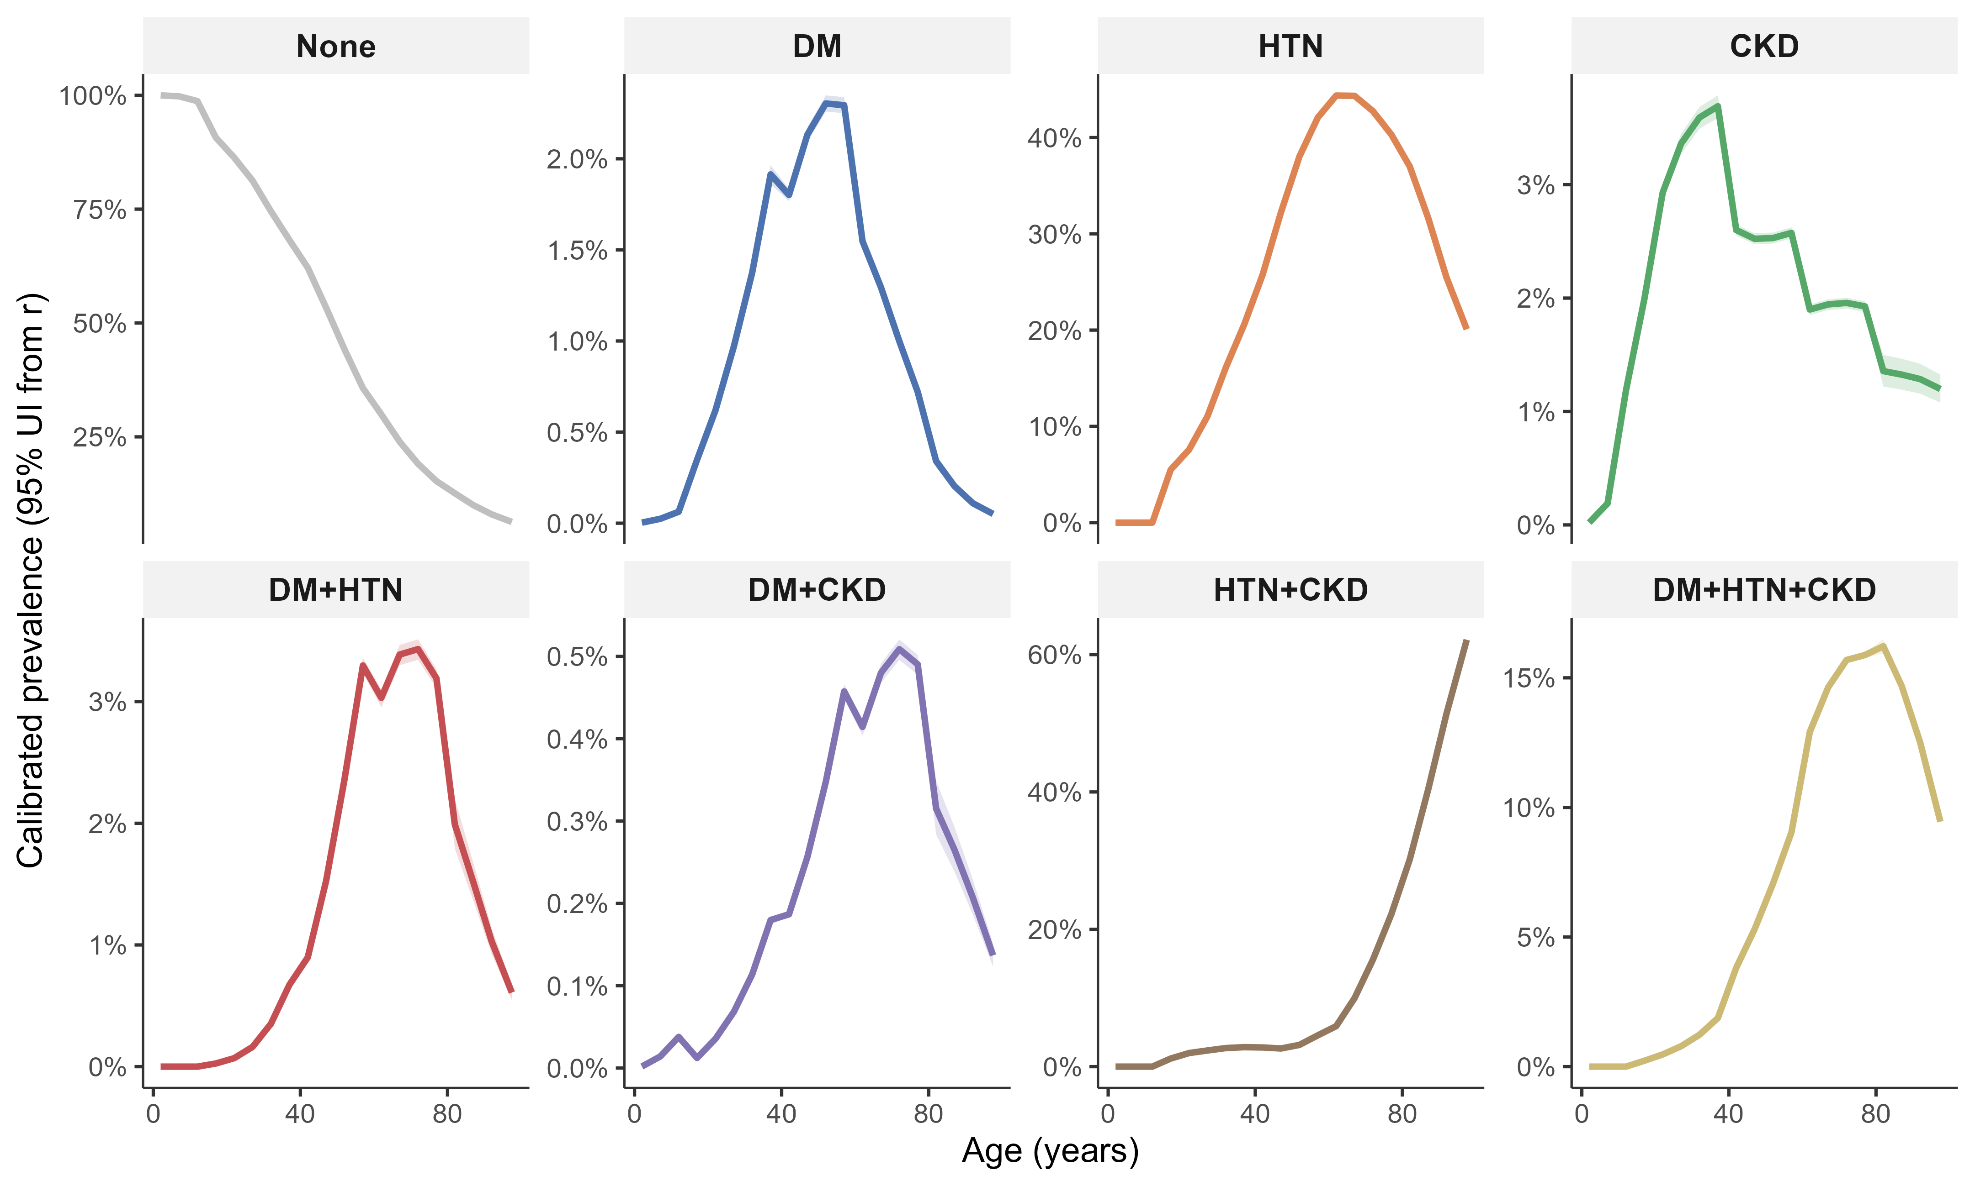
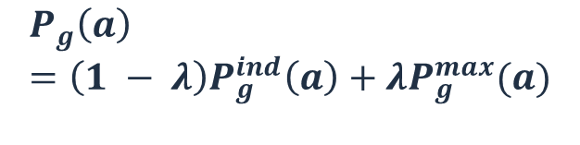
Calibrated profile specific prevalence by age group in general population
$$P_{g}\left(a\right)=\left(1 − λ\right)P_{g}^{ind}\left(a\right)+λP_{g}^{max}(a)$$

Slide 47
True level of clustering? (adjustment factor)
To what extent do DM, hypertension, and CKD cluster in the general population relative to the independence and maximum-clustering scenarios?
  Does general-population individual survey from Brazil and other Latin countries record these three conditions across all ages?
  If yes, we can estimate age-specific observed 8 profile prevalence which can be used as a dependence structure

Slide 48
Definition of CKD
SINAN based CKD patients vs. GBD-based CKD patients
Average risk of severe chikungunya
GBD patients involve kidney problem patients with milder symptoms
Different selection mechanism
  GBD prevalence reaches ~69% at age 90+ in Brazil, while SINAN-recorded CKD among chikungunya cases stays under 2% even at the oldest ages
Current assumption:
  RR is constant across the full CKD severity spectrum (milder symptoms from GBD and more severe symptoms in SINAN)

Slide 49
  Next step
    Country level general population individual-level survey data
    Estimate country level age specific background prevalence using individual level survey data calibration
    Link estimated standardised RR + background prevalence + FOI to estimate burden

