Slide 1
Summary
Susceptible pool assumption: susceptible pool size is fixed based on long-term average FOI using simple catalytic model (spatially coarse) – unvalidated immunity assumption
Non-identifiability: β estimation too flexible to test this assumption (model cannot validate whether the current immunity assumption is correct)
Spatial resolution: each state treated as homogeneous (well-mixed) vs. documented within-state heterogeneity -- unreconciled

Slide 2
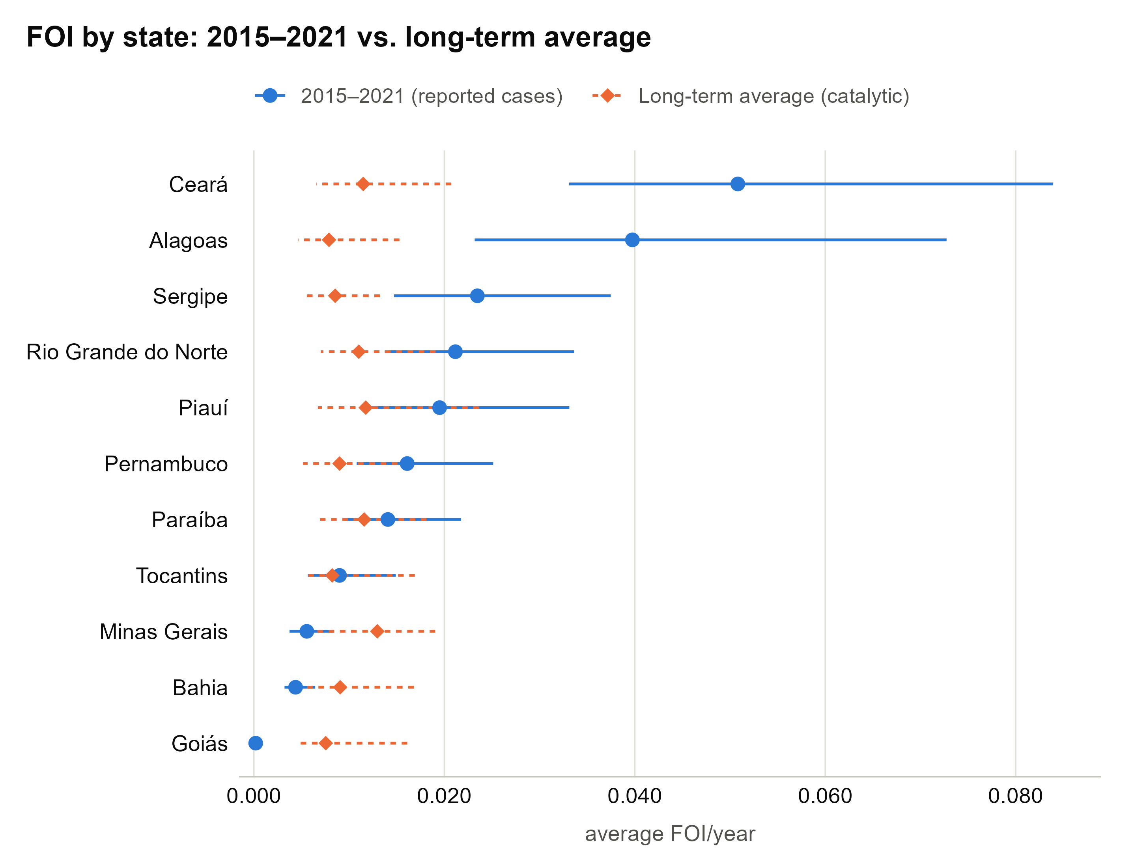
1) On the identifiability of the transmission model, and how it interacts with the characterisation of prior immunity.
Initial susceptible is not jointly calibrated with beta
  Fixed using catalytic model (simple catalytic model)
  The model fit looks convincing, but beta is too flexible to absorb error and can be fitted to any level of S0 (non-identifiable)
  The problem is that model fits to all different levels of S0 (with flexible time-varying beta) but downstream BRR results are materially different

Slide 3
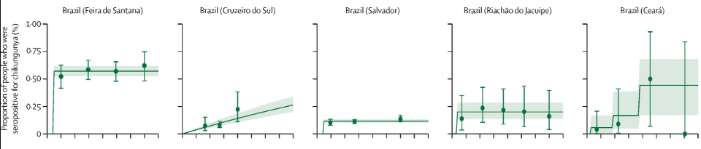
2) On the assumption of long-term history of chikungunya circulation
Average annual force of infection is based on long term exposure to chikungunya infection. In settings with short term exposure to chikungunya infection, this parameter should be interpreted with caution and not be misinterpreted as average annual FOI within the short-term exposure period.
The use of current long-term average FOI for future studies.. e.g., future projection of FOI?
Short term vs. long-term circulation in some countries is relatively clear (Brazil) but not in many countries.

Slide 4
3) spatial concern that the authors raise themselves but do not fully reconcile
fitting one uniform epidemic curve with a single time varying transmission rate to that combined case series risks producing a fitted trajectory that is really an artefact of several overlapping local outbreaks rising and falling at different times and in different places rather than a genuine, interpretable transmission parameter for the state as a whole
Travel vaccination:
  spatial focality of chikungunya transmission, together with year-to-year variation in outbreak size and timing, might affect how representative these estimates are of the exposure a traveller would actually fac

