Slide 1
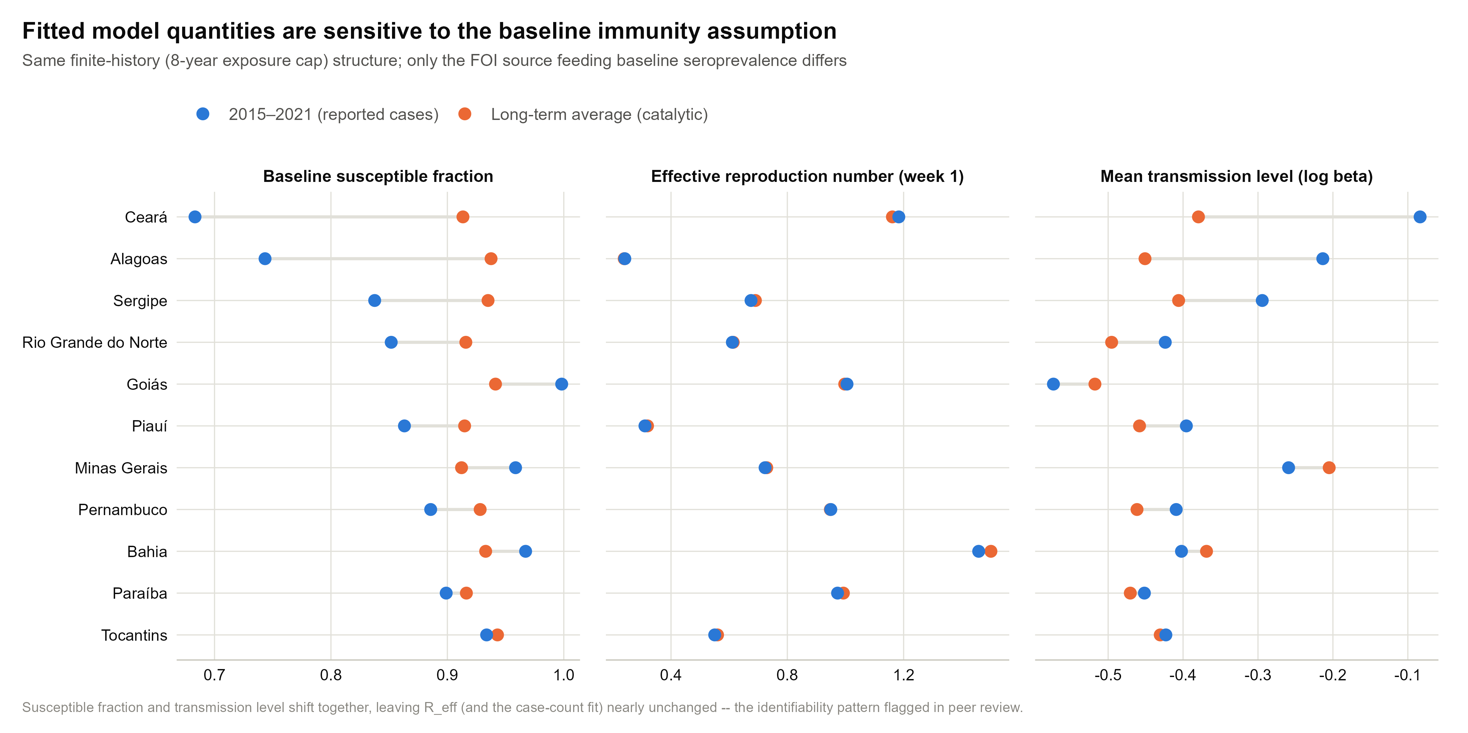
1) On the identifiability of the transmission model, and how it interacts with the characterisation of prior immunity.
Initial susceptible is not jointly calibrated with beta
  Fixed using catalytic model (simple catalytic model)
  The model fit looks convincing, but beta is too flexible to absorb error and can be fitted to any level of S0 (non-identifiable)
  The problem is that model fits to all different levels of S0 (with flexible time-varying beta) but downstream BRR results are materially different

Slide 2
2) On the assumption of long-term history of chikungunya circulation
Average annual force of infection is based on long term exposure to chikungunya infection. In settings with short term exposure to chikungunya infection, this parameter should be interpreted with caution and not be misinterpreted as average annual FOI within the short-term exposure period.
The use of current long-term average FOI for future studies.. e.g., future projection of FOI?
Short term vs. long-term circulation in some countries is relatively clear (Brazil) but not in many countries.

Slide 3
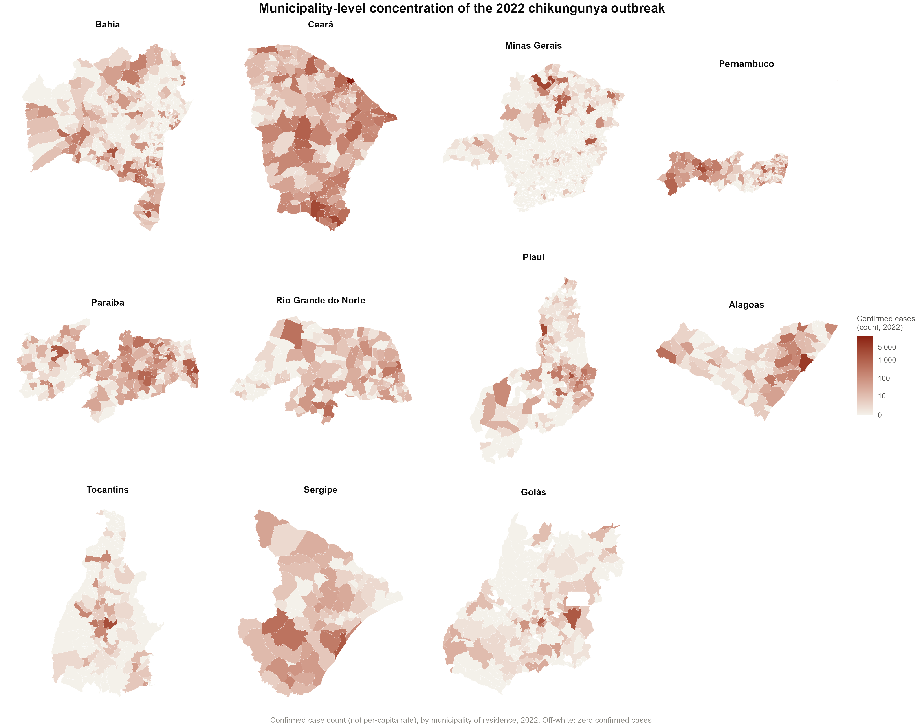
3) spatial concern that the authors raise themselves but do not fully reconcile
fitting one uniform epidemic curve with a single time varying transmission rate to that combined case series risks producing a fitted trajectory that is really an artefact of several overlapping local outbreaks rising and falling at different times and in different places rather than a genuine, interpretable transmission parameter for the state as a whole
When estimating attack rate, should total N be restricted under spatial focality? Currently using the entire population of the state (effective population?)
Travel vaccination:
  spatial focality of chikungunya transmission, together with year-to-year variation in outbreak size and timing, might affect how representative these estimates are of the exposure a traveller would actually face

Slide 4
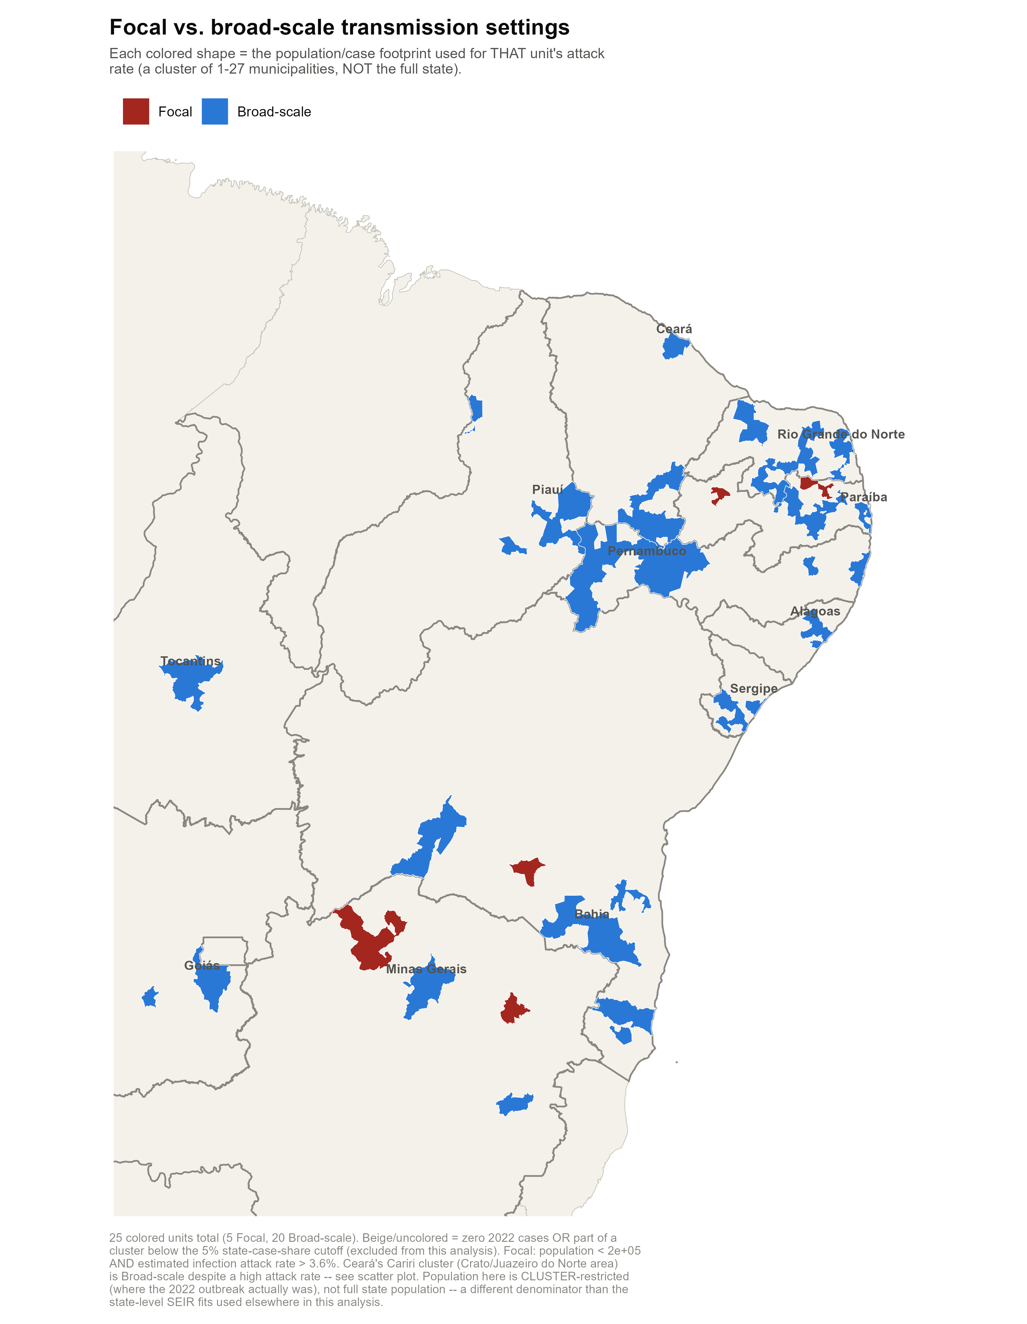
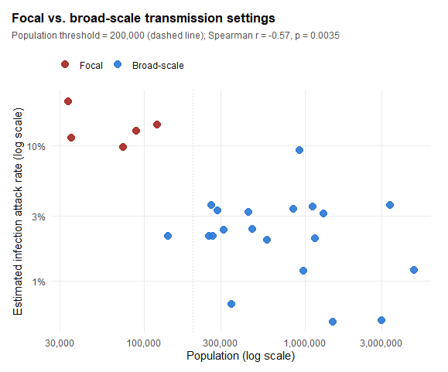

Slide 5
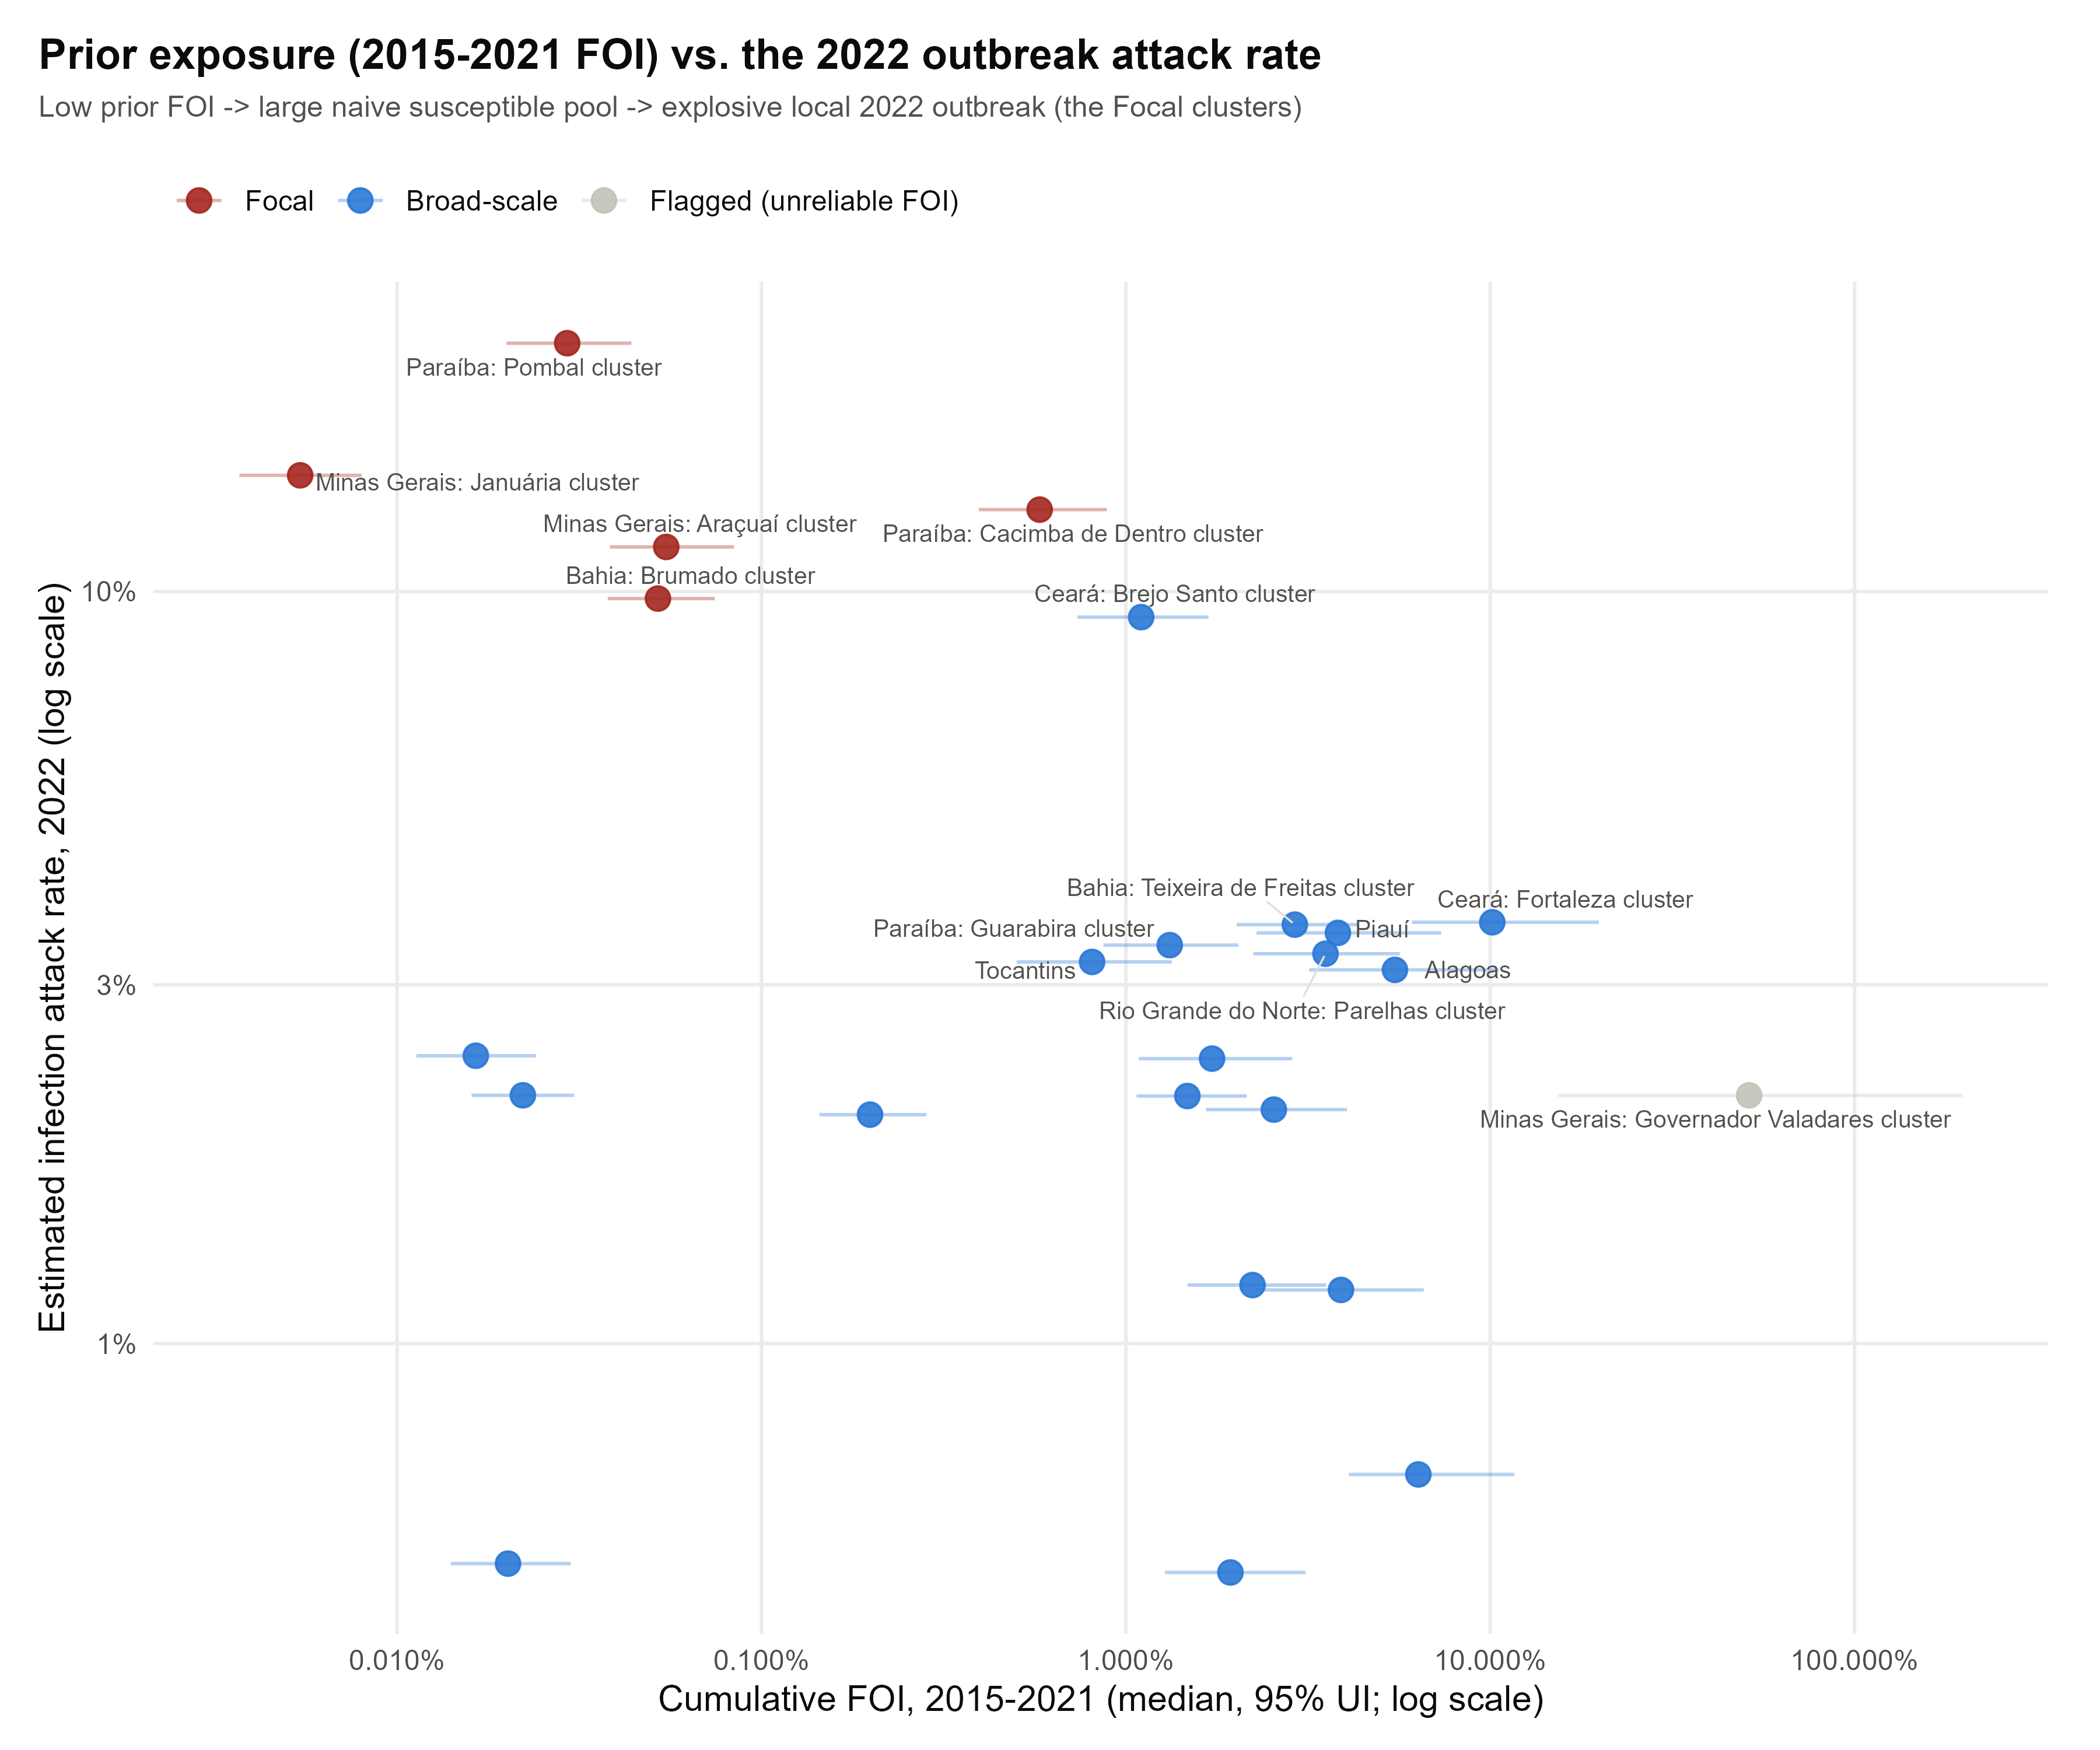

Slide 6
Susceptible pool assumption: susceptible pool size is fixed based on long-term average FOI using simple catalytic model (spatially coarse) – unvalidated immunity assumption
Non-identifiability: β estimation too flexible to test this assumption (model cannot validate whether the current immunity assumption is correct)
Spatial resolution: each state treated as homogeneous (well-mixed) vs. documented within-state heterogeneity unreconciled
The fitted β(t) is a model artefact, calibrated to a number of aggregated outbreaks with temporally staggered and geographically heterogeneous pattern → need to check which state is okay with aggregation but which are not?

Slide 7
Transmission archetype and
comorbidity-stratified burden model

Slide 8
Analysis step
1
Transmission history
Classify 103 countries into A–D archetypes based on sustained circulation, endemic equilibrium, episodic recurrence, or conditional potential.
2
Archetype-specific infection model
Replace lifelong continuous exposure with effective historical exposure duration and infection probability.
3
Comorbidity structure
Convert 7 underlying-condition prevalences into mutually exclusive 0, 1, and 2+ comorbidity groups.
4
Clinical risk and burden
Apply comorbidity-specific hospitalisation and death risks, then compute hospitalisations, deaths and DALYs.

Slide 9
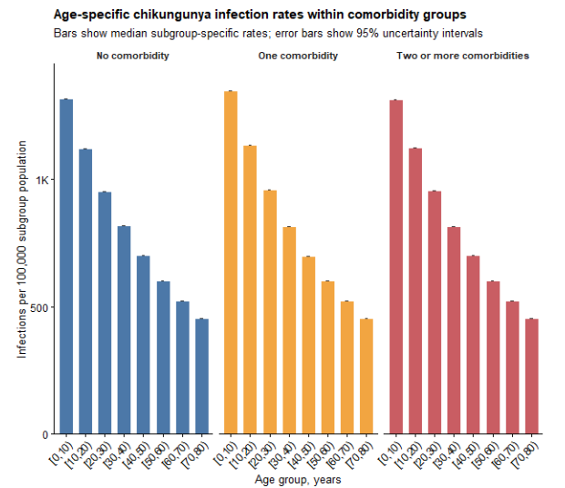
Motivation: move beyond a single long-term catalytic model?
A long-term average FOI can make all settings look as if exposure accumulated continuously throughout life.
This is problematic where chikungunya was introduced recently or occurs as episodic outbreaks.
A single catalytic model can therefore understate incidence and older-age burden in finite-history settings.

Slide 10
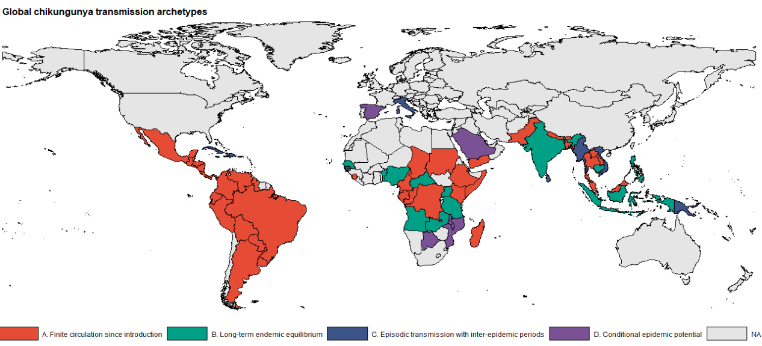
Countries are classified into 4 archetypes
103 countries classified
A
Finite circulation since introduction
39
B
Long-term endemic equilibrium
12
C
Episodic transmission
42
D
Conditional epidemic potential
10

Slide 11
Common infection model: separate past exposure from current risk
Historical immunity
Current burden year
E is an effective historical exposure duration.
It determines how much prior outbreaks have depleted susceptible population
E differs by archetype
q is the infection probability during the burden period.
For continuous annual risk, q = 1 − exp(−λ).
For episodic settings, q is annualised or conditional on an outbreak.

Slide 12
A. Finite circulation since introduction
A
Transmission history is capped by time since introduction.
T_c is years since sustained transmission began in country c.
Individuals younger than T_c accumulate exposure according to age.
Individuals older than T_c are capped at T_c years of exposure
  Different from assigning a lifetime of exposure to older adults as in endemic setting

Slide 13
B. Long-term endemic equilibrium
B
This retains the simple catalytic assumption of continuous exposure from birth.
Historical exposure grows linearly with age.
Older cohorts have progressively lower susceptibility.
Appropriate for countries where transmission is long established and repeatedly observed over time.

Slide 14
C. Episodic transmission with inter-epidemic periods
C
Historical exposure accumulates through discrete epidemic opportunities, not continuously every year.
τ_c is the inter-epidemic interval; in PSA, τ_c is sampled across 7–20 years.
n counts how many outbreak opportunities an age cohort has experienced.
h_out converts a long-term annual FOI into one outbreak-level cumulative hazard.
The annualised burden averages a larger outbreak-year risk over epidemic and non-epidemic years.

Slide 15
D. Conditional epidemic potential
D
D estimates burden conditional on epidemic transmission occurring; it is not an unconditional annual burden.
Base case assumes no prior sustained local transmission
  historical susceptibility is 1 for all ages.
If prior local transmission is later documented, E(D) can be replaced by known historical exposure.
Because P(outbreak) is not estimated here, D must be labelled as conditional epidemic potential.

Slide 16
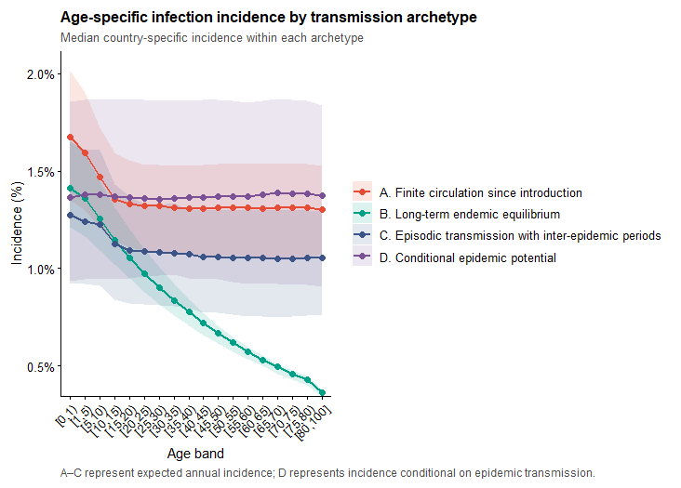
INFECTION RESULTS
Archetype-specific infection incidence
B declines most strongly with age because exposure accumulates continuously from birth.
A has flatter older-age incidence because exposure is capped by introduction history.
C depends on inter-epidemic timing and event hazard concentration.
D should be interpreted as potential burden if transmission occurs, not expected annual incidence.

Slide 17
Comorbidity-stratified burden model

Slide 18
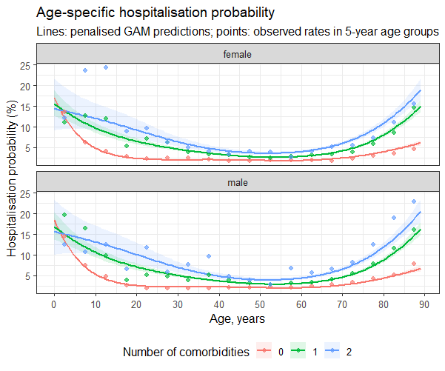
Estimating hospitalisation risk by age and comorbidity
Data: confirmed chikungunya surveillance records from Brazil, 2017–2024.
Outcome: hospitalisation among confirmed cases.
Predictors: age, sex, and comorbidity-count group.
Model: flexible age-specific risk with no-comorbidity as the reference group.

Slide 19
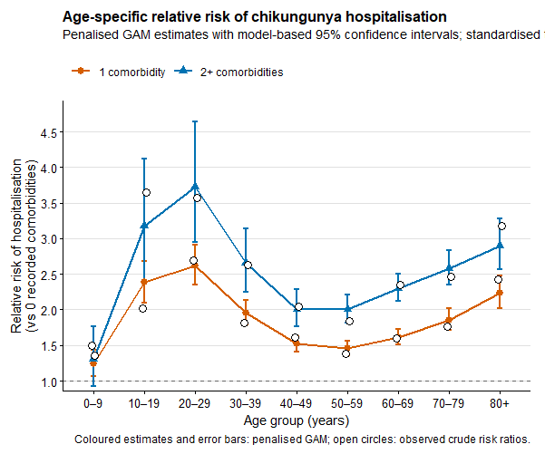
Standardised hospitalisation relative risks
Predicted hospitalisation risk is averaged across female and male patients within each age–comorbidity stratum.
Relative risks compare each comorbidity group to the no-comorbidity reference

Slide 20
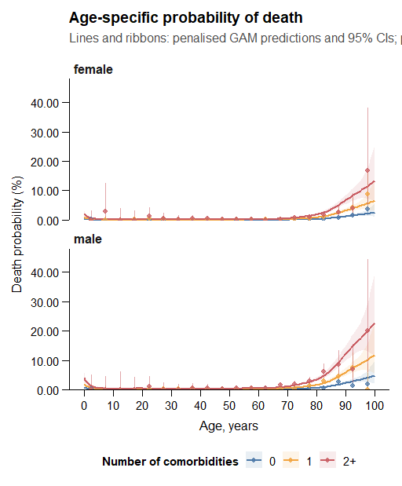
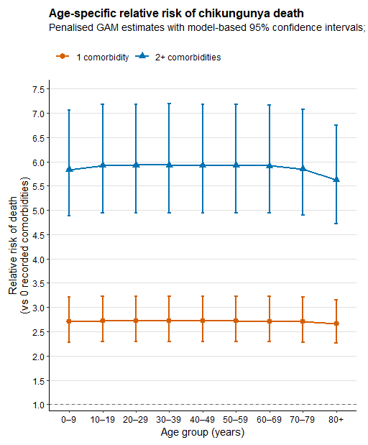
Fatality risk and death relative risks

Slide 21
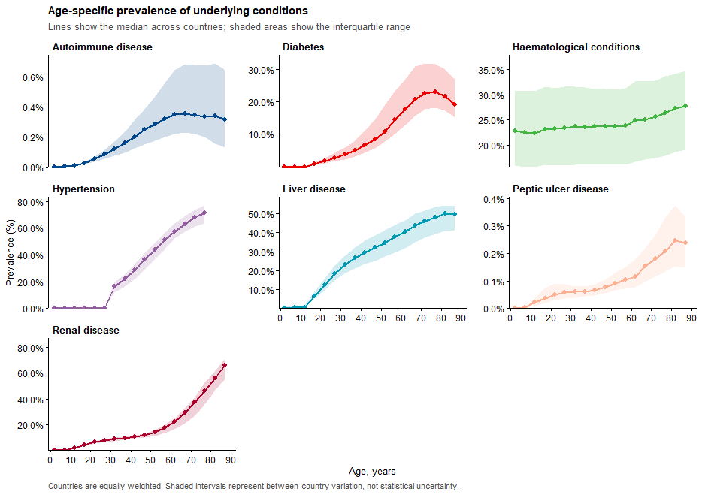
Global prevalence of underlying conditions by age
GBD prevalence of underlying conditions
Seven underlying conditions were aligned with variables observed in SINAN Brazil surveillance.
Prevalence is available by country and 5-year age group.

Slide 22
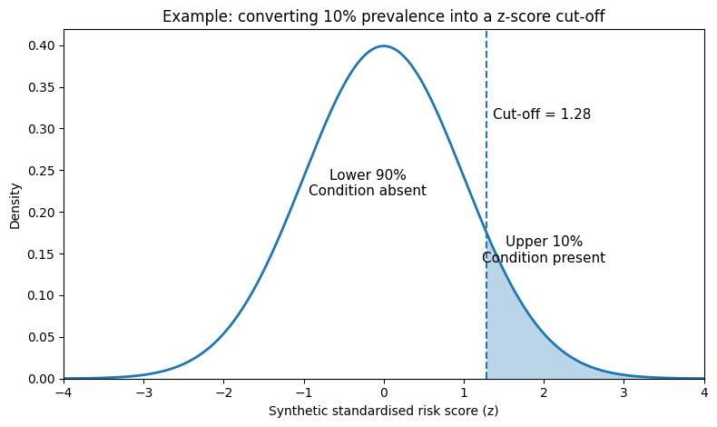
From disease prevalence to individual disease status
For each country × age group, create 10,000 synthetic individuals.
Each synthetic individual receives one standardised score for each of the seven conditions (randomly generated scores following normal distribution of N(0,1))
Thresholds for binary classification is defined based on observed prevalence of condition
Jointly combining 7x7 correlation matrix (corr score between 7 conditions) to updated scores
Prevalence determines the condition-specific cut-off
A 10% prevalence corresponds to a cut-off of 1.28 because 90% of the bell curve lies below 1.28.
Condition | Prevalence | Cut-off | Positive group
Diabetes | 10% | 1.28 | Highest 10%
Hypertension | 30% | 0.52 | Highest 30%
Renal disease | 5% | 1.64 | Highest 5%

Slide 23
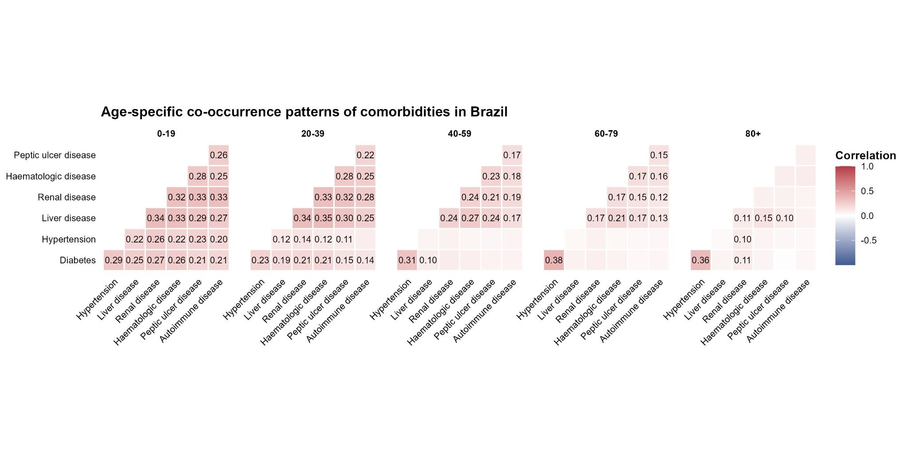
Disease correlations determine who receives overlapping conditions
The seven condition scores are first generated as standardised random scores.
The age-specific correlation matrix then links the scores so related conditions tend to be high in the same synthetic individuals.
Cut-offs are not changed by the correlation step
The same disease-specific thresholds are applied after the scores are linked.

Slide 24
Counting conditions within the synthetic population
After applying condition-specific cut-offs, each synthetic individual has seven binary disease indicators.
Individual | Diabetes | Hypertension | Renal | Liver | Other | Total
Person 1 | 0 | 0 | 0 | 0 | 0 | 0
Person 2 | 0 | 1 | 0 | 0 | 0 | 1
Person 3 | 1 | 1 | 0 | 0 | 0 | 2
Person 4 | 0 | 1 | 1 | 1 | 0 | 3
Person 5 | 1 | 0 | 0 | 0 | 0 | 1
The final output for each country × age group is mutually exclusive: P(0) + P(1) + P(2+) = 1.

Slide 25
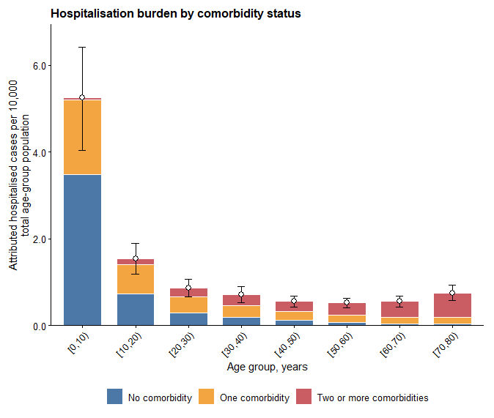
Hospitalisation burden by age and comorbidity status
Young age groups can contribute substantial hospitalisation burden even with lower comorbidity prevalence because infection incidence is high.

Slide 26
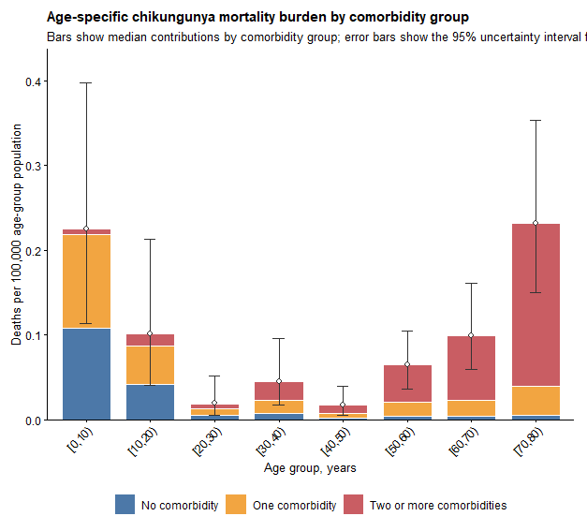
Mortality burden by age and comorbidity status
Young and older age groups can contribute substantial mortality burden.

Slide 27
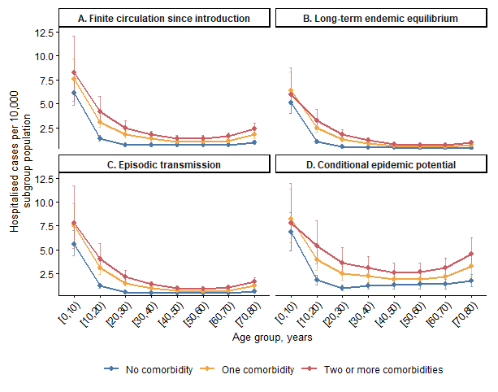
Hospitalisation burden differs by transmission archetype and comorbidity group
Long-term endemic equilibrium tends to have the lowest and most stable hospitalisation burden.
Conditional epidemic potential has the highest burden because susceptibility is high and risk is conditional on transmission
Comorbidity gradients persist across all archetypes.

