Slide 1
Comorbidity-stratified burden model

Slide 2
How chikungunya hospitalisation and mortality risk differ by age and underlying conditions
  0, 1, and 2+ underlying conditions, with individual conditions as a secondary analysis
  Age- and comorbidity-specific disease burden and vaccine benefit–risk

Slide 3
$$H_{c,a,g}=I_{c,a} ∗P\left(symptomatic\right|infection) ∗ π_{c,a,g} ∗h_{c,a,g}$$
Determined by FOI (catalytic model)
Vary across age, country
Model predicted estimates
Constant across age, country
Prevalence of background comorbidity groups
- Determined by IHME data
Country-, age-, and comorbidity-specific hospitalisation probability among symptomatic CHIKV cases
If unavailable: calibrate country-specific overall age-specific hospitalisation rates using Brazil-derived comorbidity RRs.

Slide 4
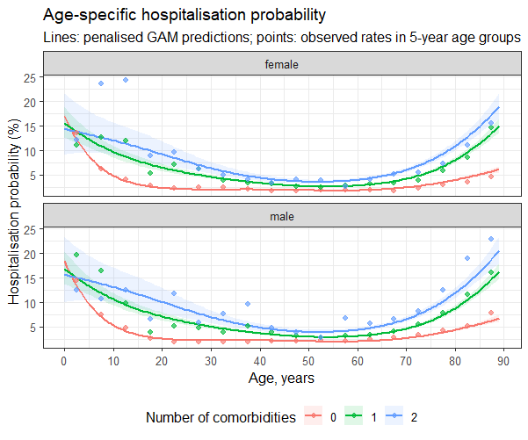
Estimating hospitalisation risk by age and comorbidity
Data: confirmed chikungunya surveillance records from Brazil, 2017–2024.
Outcome: hospitalisation among confirmed cases.
Predictors: age, sex, and comorbidity-count group.
Model: flexible age-specific risk with no-comorbidity as the reference group.

Slide 5
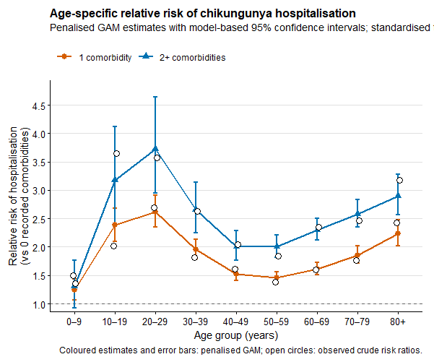
Standardised hospitalisation relative risks
Predicted hospitalisation risk is averaged across female and male patients within each age–comorbidity stratum.
Relative risks compare each comorbidity group to the no-comorbidity reference
Low baseline hospitalization probability among those who aged 20s

Slide 6
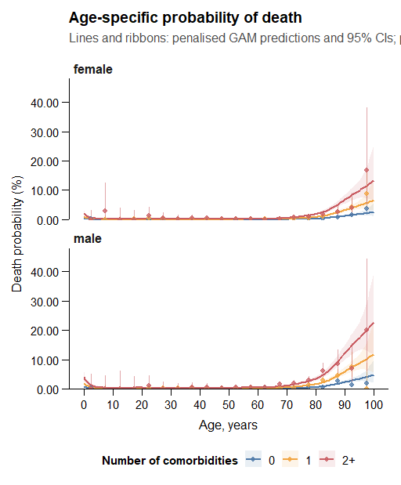
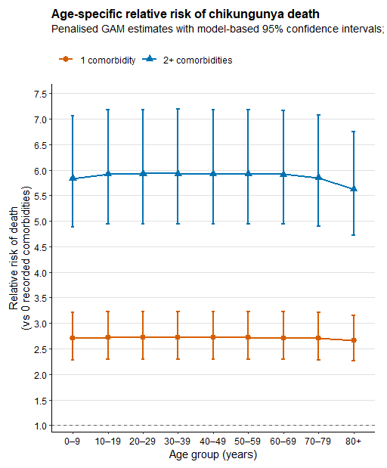
Fatality risk and death relative risks

Slide 7
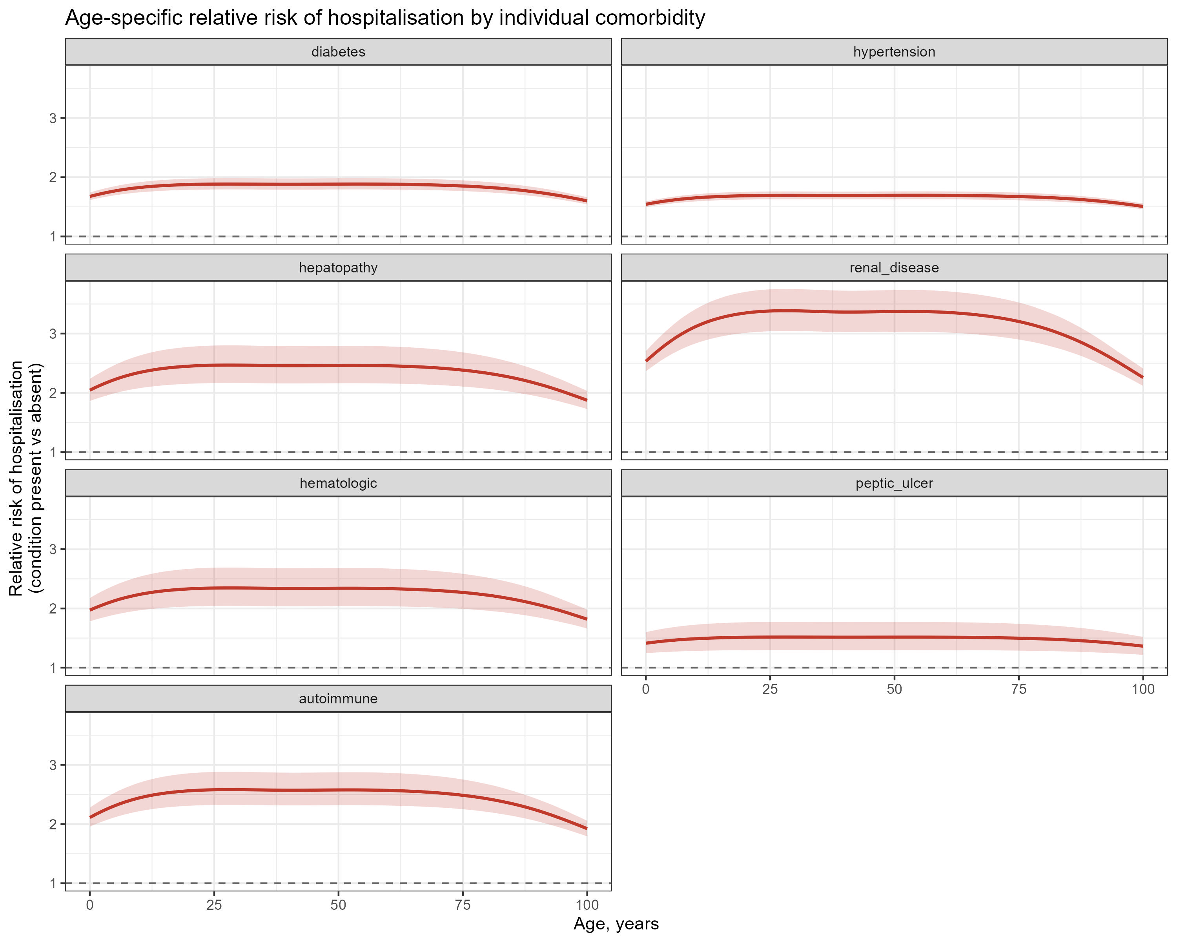
Relative risk of hospitalisation for each condition

Slide 8
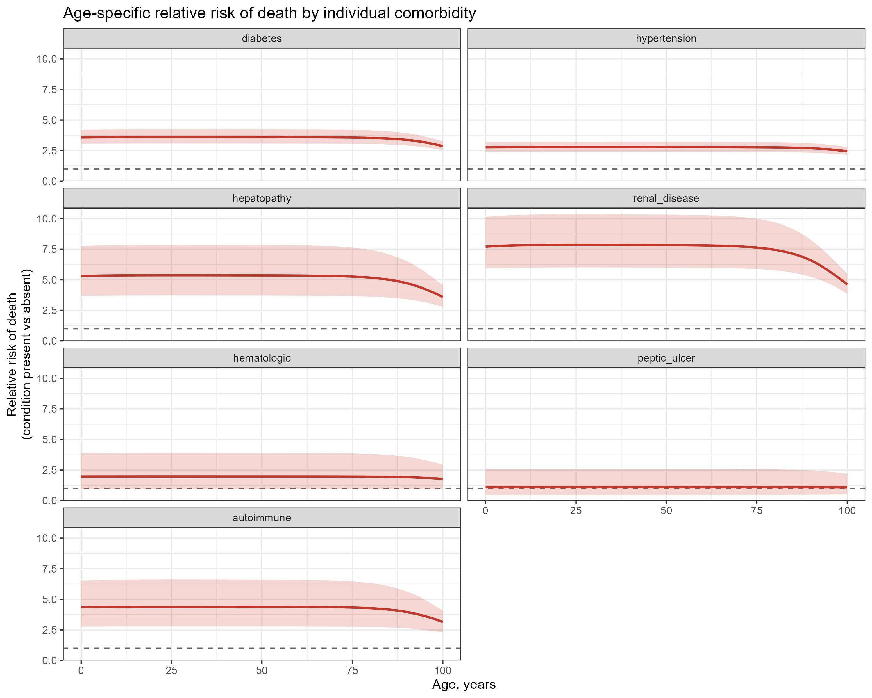
Relative risk of death for each condition

Slide 9
Age interaction:
Relative risks of hospitalisation and deaths by age, comorbidity group, and individual condition are based only on Brazil data – extrapolation to other countries
  How to improve transportability?
Age interaction:
  Is there any age-modifying effect on relative risk given that number of comorbidities are the same?
Severe or hospitalised cases are more likely to be captured in the surveillance system – selection bias
$$H_{c,a,g}=I_{c,a} ∗P\left(symptomatic\right|infection) ∗ π_{c,a,g} ∗h_{c,a,g}$$
Comorbidity and age specific chikungunya disease burden and benefit-risk of vaccine(s) across Latin American countries
  1. Country specific hospitalisation data (preferably age-specific)
  2. Country specific chikungunya case fatality data (preferably age-specific)
  3. (at least above two) will make strong evidence on CHIKVD burden across age/comorbid groups
  4. (if possible), country specific CHIKV case data along with their comorbidity status (as in Brazil)

Slide 10
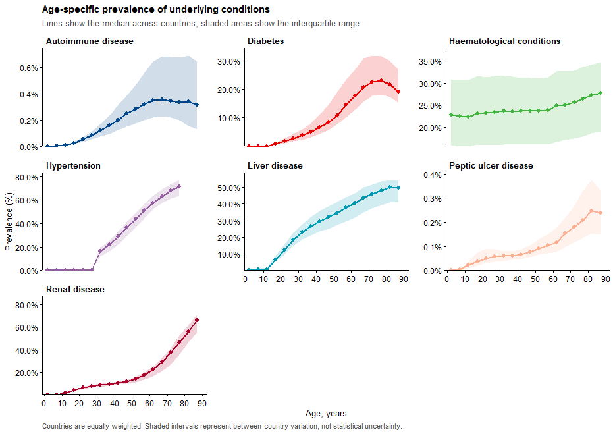
Global prevalence of underlying conditions by age
GBD prevalence of underlying conditions
Seven underlying conditions were aligned with variables observed in SINAN Brazil surveillance.
Prevalence is available by country and 5-year age group.

Slide 11
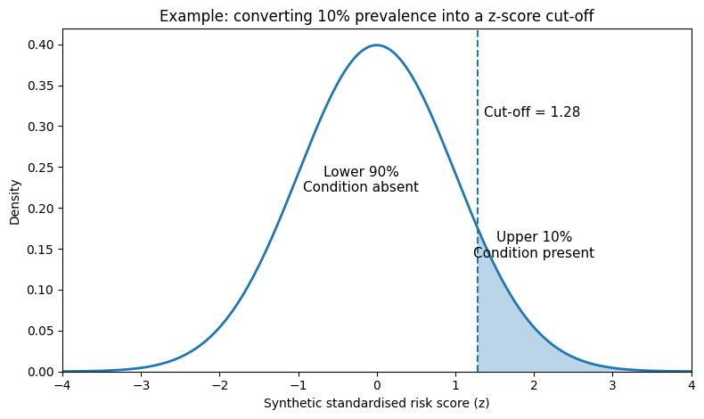
From disease prevalence to individual disease status
For each country × age group, create 10,000 synthetic individuals.
Each synthetic individual receives one standardised score for each of the seven conditions (randomly generated scores following normal distribution of N(0,1))
Thresholds for binary classification is defined based on observed prevalence of condition
Jointly combining 7x7 correlation matrix (corr score between 7 conditions) to updated scores
Prevalence determines the condition-specific cut-off
A 10% prevalence corresponds to a cut-off of 1.28 because 90% of the bell curve lies below 1.28.
Condition | Prevalence | Cut-off | Positive group
Diabetes | 10% | 1.28 | Highest 10%
Hypertension | 30% | 0.52 | Highest 30%
Renal disease | 5% | 1.64 | Highest 5%

Slide 12
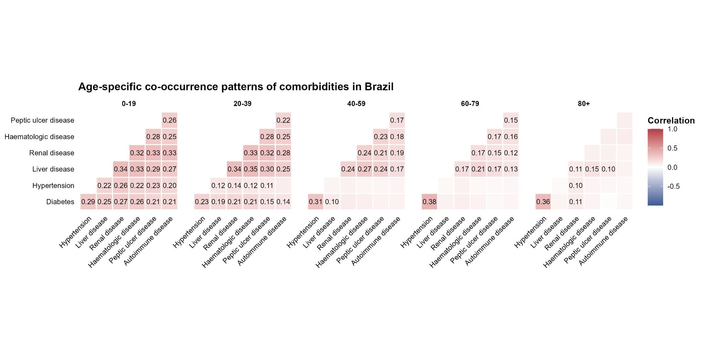
Disease correlations determine who receives overlapping conditions
The seven condition scores are first generated as standardised random scores.
The age-specific correlation matrix then links the scores so related conditions tend to be high in the same synthetic individuals.
Cut-offs are not changed by the correlation step
The same disease-specific thresholds are applied after the scores are linked.

Slide 13
Counting conditions within the synthetic population
After applying condition-specific cut-offs, each synthetic individual has seven binary disease indicators.
Individual | Diabetes | Hypertension | Renal | Liver | Other | Total
Person 1 | 0 | 0 | 0 | 0 | 0 | 0
Person 2 | 0 | 1 | 0 | 0 | 0 | 1
Person 3 | 1 | 1 | 0 | 0 | 0 | 2
Person 4 | 0 | 1 | 1 | 1 | 0 | 3
Person 5 | 1 | 0 | 0 | 0 | 0 | 1
The final output for each country × age group is mutually exclusive: P(0) + P(1) + P(2+) = 1.

Slide 14
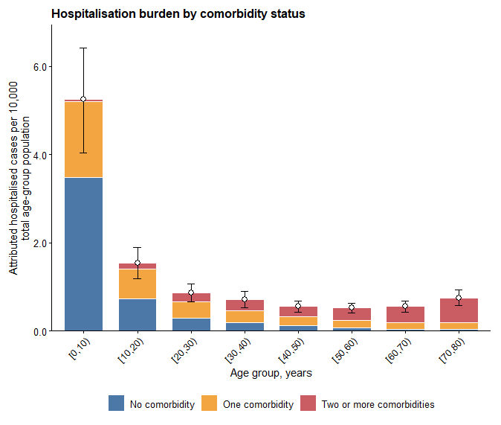
Hospitalisation burden by age and comorbidity status
Young age groups can contribute substantial hospitalisation burden even with lower comorbidity prevalence because infection incidence is high.

Slide 15
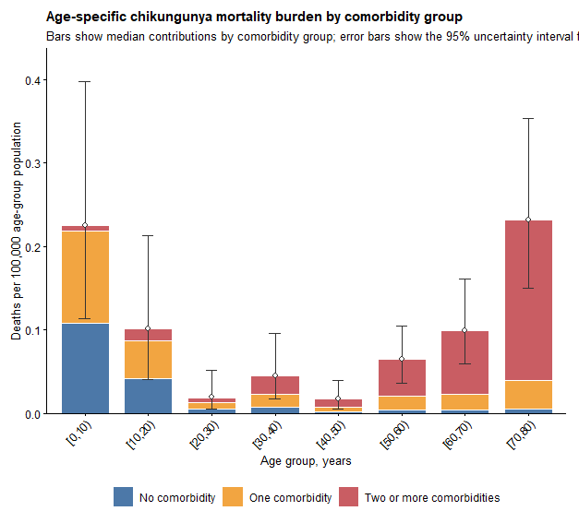
Mortality burden by age and comorbidity status
Young and older age groups can contribute substantial mortality burden.

Slide 16
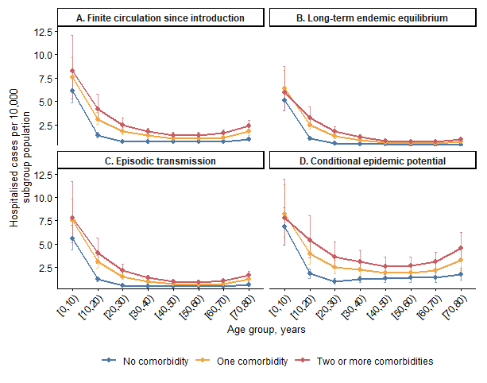
Hospitalisation burden differs by transmission archetype and comorbidity group
Long-term endemic equilibrium tends to have the lowest and most stable hospitalisation burden.
Conditional epidemic potential has the highest burden because susceptibility is high and risk is conditional on transmission
Comorbidity gradients persist across all archetypes.

Slide 17
Transmission archetype and
comorbidity-stratified burden model

Slide 18
Analysis step
1
Transmission history
Classify 103 countries into A–D archetypes based on sustained circulation, endemic equilibrium, episodic recurrence, or conditional potential.
2
Archetype-specific infection model
Replace lifelong continuous exposure with effective historical exposure duration and infection probability.
3
Comorbidity structure
Convert 7 underlying-condition prevalences into mutually exclusive 0, 1, and 2+ comorbidity groups.
4
Clinical risk and burden
Apply comorbidity-specific hospitalisation and death risks, then compute hospitalisations, deaths and DALYs.

Slide 19
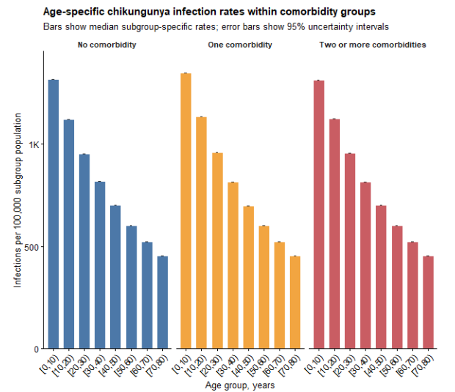
Motivation: move beyond a single long-term catalytic model?
A long-term average FOI can make all settings look as if exposure accumulated continuously throughout life.
This is problematic where chikungunya was introduced recently or occurs as episodic outbreaks.
A single catalytic model can therefore understate incidence and older-age burden in finite-history settings.

Slide 20
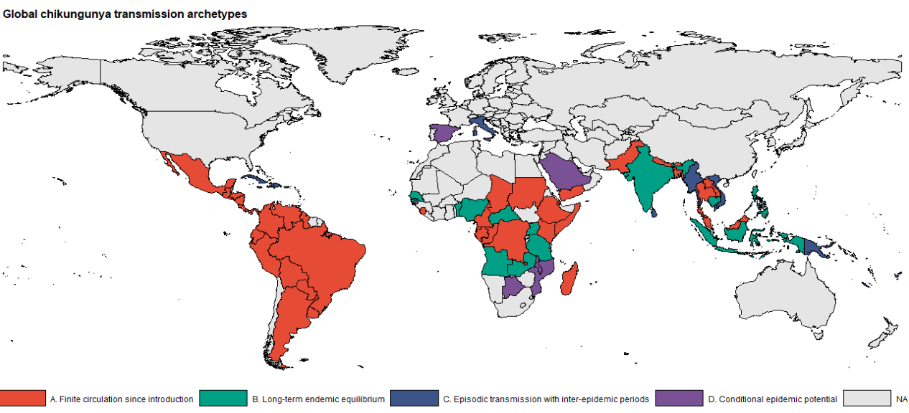
Countries are classified into 4 archetypes
103 countries classified
A
Finite circulation since introduction
39
B
Long-term endemic equilibrium
12
C
Episodic transmission
42
D
Conditional epidemic potential
10

Slide 21
Common infection model: separate past exposure from current risk
Historical immunity
Current burden year
E is an effective historical exposure duration.
It determines how much prior outbreaks have depleted susceptible population
E differs by archetype
q is the infection probability during the burden period.
For continuous annual risk, q = 1 − exp(−λ).
For episodic settings, q is annualised or conditional on an outbreak.

Slide 22
A. Finite circulation since introduction
A
Transmission history is capped by time since introduction.
T_c is years since sustained transmission began in country c.
Individuals younger than T_c accumulate exposure according to age.
Individuals older than T_c are capped at T_c years of exposure
  Different from assigning a lifetime of exposure to older adults as in endemic setting

Slide 23
B. Long-term endemic equilibrium
B
This retains the simple catalytic assumption of continuous exposure from birth.
Historical exposure grows linearly with age.
Older cohorts have progressively lower susceptibility.
Appropriate for countries where transmission is long established and repeatedly observed over time.

Slide 24
C. Episodic transmission with inter-epidemic periods
C
Historical exposure accumulates through discrete epidemic opportunities, not continuously every year.
τ_c is the inter-epidemic interval; in PSA, τ_c is sampled across 7–20 years.
n counts how many outbreak opportunities an age cohort has experienced.
h_out converts a long-term annual FOI into one outbreak-level cumulative hazard.
The annualised burden averages a larger outbreak-year risk over epidemic and non-epidemic years.

Slide 25
D. Conditional epidemic potential
D
D estimates burden conditional on epidemic transmission occurring; it is not an unconditional annual burden.
Base case assumes no prior sustained local transmission
  historical susceptibility is 1 for all ages.
If prior local transmission is later documented, E(D) can be replaced by known historical exposure.
Because P(outbreak) is not estimated here, D must be labelled as conditional epidemic potential.

Slide 26
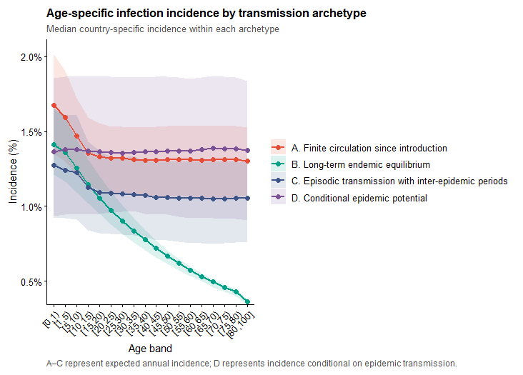
INFECTION RESULTS
Archetype-specific infection incidence
B declines most strongly with age because exposure accumulates continuously from birth.
A has flatter older-age incidence because exposure is capped by introduction history.
C depends on inter-epidemic timing and event hazard concentration.
D should be interpreted as potential burden if transmission occurs, not expected annual incidence.

