Slide 1
Chikungunya vaccine (Ixchiq®) benefit risk analysis

Slide 2
Input data
age_group | SAE | death | tot_doses | P(SAE|Vaccination) | P(Death|Vaccination) | P(SAE|chikungunya clinical + confirmed) | P(Death|chikungunya clinical + confirmed)
18-64 | 7 | 0 | 32949 | 0.0002 | 0 | 0.0217 | 0.00054
65+ | 22 | 1 | 18445 | 0.0012 | 0.00005 | 0.0277 | 0.00388
Death attributable to chikungunya is based on all chikungunya symptomatic cases (not based on IFR), potentially could be higher than infection fatality rate.
  Due to lack of data, CFR from Brazil surveillance data was used as a proxy of IFR
  True IFR could be lower than CFR
Hospitalisation among total chikungunya symptomatic cases was used as a proxy of SAE
  SAE has stricter definitions with life threatening cases while hospitalisation covers broader spectrum. True SAE could be lower than the observed hospitalisation

Slide 3
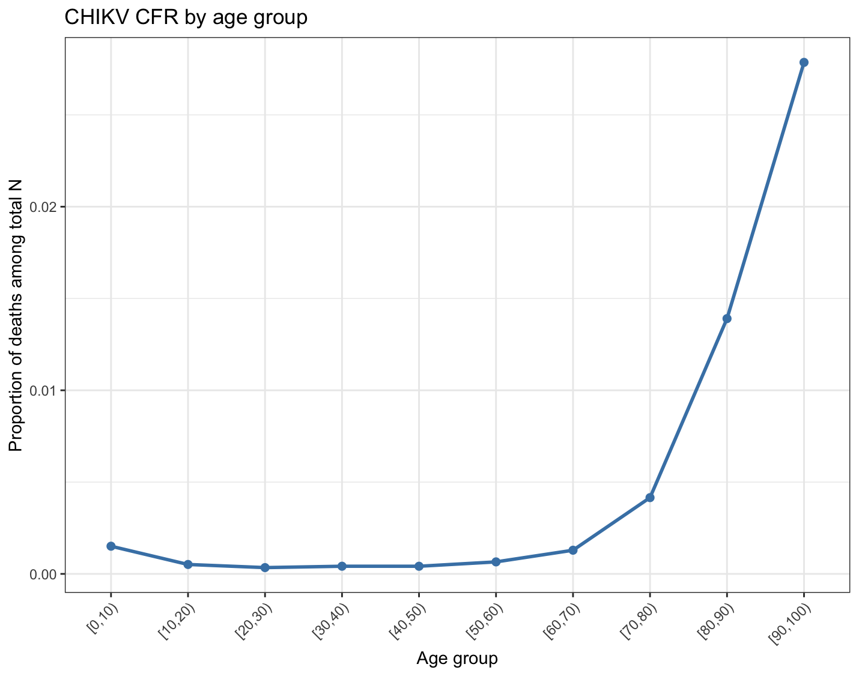
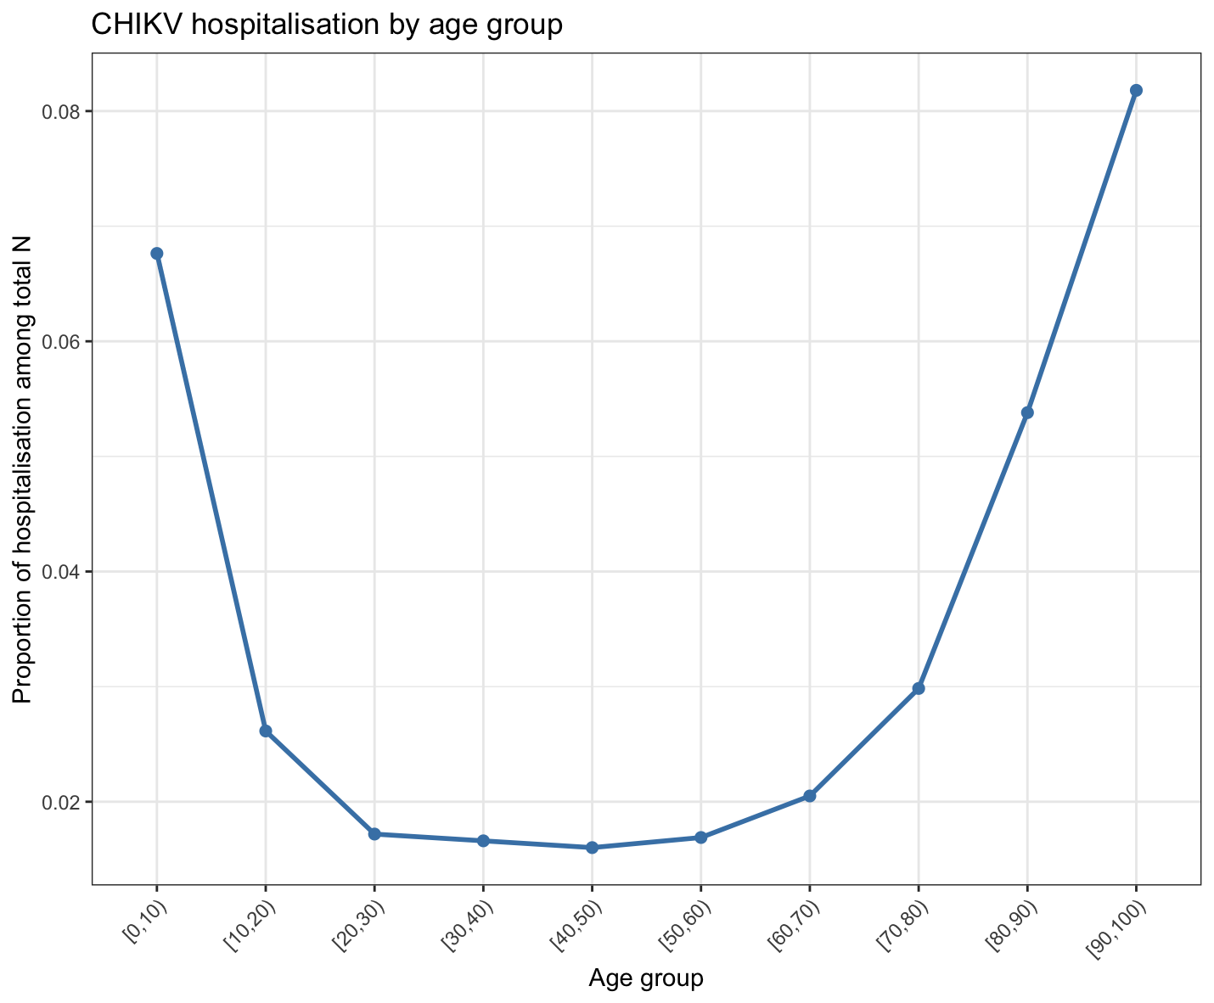
Chikungunya fatality rate and hospitalistion rate by age group

Slide 4
Model assumptions
Scenario
Vaccination for a traveller fully susceptible to chikungunya to an outbreak country:
  Small outbreak
  Medium outbreak
  Large outbreak
    Travel duration varies by:
      14 days
      30 days
      50 days
        All assumed 4 months of outbreak duration based on La Reunion 2025 outbreak for attack rate calculation
Vaccination for residents in endemic countries
  Low endemic
  Moderate endemic
  High endemic

Slide 5
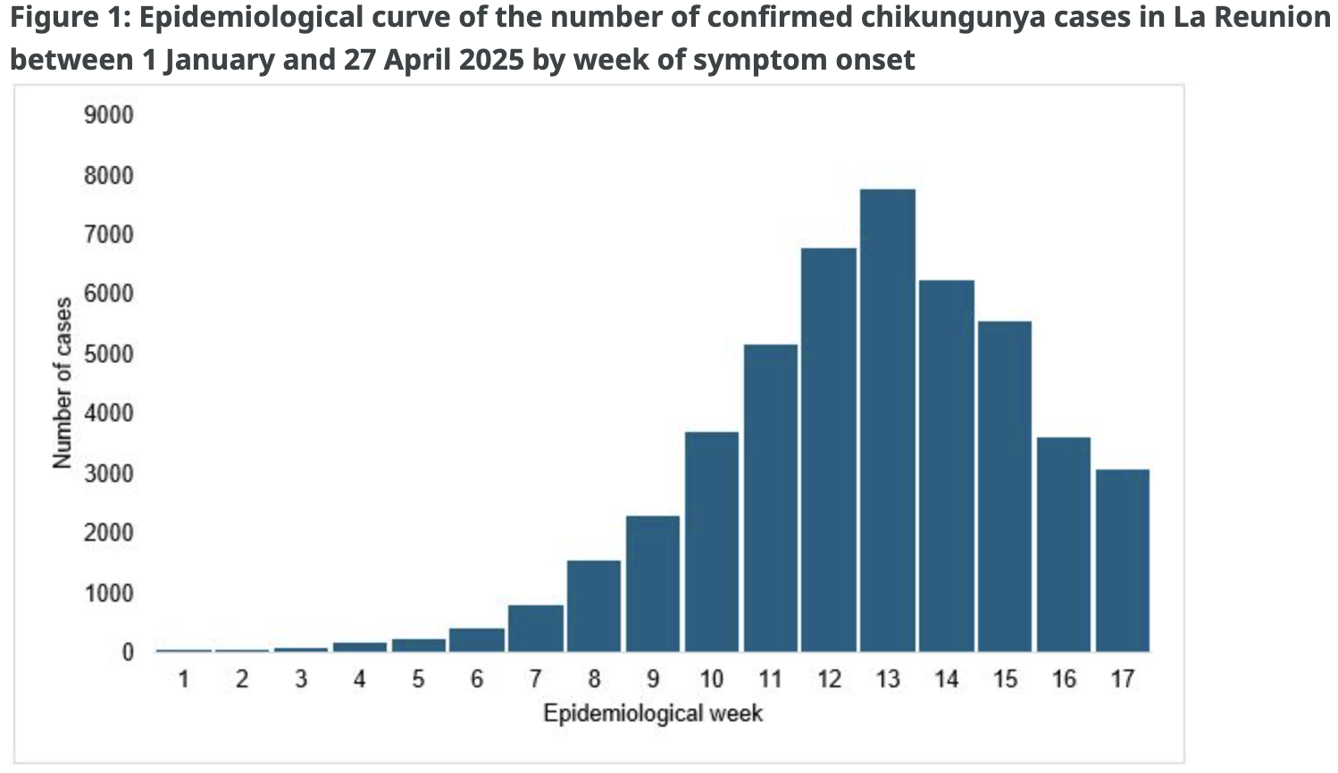
Outbreak duration (from La Reunion case) ~ 4 months
WHO (2025)

Slide 6
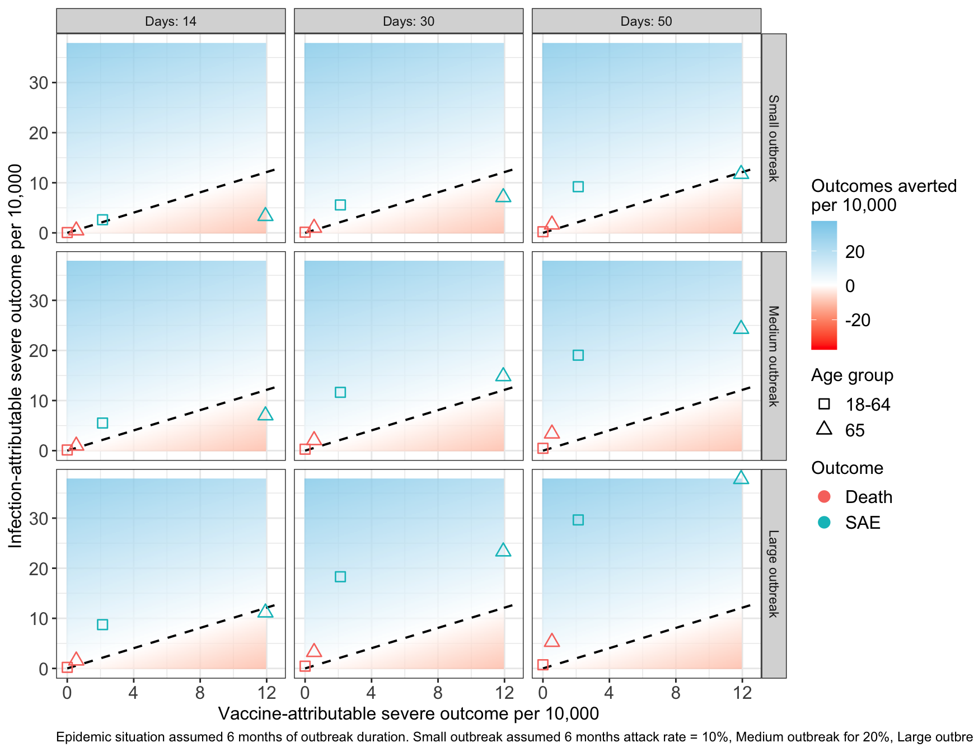
SAEs by outbreak size and exposure days (for travellers)
Small outbreak
  10% attack rate for 6 months
    FOI = 0.21
Medium outbreak
  20% attack rate for 6 months
    FOI = 0.45
Large outbreak
  30% attack rate
    FOI = 0.71

Slide 7
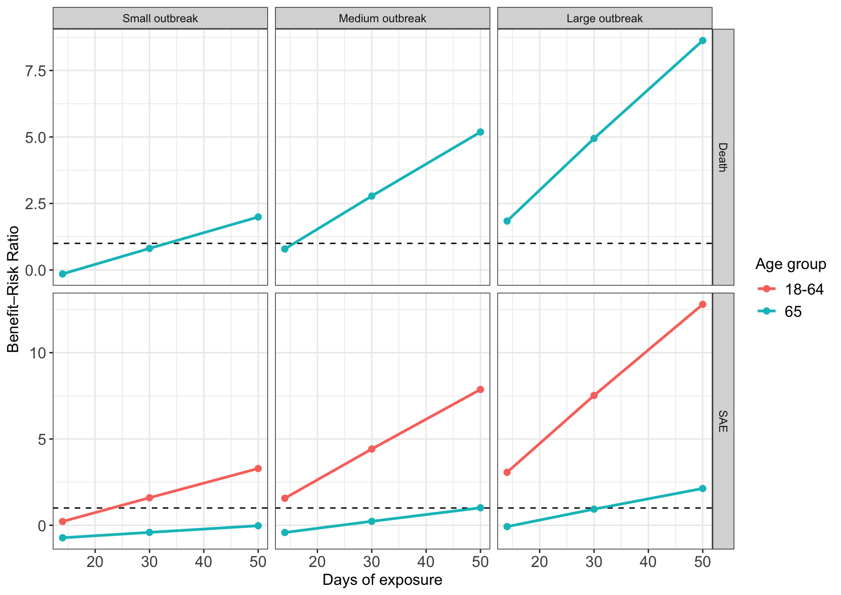
Benefit risk ratio

Slide 8
Inference
Benefit risk ratio depends highly on
  Outbreak size
  Duration of outbreak
  Duration of travel (exposure time)
    The larger the outbreak, the higher the vaccine benefit risk ratio
    The longer the travel duration, the higher the vaccine benefit risk ratio
    The shorter the outbreak duration with the same attack rate, the higher the vaccine benefit ratio
    Varies by epidemiological context
With the independent vaccine induced SAE rate and age-dependent background CFR and hospitalisation, vaccine is more favourable to elderlies

