Slide 1
Personalized Web Music Service
Student id, name

Slide 2
Project Objective
Providing personalized music service.
Users can search for favorite music.
By keeping user’s favorite music, user can create a list of favorites.
Users can find popular music based on users' favorites list.

Slide 3
Functions
Join and leave(회원 가입 및 탈퇴)
Sign in and sign out(로그인 및 로그아웃)
Change password(비밀번호 변경)
My page(마이 페이지)
Search music(음악 검색)
Favorites(즐겨찾기)
Download(다운로드)
View popular rankings(인기순위 보기)
Admin page(관리자 페이지)

Slide 4
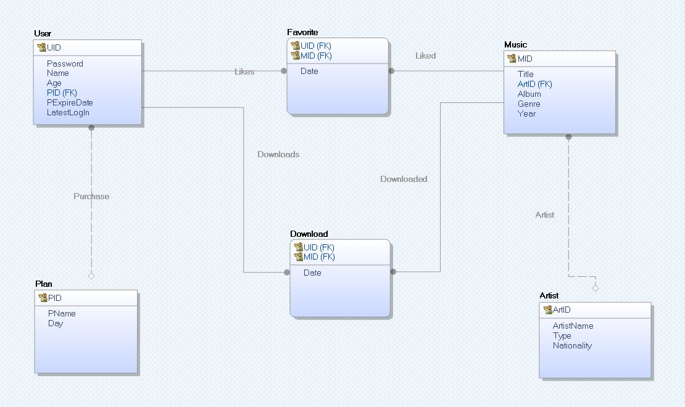
DB Design
ER diagram

Slide 5
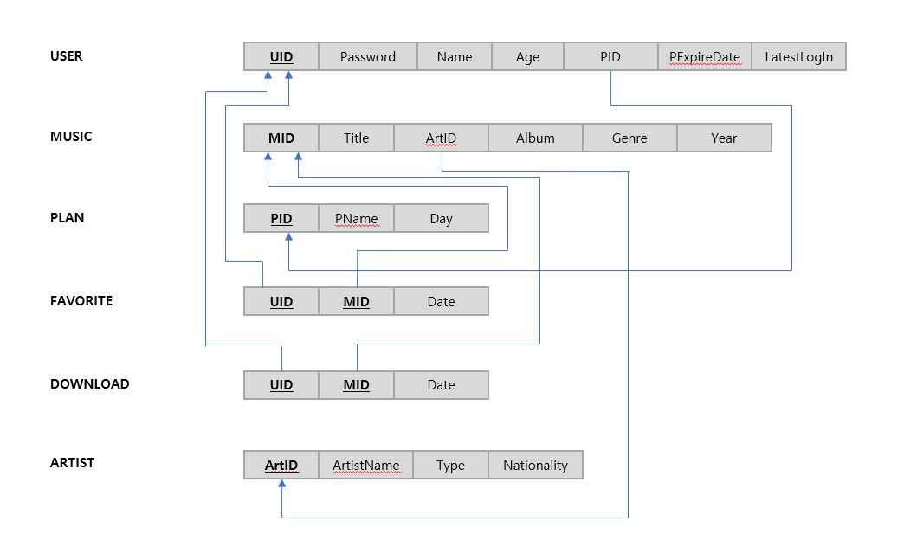
DB Design
Relational model

Slide 6
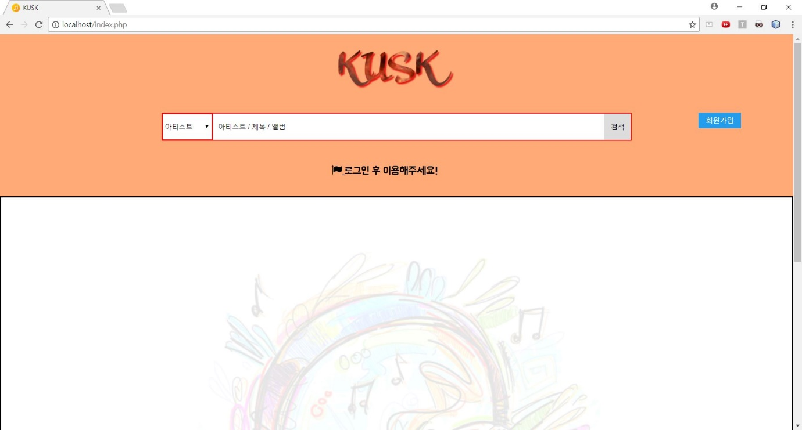
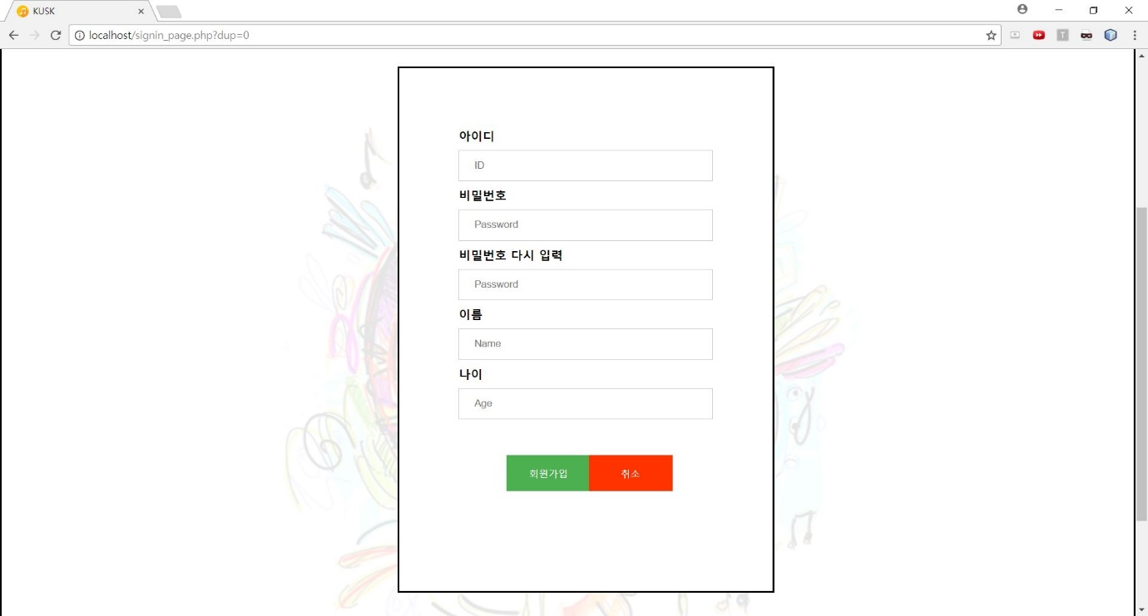
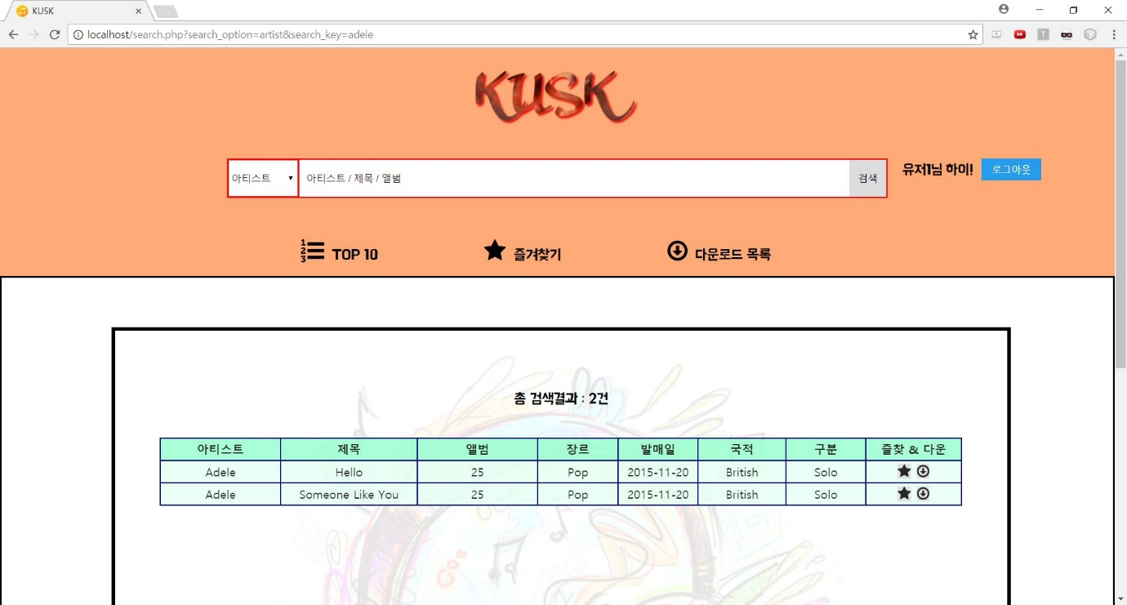
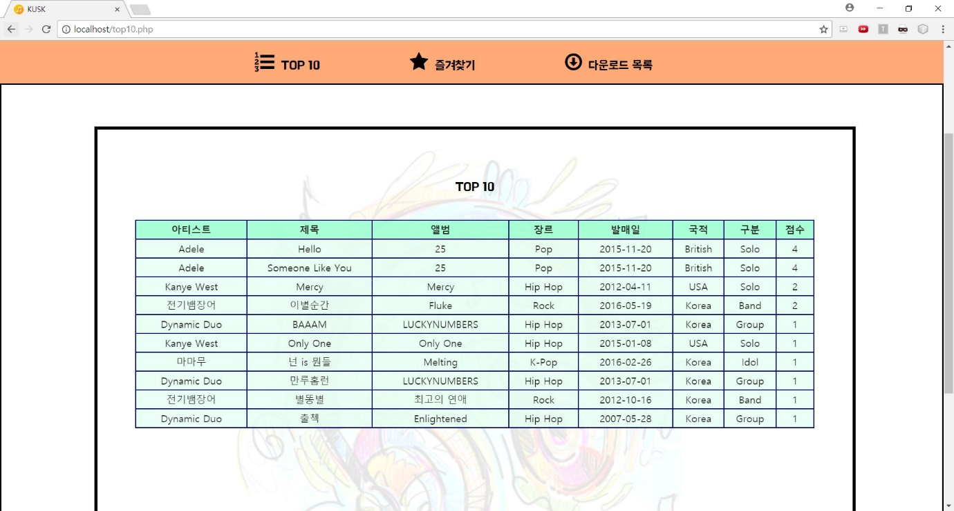
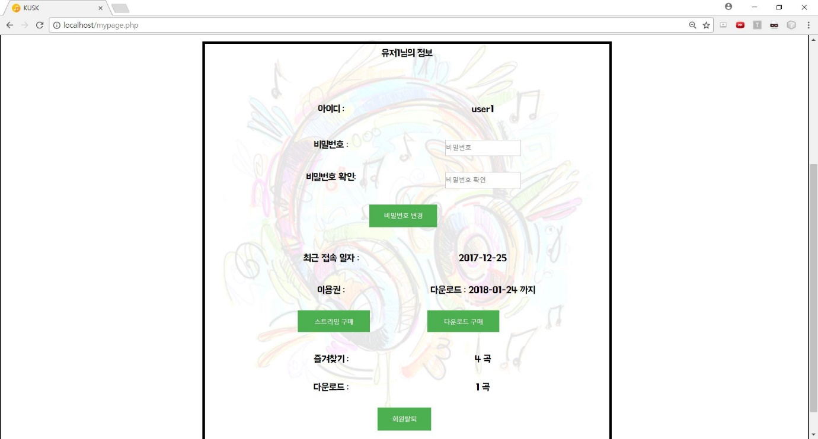
Demonstration
Please demonstrate your project when the meeting.

