Slide 1
CMPT 405/705
Design & Analysis of Algorithms
February 7, 2022

Slide 2
Plan for today
Fast(er) matrix multiplication
+ some related problems

Slide 3
Faster Matrix Multiplication

Slide 4
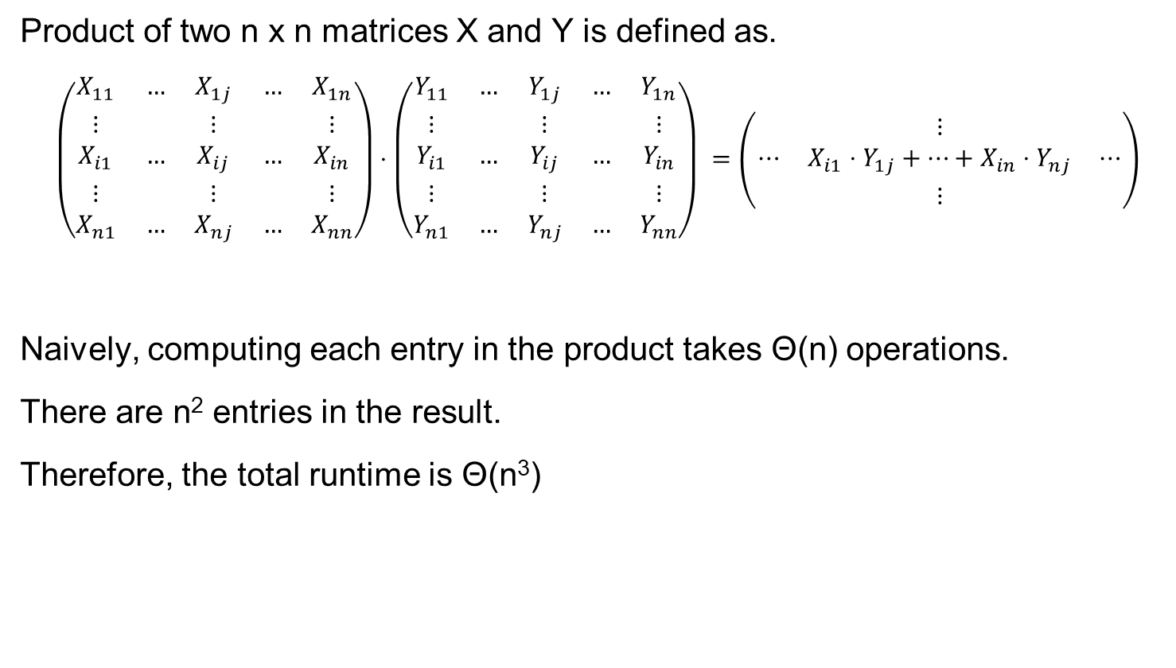
Matrix multiplication
Product of two n x n matrices X and Y is defined as.
$$\left(\begin{matrix}X_{11} & … & X_{1j} & … & X_{1n} \\ ⋮ & & ⋮ & & ⋮ \\ X_{i1} & … & X_{ij} & … & X_{in} \\ ⋮ & & ⋮ & & ⋮ \\ X_{n1} & … & X_{nj} & … & X_{nn}\end{matrix}\right)⋅\left(\begin{matrix}Y_{11} & … & Y_{1j} & … & Y_{1n} \\ ⋮ & & ⋮ & & ⋮ \\ Y_{i1} & … & Y_{ij} & … & Y_{in} \\ ⋮ & & ⋮ & & ⋮ \\ Y_{n1} & … & Y_{nj} & … & Y_{nn}\end{matrix}\right) =\left(\begin{matrix} & ⋮ & \\ ⋯ & X_{i1}⋅Y_{1j}+…+X_{in}⋅Y_{nj} & ⋯ \\ & ⋮ & \end{matrix}\right)$$
Naively, computing each entry in the product takes Θ(n) operations.
There are n² entries in the result.
Therefore, the total runtime is Θ(n³)
Can we do better?

Slide 5
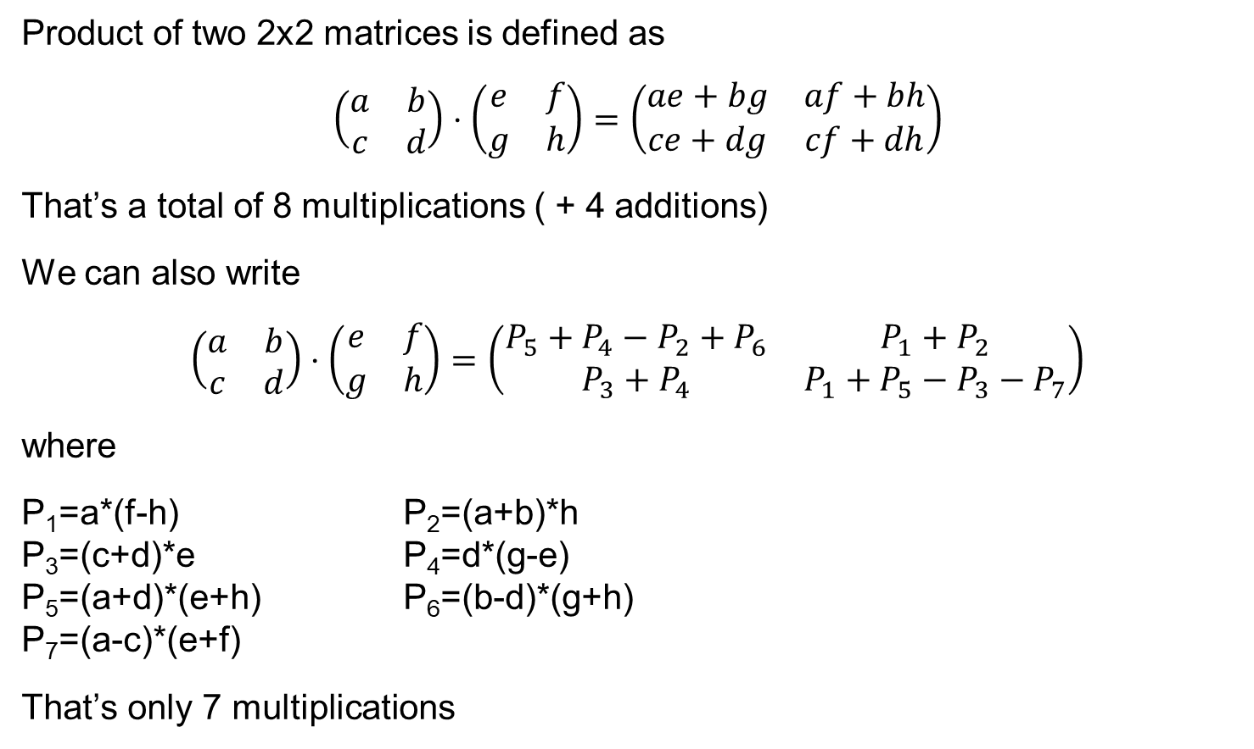
Strassen’s Algorithm
Product of two 2x2 matrices is defined as
$$\left(\begin{matrix}a & b \\ c & d\end{matrix}\right)⋅\left(\begin{matrix}e & f \\ g & h\end{matrix}\right)=\left(\begin{matrix}ae+bg & af+bh \\ ce+dg & cf+dh\end{matrix}\right)$$
That’s a total of 8 multiplications ( + 4 additions)
We can also write
$$\left(\begin{matrix}a & b \\ c & d\end{matrix}\right)⋅\left(\begin{matrix}e & f \\ g & h\end{matrix}\right)=\left(\begin{matrix}P_{5}+P_{4}−P_{2}+P_{6} & P_{1}+P_{2} \\ P_{3}+P_{4} & P_{1}+P_{5}−P_{3}−P_{7}\end{matrix}\right)$$
where
P₁=a*(f-h) P₂=(a+b)*h P₃=(c+d)*e P₄=d*(g-e) P₅=(a+d)*(e+h) P₆=(b-d)*(g+h) P₇=(a-c)*(e+f)
That’s only 7 multiplications
Can we use it to multiply nxn matrices faster?

Slide 6
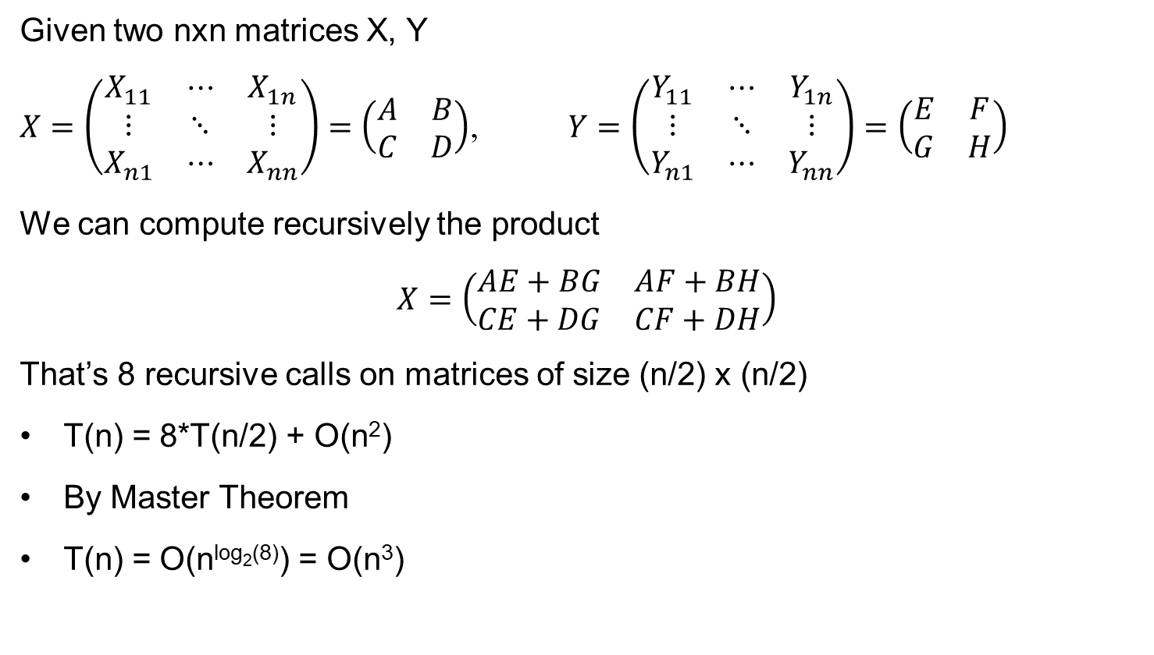
Naive recursive Algorithm
Given two nxn matrices X, Y
$X=\left(\begin{matrix}X_{11} & ⋯ & X_{1n} \\ ⋮ & ⋱ & ⋮ \\ X_{n1} & ⋯ & X_{nn}\end{matrix}\right)=\left(\begin{matrix}A & B \\ C & D\end{matrix}\right)$, $Y=\left(\begin{matrix}Y_{11} & ⋯ & Y_{1n} \\ ⋮ & ⋱ & ⋮ \\ Y_{n1} & ⋯ & Y_{nn}\end{matrix}\right)=\left(\begin{matrix}E & F \\ G & H\end{matrix}\right)$
We can compute recursively the product
$$X=\left(\begin{matrix}AE+BG & AF+BH \\ CE+DG & CF+DH\end{matrix}\right)$$
That’s 8 recursive calls on matrices of size (n/2) x (n/2)
T(n) = 8*T(n/2) + O(n²)
By Master Theorem
T(n) = O(n^{log2(8)}) = O(n³)

Slide 7

Example: blocks of submatrices
For example, if X is 4x4 matrix
$$X=\left(\begin{aligned}1 \\ 1 \\ 2 \\ 4 \end{aligned}\begin{aligned}1 \\ 1 \\ 2 \\ 4 \end{aligned}\begin{aligned}5 \\ 6 \\ 9 \\ 9 \end{aligned}\begin{aligned}7 \\ 8 \\ 9 \\ 9\end{aligned}\right)=\left(\begin{matrix}A & B \\ C & D\end{matrix}\right)$$
We can compute recursively the product
$A=\left(\begin{matrix}1 & 1 \\ 1 & 1\end{matrix}\right)$ $B=\left(\begin{matrix}5 & 7 \\ 6 & 8\end{matrix}\right)$
$C=\left(\begin{matrix}2 & 2 \\ 4 & 4\end{matrix}\right)$ $D=\left(\begin{matrix}9 & 9 \\ 9 & 9\end{matrix}\right)$

Slide 8
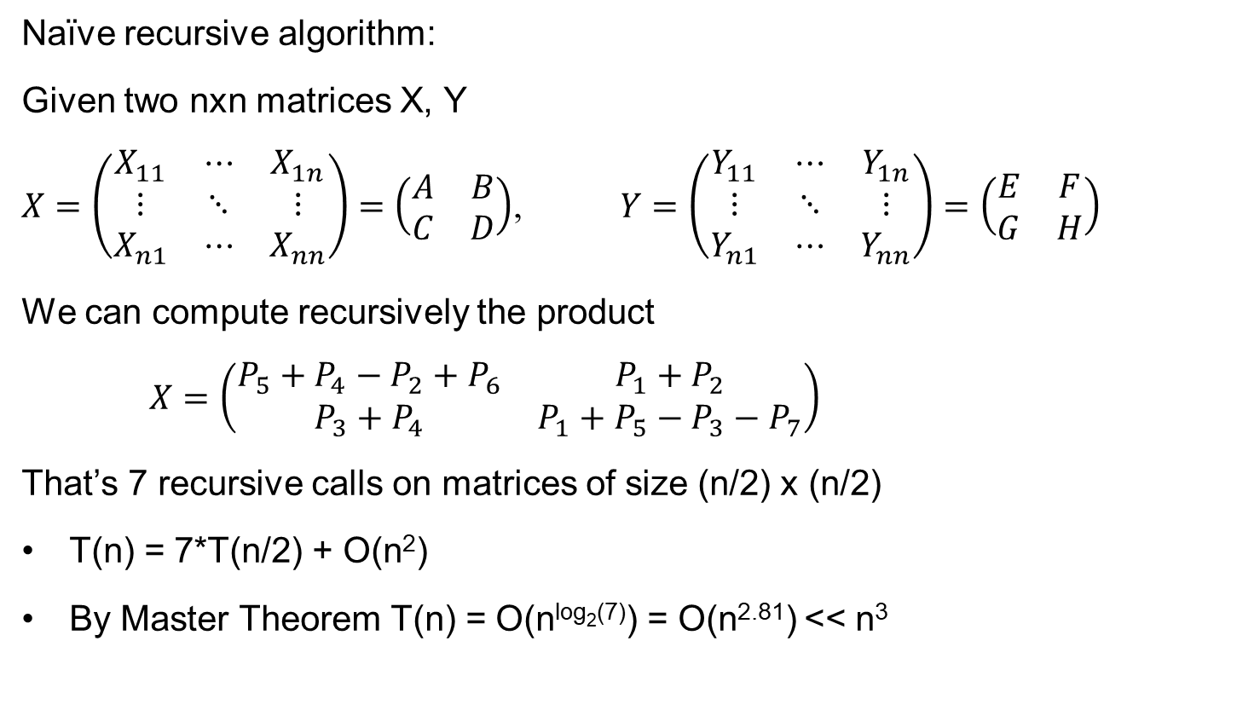
Strassen’s Algorithm
Naïve recursive algorithm:
Given two nxn matrices X, Y
$X=\left(\begin{matrix}X_{11} & ⋯ & X_{1n} \\ ⋮ & ⋱ & ⋮ \\ X_{n1} & ⋯ & X_{nn}\end{matrix}\right)=\left(\begin{matrix}A & B \\ C & D\end{matrix}\right)$, $Y=\left(\begin{matrix}Y_{11} & ⋯ & Y_{1n} \\ ⋮ & ⋱ & ⋮ \\ Y_{n1} & ⋯ & Y_{nn}\end{matrix}\right)=\left(\begin{matrix}E & F \\ G & H\end{matrix}\right)$
We can compute recursively the product
$X=\left(\begin{matrix}P_{5}+P_{4}−P_{2}+P_{6} & P_{1}+P_{2} \\ P_{3}+P_{4} & P_{1}+P_{5}−P_{3}−P_{7}\end{matrix}\right)$
That’s 7 recursive calls on matrices of size (n/2) x (n/2)
T(n) = 7*T(n/2) + O(n²)
By Master Theorem T(n) = O(n^{log2(7)}) = O(n^{2.81}) << n³
P₁=A*(F-H) P₂=(A+B)*H P₃=(C+D)*E P₄=D*(G-E) P₅=(A+D)*(E+H) P₆=(B-D)*(G+H) P₇=(A-C)*(E+F)

Slide 9
Faster Matrix Multiplication
We saw an algorithm with running time T(n) = O(n^{log2(7)}) = O(n^{2.8074})
Faster (theoretical) algorithms:
Instead of finding tricks with 2x2 matrices, we can try looking at 3x3, 4x4…
Around 1980’s there were results showing:
Multiplying 20x20 matrices with 4,460 multiplications. This gives T(n) = 4460*T(n/20) = O(n^{2.80496})
Multiplying 48x48 matrices with 47,217 multiplications. This gives T(n) = 47,217 *T(n/48) = O(n^{2.801474})
A breakthrough: T(n) = O(n^{2.376}) [Coppersmith-Winograd 1987]
Best know algorithm today: T(n) = O(n^{2.3728639}) [Le Gall 2014]
A huge open problem: Can matrix multiplication be solved in O(n²) time?
ω (omega) denotes the smallest exponent possible for a MM algorithm
Q: is it true that ω=2?

Slide 10
Faster Matrix Multiplication
(I believe) Strassen’s algorithm is used in practice
In practice there are all sort of implementation issues, and most of these theoretical algorithms are not practical.
Issues in practice:
Sparsity
Cache
Numeric issues
But this is a theoretical course, so we don’t care about these issues here.

Slide 11
Let‘s talk about Matrix Multiplication a bit more.
We‘ll return to divide and conquer next time

Slide 12
Freivalds' algorithm Verifying Matrix Multiplication in O(n²) time

Slide 13
Verifying matrix multiplication
Can we do faster?
Input: Three NxN (real/integer) matrices A,B,C
Goal: check if A*B = C
Trivial solution: Compute A*B and compare the solution to C.
Runtime:
Naively, the runtime is O(N³) for multiplying two matrices + O(N²) for checking equality of two matrices.
5 minutes ago: Matrix multiplication can be solved in time O(N^{2.81}).
Fastest algorithm: Matrix multiplication can be solved in time O(N^{2.3728639}).
Therefore the total runtime is O(N^{2.3728639}).
Note that we need to return only TES/NO, as opposed to n² values.

Slide 14
Verifying matrix multiplication
Input: Three NxN (real/integer) matrices A,B,C
Goal: check if A*B = C
Theorem: There exists an algorithm that runs in O(N²) time and returns the correct answer with probability > 0.999.
Freivalds' algorithm: On input A,B,C
Repeat 10 times
Sample r∈{0,1}^{N} by picking each r_{i} to be 0/1 w.p. ½ independently
Compute z = A*B*r (in O(N²) time)
Compute z’ = C*r (in O(N²) time)
If z≠z’ return “NOT EQUAL”
If reached here, return “EQUAL”
How can we compute A*B*z in O(N²) time?

Slide 15
Verifying matrix multiplication
Sample r∈{0,1}^{N} by picking each r_{i} to be 0/1 w.p. ½ independently
Compute z = A*B*r (in O(N²) time)
Compute z’ = C*r (in O(N²) time)
If z≠z’ return “NOT EQUAL”
Analysis: Let’s analyze one iteration of the algorithm.
If A*B = C, then clearly Pr_{r}[z=z’]=1.
Therefore, if A*B = C, then the algorithm outputs “EQUAL” with probability 1.

Slide 16
Verifying matrix multiplication
Claim: If A*B ≠ C, then Pr_{r}[z=z’] <= 1/2.
This implies that Pr[all 10 iterations have z=z’] <= 1/2¹⁰< 1/1000.
Proof of claim:
Let D=A*B-C. Then D is a non-zero matrix and
Pr_{r}[z=z’] = Pr_{r}[z-z’=0] = Pr_{r}[(A*B-C)v ≡ 0] = Pr_{r}[Dv ≡ 0].
Since D is a non-zero matrix, there is some i,j∈[N] such that D_{i,j} ≠0.
Focus only on the i’th row of D. We prove that Pr_{r}[<D_{i},r> = 0] <= ½.
0 | 0 | 0 | 0 | 0
0 | 0 | 0 | 0 | 0
1 | 0 | 2 | 0 | 0
0 | 0 | 0 | 0 | 0
0 | 4 | 0 | 0 | 1
r₁
r₂
r₃
r₄
r₅
x =

Slide 17
Verifying matrix multiplication
Claim: Let v= (v₁…v_{N}) be a non-zero row of N integers/reals
Sample r∈{0,1}^{N} by picking each r_{i} to be 0/1 w.p. ½ independently
Then Pr_{r}[∑_{j} r_{j} v_{j} = 0] <= ½.
Proof: Suppose for concreteness that v_{N}≠0. Sample first r₁,r₂,…r_{N-1}. Then there is at most one possible value for r_{N} so that ∑_{j} r_{j} v_{j} = 0.
Example1: if ∑_{j<=N-1} r_{j} v_{j} = 0, then only r_{N}=0 will make the entire sum 0.
Example2: if ∑_{j<=N-1} r_{j} v_{j} = -1, then only r_{N}=1 will make the entire sum 0.
Therefore, for any fixing of r₁,r₂,…r_{N-1} we have
Pr_{r}[∑_{j} r_{j} v_{j} = 0] <= ½.

Slide 18
Verifying matrix multiplication
Back to our claim
Claim: If A*B ≠ C, then Pr_{r}[z=z’] <= 1/2.
Proof of claim:
Let D=A*B-C. Then D is a non-zero matrix and
Pr_{v}[z=z’] = Pr_{v}[z-z’=0] = Pr[(A*B-C)v ≡ 0] = Pr[Dv ≡ 0].
Focus only on the i’th row of D.
We have Pr[Dr ≡ 0] <= Pr_{r}[<D_{i},r> = 0] <= ½, as required.
0 | 0 | 0 | 0 | 0
0 | 0 | 0 | 0 | 0
1 | 0 | 2 | 0 | 0
0 | 0 | 0 | 0 | 0
0 | 4 | 0 | 0 | 1
r₁
r₂
r₃
r₄
r₅
x =

Slide 19
Verifying matrix multiplication
Freivalds' algorithm: On input A,B,C
Repeat 10 times
Sample r∈{0,1}^{N} by picking each r_{i} to be 0/1 w.p. ½ independently
Compute z = A*B*v (in O(N²) time)
Compute z’ = C*v (in O(N²) time)
If z≠z’ return “NOT EQUAL”
If reached here, return “EQUAL”
Theorem:
If AB = C, then Pr[Algorithm returns “EQUAL] = 1
If AB ≠ C, then Pr[Algorithm returns “”NOT EQUAL”] >0.999

Slide 20
Verifying Matrix Multiplication:
The polynomial identity testing lens

Slide 21
Verifying matrix multiplication - revisited
Input: Three NxN (real/integer) matrices A,B,C
Goal: check if A*B = C
Theorem: There exists an algorithm that runs in O(N²) time and returns the correct answer with probability > 0.999.
Freivalds' algorithm: On input A,B,C
Repeat 10 times
Sample r∈{0,1}^{N} by picking each r_{i} to be 0/1 w.p. ½ independently
Compute z = A*B*r (in O(N²) time)
Compute z’ = C*r (in O(N²) time)
If z≠z’ return “NOT EQUAL”
If reached here, return “EQUAL”

Slide 22
Verifying matrix multiplication - revisited
Goal: Given three NxN (real/integer) matrices A,B,C, check if A*B = C
Theorem: There exists an algorithm that runs in O(N²) time and returns the correct answer with probability > 0.999.
Recall: The analysis boils down to checking if a given matrix D∈R^{NxN} is identically zero or not.
We do it by picking a random r∈S^{N} and checking if Dr is the all-zero vector.
Equivalently, we can phrase the problem as polynomial identity testing:
Let p_{i}(r₁,r₂,…r_{n}) = D_{i,1}r₁ + D_{i,2}r₂ + … D_{i,n}r_{n} be the inner product with the i'th row.
Each p_{i} is a polynomial of degree 1.
Therefore if one of the p_{i}’s is not zero, then Pr[p_{i}(v₁,v₂,…v_{n}) = 0] < 1/|S|

Slide 23
Matrix Multiplication modulo p

Slide 24
Matrix multiplication: heuristics vs worst case
We said MM algorithms must run in time at least O(n²), but the best algorithm we have is slower than that.
A motivating question: Can we come up with an algorithm that runs in O(n²) time, but the guarantee is that it outputs the correct answer only most inputs (and not all inputs)?
Algorithm works ok on most inputs, but “gives up on some hard instances”.
Question: How can we formalize “most inputs”?
How can we say formally “the algorithm succeeds on 99% on the inputs?

Slide 25
Matrix multiplication modulo p
Matrix Multiplication modulo p for a prime p (e.g. p=2,7,59…):
Input: A,B - NxN matrices with values in Z_{p}. That is, each entry is in {0,1,…p-1}
Goal: compute A*B modulo p
Observation: Suppose we want to multiply two NxN matrices over integers (without modulo), and let’s say all entries are in [-K…K].
Then, each entry in the result is in [-K*N², K*N²].
Claim: If Matrix Multiplication mod p can be solved in time T(N) ∀p<log(K*N²), then Matrix Multiplication over integers can be solved in time O(T*polylog(N)).
Proof idea: Compute multiplication mod 2,3,5,7,11, 13…log(K*N²).
Then use Chinese Remainder Theorem to compute the answers in integers.

Slide 26
Matrix multiplication modulo p
Chinese remainder theorem by example:
Suppose we know that X (one of the entries in A*B) is between -100 and 100.
And we also know that
X = 0 mod 2
X = 0 mod 3
X = 1 mod 5
X = 2 mod 7
Q: What is X?
Answers in integers: Chinese remained theorem gives us X = 156 mod 210
Answers in [-100, 100]: If X is between -100 and 100, then X = -54.
CRT finds an answers modulo 2*3*5*7=210

Slide 27
Matrix Multiplication mod p:
Heuristics vs worst case algorithms

Slide 28
Matrix multiplication: heuristics vs worst case
Theorem [self correction for Matrix Multiplication mod p]:
Suppose ALG is an algorithm that gets two NxN matrices A,B over Z_{p}.
ALG runs in time T(N)
Pr_{A,B}[ALG(A,B) = A*B mod p] > 0.99
Then, there is an algorithm ALG* ,that gets two NxN matrices A,B over Z_{p}.
ALG* runs in time O(T(N))
Pr[ALG*(A,B) = A*B mod p] > 0.96 for all inputs A,B
ALG computes the correct answer (mod p) for most inputs.
ALG* computes the correct answer (mod p) for all inputs.

Slide 29
Matrix multiplication: heuristics vs worst case
Theorem [self correction for Matrix Multiplication mod p]:
Suppose ALG is an algorithm that gets two NxN matrices A,B over Z_{p}.
Pr_{A,B}[ALG(A,B) = A*B mod p] > 1-δ
ALG* gets A,B and works as follows:
Choose two uniformly random NxN matrices R, S over Z_{p}.
We make 4 calls to ALG: ALG(A-R,B-S) ; ALG(R,B-S) ; ALG(A-R,S) ; ALG(R,S)
Return ALG(A-R,B-S) + ALG(R,B-S) + ALG(A-R,S) + ALG(R,S)
Running time: if ALG runs in time T(N), then ALG* runs in time O(T(N)),
because it essentially makes 4 calls to ALG.

Slide 30
Matrix multiplication: heuristics vs worst case
Theorem [self correction for Matrix Multiplication mod p]:
Suppose ALG is an algorithm that gets two NxN matrices A,B over Z_{p}.
Pr_{A,B}[ALG(A,B) = A*B mod p] > 1-δ
ALG* gets A,B and works as follows:
Choose two uniformly random NxN matrices R, S over Z_{p}.
We make 4 calls to ALG: ALG(A-R,B-S) ; ALG(R,B-S) ; ALG(A-R,S) ; ALG(R,S)
Return ALG(A-R,B-S) + ALG(R,B-S) + ALG(A-R,S) + ALG(R,S)
Correctness:
Key observation: each of the for calls are on uniformly random inputs

Slide 31
Proof of Correctness
ALG* on input (A,B) and works as follows:
Choose two uniformly random NxN matrices R, S over Z_{p}.
We make 4 calls to ALG: ALG(R,S) ; ALG(A-R,S) ; ALG(R,B-S) ; ALG(A-R,B-S)
Return ALG(R,S) + ALG(A-R,S) + ALG(R,B-S) + ALG(A-R,B-S)
Key observation: each of the for calls are on uniformly random inputs.
Each of the 4 calls outputs the correct answer with probability > 1-δ.
Therefore, Pr[all four calls produce the correct answer] > 1-4δ.
If all four are correct, then ALG* returns:
ALG(R,S) + ALG(A-R,S) + ALG(R,B-S) + ALG(A-R,B-S)
= R*S + (A-R)*S + R*(B-S) + (A-R)*(B-S)
= A*S + A*(B-S)
= A*B

Slide 32
Proof of Correctness
ALG* on input (A,B) and works as follows:
Choose two uniformly random NxN matrices R, S over Z_{p}.
We make 4 calls to ALG: ALG(R,S) ; ALG(A-R,S) ; ALG(R,B-S) ; ALG(A-R,B-S)
Return ALG(R,S) + ALG(A-R,S) + ALG(R,B-S) + ALG(A-R,B-S)
Key observation: each of the for calls are on uniformly random inputs.
Each of the 4 calls outputs the correct answer with probability > 0.99 = 1-δ.
Therefore, Pr[all four calls produce the correct answer] > 1-4δ.
Therefore, for all inputs A,B Pr[ALG*(A,B) = A*B] >1-4δ > 0.96.
We converted ALG that works for most inputs into ALG* that works for all inputs.

Slide 33
Boosting the success probability
We converted ALG that works for most inputs into ALG* that produces the correct answer for all inputs, with probability > 0.96.
Now we have ALG* such that Pr[ALG*(A,B) = A*B] > 0.96 for all inputs A,B.
We can boost the success probability by repeating ALG* and taking the most common answer.
ALG**: on input (A,B) works as follows
Run ALG*(A,B) k times, and remember the k answers
Take the most popular answer.
Pr[ALG*(A,B) = A*B] > 0.96 ➔ the majority of answers will be correct with high prob.

Slide 34
Questions?
Comments?

