Slide 1
CMPT 405/705
Design & Analysis of Algorithms
February 9, 2022

Slide 2
Plan for today
Divide and conquer algorithms
Quick sort
Median find

Slide 3
Quick Sort

Slide 4
Quick Sort
Given an array A[0…n-1]
Choose an element in the array, call it the pivot.
Rearrange the elements in the array so that:
All A[i] < pivot are to the left of pivot.
All A[i] >= pivot are to the right of pivot.
Recursively sort to the left of the pivot.
Recursively sort to the right of the pivot.

Slide 5
Quick Sort
Example: Input: [4, 1, 8, 7, 10, 3]
Let pivot =7
Rearrange to get [4,1,3] and [7, 10, 8]
Sort [4, 1, 3] ➔[1, 3, 4]
Sort [7, 10, 8] ➔ [7, 8, 10]
Correctness: obvious.

Slide 6
Quick Sort
Running time – O(n log(n)) for good pivots
Q: What is a good pivot?
A:The one that splits the array into equal halves
Indeed: if the pivot splits the array into two subarrays of size n/2, then
T(n) = O(1) + O(n) + 2*T(n/2)
Therefore, by Master theorem: T(n) = O(n log(n))
Q: how can we find a good pivot?
Choose a pivot
Rearranging
Recursion

Slide 7
Quick Sort
Q: What if the pivot splits the array n/3 vs 2n/3?
A: we will get a recurrence relation
T(n) = O(1) + O(n) + T(n/3) + T(2n/3)
This also gives T(n) = O(n log(n)) // we used a tree drawing to prove it.
Even if we get n/5 vs 4n/5 that will also suffice.
Even if we get n/16 vs 15n/16 that will also suffice.
Choose a pivot
Rearranging
Recursion

Slide 8
Finding a good pivot
Question: How can we find a good pivot?
We’ll see two algorithms:
A randomized algorithm
A deterministic algorithm

Slide 9
Finding median of an array

Slide 10
Finding k‘th smallest element

Slide 11
Finding k'th smallest element
Input: array A[0…n-1] (unsorted)
Goal: find k’th smallest element in A
If k=1,2,3, can do a linear search and remember the k smallest elements.
In each iteration we will update the saved k smallest elements
The running time of this is O(kn).
This is ok if k=1,2,3, but not great for k=n/2
We can sort the array and find the k’th element…
That kinda misses the point if we use median-find for quick-sort

Slide 12
Finding k'th smallest element
Input: array A[0…n-1] (unsorted)
Goal: find k’th smallest element in A
If k=1,2,3, can do a linear search and remember the k smallest elements.
In each iteration we will update the saved k smallest elements
A = [3,4,1,7,2] k =2
3, 4: min = 3, second-min=4
Read 1: min=1 second-min=3
Read 7: min=1 second-min=3
Read 2: min=1 second-min=2

Slide 13
Finding k‘th smallest element – randomized algorithm

Slide 14
Finding k'th smallest element
Input: array A[0…n-1] (unsorted)
Goal: find k’th smallest element in A
A randomized algorithm: Let T be a parameter
Sample T uniformly random elements from A: A[i₁], A[i₂] … A[i_{T}].
Compute M = their median. Achieved by sorting them in O(T²) time.
Let L be the A[i]’s that are < M
Let H be the A[i]’s that are ≥ M
If |L| > k, apply recursion on L (with same k)
If |L| < k, apply recursion on H (with k-|L|)
Key claim: with high probability the recursion removes at least n/16 elements
We make only one recursive call

Slide 15
Finding k'th smallest element
Example: Input: [6, 1, 8, 7, 10, 3, 12, 5, 2] and some parameter k.
Suppose we got M = 7 // using sampling (e.g. 7,12,2) + find the median
Then the small elements are L = [6,1,3,5,2] the large elements are H = [8,7,10,12]
If k=4, then we use recursion to find the 4’th smallest elt in L ➔ 5
If k=7, then we use recursion to find the (7-|L|)’th smallest elt in H ➔ 8

Slide 16
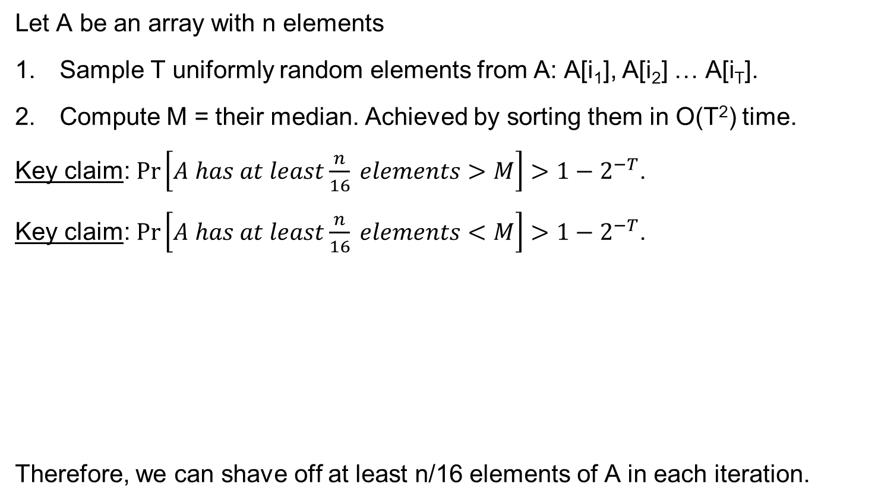



Finding k'th smallest element
Let A be an array with n elements
Sample T uniformly random elements from A: A[i₁], A[i₂] … A[i_{T}].
Compute M = their median. Achieved by sorting them in O(T²) time.
Key claim: $\operatorname{Pr}\left[A has at least\frac{n}{16} elements>M\right]>1−2^{−T}$.
Key claim: $\operatorname{Pr}\left[A has at least\frac{n}{16} elements<M\right]>1−2^{−T}$.
Therefore, we can shave off at least n/16 elements of A in each iteration.
median of sample
sample
1
$$\frac{n}{16}$$
$$\frac{15n}{16}$$
$$n$$

Slide 17
Finding k'th smallest element
If length(A)<16, just find k’th element in O(1) time
Sample T uniformly random elements from A: A[i₁], A[i₂] … A[i_{T}].
Compute M = their median. Achieved by sorting them in O(T²) time.
Let L be the A[i]’s that are < M
Let H be the A[i]’s that are ≥ M
If |L| > k, apply recursion on L (with same k)
If |L| < k, apply recursion on H (with k-|L|)
check if recursions removes at least N/16 elements. If not, resample
The total running time of the search algorithm is T(n) < T(15n/16)+O(n)+O(T²)
➔ T(n) = O(n) assuming T<sqrt(n)

Slide 18
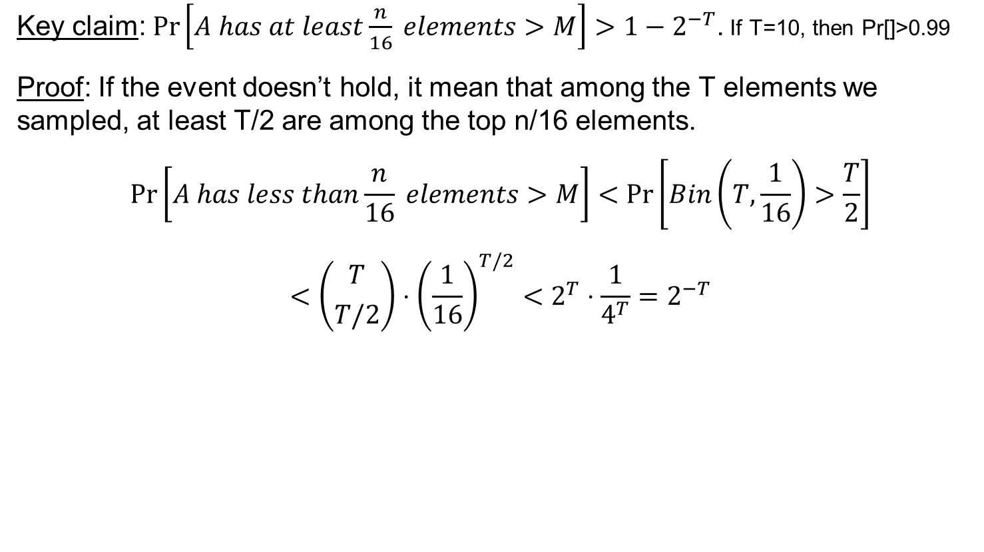

Finding k'th smallest element
Key claim: $\operatorname{Pr}\left[A has at least\frac{n}{16} elements>M\right]>1−2^{−T}$. If T=10, then Pr[]>0.99
Proof: If the event doesn’t hold, it mean that among the T elements we sampled, at least T/2 are among the top n/16 elements.
$$\operatorname{Pr}\left[A has less than\frac{n}{16} elements>M\right]<\operatorname{Pr}\left[Bin\left(T,\frac{1}{16}\right)>\frac{T}{2}\right]$$
$$<\left({T \atop T/2}\right)⋅{\left(\frac{1}{16}\right)}^{T/2}<2^{T}⋅\frac{1}{4^{T}}=2^{−T}$$
median of sample
samples
1
$$\frac{15n}{16}$$
$$n$$

Slide 19
Finding k'th smallest element
Let A be an array with n elements
Sample T uniformly random elements from A: A[i₁], A[i₂] … A[i_{T}].
Compute M = their median. Achieved by sorting them in O(T²) time.
Key claim: $\operatorname{Pr}\left[A has at least\frac{n}{16} elements>M\right]>1−2^{−T}$.
Key claim: $\operatorname{Pr}\left[A has at least\frac{n}{16} elements<M\right]>1−2^{−T}$.
Therefore, we can shave off at least n/16 elements of A in each iteration.
median of sample
sample
1
$$\frac{n}{16}$$
$$\frac{15n}{16}$$
$$n$$

Slide 20
Quick Sort
Given an array A[0…n-1]
Choose an element in the array, call it the pivot.
Rearrange the elements in the array so that:
All A[i] < pivot are to the left of pivot.
All A[i] >= pivot are to the right of pivot.
Recursively sort to the left of the pivot.
Recursively sort to the right of the pivot.
We choose pivot using “find k’th smallest element” with k=n/2.
Fact: We can choose pivot to be a uniformly random index, and the expected running time will be O(n log(n)).
But we’ll do it later in the course.

Slide 21
Questions?
Comments?

