Slide 1
Amplitude Modulation
1475043
이효림
hyoruim@gmail.com
Department of Electronic and Electrical Engineering
Ewha Womans University

Slide 2
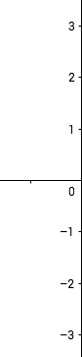
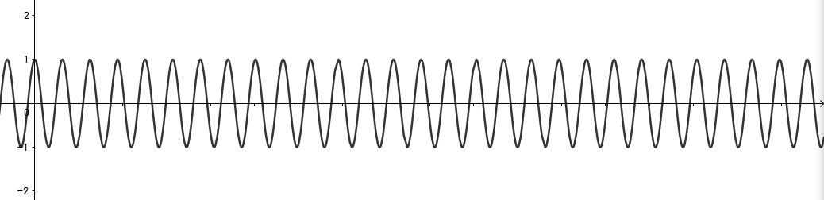

1.
From figure 1, we can find the exact expression of $f\left(t\right)$.
$f\left(t\right)=1$, $f\left(t\right) cosω_{c}t=cosω_{c}t$ $(0<t≤20, 60<t≤80)$
$f\left(t\right)=0$, $f\left(t\right) cosω_{c}t=−cosω_{c}t$ $(20<t≤60, 80<t≤100)$
20
60
80
100

Slide 3
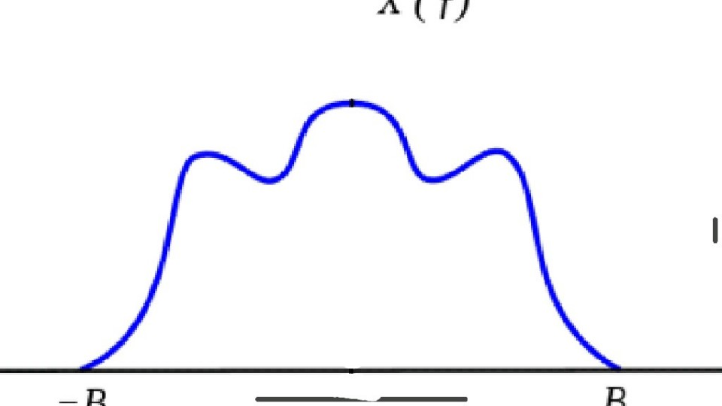









2.
$ω_{c}=2πf_{c}$, $f\left(t\right)cosω_{c}t=f\left(t\right)cos2πf_{c}t$
$x\left(t\right)cos⁡(2πf_{c}t)$ ←F.T.→ $\frac{1}{2}[X\left(f−f_{c}\right)+X\left(f+f_{c}\right)]$
From the modulation property (the expression above), the amplitude of the signals reduced to half. And the signals moved to the carrier frequency both in positive area and negative area.
$$\frac{1}{2}X(0)$$
$${−f}_{c}−B$$
$${−f}_{c}$$
$${−f}_{c}+B$$
$$f_{c}−B$$
$$f_{c}$$
$$f_{c}+B$$
$$f$$

Slide 4
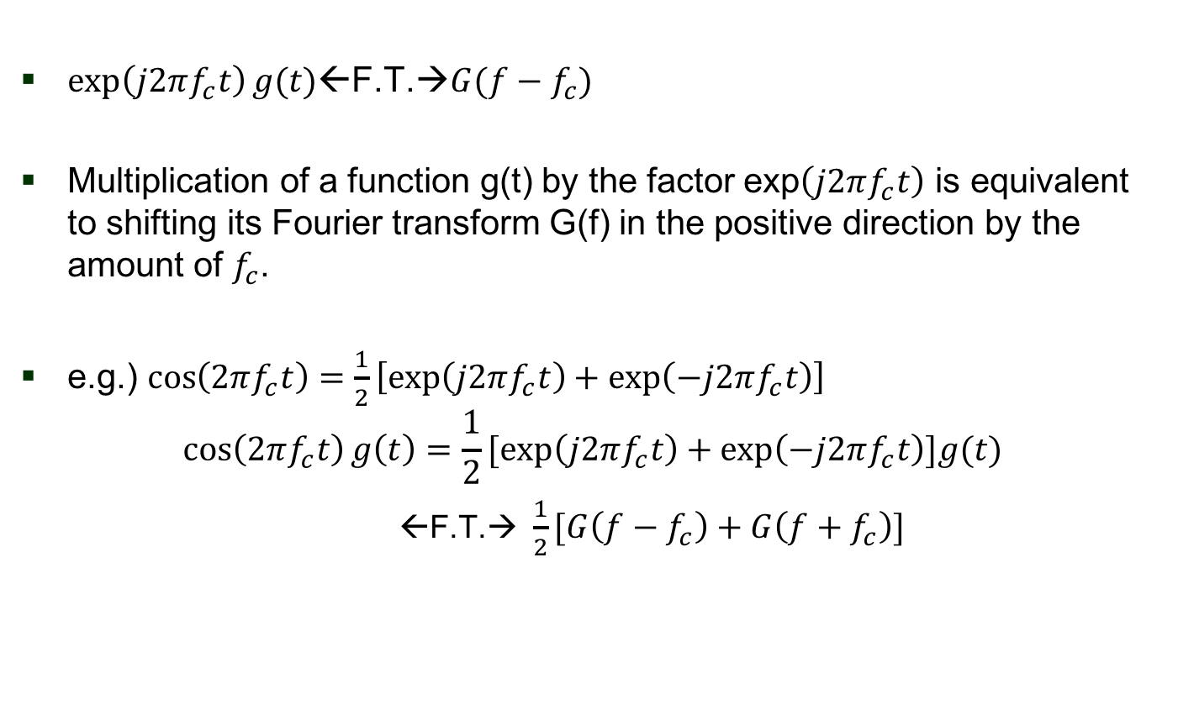
3. Fourier Transform and Its Modulation Property
$\exp\left(j2πf_{c}t\right)g(t)$←F.T.→$G(f−f_{c})$
Multiplication of a function g(t) by the factor exp$\left(j2πf_{c}t\right)$ is equivalent to shifting its Fourier transform G(f) in the positive direction by the amount of $f_{c}$.
e.g.) $\cos\left(2πf_{c}t\right)=\frac{1}{2}\left[\exp\left(j2πf_{c}t\right)+\exp\left(−j2πf_{c}t\right)\right]$
$$\cos\left(2πf_{c}t\right)g\left(t\right)=\frac{1}{2}[exp\left(j2πf_{c}t\right)+\exp\left(−j2πf_{c}t\right)]g(t)$$
  ←F.T.→ $\frac{1}{2}[G\left(f−f_{c}\right)+G\left(f+f_{c}\right)]$

