Slide 1
Band Gap of the SSH Chain
SSH: Su–Schrieffer–Heeger model, a chain with alternating bonds
tight-binding: electrons hop between neighboring atoms
t₁, t₂: hopping energies inside / between unit cells (arbitrary units)
20251320 Hyosan Shin · PHY4008 Computational Physics · Midterm

Slide 2
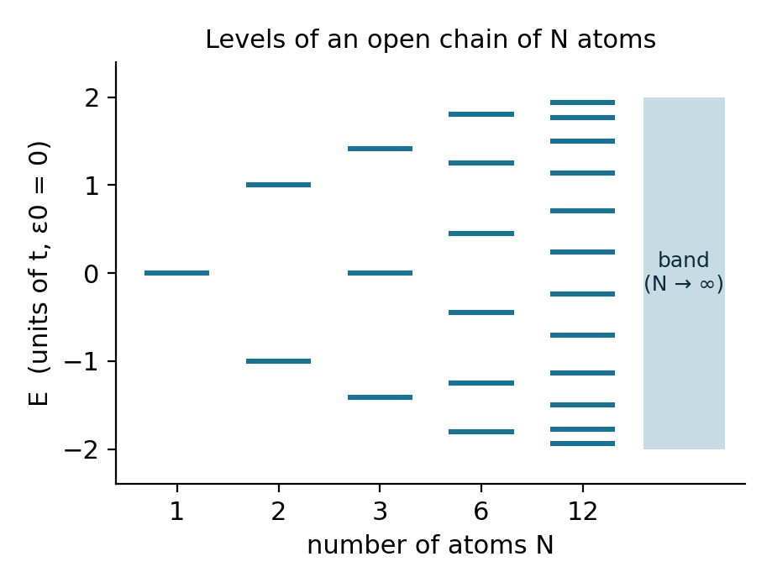
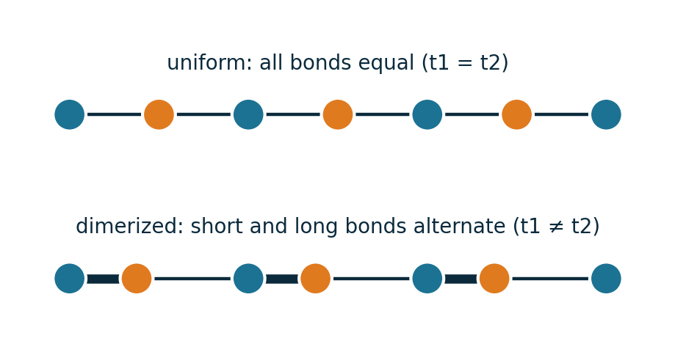
Motivation: from atoms to bands
N atoms → N levels → a band
The gap separates metals from semiconductors
Alternating bonds can open a gap (polyacetylene)
N: number of atoms; E: electron energy in units of the hopping energy t
Right: schematic, not a calculation result.
SSH chain · band gap
Ref: [1]
2

Slide 3
Question and quantities
How does the band gap change with t₂/t₁, and how well does a finite-chain calculation converge to it?
1
Bands
2
Gap
3
Finite chain
E±(k): eigenvalues at every k
min E₊ − max E₋ over all k
smallest |E| of an open chain (2N×2N matrix)
t₁, t₂: hopping energies (an electron hops within / between unit cells; arbitrary units). N_{c}: number of unit cells.
Scope: band gap.
SSH chain · band gap
3

Slide 4
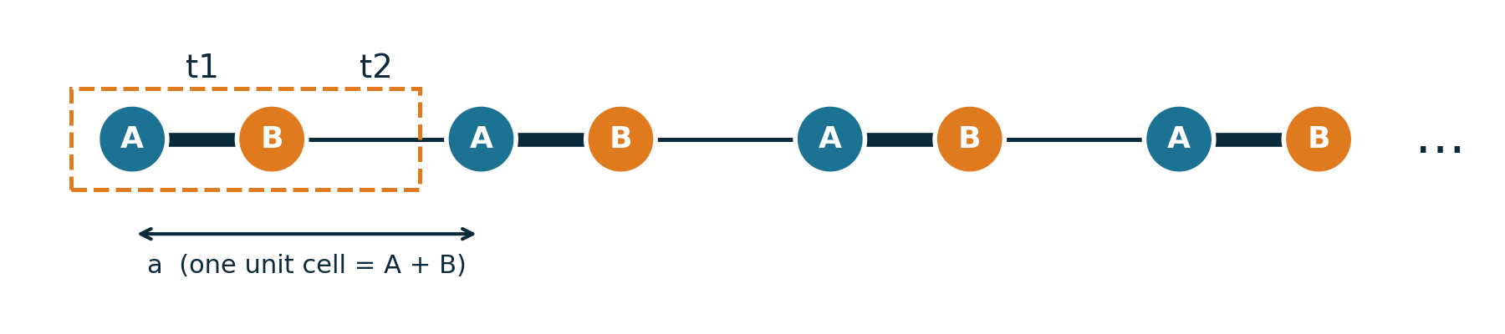
SSH model, assumptions, boundary conditions
Assumptions
Boundary conditions
Convention
Nearest-neighbor hopping only
Orthogonal orbitals
No on-site energy
Periodic: bands, H(k)
Open: finite chain
Finite chain starts at A
First bond is t₁
t₁, t₂ in arbitrary units
hopping: energy scale for an electron to move to a neighboring atom · orbital: the electron's state on one atom · on-site energy: energy of an electron sitting on one atom · unit cell: the repeating unit (atoms A and B)
SSH chain · band gap
Ref: [2], [3]
4

Slide 5
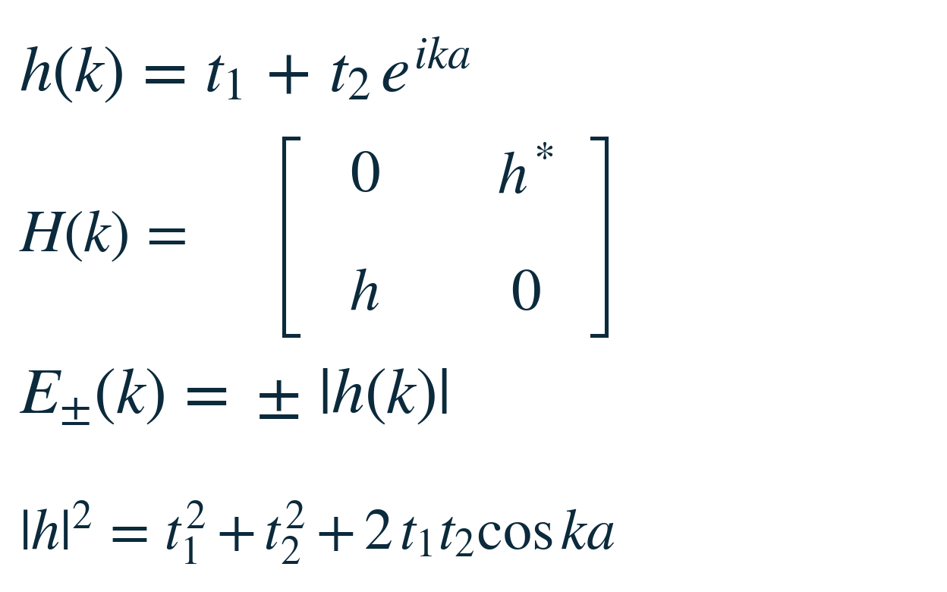

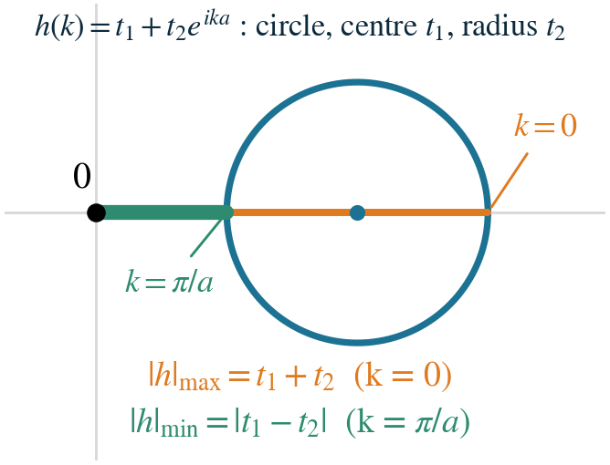
The gap formula, taken from the references
E_{gap} = 2|t₁ − t₂|
band gap of the SSH chain, as given in [1], [3]
Band energies (as given in [1], [3])
E±(k) = ± √(t₁² + t₂² + 2 t₁t₂ cos ka)
largest at k = 0 (t₁ + t₂), smallest at k = π/a (|t₁ − t₂|)
What this project does
Take the formula from the references; do not derive it here.
Compute the bands and the gap numerically for many values of t₂/t₁.
Compare the numerical gap with the formula (slides 8 and 9).
k: wavenumber (label of the electron states, 1/length) · a: unit-cell length · t₁, t₂: hopping energies (inside / between unit cells)
SSH chain · band gap
Ref: [1], [3]
5

Slide 6
Quantities computed
1
Bands
 | A₁ | B₁ | A₂ | B₂
A₁ | 0 | t₁ | 0 | 0
B₁ | t₁ | 0 | t₂ | 0
A₂ | 0 | t₂ | 0 | t₁
B₂ | 0 | 0 | t₁ | 0
eigenvalues of H(k) at each k
2
Gap
min E₊ − max E₋
3
Finite chain
smallest |E| of the 2N×2N matrix
H for N_{c} = 2 unit cells (4 atoms): an example, not a result
Open chain: diagonalize the full 2N×2N matrix.
SSH chain · band gap
6

Slide 7
Numerical workflow
Read input/params.json
read params.json
for k in grid:
h = t1 + t2 * exp(i*k*a)
E± = eigvalsh(2x2 matrix)
gap = min(E+) - max(E-)
H_chain = 2N x 2N, bonds t1, t2, t1, ...
E = eigvalsh(H_chain)
compare with analytic; save to output/
1
Diagonalize: 2×2 per k, 2N×2N for the open chain
2
Compare with analytic results; vary resolution
3
Save tables and figures to output/
4
pseudocode (flow only) · params.json: text file holding all settings · N: number of unit cells
SSH chain · band gap
7

Slide 8
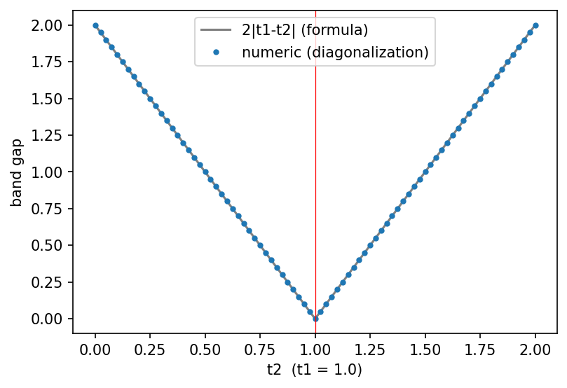
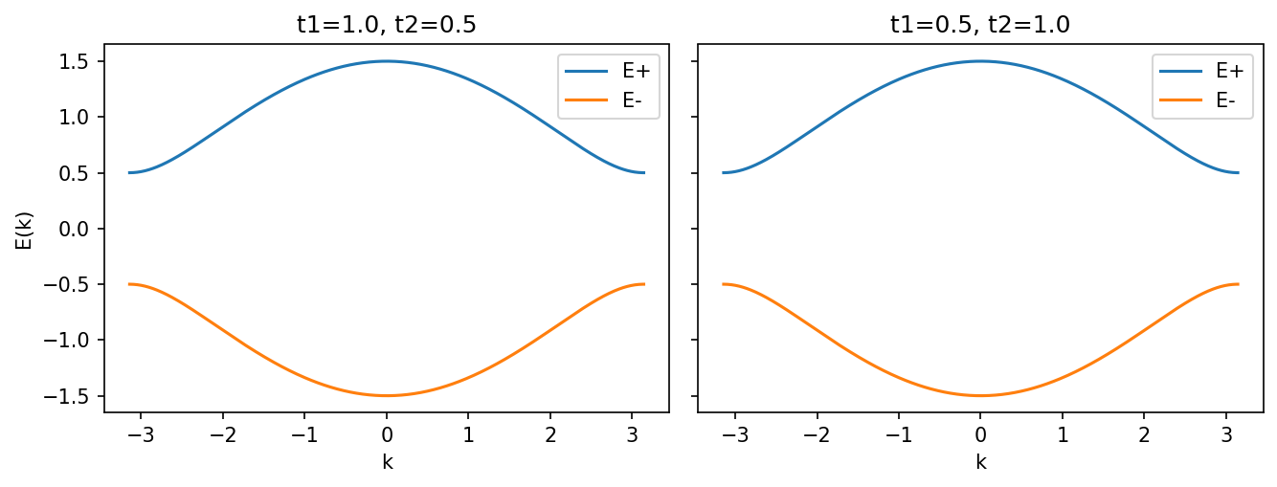
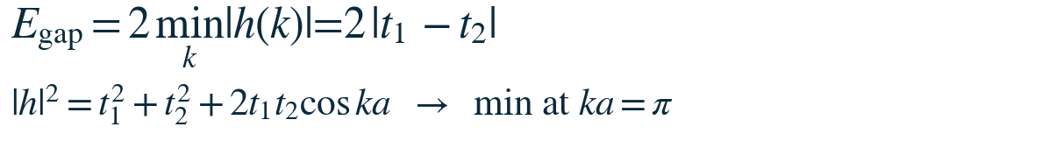
Result: the gap depends on t₁ − t₂
Bands for (t₁, t₂) = (1, 0.5) and (0.5, 1): same shape
gap_numeric (notebook §3)
ks = np.linspace(-np.pi, np.pi, n_k)
off = t1 + t2*np.exp(1j*ks) # h(k)
H[:,0,1] = off; H[:,1,0] = np.conj(off)
w = np.linalg.eigvalsh(H) # 2x2 per k
gap = w[:,1].min() - w[:,0].max()
Dots: numerical gap. Line: the formula 2|t₁ − t₂| from the references [1], [3]
SSH chain · band gap
Ref: [1], [3]
8

Slide 9
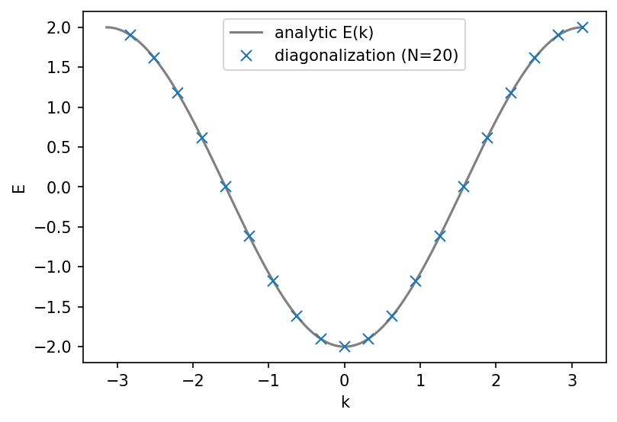
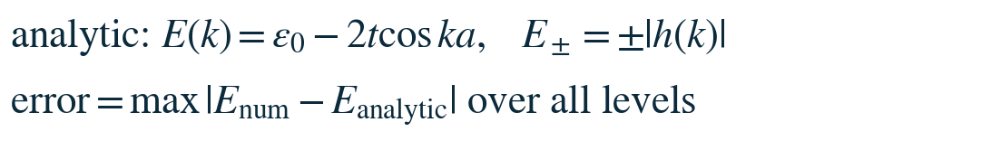
Validation: comparison with exact results
Check | Result: max |difference|
Ring (20 atoms, ends joined) vs analytic E(k) | 1.1×10⁻¹⁵
SSH 2×2 vs ±|h(k)| | 2.2×10⁻¹⁶
Gap vs 2|t₁ − t₂| | 2.4×10⁻¹⁶
t₁ = t₂: SSH ring vs monatomic ring | difference 0
error = max |numerical − exact| over all levels. The checks show that the code reproduces the exact results, not that the model matches a real material.
SSH chain · band gap
Ref: [2], [3]
9

Slide 10
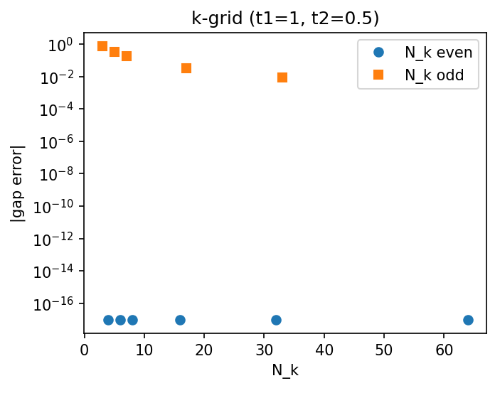
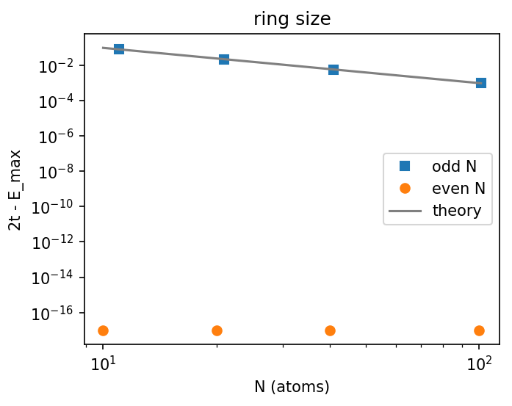
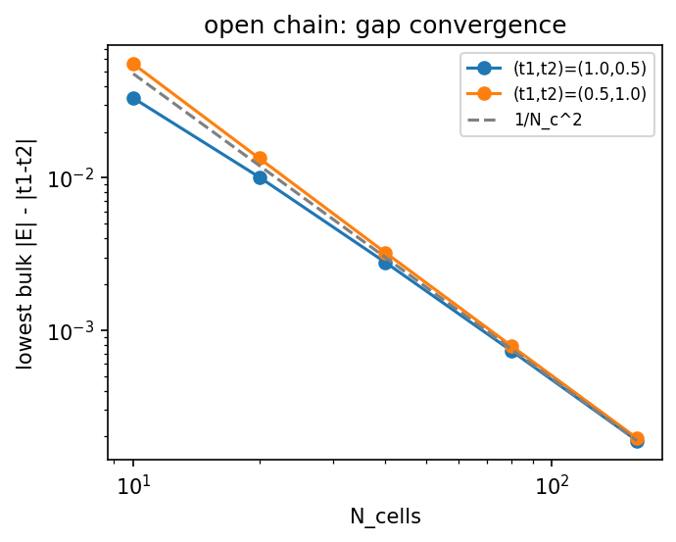
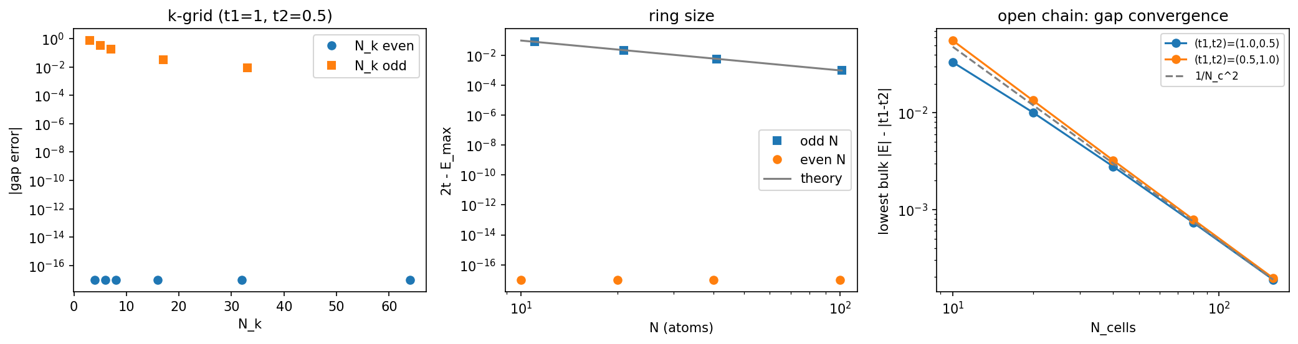
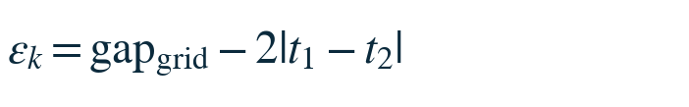
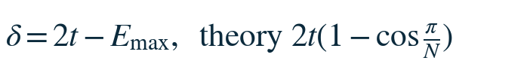
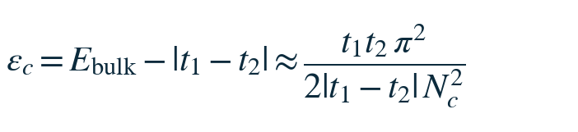
Numerical resolution and sampling
k grid: an even number of k points contains k = π (error 0); an odd number skips it (error 0.033 at 17 points)
Ring of N atoms: an odd N misses the band top
Open chain with N_{c} unit cells: error 0.033, 0.010, 0.0028 at N_{c} = 10, 20, 40, roughly 1/N_{c}²
Sampling: not applicable. The calculation is deterministic (no random numbers).
SSH chain · band gap
10

Slide 11
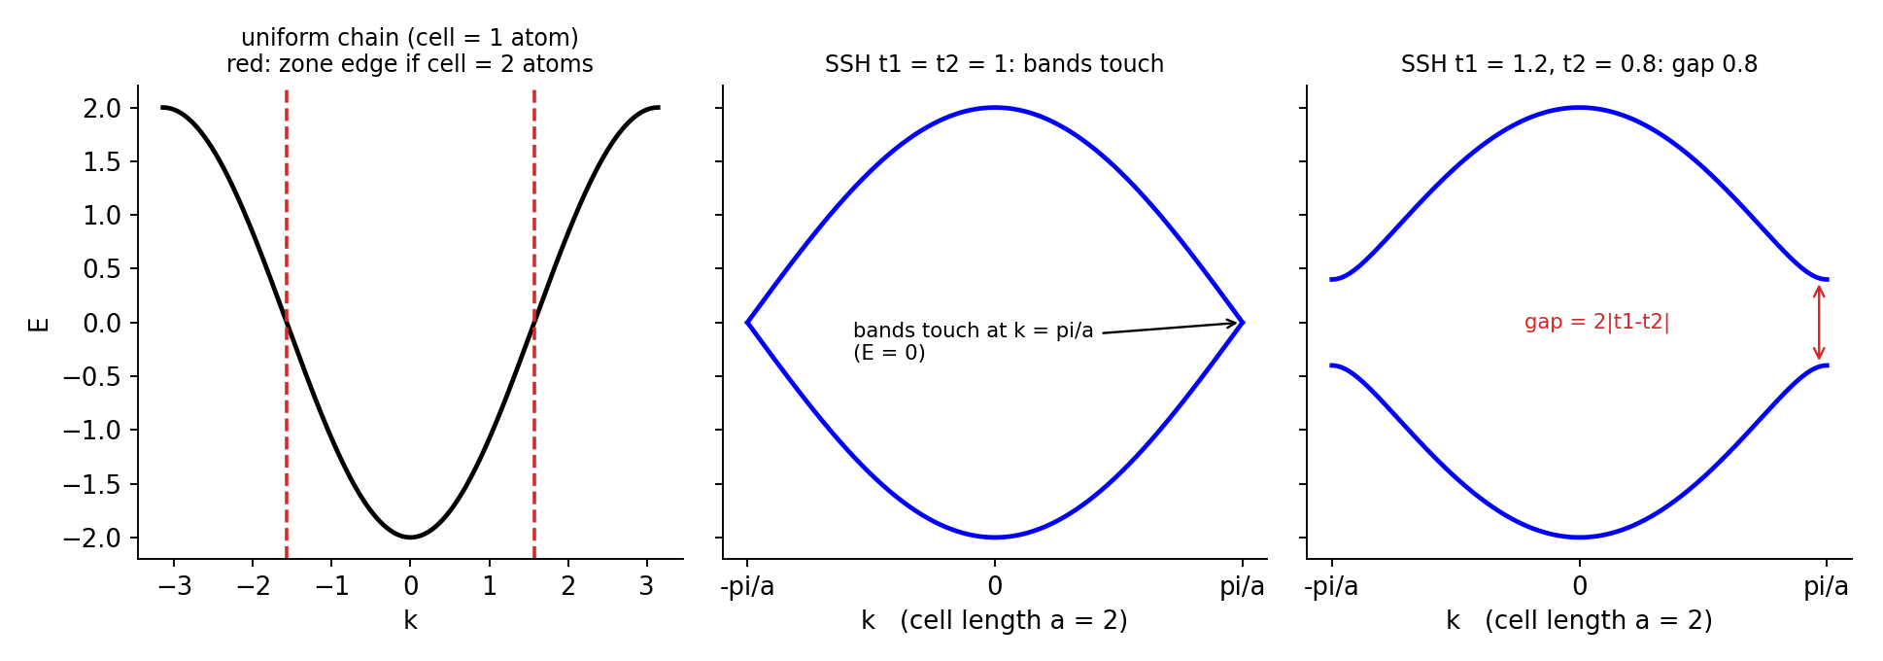
Interpretation (as explained in the references)
t₁ = t₂: a uniform chain, the two bands touch at k = π/a
t₁ ≠ t₂: a gap opens, 2|t₁ − t₂| (0.8 for 1.2 and 0.8)
Two electrons per cell fill the lower band: gap open = insulator, closed = metallic
Why alternating bonds open a gap (Peierls instability) is explained in [1], [4]; it is not derived here.
SSH chain · band gap
Ref: [1], [2], [4]
11

Slide 12
Limitations and how to check them
Not done / limitation | How to check
Real polyacetylene hopping values not used | Repeat with literature t₁, t₂ and compare with the measured gap
Chain length up to 160 cells; small gaps (e.g. t₂ = 0.9) not yet asymptotic | Longer chains: check the 1/N_{c}² trend
2D and electron–electron interaction | Outside this model
Convention: which atom the chain starts with | Starting with B swaps which chain has the states
SSH chain · band gap
12

Slide 13
Summary
Study
Finding
Limitations
From the references
• SSH chain: bands, gap and a finite chain by matrix diagonalization
• Gap = 2|t₁ − t₂|, closing at t₁ = t₂
• Agrees with the analytic result to ~10⁻¹⁵
• Finite-chain gap converges as 1/N_{c}²
• Hopping values are arbitrary units (no real polyacetylene)
• Small gaps need longer chains
• Nearest-neighbor, non-interacting model
• Gap formula 2|t₁ − t₂| [1], [3]
• Tight-binding model [1], [2]
• Checked numerically in this project
2|t₁ − t₂|
~10⁻¹⁵
1/N_{c}²
band gap
agreement with analytic results
finite-chain convergence
13

Slide 14
Backup: the gap formula from the references
As given in [1], [3]:
E±(k) = ± √(t₁² + t₂² + 2 t₁t₂ cos ka)
k = 0: largest, t₁ + t₂
k = π/a: smallest, |t₁ − t₂|
So the gap is 2|t₁ − t₂|, unchanged if t₁ and t₂ are swapped.
SSH chain · band gap
Ref: [3]
14

Slide 15
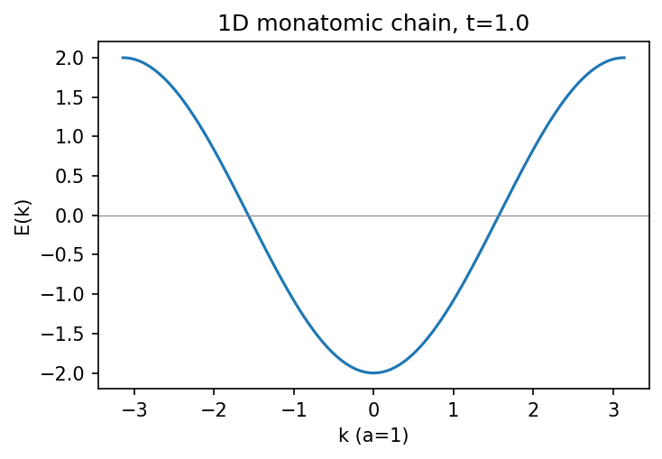
Backup: monatomic chain (reference)
E(k) = ε₀ − 2t cos ka, bandwidth 4t
N k-points, 2N spin states, N electrons → half-filled → metal
Re-counting with a 2-atom cell folds the band
SSH with t₁ = t₂ equals this chain (spectrum difference 0)
SSH chain · band gap
Ref: [2]
15

Slide 16
Backup: reproducibility and sources
Run
References
Notebook: Restart Kernel and Run All (~10 s)
python project.py → output/
input/params.json holds every setting
manifest.json: SHA-256 checksum of every file
requirements.txt: pinned versions
[1] W. P. Su, J. R. Schrieffer, A. J. Heeger, Phys. Rev. Lett. 42, 1698 (1979)
[2] N. W. Ashcroft, N. D. Mermin, Solid State Physics (1976): Ch. 8, Ch. 10 (tight-binding method)
[3] J. K. Asbóth, L. Oroszlány, A. Pályi, A Short Course on Topological Insulators (Springer, 2016), arXiv:1509.02295, Ch. 1
[4] R. E. Peierls, Quantum Theory of Solids (Oxford, 1955)
Defined in this project: the error definitions and the 1/N_{c}² estimate
AI assistance
Claude (Anthropic) was used for the code, validation checks, README and slide design.
The formulas are taken from the cited references and checked numerically with the code.
SSH chain · band gap
16

