Slide 1
Light QLSTM
인지부조화 TEAM

Slide 2
CONTENTS
Problem definition
Idea
Dataset
4. Base code
5. Light QLSTM
6. Conclusion

Slide 3
01. Problem Definition
Probelm3. QML
Using a quantum computer to learn a circular RNN for
sequential data analysis
Implement
QML Algorithm
CQHML Algorithm

Slide 4
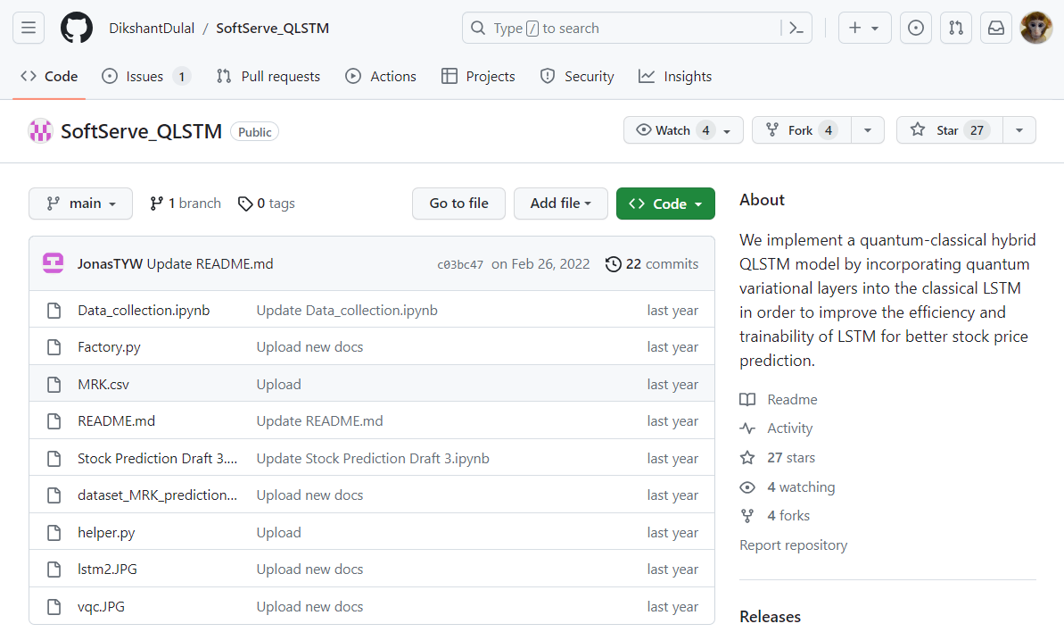
02. Idea
Stock price prediction
Quantum LSTM
Temperature prediction
Light Quantum LSTM

Slide 5
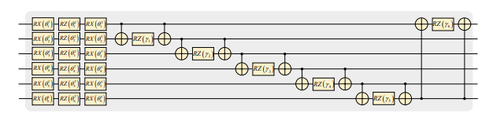
02. Idea
Ansatz Implementation
: Refer to the paper “Expressibility and entangling capability of parameterized /.quantum circuits for hybrid quantum-classical algorithms”

Slide 6
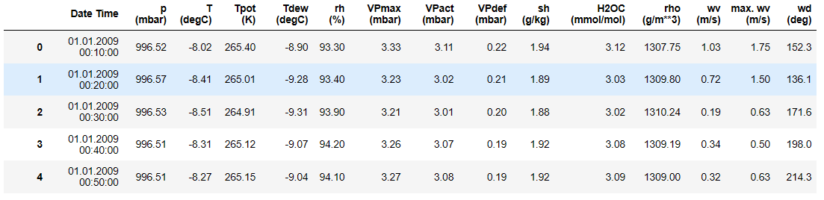
03. Data set
- kaggle data : Germany Jena Climate Dataset
315937 rows x 15 columns

Slide 7
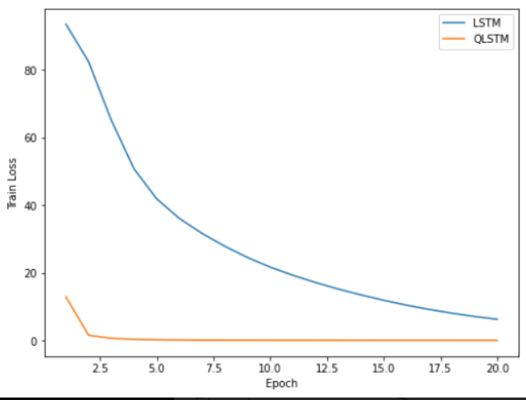
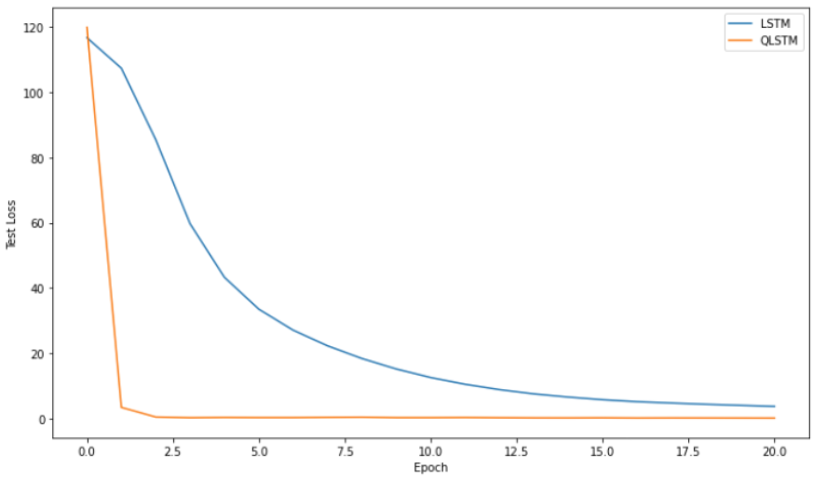
04. Base Code : loss
Train loss
Test loss
LSTM
QLSTM
QLSTM
LSTM

Slide 8
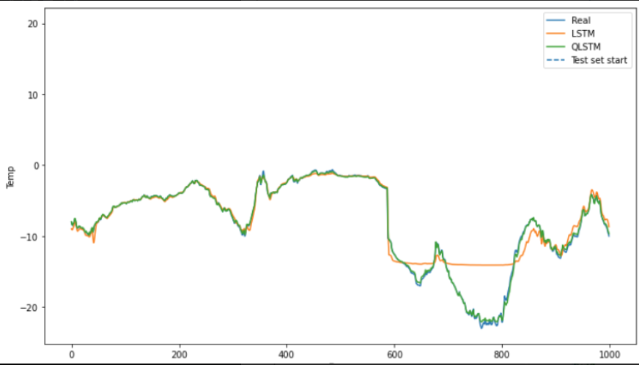
04. Base Code : prediction
LSTM
QLSTM
Real

Slide 9
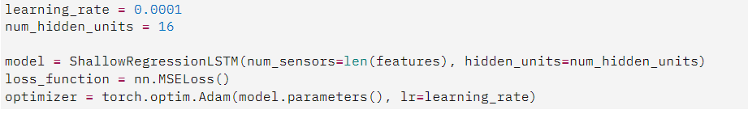
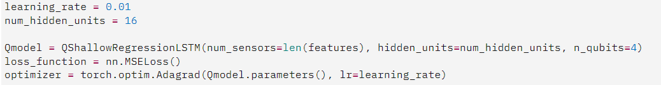
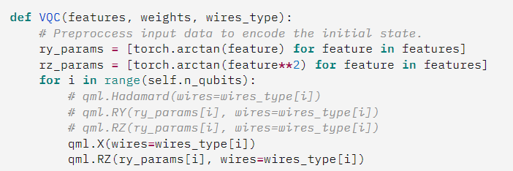
04. Base Code : Hyper parameter tuning
Classical LSTM
Learning rate
epoch
Hidden units
Quantum LSTM
Learning rate
epoch
Hidden units
VQC <- params

Slide 10
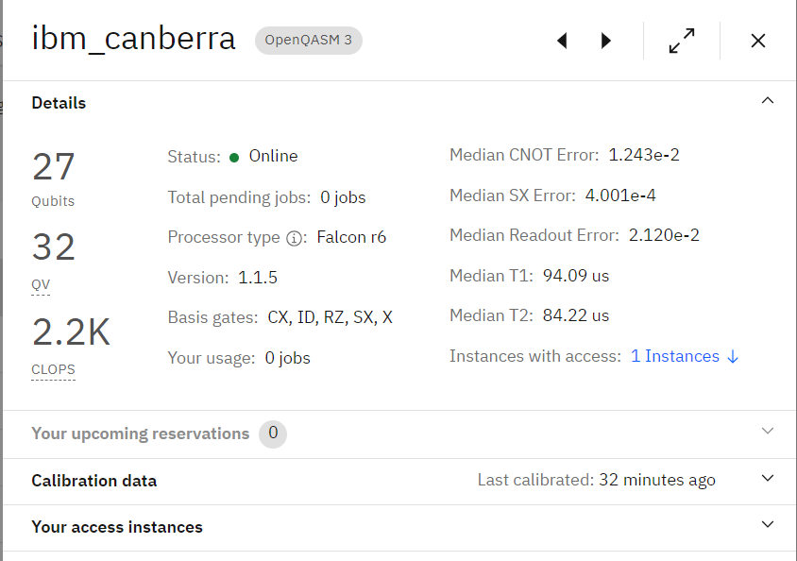
05. Light QLSTM
Make Hardware-friendly by changing the fixable part of the circuit to Basis gate

Slide 11
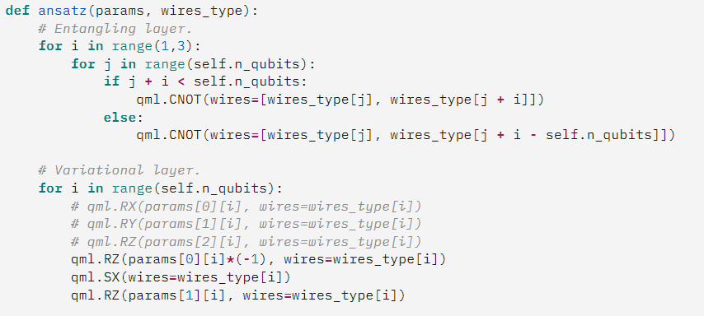
05. Light QLSTM
Modify the circuit by configuring only the Basis gates

Slide 12
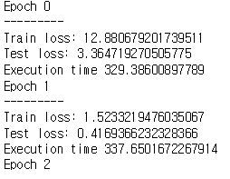
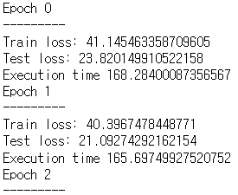
06. Conclusion
Loss rate increased
Faster execution time
QLSTM
Light QLSTM

Slide 13
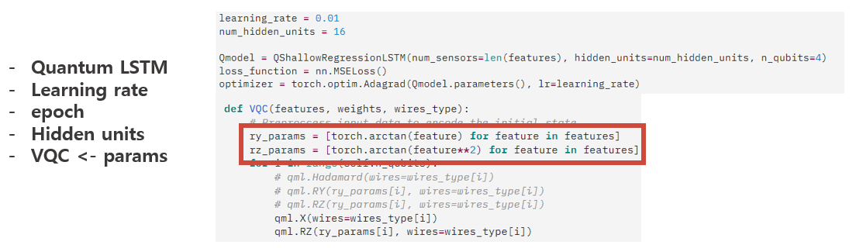
06. Conclusion : What we learned
1. Hyper parameter tuning in Quantum Circuit (in ansatz)
2. The importance of replacing them with hardware-friendly circuits

Slide 14
06. Conclusion : future job
1. Lower the loss value
more hyperparameter tuning for accuracy in VQC
2. Access Real Device
include the measurement part in the circuit

