Slide 1
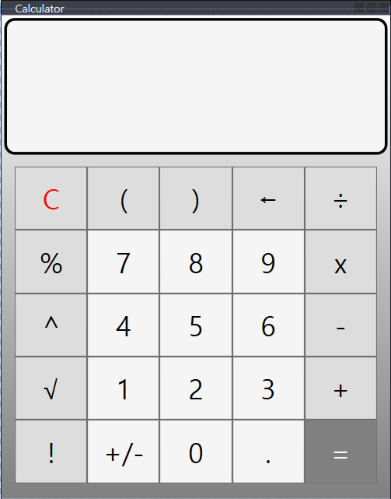

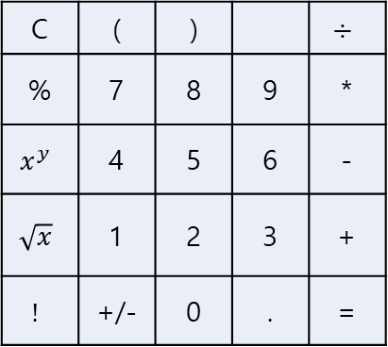
2
1 + 1 =
1 + 1 =
2
C | ( | ) |  | $$÷$$
% | 7 | 8 | 9 | *
$$x^{y}$$ | 4 | 5 | 6 | -
$$\sqrt{x}$$ | 1 | 2 | 3 | +
$$!$$ | +/- | 0 | . | =
Calculator

