Slide 1
Radix Sort
CS 375
Samuel Bae
Ho-On Yoshida

Slide 2

Basic Idea
Non-comparative sorting algorithm
Sorts in linear time
Sort from least significant digit to most significant digit
Stable sorting
238
123
934
344
377
123
934
344
377
238
123
934
238
344
377
123
238
344
377
934
Array to sort
After sorting LSD
After sorting 2nd LSD
After sorting MSD

Slide 3
Understanding the Algorithm
Sorts from the LSD to MSD using another sort
Its complexity will be determined by the complexity of the sort it uses
Use counting sort
Keeps stable sorting property
Use it for each digit we sort

Slide 4
Pseudocode: radixSort() - counting
radixSort(vect, size, max, digits, k)
int mod = k, div = 1
declare oVect, dVect, sVect
for i from 0 to digits
for j from 1 to size
dVect[ j ] = vect[ j ]/div
for j from 1 to size //Counting Sort
oVect[ dVect[ j ] ] = oVect[ dVect[ j ] ] + 1
for j from 1 to k
oVect[ j ] = oVect [ j ] + oVect[ j-1 ]
for j from size down to 1
sVect[ oVect[ dVect[ j ] ] ] = vect[ j ]
oVect[ dVect[ j ] ] = oVect[ dVect[ j ] ] – 1
update mod, div, and vect with sVect

Slide 5
Complexity
Radix sort using counting sort
Counting sort: O(n+k)
Radix sort performs counting sort d times, where d is the number of digits
So Radix sort has a running time of O(dn+dk)
But d will always be a constant for that run of radix sort and k is O(n)
Therefore the running time of Radix Sort:
O(n)

Slide 6
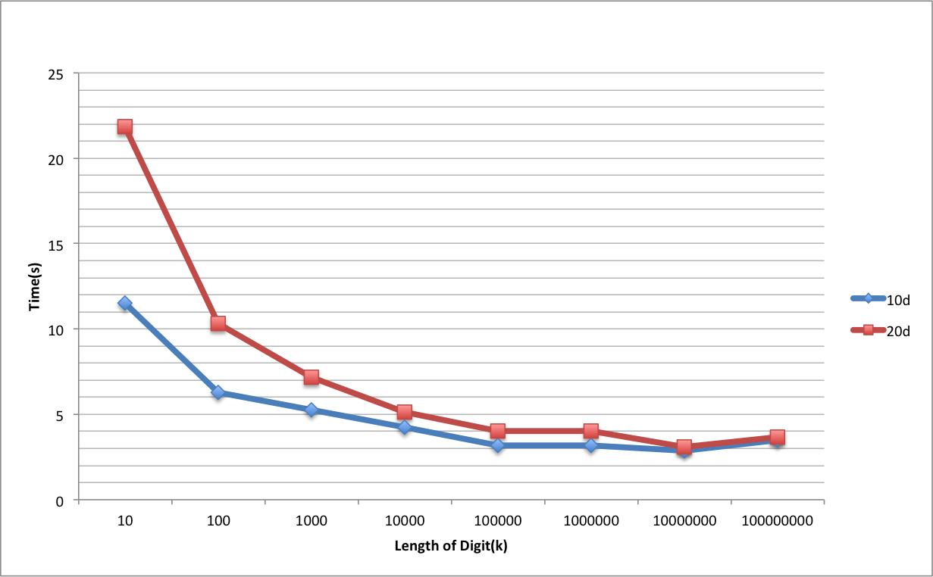
Test Result of 10d and 20d

Slide 7
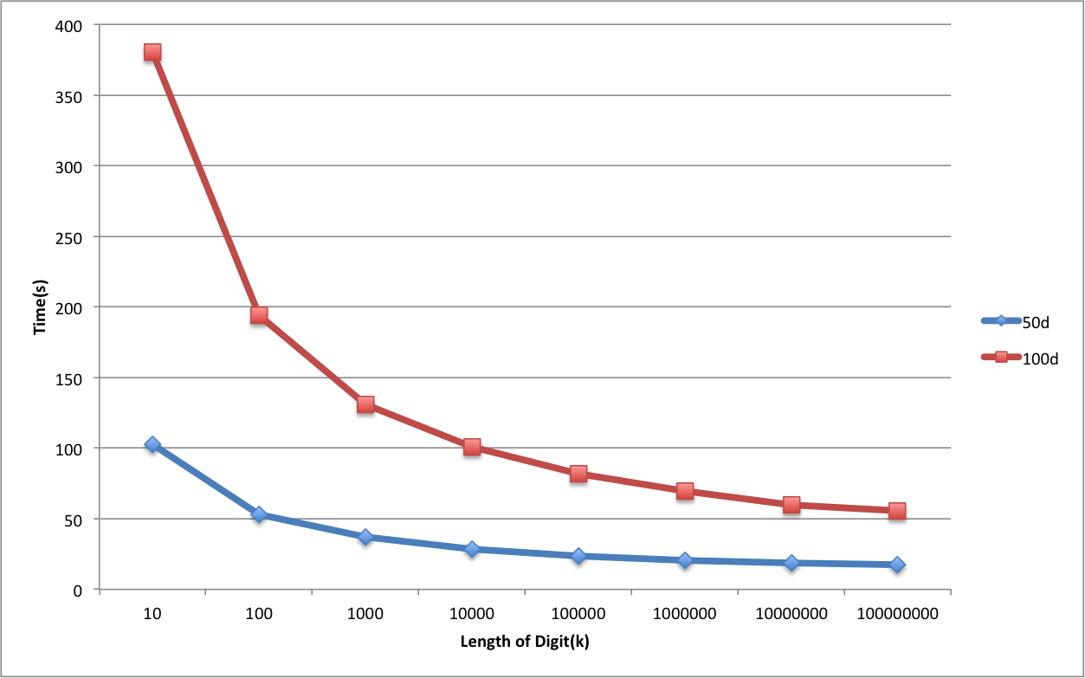
Test Result of 50d and 100d

Slide 8
Conclusion
Radix sort
Linear sort → O(n) running time
LSD to MSD
Stable Sort
Performance improvement as length of k increases
But only to a certain point, then performance diminishes

Slide 9
Thank You

