Slide 1
KIN 482D: Computational modeling of human sensorimotor control and learning
Semester Overview (March 30, 2026)
Dr. Hyosub Kim
School of Kinesiology / Graduate Program in Neuroscience

Slide 2
Roadmap for today
What have we learned this semester?
Next steps
Course feedback
Work on final projects

Slide 3
Why computational modeling?
Capture key components of a complex system/behavior
Clarify and formalize our scientific intuitions
Use math to remove ambiguities
Generate testable (falsifiable) predictions
Limit number of unnecessary experiments by using simulations – save time, money, and human and animal resources
No silver bullet: “All models are wrong, but some are useful.” (George Box)

Slide 4
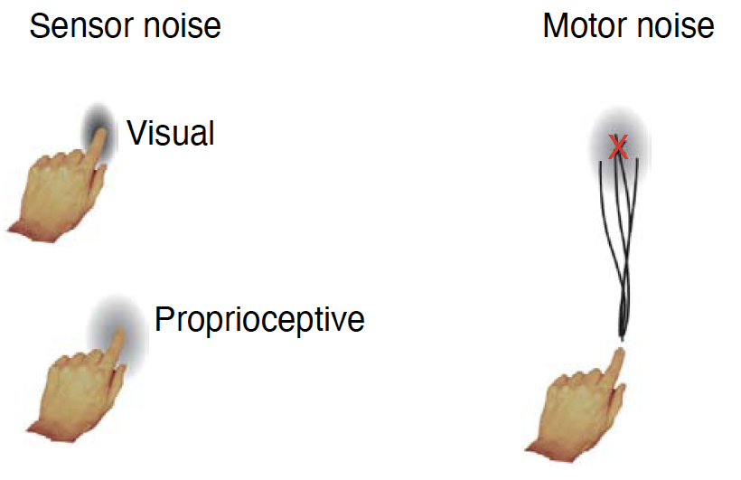
What sort of modeling will you learn?
We will be modeling the human sensorimotor system, specifically with regard to perception, motor planning, and motor learning
One of the great mysteries of sensorimotor control, and neuroscience, is how the nervous system deals with uncertainty – What does this mean? What uncertainty?
Bayesian modeling (inference) is the most successful approach to this problem – also happens to be [one of] the best foundations for all other types of modeling
From Kording & Wolpert (2006)

Slide 5
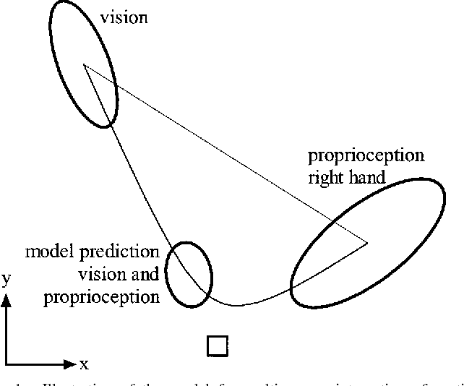
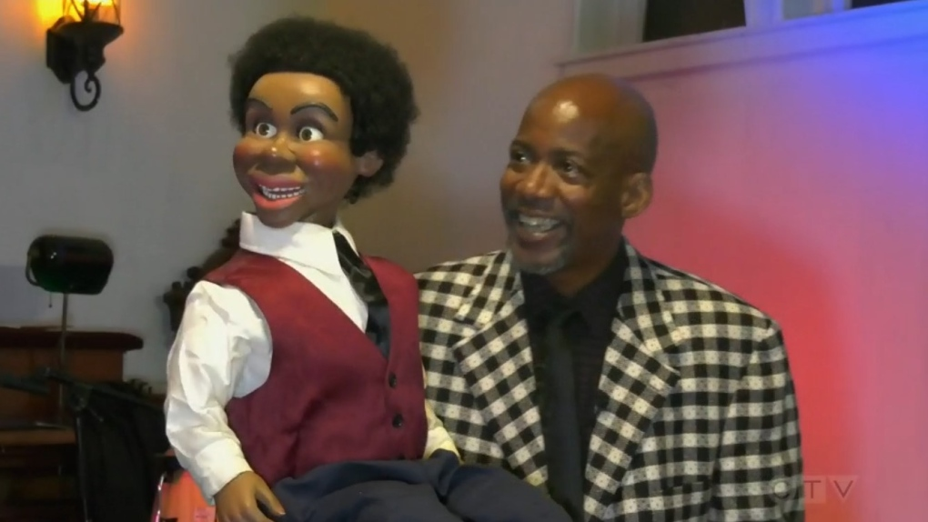
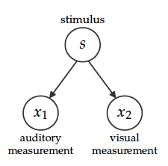
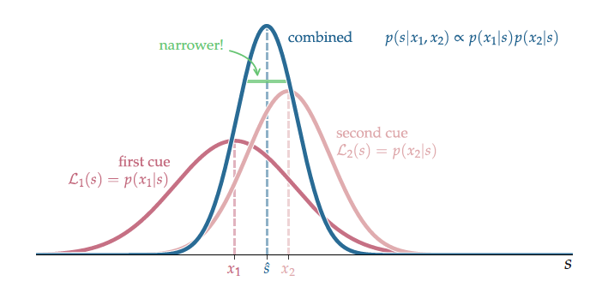
Motivating examples: Multi-sensory integration (“cue combination”)
The ventriloquist effect
Vision and proprioception (van Beers et al 1999)
Graphical generative model

Slide 6
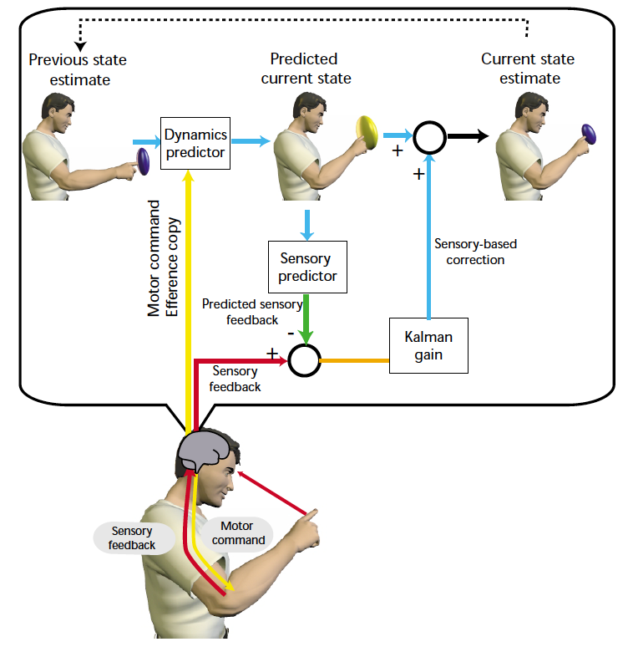
Motivating examples: sensorimotor learning
Kalman filter model
Optimal combination of prior information with incoming measurements
Model of sensorimotor control and learning
Wolpert and Ghahramani (2000)

Slide 7
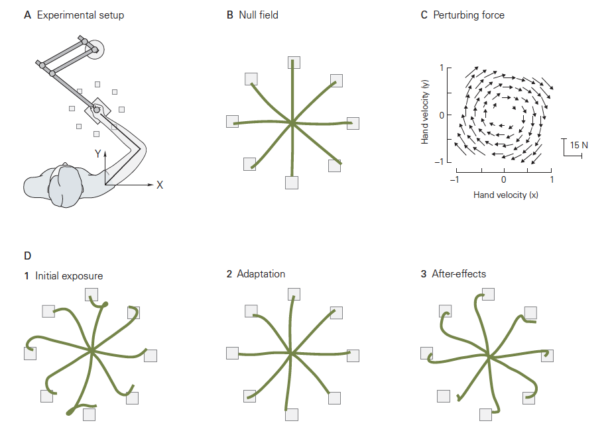
Motivating examples: sensorimotor learning
Kalman filter model
Optimal combination of prior information with incoming measurements
Model of sensorimotor control and learning
Sensorimotor adaptation – recalibration of sensorimotor maps
More generally, extremely useful algorithm used in GPS, spacecraft, brain-machine interfaces, and many other applications
Kandel 5th ed.

Slide 8
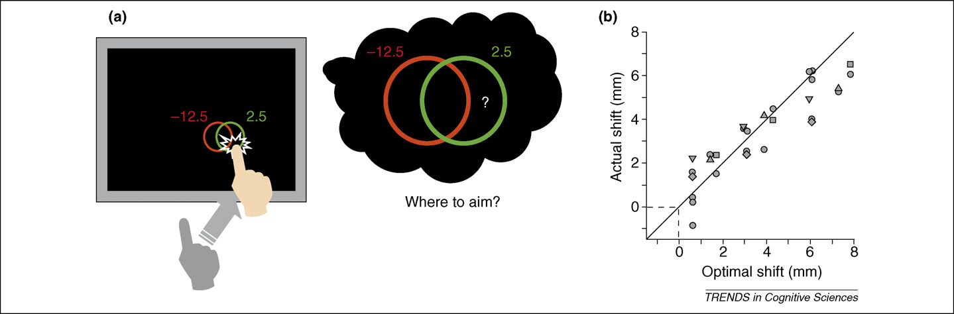
Motivating examples: Optimal motor planning
Bayesian model can explain how our motor system accounts for intrinsic variability (motor noise) when planning movements.
Trommershauser et al (2008)

Slide 9
Learning Outcomes
The course is designed to achieve the following primary learning outcomes:
Understand and be able to explain the motivation and rationale for computational modeling and the types of models that are appropriate for different questions. ✅
Demonstrate knowledge of the fundamental methods of Bayesian modeling: deriving graphical generative models, performing Bayesian inference, computing response probabilities, and model fitting and model comparison. ✅
Gain proficiency with simulating Bayesian models with Python code and understand the implications of different parameter values, test conditions, and outputs. [We’ll see over the next two Wednesdays ☺] ✅
Demonstrate the ability to understand, critique, and discuss research articles that incorporate computational modeling of human behavior. ✅
Gain proficiency with applying modeling to novel questions. ✅ [Next step is to bring these skills into future work/research and answer your own questions.]

Slide 10
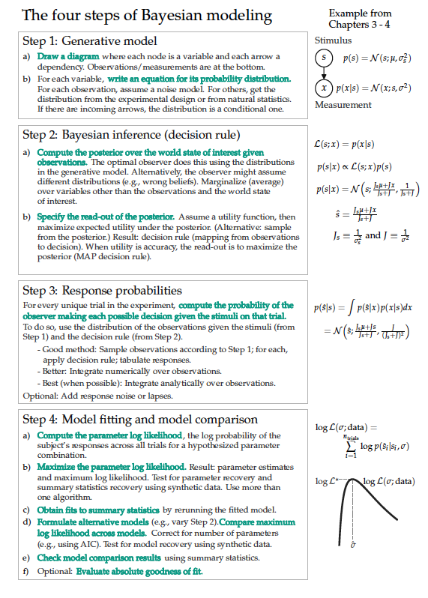

Slide 12
Other topics to explore next
Modeling behavior of human and artificial agents:
Reinforcement learning
Optimal (feedback) control
Neuromatch Academy
Statistical inference:
Bayesian data analysis/statistics
Machine/statistical learning
Math:
Linear algebra
Math Tools course from NYU

Slide 13
10-15 minutes for course feedback
Instructions from email:
Consider letting students know how the survey responses are used at UBC so they are aware that their input can make a difference, such as by providing feedback that you can use to make improvements in the future.
Assure students that the surveys are confidential. You will receive a summary report only after all grades are submitted and finalized. There is no risk of repercussions to students for giving honest, constructive feedback.
Where feasible, provide 10-15 minutes in class for students to complete the survey using their devices to log into Canvas.

Slide 14
Final project time
Look at rubric
Turn in by tomorrow (Tues) at 11:59pm – no late submissions!
Your presentation should be 10-12 minutes (3-5 minutes Q&A):
• Clearly explain the research question and motivation
• Walk through the generative model
• Explain the inference and response distribution steps
• Show and interpret key simulations or results
• Defend assumptions and interpretive choices
You are evaluated on conceptual understanding and command of the model, not presentation polish.

Slide 15
Final project time
Peer reviews automatically assigned after submission
Be clear and supportive in your feedback, but do not shy away from pointing out areas for improvement. The following is an example of helpful feedback:
“I thought your plots were quite effective in showing what happens when you change $\sigma$ values. I especially liked how you had multiple functions in the same plot and used color shading with a legend. It made it very easy to compare the results of your simulations. However, I think providing more of an explanation, and examples, of what might underlie different $\sigma$ values would have been helpful. Would you expect to see high (or low) values among different patient populations or due to injury?”

