Slide 1
Announcements (Mon, Nov 18)
A6:
About one-third of you received a 0.5/1 because you either didn’t write a proper function or you made a mistake in one of the bootstrapping steps
Remember: a function should be flexible; if you hard code in something that is supposed to be a parameter (e.g., the # of bootstrap samples, the confidence level, etc.), then the function no longer serves its original purpose AND it’s incorrect because the user thinks they can set the value of something they actually cannot
For each bootstrap sample, how many observations should you be (re)sampling from?

Slide 2
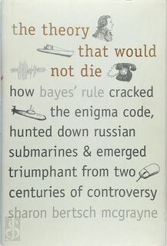
Bayesian statistics

Slide 3
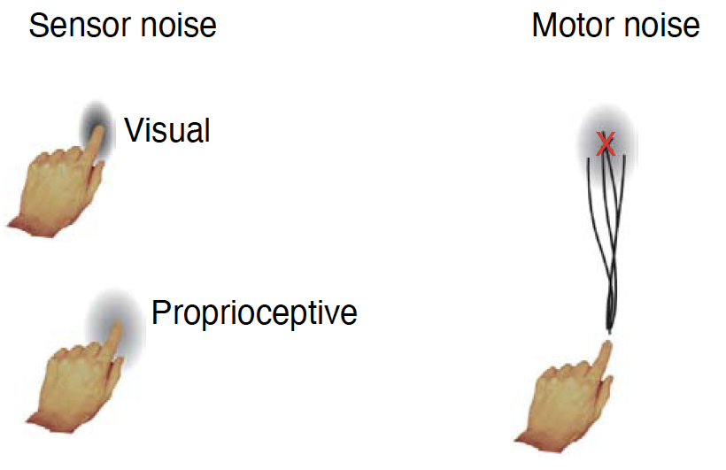
(From KIN 482D) What sort of modelling will you learn?
We will be modeling the human sensorimotor system, specifically with regard to perception, motor planning, and motor learning
One of the great mysteries of sensorimotor control, and neuroscience, is how the nervous system deals with uncertainty
Bayesian modelling (inference) is one of the most successful approaches to this problem – also happens to be one of the best foundations for all other types of modelling
From Kording & Wolpert (2006)

Slide 4
Motivating examples: Multi-sensory integration (“cue combination”)
What do I mean by multisensory integration?
What are some examples?

Slide 5
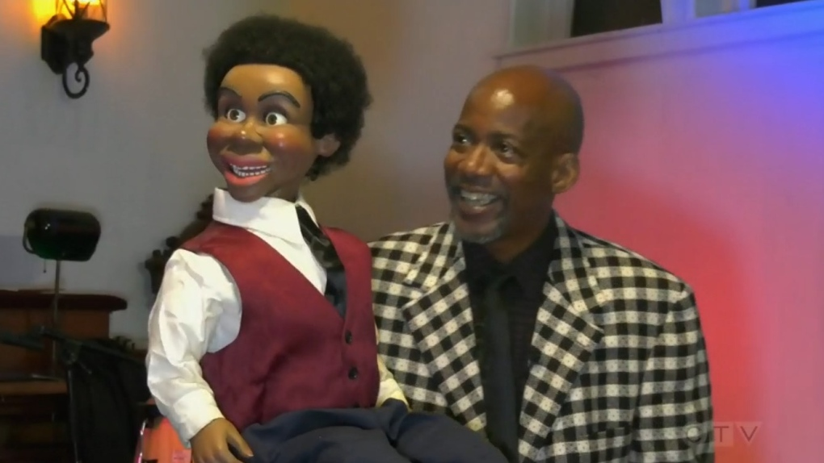
Motivating examples: Multi-sensory integration (“cue combination”)
The ventriloquist effect

Slide 6
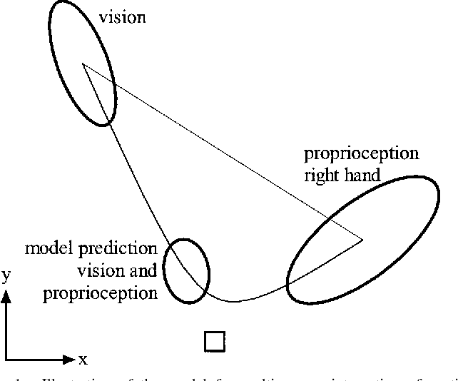
Motivating examples: Multi-sensory integration (“cue combination”)
The ventriloquist effect
Vision and proprioception (van Beers et al 1999)

Slide 7
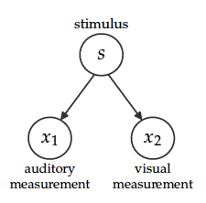
Motivating examples: Multi-sensory integration (“cue combination”)
The ventriloquist effect
Vision and proprioception (van Beers et al 1999)
Graphical generative model

Slide 8
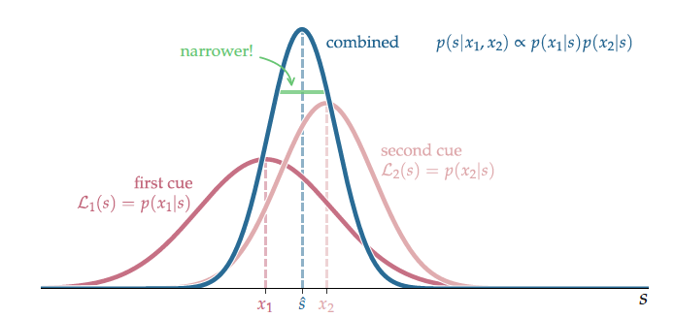
Motivating examples: Multi-sensory integration (“cue combination”)
The ventriloquist effect
Vision and proprioception (van Beers et al 1999)
Graphical generative model

Slide 9
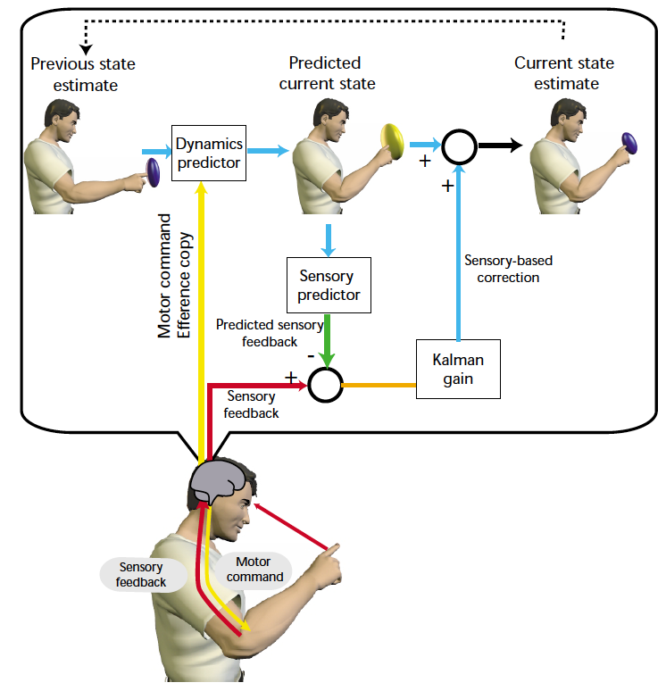
Motivating examples: sensorimotor learning
Kalman filter model
Optimal combination of prior information with incoming measurements
Model of sensorimotor control and learning
Wolpert and Ghahramani (2000)

Slide 10
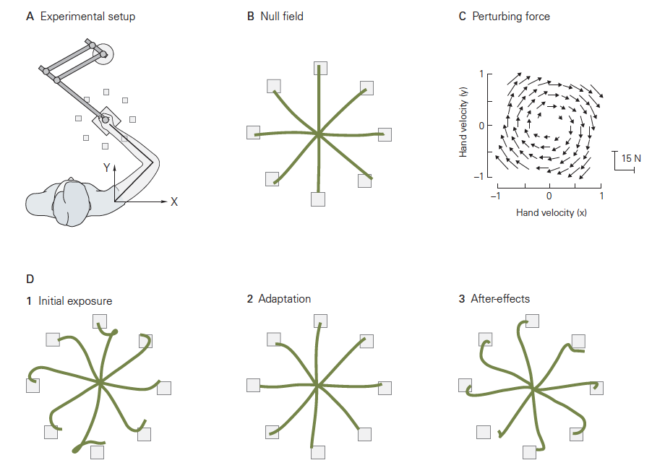
Motivating examples: sensorimotor learning
Kalman filter model
Optimal combination of prior information with incoming measurements
Model of sensorimotor control and learning
Sensorimotor adaptation – recalibration of sensorimotor maps
Kandel 5th ed.

Slide 11
Motivating examples: sensorimotor learning
Kalman filter model
Optimal combination of prior information with incoming measurements
Model of sensorimotor control and learning
Sensorimotor adaptation – recalibration of sensorimotor maps
More generally, extremely useful algorithm used in GPS, spacecraft, brain-machine interfaces, and many other applications
Kandel 5th ed.

Slide 12
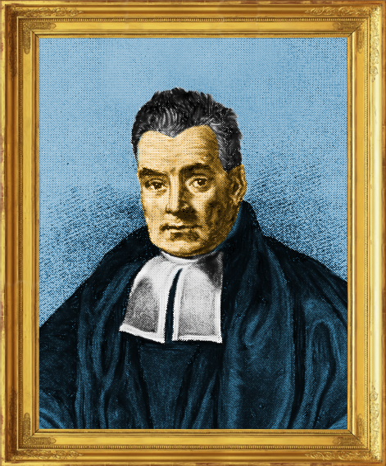
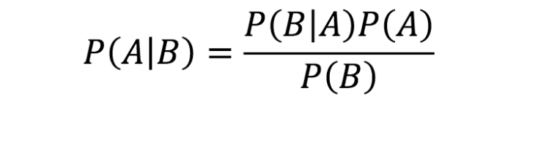
Why Bayesian models?
Provides very principled framework for learning modeling, whether you’re interested in perception, motor control, learning, decision-making, etc.
Very successful track record (many examples throughout semester)
Our brains may be Bayesian!
We make perceptual, motor judgments by combining prior beliefs with incoming sensory information
Our brains appear to do this in a statistically optimal way for many tasks
Rev. Thomas Bayes (1702-1761)
Shared under CCBY 4.0 license

Slide 13
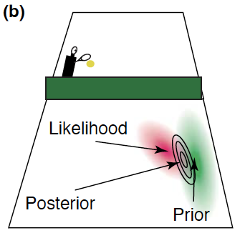
“Bayesian decision theory in sensorimotor control”
Bayesian inference is used for sensing, guiding, planning, and predicting movement.
Kording and Wolpert (2006)

Slide 14
Announcements (Wed, 11/20)
Final project rubric up on Canvas – 1 pt if you completed and turned in part 1 on time
A7
(“Option” 1) For those who did not receive full marks on A6. Must resubmit annotated version of A6
Fix your code AND create a new cell explaining where you originally went wrong and how you fixed it
Resubmit to A6 on Canvas
(Option 2) Provide a one-paragraph update on where you are at with final project.
What have you done so far? What has gone smoothly? What has been difficult? Be specific.
Feel free to prep me on anything you want me to know before I see your final submission.
If you haven’t made progress since part 1, provide clear roadmap with dates for completing the project
Submit A7 notebook to A7 on Canvas
Read version of Signal Processing chapter that is uploaded to JupyterHub – online textbook chapter is not rendering correctly

Slide 15
Plan for today
Review Monday’s material
Complete lecture 16 notebook
Time permitting, go through some examples of Bayesian modeling

Slide 16
Revisiting some ideas from Monday
I was NOT encouraging gambling ☺
However, it is true that understanding probability theory can help in games of chance
Best to know how to formally (properly) deal with uncertainty
Clinical relevance
Sensorimotor control
Stock investments
Quantum phenomena

Slide 17
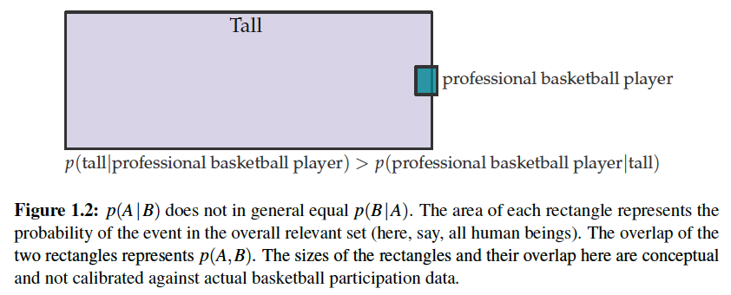
Revisiting some ideas from Monday
The point of the diagnostic example is NOT that you shouldn’t trust medical tests – you absolutely should! BUT, interpretation is not always as straight forward as we may think.
Prior can play a very large role (e.g., signs and symptoms of a dx plus a positive diagnostic result is very different than a positive result during a random screening)
P(A|B) does NOT necessarily equal P(B|A)
The probability of testing positive given you have the disease is NOT necessarily equal to the probability of having the disease given that you test positive

Slide 18
Revisiting some ideas from Monday
Play with the prior (prevalence) in the diagnostic example to see how it changes your posterior
Consider a prior of 0.8 (e.g., a person exhibits signs and symptoms consistent with the disease process) – now what is your posterior belief?
Bear in mind that the disease prevalence was serving as our prior in this example because we had no other information; however, if we were a medical professional examining a patient, our prior would incorporate signs and symptoms and not only prevalence
The point is that the prior incorporates our knowledge about the inferential question other than the measurement/observation/data

Slide 19
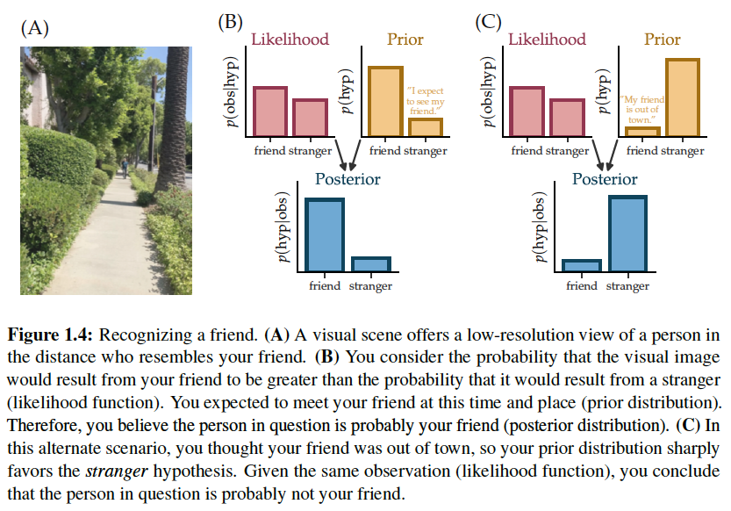
Inference: Is that my friend?
The likelihood of a hypothesis is the probability of the observation given the hypothesized world state
The prior is the probability of the hypothesized world state based on all knowledge you have apart from (prior to) the observation
The posterior is the probability of the hypothesized world state given the observation
Write probability statements on board

Slide 20
The denominator in Bayes’ Rule
 | D | ND
+ | P(+, D) | P(+, ND)
- | P(-, D) | P(-, ND)
(joint probability)
 | D | ND
+ | P(+|D)P(D) | P(+|ND)P(ND)
- | P(-|D)P(D) | P(-|ND)P(ND)
P(A,B) = P(A|B)P(B)
 | D | ND
+ | 0.99 * 0.01 | 0.05 * 0.99 | 0.0594
- | 0.01 * 0.01 | 0.95 * 0.99 | 0.9406
 | 0.01 | 0.99
Marginal probabilities

Slide 21
The denominator in Bayes’ Rule
Don’t sweat too much for this class – much more important to understand prior, likelihood, and posterior
Oftentimes, you don’t need to compute the denominator (lecture notebook has examples)
In diagnostic example, you do neet compute because we’re NOT dealing with probability distributions (which can be normalized)

