Slide 1
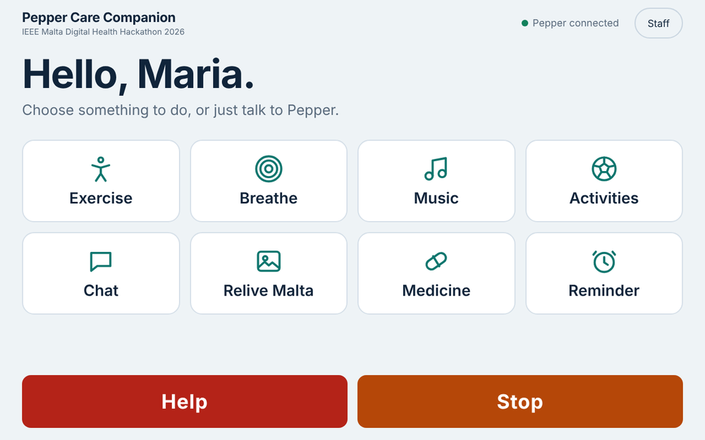
IEEE MALTA DIGITAL HEALTH HACKATHON 2026
Pepper's tablet
what residents see, and how it talks to the robot
Ankit Kumar, University of Malta
Notes:
Screens in this deck are captured from the real tablet page running in a browser with simulated robot state. They are not photos of a Pepper. The package has not yet been run on a real robot.

Slide 2



One screen. Eight tiles.
Touch a tile
or just say it
Help and Stop always there

Slide 3
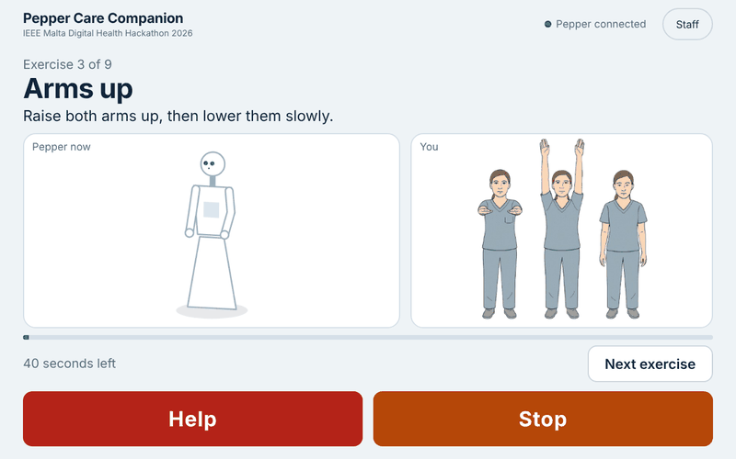
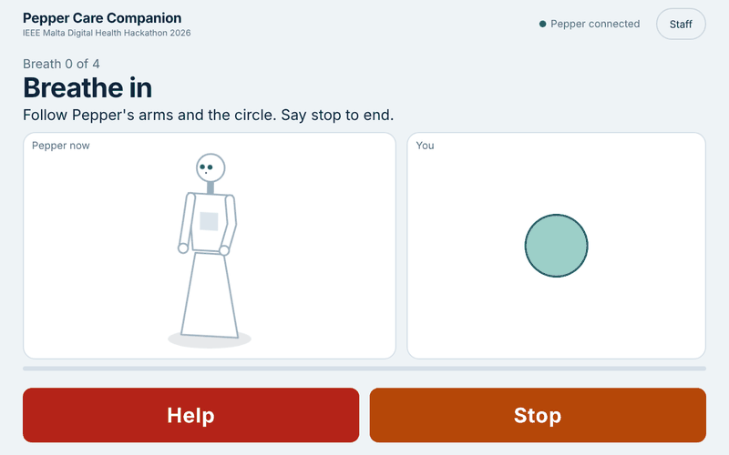
Move with Pepper
Exercise
Breathe
Plays in slideshow mode

Slide 4
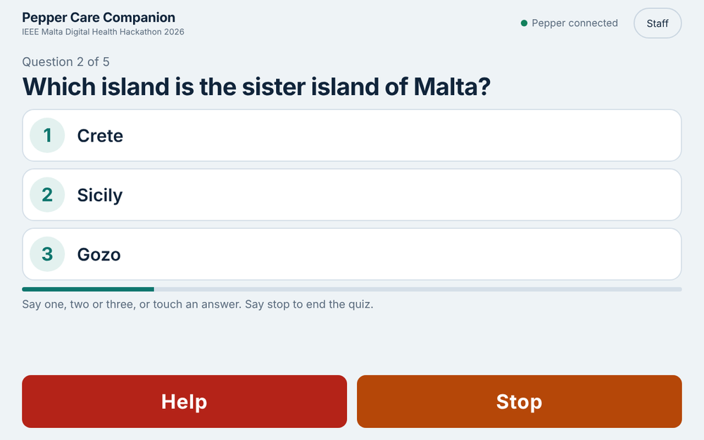
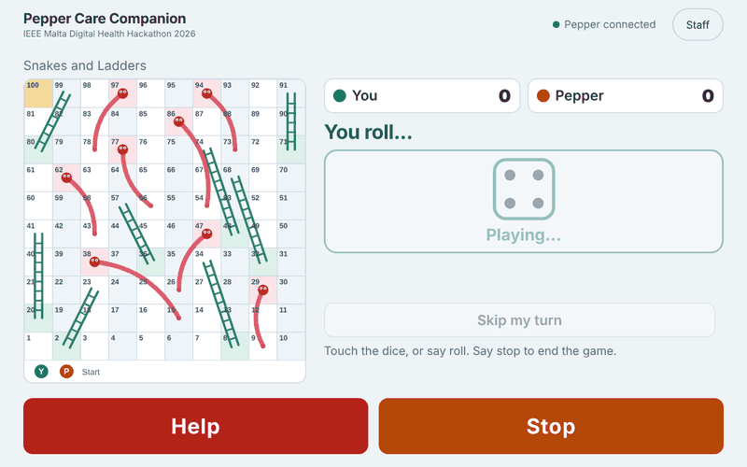
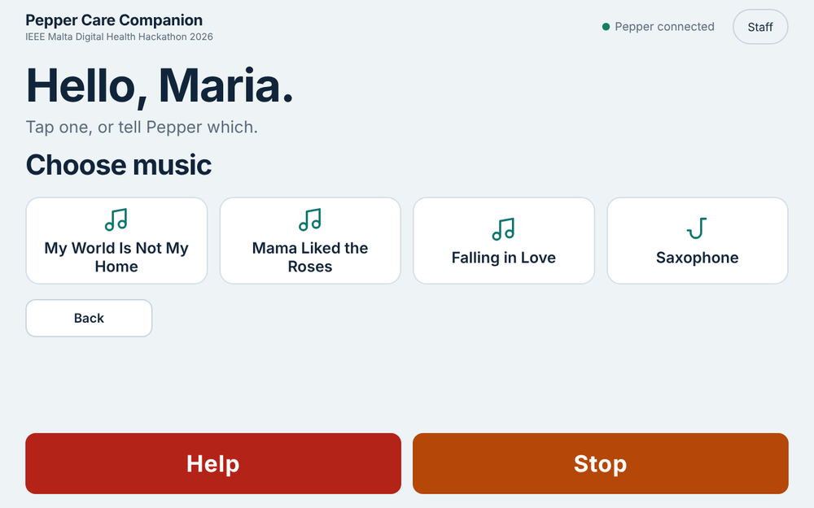
Play and listen
Quiz
Snakes and Ladders
Music
Every answer works by voice or by touch

Slide 5
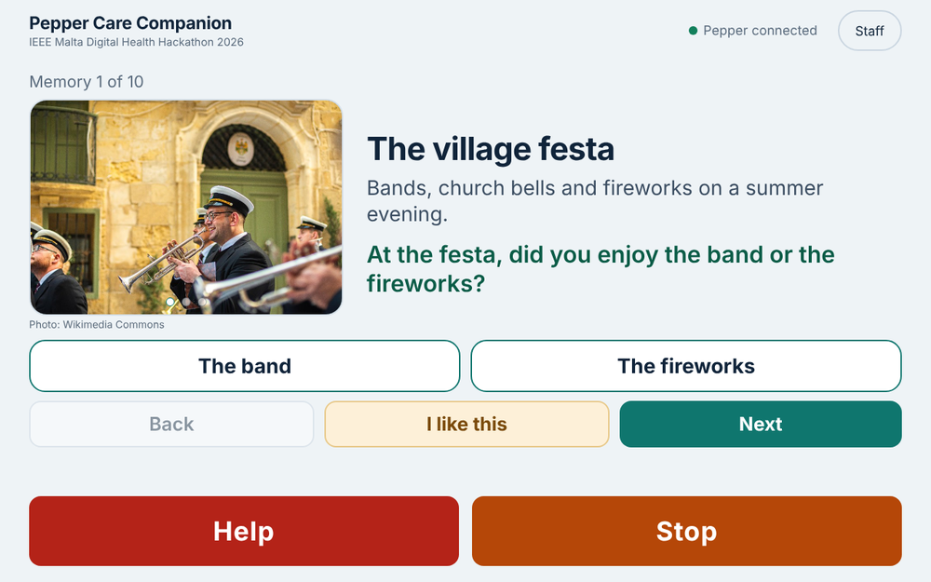
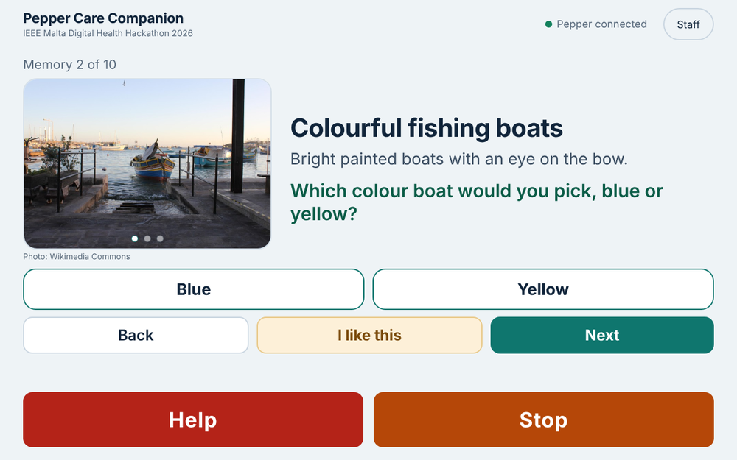
Remember Malta together
A picture, one question, two answers. No right or wrong.

Slide 6
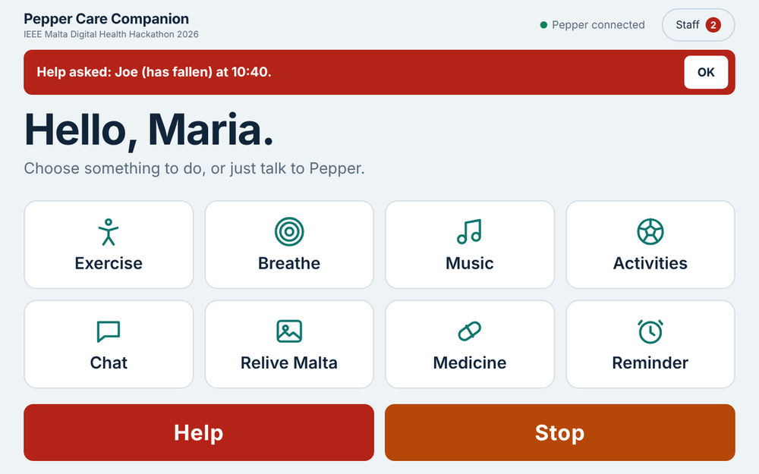
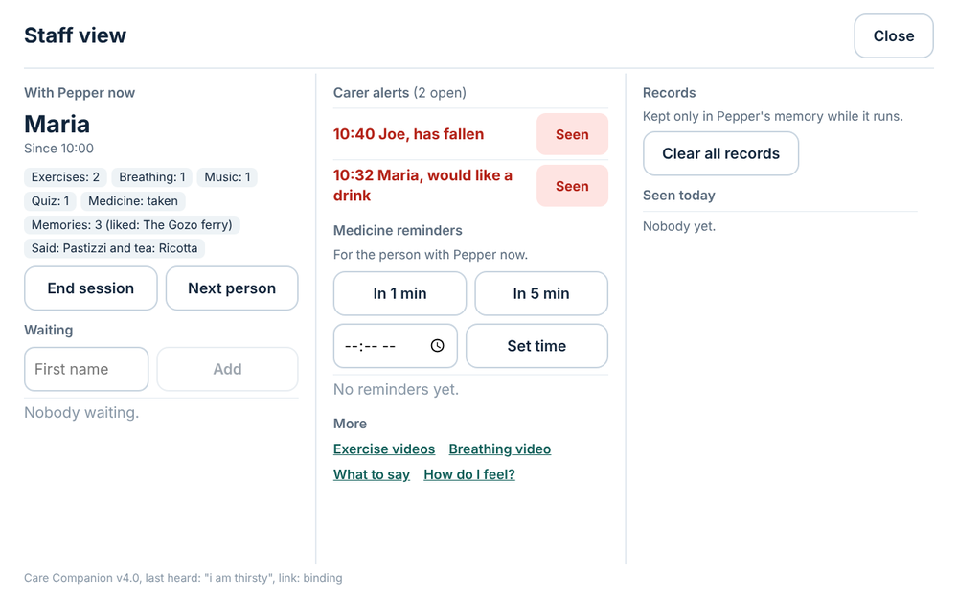
The carer stays in the loop
Alert with a reason
Staff view

Slide 7





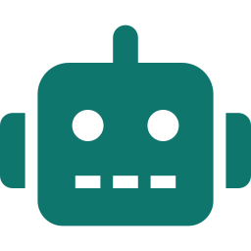


All of it stays on the robot
INSIDE PEPPER
shows
writes
heard
taps
reads
Tablet page
Care Controller
ALMemory
Dialog
touch
arms, voice, music
speech
No cloud. No internet. Nothing leaves the robot.
Notes:
Tablet page: HTML and JavaScript served from the robot's own package, shown with ALTabletService. The controller pushes state to the page with executeJS; the page sends taps back through the tablet's JS event, which the controller picks up. The dialog (QiChat) and the controller share plain ALMemory keys such as $pepperCmd. The controller drives arms, voice, music and eyes. The arrow labels are simplified.

Slide 8



Local. Private. Supervised.
Stays on the robot
Carer in control
Voice or touch
A research prototype for supervised use. Not a medical device.

