Slide 1
A hospital robot that knows when to slow down
IEEE GLOBAL ROBOT CHAMPIONSHIPS MALTA 2026
People-aware safety and battery protection, shown in eleven ward cases
SAFE
TOO CLOSE
MOVE AWAY
Team Genesis · University of Malta
Simulated from the safety layer's own rules, not footage
Notes:
A trolley robot in a hospital corridor shares space with people. This deck shows eleven scripted ward cases built from the MII safety layer's rules, plus a battery protection layer and a proposed sensor layout. Everything shown is simulated from those rules, not recorded footage.

Slide 2
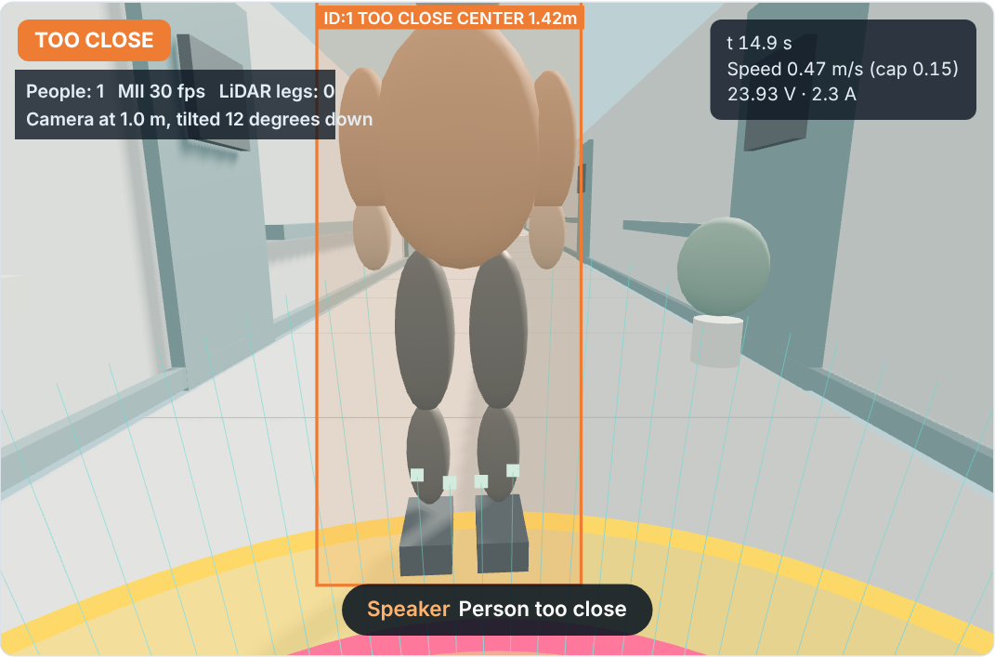
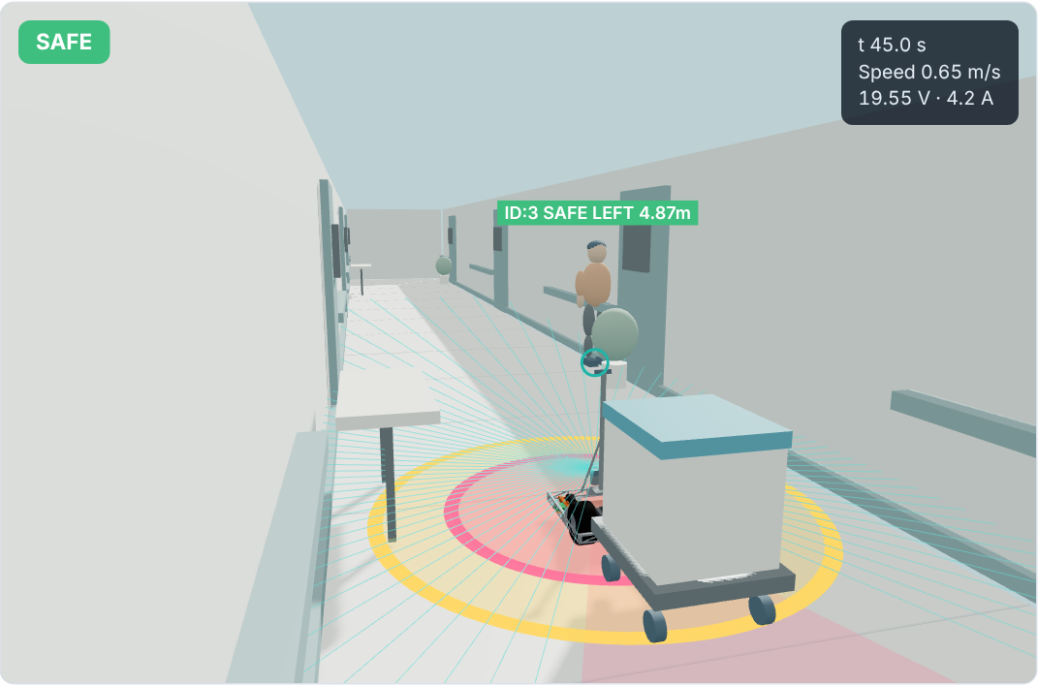
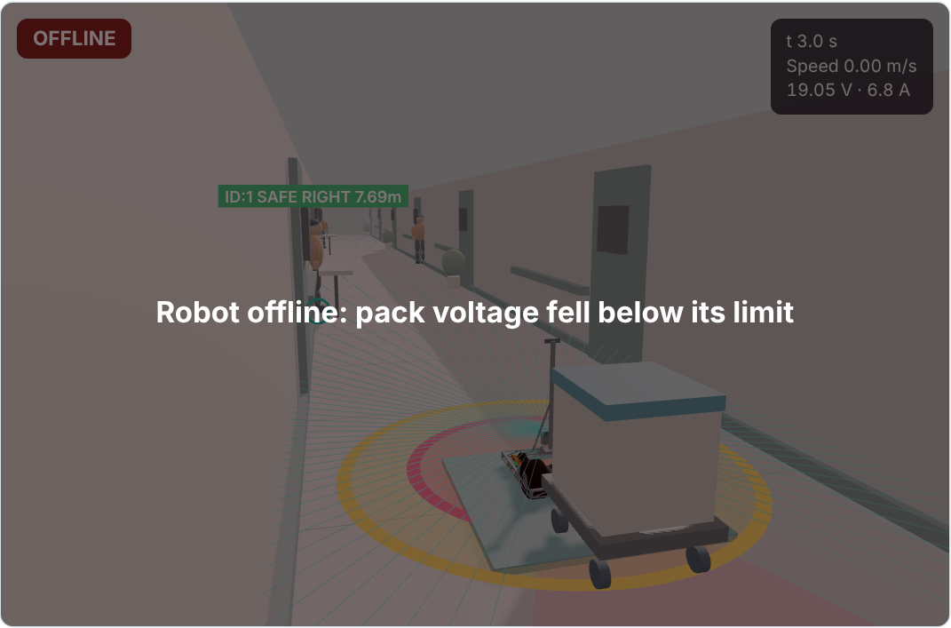
Hospital corridors leave no room for error
< 1 m
20 kg
19.2 V
A visitor can step out within a metre of the robot
A towed trolley that must stop before the person does
Below this, the robot loses power mid-corridor
So the robot has to watch, warn and slow down by itself.
Notes:
Three realities of a ward. People appear suddenly from rooms. The towed 20 kg trolley still needs distance to stop. And a tired battery can sag below 19.2 V under load, which cuts power. The rest of the deck answers these three.

Slide 3
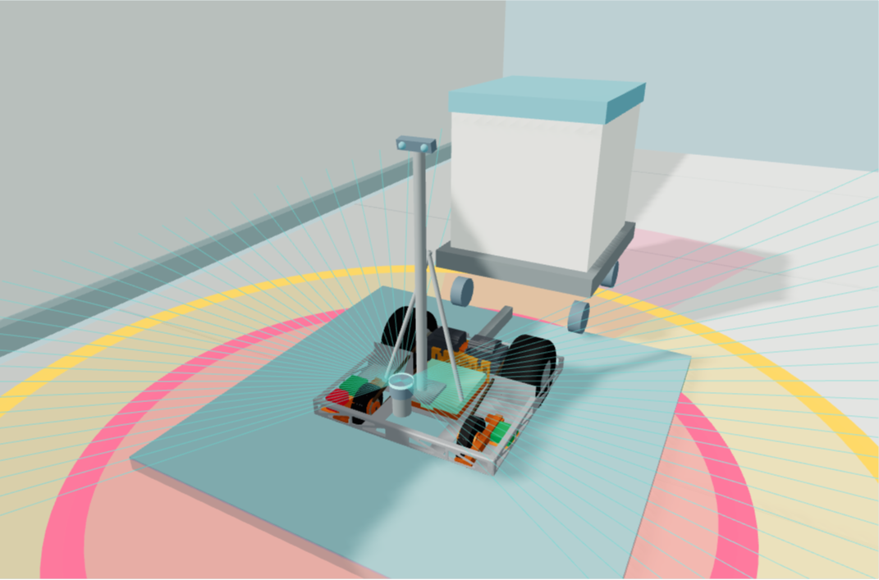
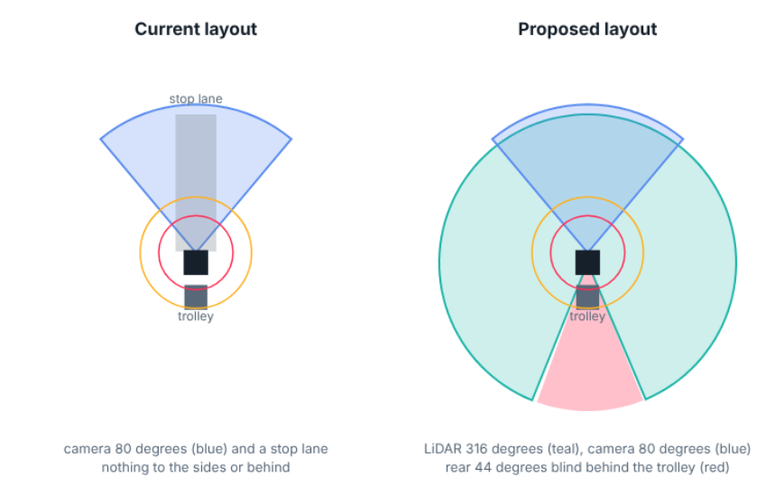
One LiDAR, one camera: where they should sit
Clears the 262 mm tyres and 222 mm motors; shin height for legs and bed wheels
Camera tilt brings the floor into view from 1.3 m ahead, covering what the scan plane misses
0.29 m
316°
1.0 m
Rear stays blind: no reversing while towing. Glass is invisible to both: keep-out zones
LiDAR scan plane
clear scan
camera, 12° down
Notes:
Measured on the Genesis CAD: chassis 666 by 672 mm, deck rim at 175 mm, rear tyres 262 mm, motors 222 mm, and a free bay about 200 mm deep at the front centre. The LiDAR goes there, on a 90 mm riser, so its scan plane at 0.29 m clears the tyres and motors: 316 of 360 degrees are clear and only the trolley blocks the rear. The camera moves from the 1.28 m mast to a short braced post at 1.0 m, tilted 12 degrees down: stiffer, clears door frames, still sees head and shoulders, and the tilt brings the floor into view where the LiDAR plane cannot see. The mast and trolley are not in the CAD, so those sizes are assumptions.

Slide 4




Three layers, six states, and hardware has the last word
1 AI suggests
2 Power supervisor can only lower speed
3 Hardware limits always win
STATE
WHEN
SPEED CAP, m/s
1.5 m TOO CLOSE
SAFE
Nobody near
full
CAUTION
Closing fast, within 3 m
0.5
PREDICTED DANGER
Will be inside 1 m soon
0.36
TOO CLOSE
Inside 1.5 m
0.15
1.0 m MOVE AWAY
CRITICAL
Inside 1.5 m and rushing
stop
MOVE AWAY
Inside 1.0 m
stop
Speed caps, the map and the planner are proposed extensions. The MII layer itself only warns.
Notes:
The AI part only suggests. A deterministic power supervisor sits behind it and can only reduce speed. Hardware limits override everything. The ladder: escalation is immediate, de-escalation needs half a second of calm. The speed-cap column is our proposed extension; the MII layer itself only issues alerts.

Slide 5
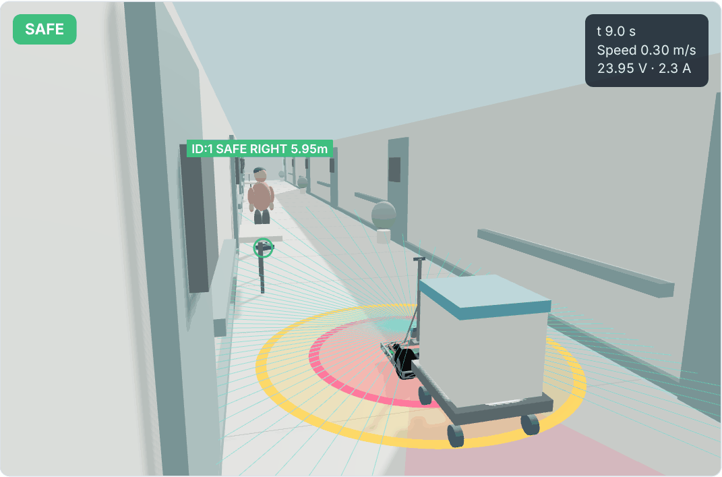
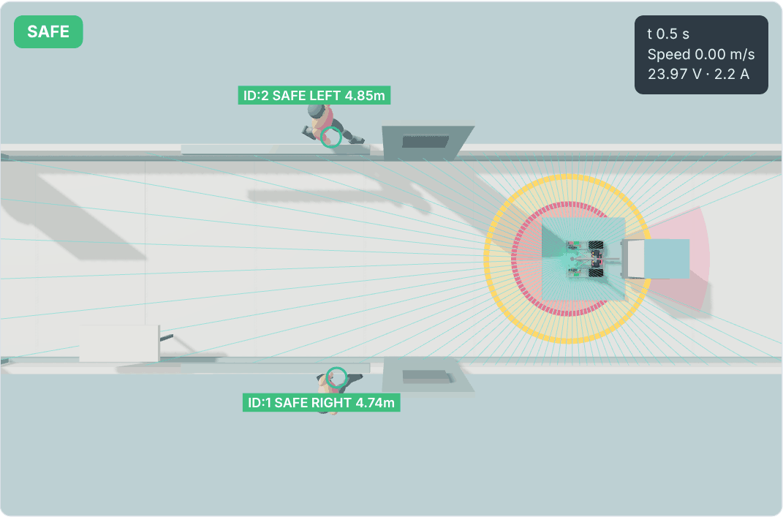
Two people cases: back off, then change the voice
Case 2: a visitor steps out
Case 3: two visitors at 0.78 m
8.1 s
14.8 s
17.3 s
0 to 45 s
45 to 75 s
after 75 s
planner yields
TOO CLOSE
MOVE AWAY, stopped
"Move away immediately"
"Please clear the path"
silent, visual cue only
Notes:
Left: a visitor leaves a doorway and closes on the robot. With the proposed layout the planner already yields at 8 s, the layer says TOO CLOSE at 14.8 s, and MOVE AWAY at 17.3 s with the robot stopped. Right: two visitors crowd the parked robot at 0.78 m. The spoken alert repeats every 15 s, changes wording after 45 s so it does not become background noise, and goes visual-only after 75 s.

Slide 6
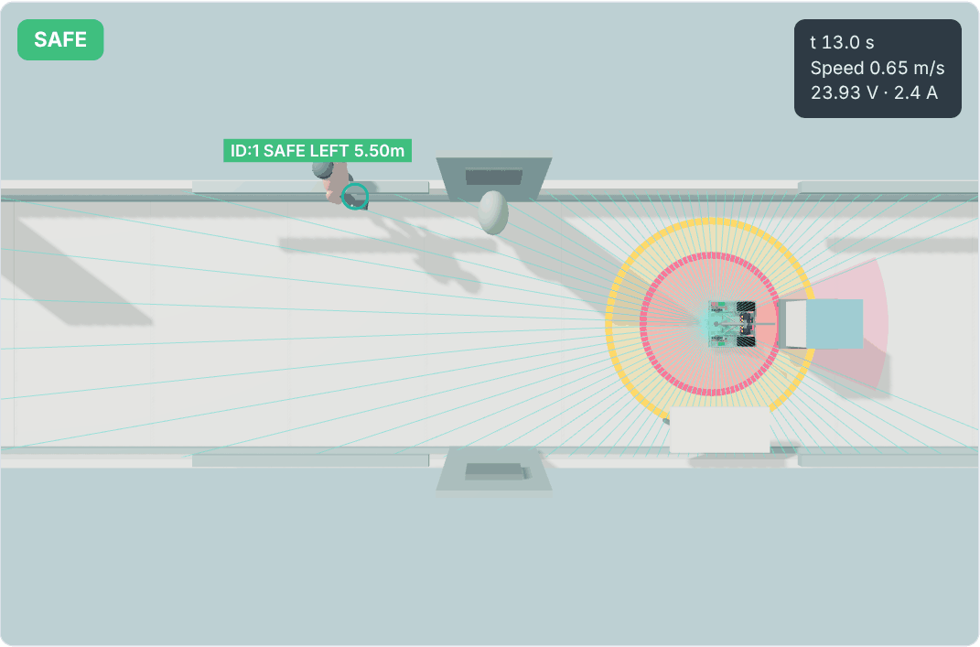
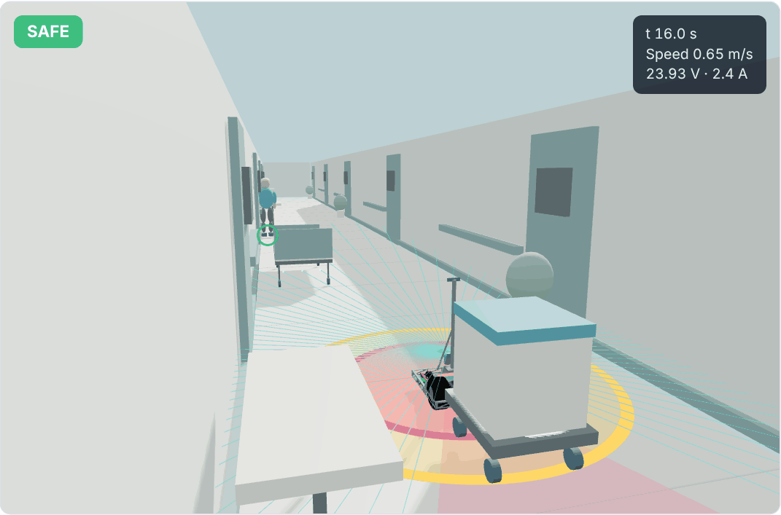
What the LiDAR adds: it sees sideways, and it can plan
Case 10: side approach
Case 11: parked bed
0.30 m/s when the visitor steps in, instead of 0.65 m/s with the camera alone
arrives at 48 s instead of waiting in front of the bed for ever
Notes:
Two new cases that only work with the proposed layout. Left: a visitor waits in a side doorway outside the camera's 80 degree view. The LiDAR tracks their legs and the planner sees them walking into the path, so the robot is down to 0.3 m/s before they step out; with the camera alone it was still doing 0.65. Right: a bed left in the corridor. Today the LiDAR only stops the robot, which then waits for ever. With a map the planner detours and arrives at 48 s. Smaller gains elsewhere: in the dark the first warning comes at 1.4 m instead of 0.8 m, people are tracked between camera frames on a slow computer, and ghost tracks are vetoed when no legs are there.

Slide 7
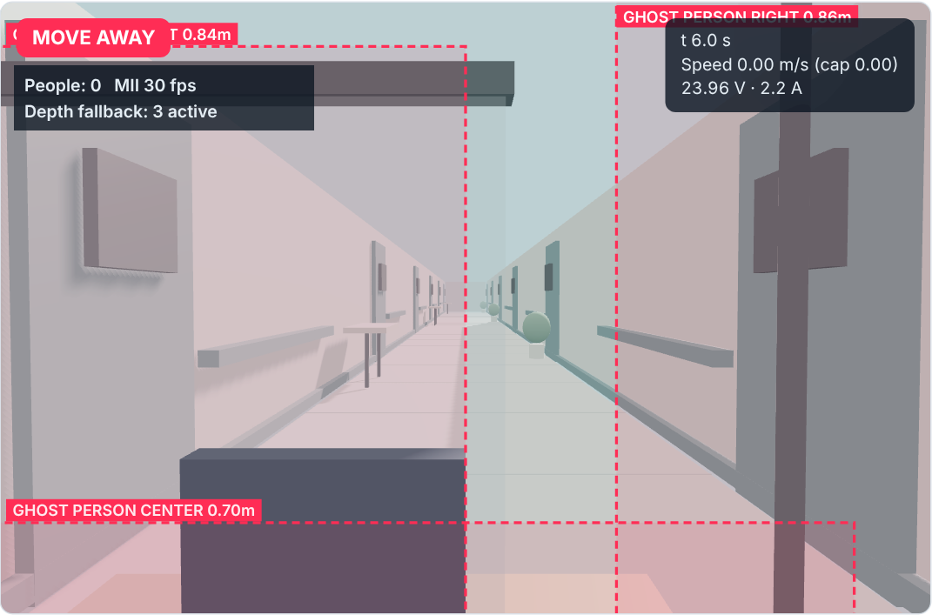
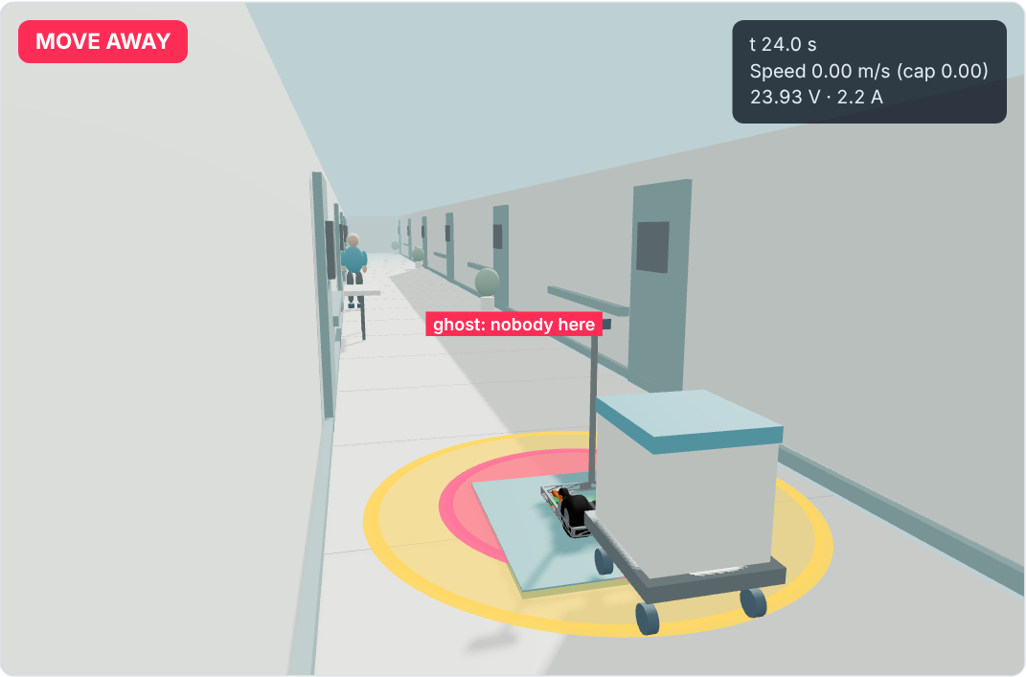
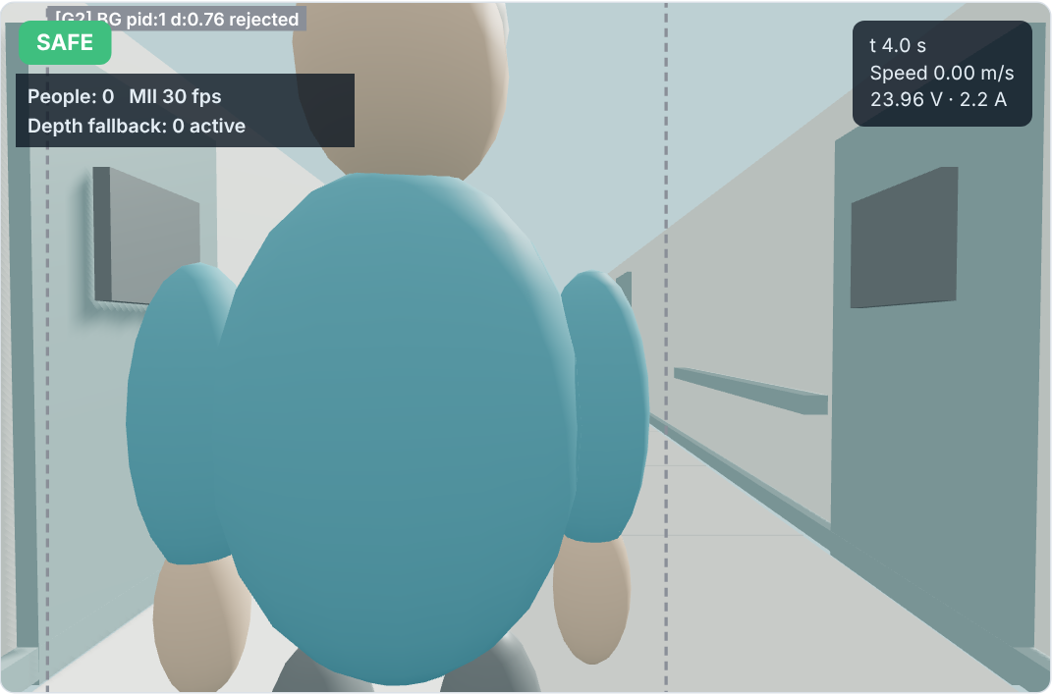
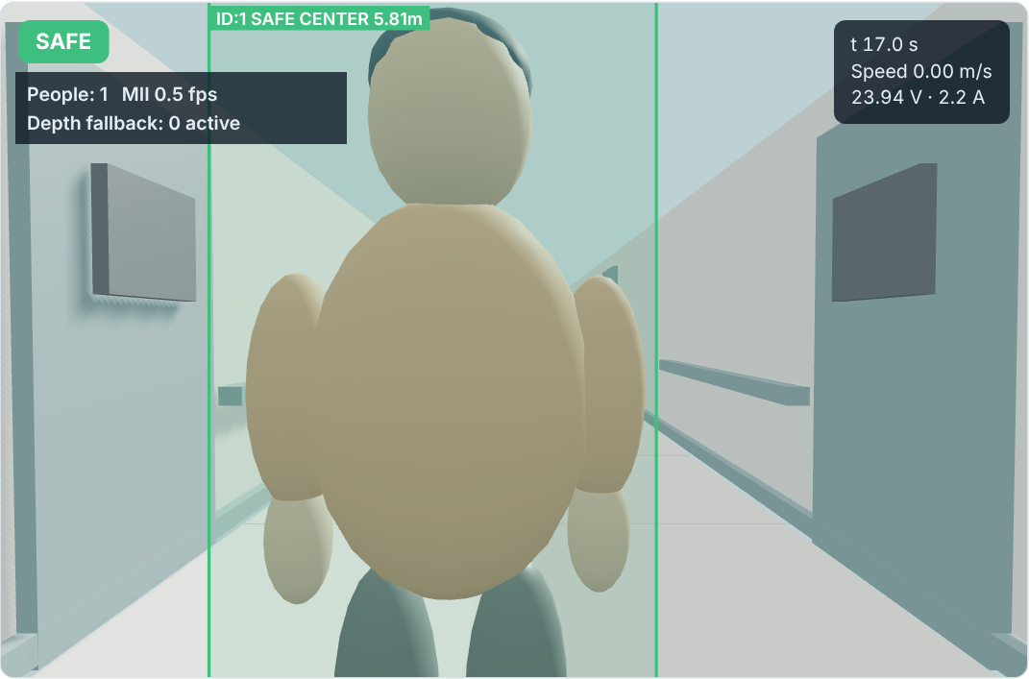

Four bugs the cases caught, all fixed in v6.0
bug in v4.0
bug in v4.0
bug in v5.2
bug in v5.2
Shouts at furniture
Alert that never ends
Blind at boot
Lost at 0.5 fps
MOVE AWAY at a desk, glass and an IV pole
Person left, robot held for 19 s
Says SAFE with a nurse right in front
On a slow computer it stays SAFE
Learns the static scene
Drops a lost track in 0.27 s
Trusts only confirmed background
Gate widens with frame time
Notes:
The cases are not only demos, they are regression tests. v4.0 scanned raw depth and fired MOVE AWAY at furniture, and kept a lost track alive so the robot stayed held after the person left. v5.2 fixed those with a background model but learned a nurse standing at boot as background, and its fixed distance gate rejected the big jumps you get at half a frame per second. v6.0 fixes all four.

Slide 8


Eleven cases, two layouts, one acceptance test
current layout
proposed
v6.0, current layout
v4.0
v5.2
v6.0
v6.0 + LiDAR
9 / 11
1 Staff stand nearby
2 Visitor crosses
3 Two visitors crowd in
4 Furniture, nobody near
v6.0 + LiDAR
5 Nurse there at boot
11 / 11
6 Person leaves
7 Dark ward
8 Slow computer
9 Tired battery, 20 kg trolley
cases passed
10 Side approach
11 Parked bed
Row 9 with the power supervisor on; off, it browns out in every column.
Notes:
Every case is a pass or fail test with a stated criterion. v4.0 fails the furniture case and the lingering alert. v5.2 fails the nurse at boot and the slow computer. v6.0 passes the nine original cases but cannot pass the two LiDAR cases, which need the sideways view and the map. v6.0 with the proposed layout passes all eleven. Row 9 is shown with the power supervisor on; with it off the robot loses power in every column.

Slide 9
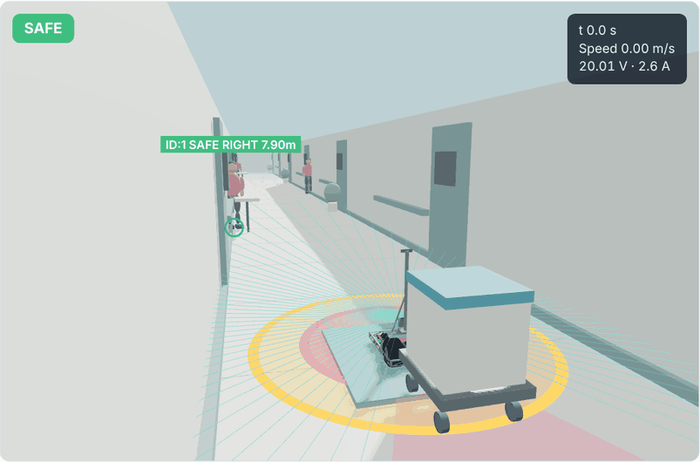
The power supervisor keeps the trolley alive
SUPERVISOR OFF
SUPERVISOR ON
2 s
68 s
browns out at the first pull-away
arrives, lowest 19.5 V
Notes:
Case 9: the 20 kg trolley on a pack at 15 percent charge, with the measured pack resistance, a 4 percent ramp and three pedestrian stops. Without the power supervisor the very first pull-away sags the pack below the 19.2 V limit and the robot goes offline before leaving the bay. With the supervisor trimming acceleration to what the pack can give, it never drops below 19.5 V and completes the run at 68 s.

Slide 10





From simulation to the ward, one safe step at a time
DONE
NEXT
Simulation
Bench drills
Ward shadow
Advisory
Motion pilot
Eleven cases pass with the LiDAR layout
Fit the LiDAR and post; volunteers at 0.78, 1.07 and 1.62 m
Log only, count false alerts per hour
Alerts on, staff briefed on the stop button
Slow or stop for alerts, approved separately
The ask: approve the sensor refit and bench drills
Questions?
Notes:
Simulation is done. Next are bench drills with staff volunteers at three marked distances (0.78, 1.07 and 1.62 m), wheels off the ground, to confirm the live states match the ladder. Then ward shadow mode (log only), advisory alerts, and only then a separately approved pilot where the robot slows or stops for alerts. Be upfront: people, paths and camera misses are scripted, the speed caps are proposed, and there is no real detector in the loop yet.

