Slide 1
Parallel Rendering
Skye Im
Virgil Tataru

Slide 2
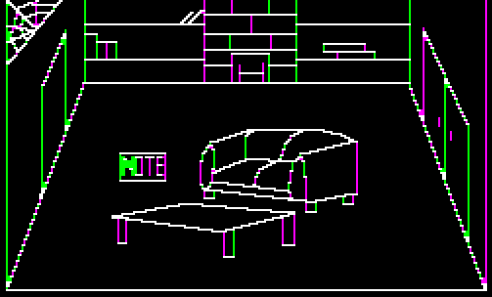
Computer graphics
Line graphics…

Slide 3
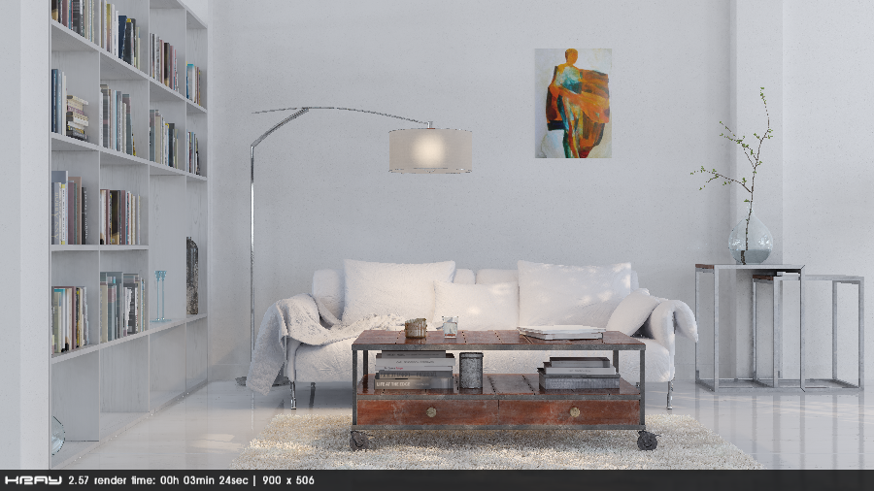
Computer graphics
To full 3D
http://forums.newtek.com/showthread.php?145511-Sofa-new-Node-test-in-Kray

Slide 4
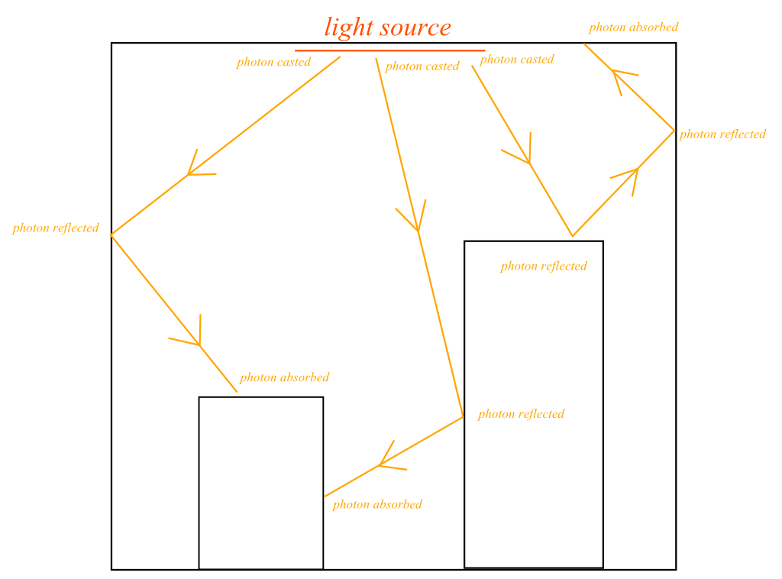
How to render?
Approach 1: Photon mapping
Shoot out light rays from the light sources, and see which ones hit the camera

Slide 5


Out of 720 rays,
only 18 hit
= 2.5% used, 97.5% wasted

Slide 6
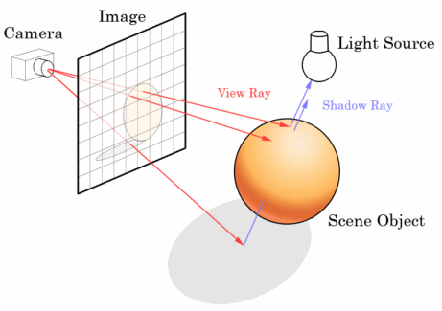
Approach 2: Raytracing!

Slide 7
What we did
3 new “M_” codes:
M_CONFIG = ‘&’
M_START = ‘$’
M_RESULT = ‘=‘

Slide 8
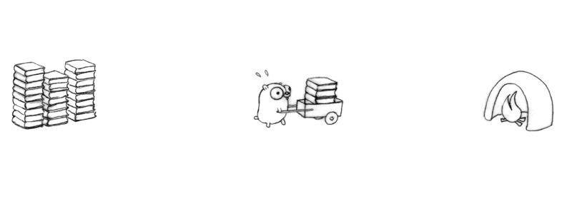
Single computer

Slide 9
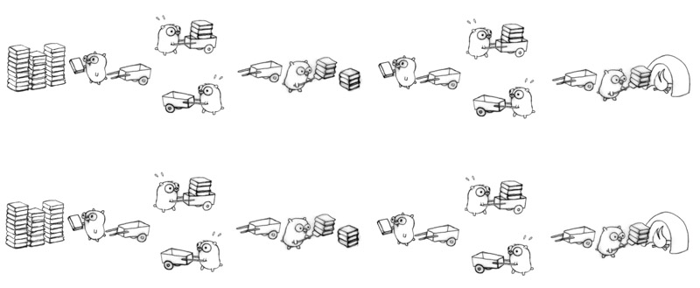
Many computers!

Slide 10


A
B
> load config.file
C
D

Slide 11
A
B
> start
C
D

Slide 12
A
B
M_START
M_START
C
D
M_START
M_START

Slide 13
A
B
C
D

Slide 14
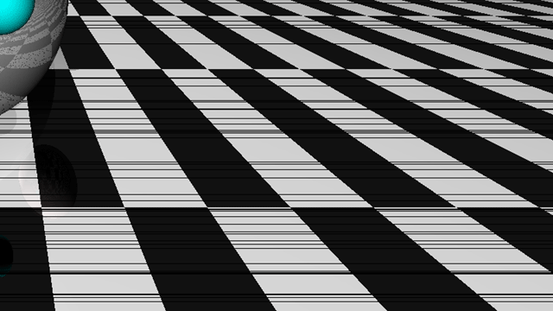
A
B
C
D
M_RESULT

Slide 15
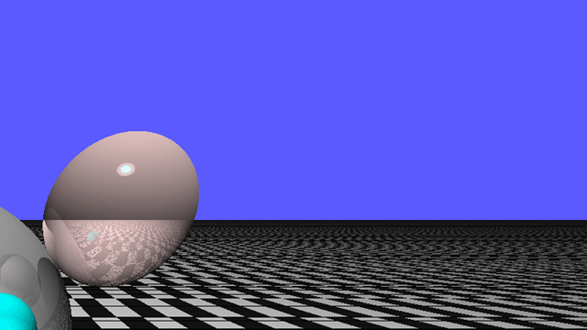
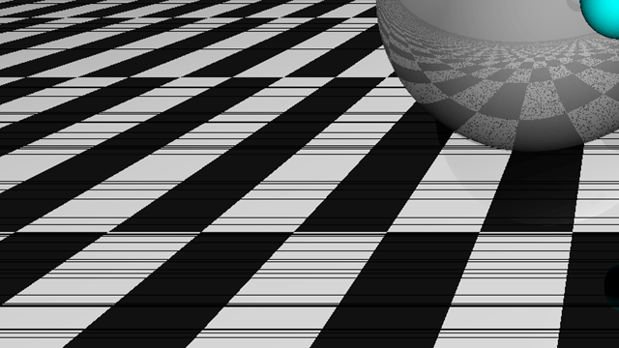
A
B
M_RESULT
C
D
M_RESULT

Slide 16
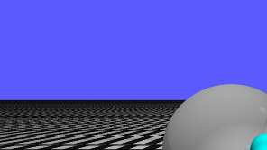
A
B
M_RESULT
C
D

Slide 17
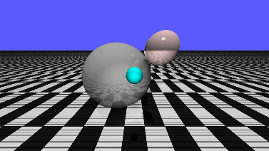
A
B
M_RESULT
M_RESULT
C
D
M_RESULT
M_RESULT

Slide 18

Questions?

Slide 19
Sending images over the chat system
BLACK,BLACK,WHITE,WHITE,GREY,WHITE…

Slide 20

Sending long messages
????
BLACK,BLACK,WHITE,WHITE,GREY,W

Slide 21
Sending long messages

Slide 22


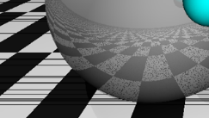
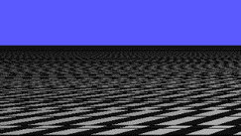
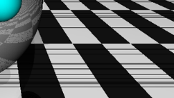
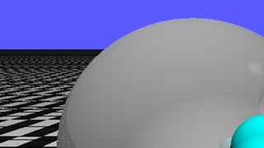
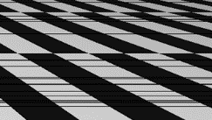
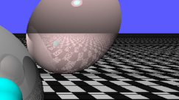
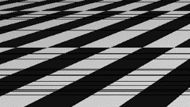

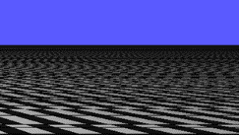


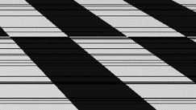
Future goals
A

Slide 23
Future goals
C

Slide 24
Future goals
A

Slide 25
Future goals
B

Slide 26
Future goals
C

Slide 27
Future goals
Some parts of the image are very fast to draw
eg, sky
Other parts take longer
More equal work distribution = faster results

Slide 28
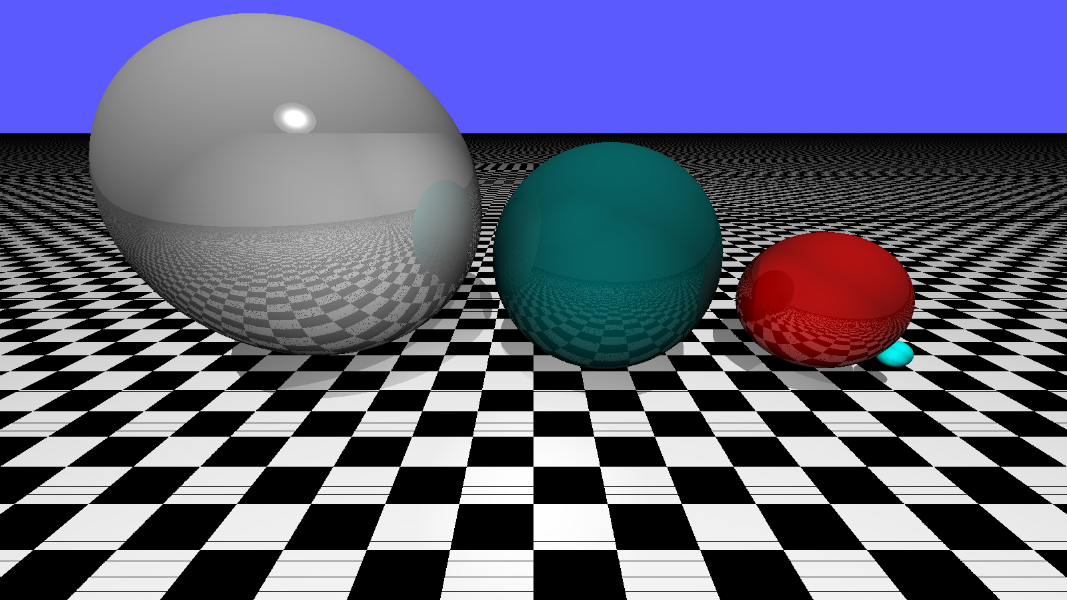
Questions?

