Slide 1
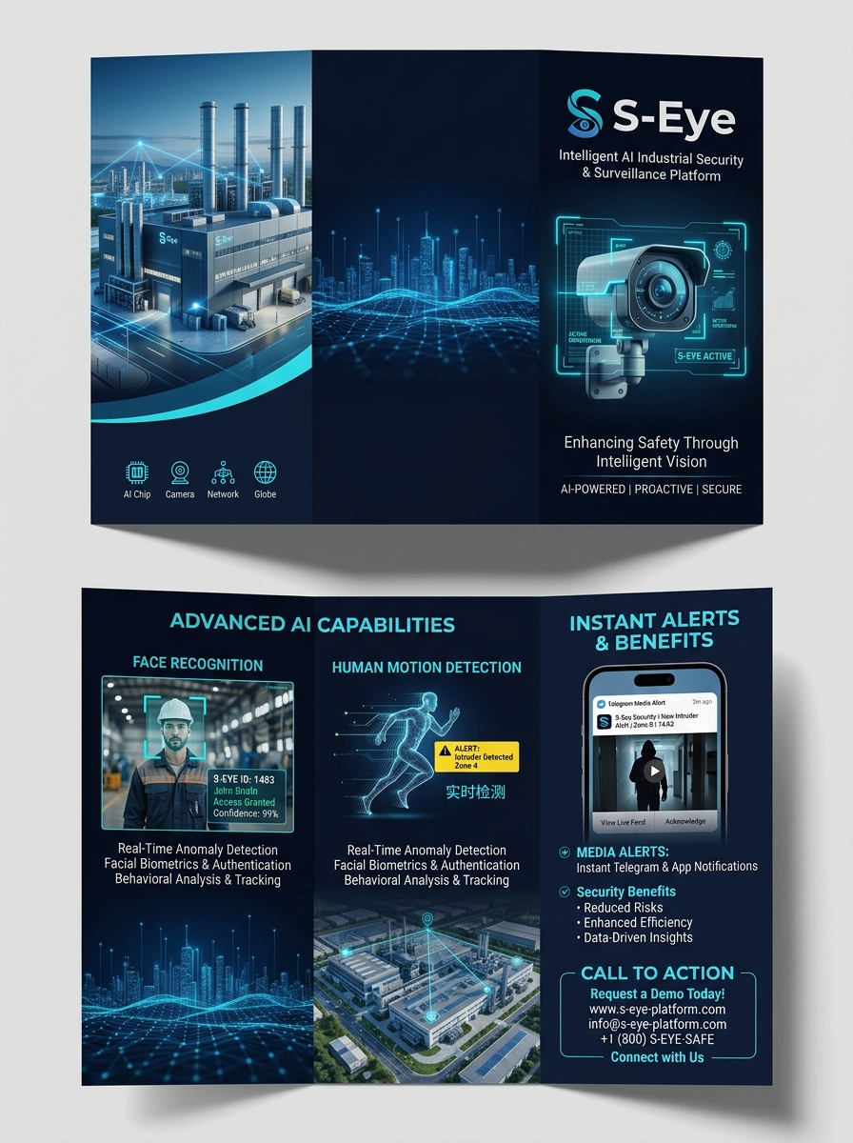
S-EYE INTELLIGENT SURVEILLANCE
Real-Time AI Industrial Security
with Media Alert Integration
• 24/7 Autonomous AI Video Stream Analysis
• Human Motion Detection & Face Recognition
• Instant Telegram Photo & Video Clip Alerts
• Zero Operator Fatigue & Proactive Deterrence

Slide 2
TECHNOLOGY OVERVIEW
Core AI Detection & Analytics Engines
Human Motion Detection Engine
✔ Real-Time Stream Processing: Ingests RTSP feeds directly from IP cameras.
✔ Restricted Zone Intrusion: Detects unauthorized entry into sensitive areas.
✔ Off-Hours Surveillance: Automatically monitors facility perimeters at night.
✔ Resource Efficiency: Discards unoccupied frames to optimize server load.
Face Recognition & Identity Verification
✔ Biometric Verification: Compares detected faces against authorized encodings.
✔ Employee vs Stranger Classification: Instantly flags unauthorized strangers.
✔ Encrypted Local Database: Securely stores employee face profiles in SQLite.
✔ Low False-Alarm Rate: High precision detection eliminates false security alerts.

Slide 3
ALERT DISPATCH SYSTEM
Real-Time Multi-Channel Media Alert Integration
Rich Photo Snapshots
Captures crystal-clear high-definition photo snapshots at the exact moment of security breach.
Video Clip Recording
Records short video clips of the event to provide immediate visual context to security teams.
Telegram Bot Dispatcher
Delivers alerts directly to private chats, tactical group channels, and broadcast security HQs.
Mobile & Desktop App Push
Cross-platform notifications containing timestamp, camera location ID, and threat level status.

Slide 4
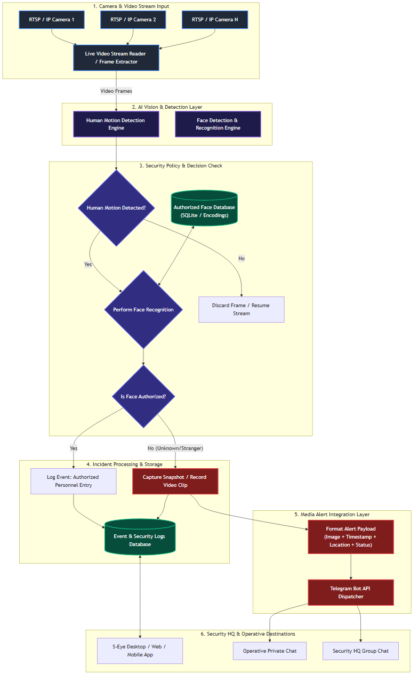
SYSTEM ARCHITECTURE
End-to-End System Workflow Architecture

Slide 5
BUSINESS IMPACT
Key Security, Financial & Operational Benefits
Proactive Security Deterrence
Shifts security operations from post-incident review to real-time incident prevention.
Zero Operator Fatigue
AI monitors all cameras 24/7 without fatigue, eliminating human monitoring errors.
Cost Efficiency & Scaling
Integrates seamlessly with existing CCTV hardware, avoiding expensive infrastructure upgrades.
Verifiable Audit Logging
Maintains complete digital logs with images, timestamps, and face IDs for compliance audits.

Slide 6
SPECIFICATIONS & CONTACT
Technical Specifications & Contact Details
Technical Specifications
• Camera Input: RTSP Streams, IP Cameras, NVR/DVR
• AI Vision Engine: Human Motion & Face Recognition
• Alert Destination: Telegram Bot API, Mobile/Desktop App
• Database Engine: Encrypted SQLite Persistence Layer
• Deployment: Local Server / Cloud Hybrid Architecture
Get Started with S-Eye
• Product Name: S-Eye Security Platform
• System Status: Production Ready / Custom Integration
• Email Support: support@s-eye-security.com
• Official Website: www.s-eye-security.com
• Request Demo: Contact Security Integration Team

